Slide 1
ED5502 Embedded Software
Lecture 13:
STM32 and RTOS: FreeRTOS
Ciaran MacNamee
See www.micrium.com for uCOS-III & uCOS-II RTOS
See www.freertos.org for FreeRTOS

Slide 2
At the end of this lecture you should be able to:
Distinguish between hard real-time and soft real-time systems
Explain the limitations of foreground / background systems operation
Describe how a real-time kernel organises and schedules tasks
Explain the states that a task can be in
Write the outline of a task to run in a real time operating system or kernel

Slide 3
Real Time Systems: Hard and Soft RT
Think of real-time systems as being systems where events must occur within a fixed time period
The timing behaviour of a system is as important as its logical correctness
Real-time systems can be soft real-time or hard real-time
Soft real-time: tasks are performed as fast as possible, but don’t have to finish by specific times
Hard real-time: tasks have to be performed correctly but also on time
Most hard real-time systems are embedded

Slide 4
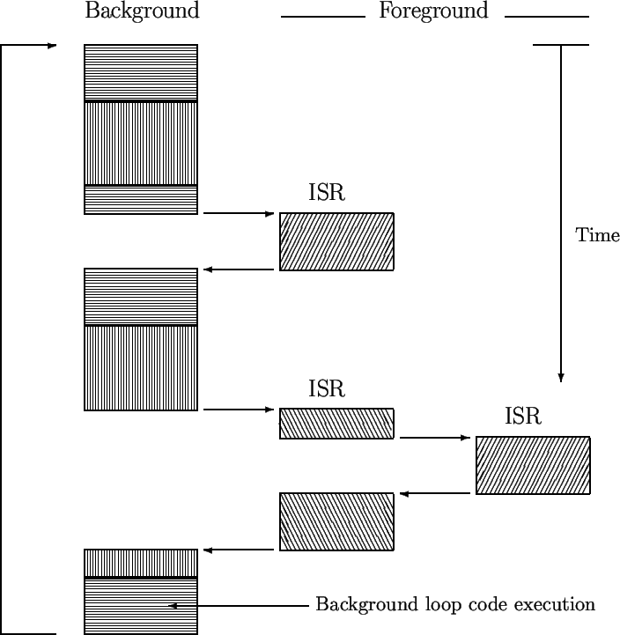
Foreground/background Systems
Foreground also called Interrupt level
Small systems such as those we have built can be described this way
Application is an infinite loop that calls functions or modules to carry out some operations = The Background
Interrupt Service Routines (ISRs) handle asynchronous events = The Foreground
Background also called Task Level
This system is a little more complex than ones we looked at because the ISR can be interrupted

Slide 5
Program Organisation of a Foreground/Background System
Partly describes the systems we have developed so far
start
Interrupt
Interrupt
Interrupt
Initialize
ISR for Task #1
ISR for Task #2
ISR for Task #3
Wait for Interrupts
RETI
RETI
RETI
Source: DW Lewis, Fundamentals of Embedded Software

Slide 6
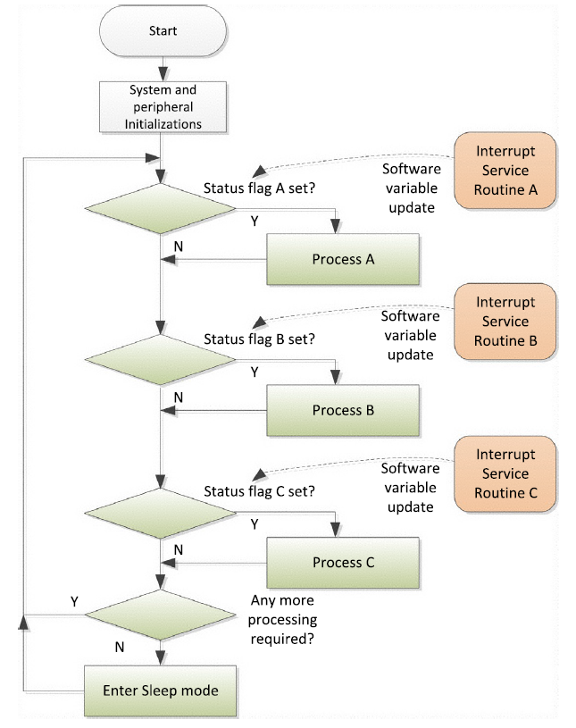
Combined Interrupt and Polling
Again, similar to our programs
Notes:
This organisation attempts to improve the timing response. ISRs are short, and set status flags, while the main loop processes the less time critical tasks.
This means that the main loop can be very messy, and again timing is hard to predict.

Slide 7
Foreground/Background System
Most of the critical work is performed in the "foreground" ISRs, with each ISR processing a hardware event.
Main program performs initialisation and then enters a "background" loop that waits for interrupts to occur
With one interrupt, allows the system to respond to external events with a predictable amount of latency
But what happens when we have a number of ISRs?

Slide 8
Foreground/Background Limitations
Time-critical operations have to be performed by the ISRs
Not by the background task because if they’re time-critical you can’t wait for the background task
ISRs may take longer than you’d like
There may be more than one ISR
Code execution is not constant so the response times are not deterministic
Code changes affect the overall timing
This approach does not scale

Slide 9
Limitations
Best possible performance requires moving as much as possible into the background.
But …
Background becomes collection of queues and associated routines to process the data.
Optimizes latency of the individual ISRs, but background needs a managed allocation of processor time
Solution is multitasking OS

Slide 10
Multi-tasking
Involves scheduling and switching the CPU among several tasks
CPU switches between several sequential tasks
The scheduler part of the OS decides which program to run and when, providing the illusion of simultaneous execution by rapidly switching between each program

Slide 11
OS and RTOS
How the scheduler decides which program to run and when determines the type of OS
Multiuser OS (Unix): scheduler will ensure each user gets a fair amount of the processing time
Desktop OS scheduler (Windows) will try to ensure the computer is responsive to its user

Slide 12
OS and RTOS
Real time schedulers allow the user to assign a priority to each thread of execution (or Task)
The scheduler then uses the priority to know which thread of execution to run next
Priority assignment enables determinism
FreeRTOS and uCOS-III are designed to be small enough to run on a microcontroller
(FreeRTOS is smaller than a full-size OS)
Like a kernel with additions
Notes:
FreeRTOS provides the core real time scheduling functionality, inter-task communication, timing and synchronisation primitives only. This means it is more accurately described as a real time kernel, or real time executive. Additional functionality, such as a command console interface, or networking stacks, can then be included with add-on components.

Slide 13
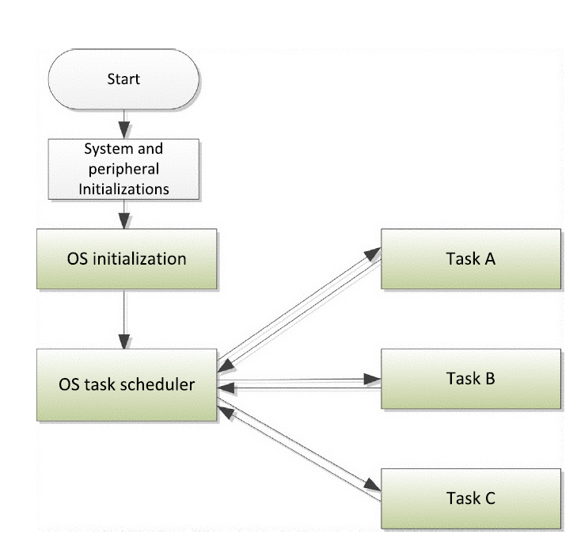
Real Time Operating System
An RTOS can handle multiple tasks
RTOS: Separate Timing and Functionality
Notes:
An RTOS can be the best option for more complex embedded systems. High priority tasks can have guaranteed timing. The disadvantages are costs and complexity as you need to learn how to set up and work with the RTOS. The advantage is that the system becomes more predictable and the code for individual tasks can be easier to develop and can be made independent (within limits) of each other.

Slide 14
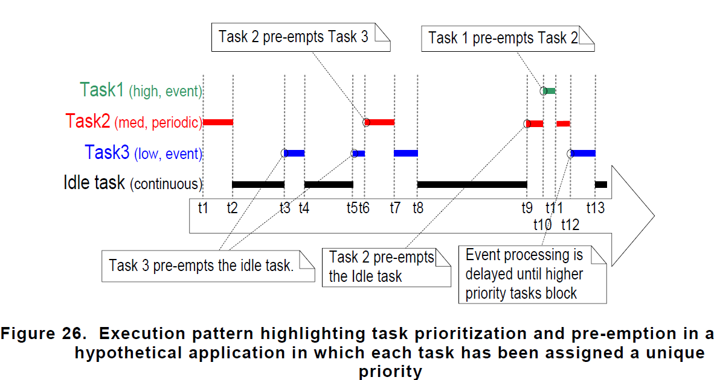
Real-Time: Deterministic
Hard Real Time: It must occur in a certain time
Soft Real Time: It should occur in a certain time

Slide 15
Tasks or Threads
A task (or thread) is a simple program that thinks it has the CPU to itself
Real-Time application design: split the work into tasks responsible for a portion of the problem
Each task gets a priority, its own set of CPU registers and its own stack area
(See next slide)

Slide 16
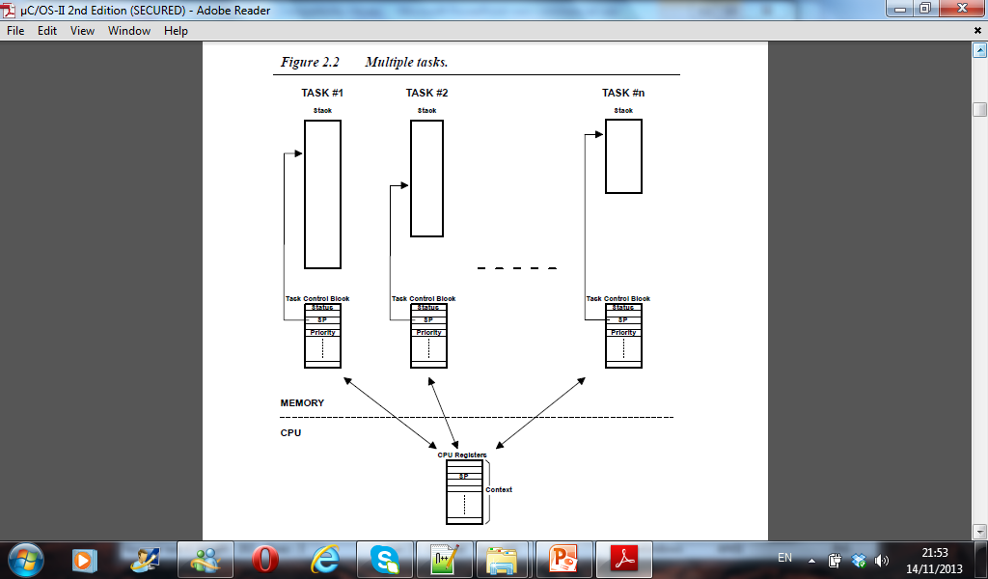
Each task gets a priority, its own set of CPU registers and its own stack area

Slide 17
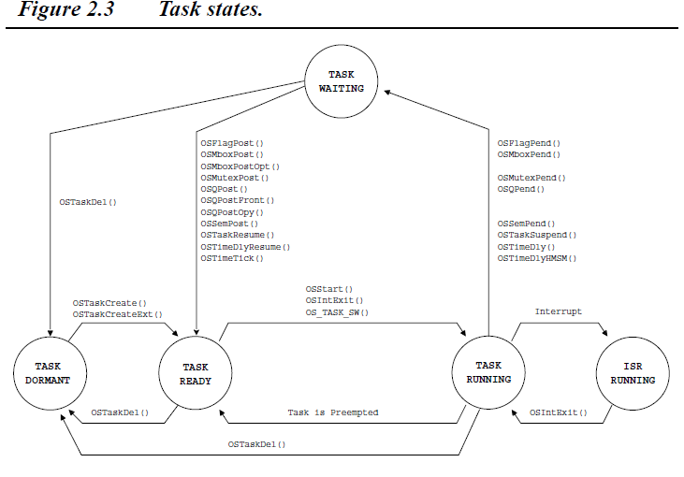
This is for uCOS-III
FreeRTOS is similar
ISR invokes the scheduler

Slide 18
Thread Design
Threads usually perform some initialization and then enter an infinite processing loop.
At the top of the loop, the thread relinquishes the processor while it waits for:
data to become available
an external event to occur, or
a condition to become true (eg delay timeout).

Slide 19
Concurrent Execution of Independent Threads
Each thread runs as if it had its own CPU separate from those of the other threads.
Threads are designed, programmed, and behave as if they are the only thread running.
Partitioning the background into a set of independent threads simplifies each thread, and thus total program complexity.

Slide 20
Each Thread Maintains Its Own Stack and Register Contents
Context of Thread 1
Context of Thread N
Stack
Registers
Stack
Registers
Z
Z
Y
Y
X
X
R25
R25
SREG
SREG

Slide 21
Tasks in a Real Time Kernel or OS
Each Task thinks it has the CPU to itself
Each has the form of an infinite loop
Never returns to main
The task may suspend or wait in which case lower priority tasks can run
Task is interrupted by the timer tick and scheduler and other interrupts and another task may be resumed if it is ready to run and has higher priority

Slide 22
Example RTOS uCOS-III (or -II)
uCOS-III (or earlier version –II) is a well-documented Real-Time Operating System
Consists of general-purpose files and some that are processor specific
The RTOS can thus be ported to multiple processors and also end-applications

Slide 23
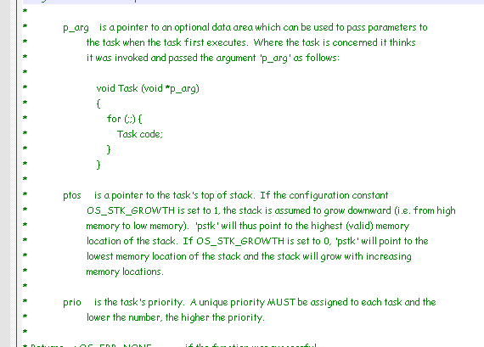
Tasks in uCOS-III
Note
for (;;) is equivalent to while (1)

Slide 24
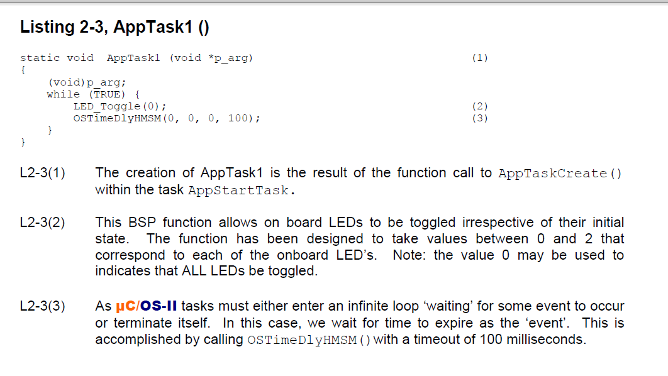
Tasks in a Real Time Kernel or OS
This example uses LED toggling in a task in the uCOS-II RTOS
for (;;) is equivalent to while (1)

Slide 25
FreeRTOS
FreeRTOS is designed to be small enough to run on a microcontroller
FreeRTOS provides real time scheduling, inter-task communication, timing and synchronisation primitives
More accurately described as a real time kernel, or real time executive
Additional functionality, such as a command console interface, or networking stacks, can be included with add-on components.

Slide 26
FreeRTOS
FreeRTOS is designed to be small enough to run on a microcontroller
Code footprint about 5.5 – 9 KiByte of Flash memory for code
About 70 words of RAM (minimum) per task
OS usually use a Periodic Tick to run but
Newer versions allow tickles operation for minimal power consumption

Slide 27
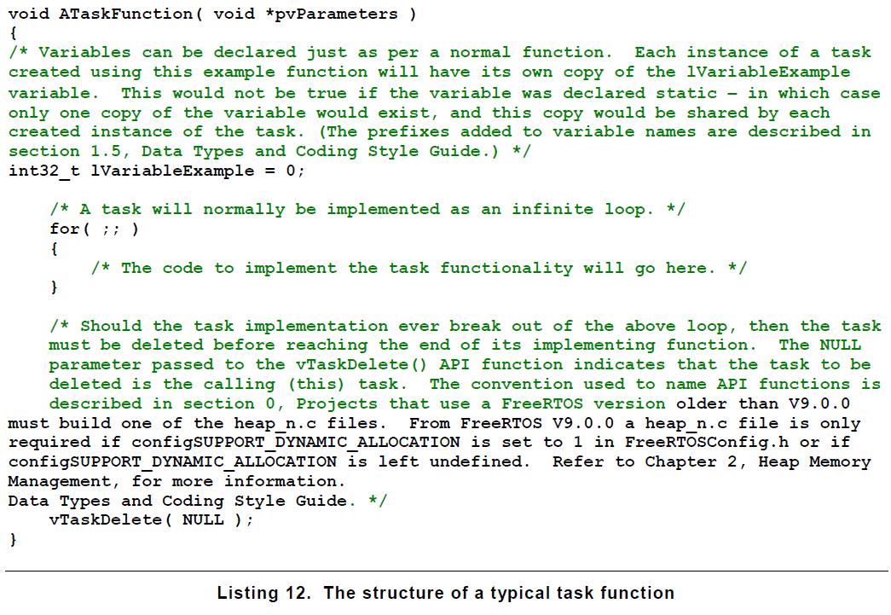
FreeRTOS Task

Slide 28
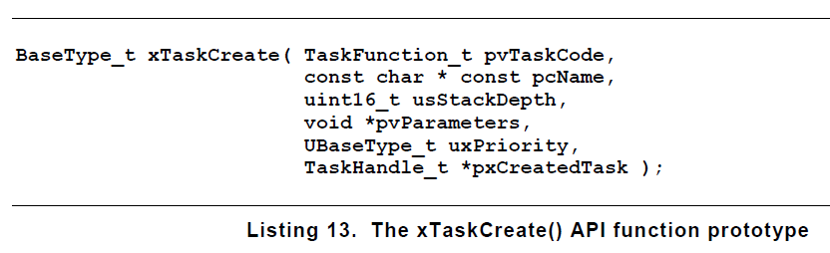
Creating a Task in FreeRTOS
See ‘Mastering the FreeRTOS Kernel .. Tutorial Guide’ for more details

Slide 29
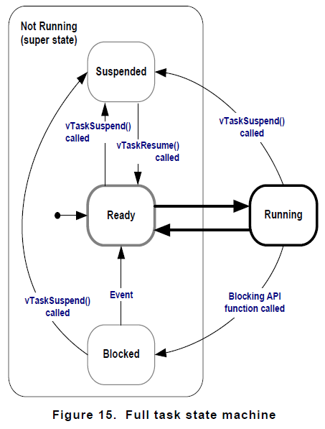
FreeRTOS Task States

Slide 30
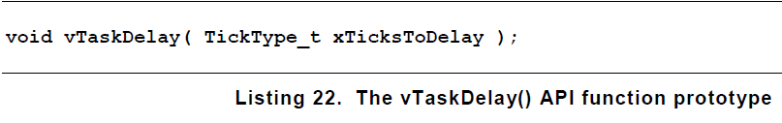
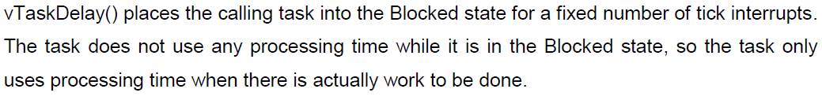
Delay in FreeRTOS
Different from the delays we have been using

Slide 31
Summary
Outline Introduction to real time kernels and real time operating systems

