Slide 1
ED5502 Embedded Software
Lecture 4:
STM32L476RG & Nucleo64
STM32 Parallel Ports
Ciaran MacNamee

Slide 2
What we will cover today
STM32L476RG Overview and Block Diagram
STM32L476RG Memory Map
STM32 Nucleo64 Board
Parallel Ports & GPIO
STM32 GPIO Ports
Simple GPIO program without HAL libraries

Slide 3
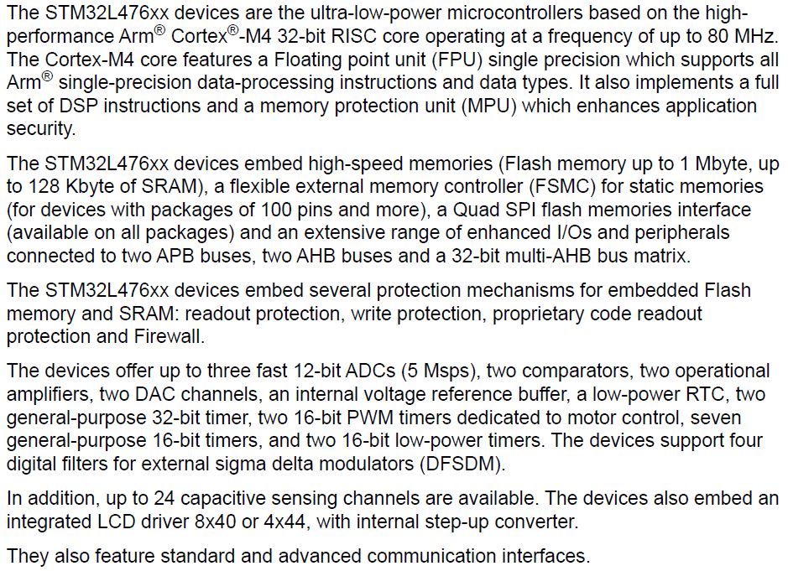
STM32L476RG Description (Excerpt)
This text is taken from the STM32L476 DataSheet
See stml476rg.pdf in Resources/Data Sheets
The next few slides are captures from that document

Slide 4
STM32L476RG Description (Excerpt)

Slide 5
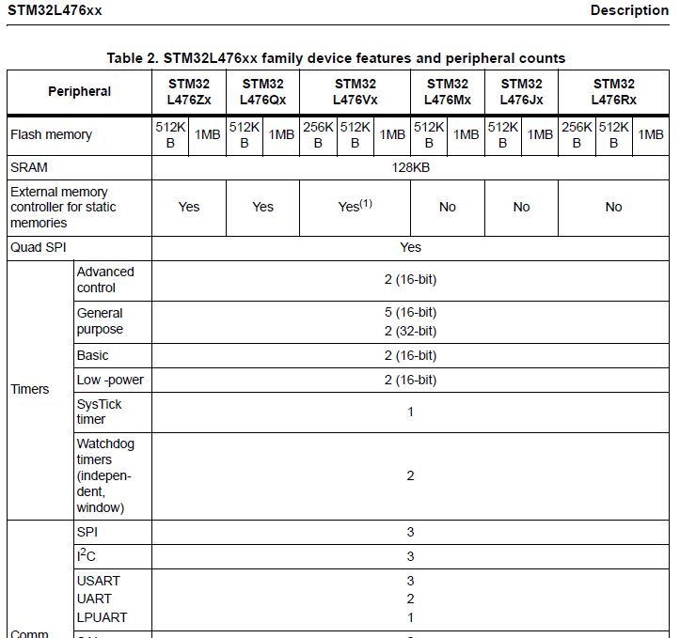
STM32L476 is a range of devices
Note also that STM32L476xx devices support 7 low power modes

Slide 6
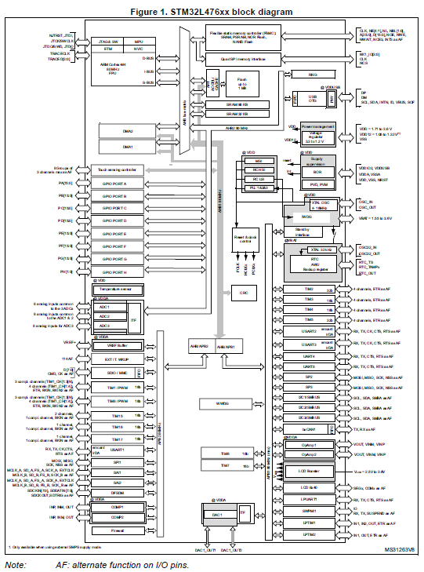
STM32L476 Block Diagram
This is an important diagram
Especially because of how the Bus Organisation determines what clock to enable to be able to use a given peripheral device
Note also that the I/O from functions like the Timers etc are shared with the GPIO pins
May mean tradeoffs
(See p17 of stm32rg.pdf for better resolution)

Slide 7
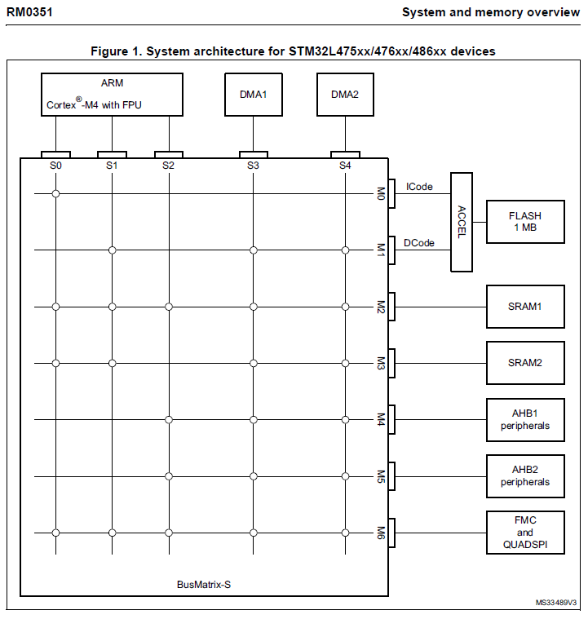
STM32L476 Bus Matrix
STM32 internal architecture allows bus connections among several on-chip devices and memories
Note also that the microcontroller has two DMA channels

Slide 8
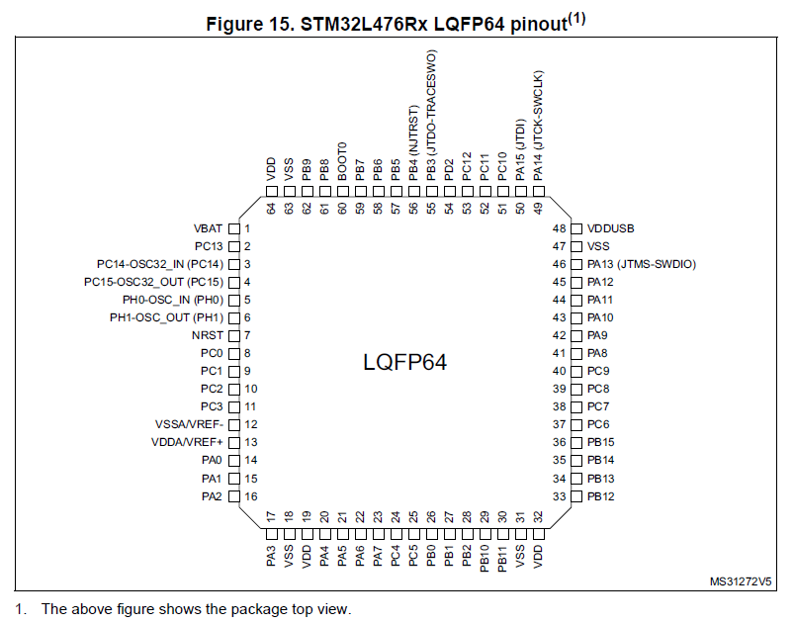
STML476RG Pinout Diagram
STM32L476 also comes in packages with more pins

Slide 9
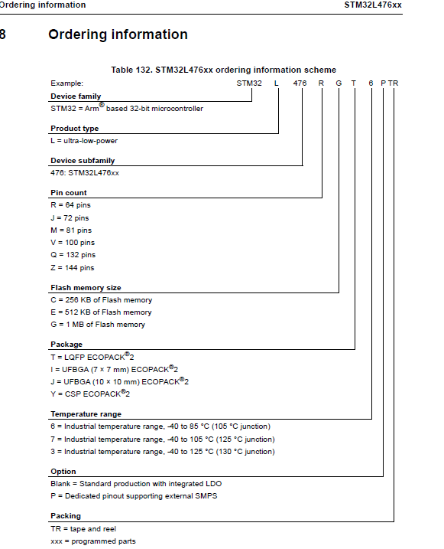
STM32L4xx Naming convention
STM32L476RGT is comes in a 64 pin LQFP package
It has 1 MB of Flash memory

Slide 10
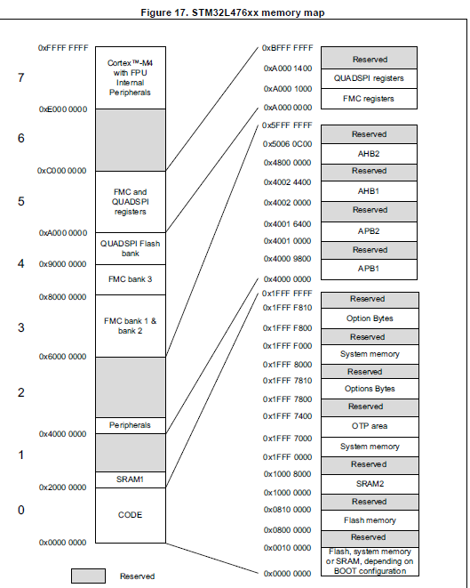
STM32L4xx Memory Mapping
Not to scale
Note that there are two banks of SRAM
They can be handled differently
Note also that the on-chip peripherals are memory-mapped at addresses 0x4000_0000 and above
This block includes the GPIO block

Slide 11
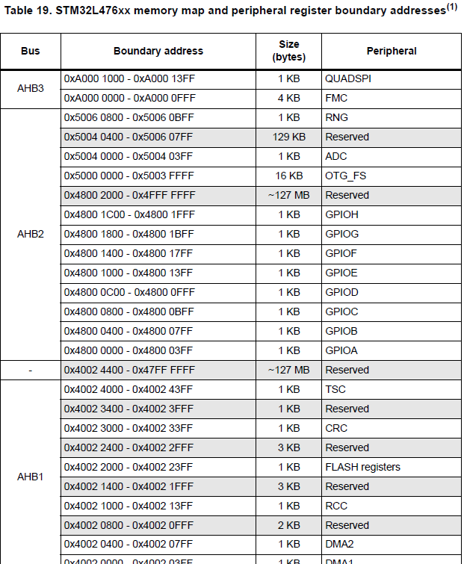
STM32L4xx Memory Map of peripherals (Excerpt)
GPIO Block is here
Full table is much longer
Notes:
Arm microcontrollers have two types of buses: AHB (Advanced High Performance Bus) and APB (Advanced peripheral Bus).
AHB is a high-performance bus designed to interface to memory and high performance I/O.
APB is designed for lower speed and low power memory and peripherals. APB usually looks like one device on an AHB bus.
So the interface hierarchy is CPU – AHB and CPU – AHB – APB.
Arm microcontrollers need to enable the clock signal for these buses, so this is an extra initialisation task.

Slide 12
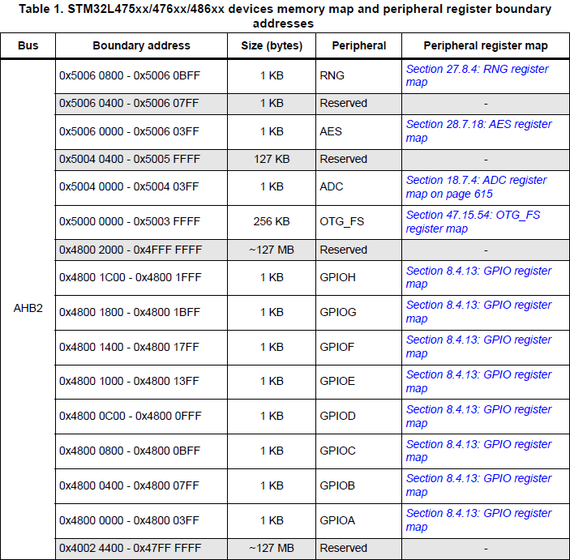
Memory Map boundaries and buses (Excerpt)
GPIO Block is on AHB2 bus
From Reference Manual

Slide 13
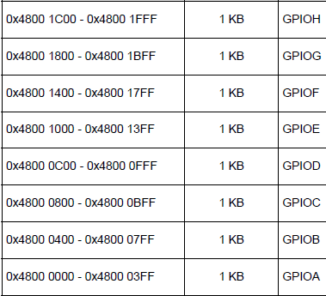
GPIO and Peripheral Memory Map
GPIO, Timers, ADCs etc are memory mapped
They are accessed like addresses in memory but they are located at a fixed range of addresses

Slide 14
GPIO and Peripheral Memory Map
Each GPIO has a number of registers associated with it
Note: this table is not complete
GPIOA_MODER is at 0x4800 0000, GPIOA_ODR is at 0x4800 0014 etc

Slide 15
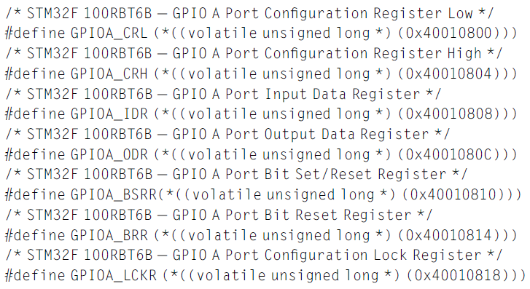
Example: GPIO registers and pointers
Notes:
The GPIO ports are the most straightforward of the on-chip I/O devices.
At heart it’s just an output port, and input port and a direction register that allows individual bits of a port to be used as an input or as an output.
Using pointers, we can give symbolic names to the ports, even though what is involved is the address of a register.

Slide 16
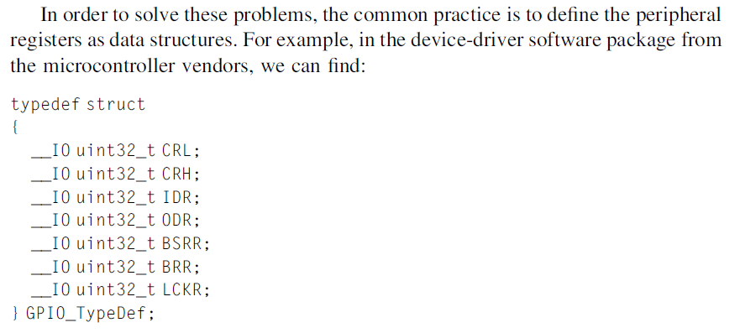
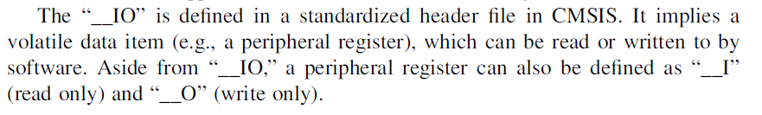
Efficient definition of GPIO registers
CMSIS: Cortex Microcontroller Software Interface Standard

Slide 17
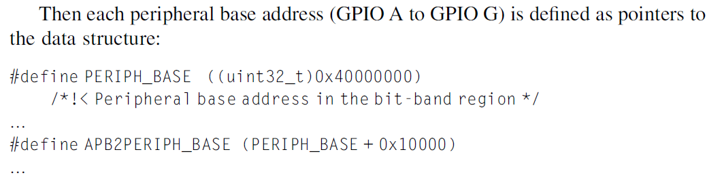
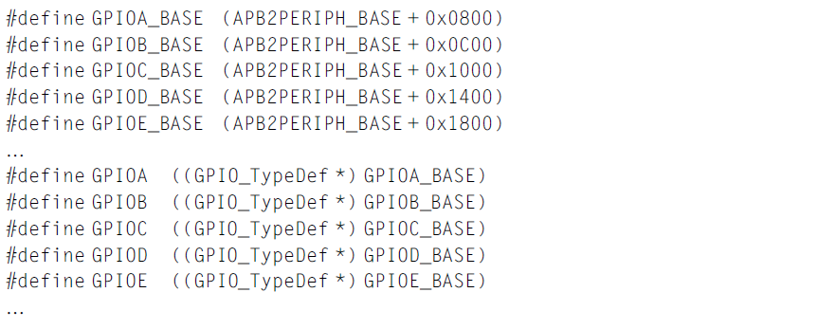
Efficient definition of GPIO registers
This example is not for STML476RG
(Addresses are different)

Slide 18
Parallel or GPIO Ports
General Purpose Input Output pins are organised as parallel ports with (for STM32) 16 elements
Each one can be an input or output and can also have other advanced options
They are used to drive LEDs, read switches or keypads, etc
Note that microcontroller pins usually have multiple functions because pins are expensive

Slide 19
Parallel Ports or GPIO Ports
Simplest on-chip I/O devices
You can set an output pin to a logic 1, high voltage level or a logic low, low voltage output under software control
Or read the logic level read in from a pin
Most ports have a similar structure:
A direction register that determines if a pin is to be an output or an input
An output port register
An input pin register

Slide 20
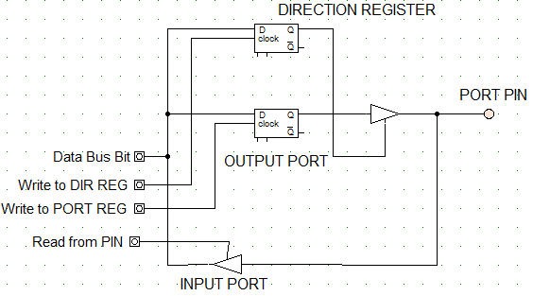
Simplified structure of a parallel port
One bit of a microcontroller port usually consists of an output port, a direction control register and input register
The STM32 GPIO ports have more features than this port
So more configuration registers are required
Also (to minimise power) the clock to each GPIO can be gated

Slide 21
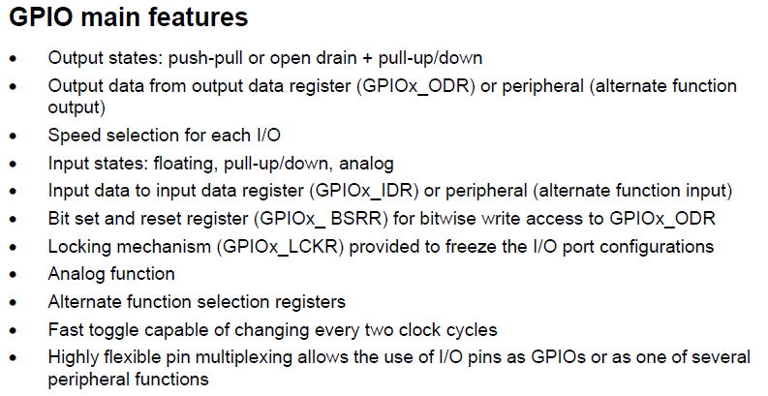
STM32 GPIO Features

Slide 22
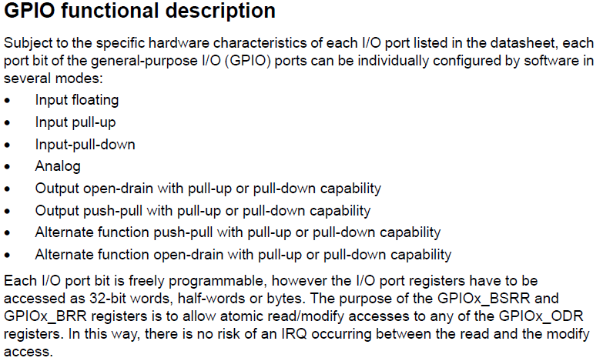
STM32 GPIO Functional Description

Slide 23
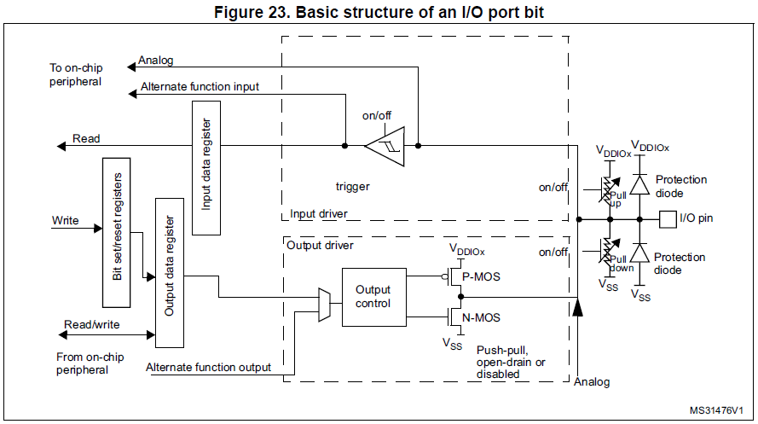
Structure of a GPIO Pin
These options are enabled/disabled using different settings in the GPIO configuration registers.
The output and input registers are also required.
We look at each of the GPIO registers in turn

Slide 24
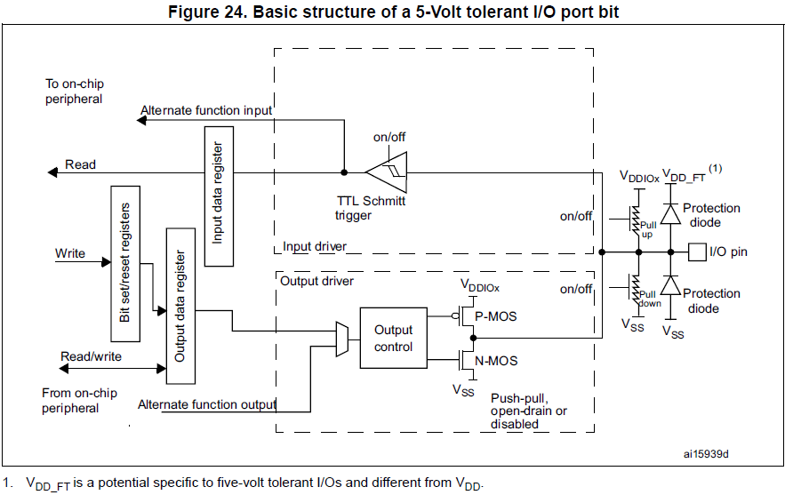
Structure of a GPIO 5V tolerant Pin

Slide 25
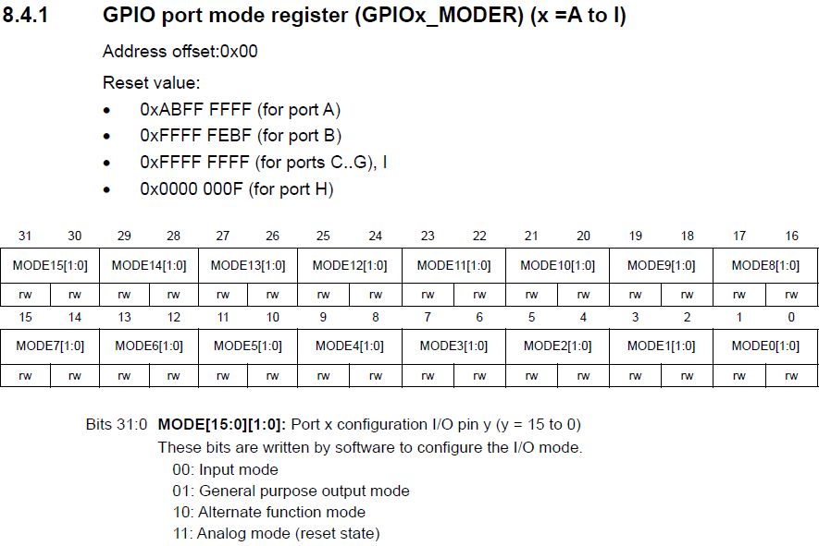
GPIO Mode Register
Each GPIO port has 16 bits
Two bits are needed for each pin option
So the mode register needs 32 bits

Slide 26
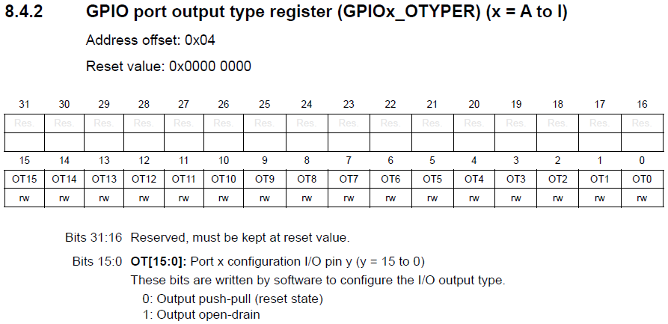
GPIO Type Register
Each GPIO port has 16 bits
The default case is the preferred option for most applications
so you may not always need to set up this register

Slide 27
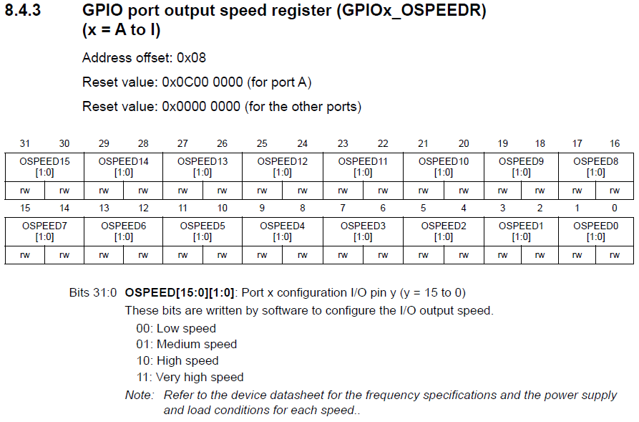
GPIO Speed Register
Output speed refers to the Slew Rate of the output pin, not the maximum frequency at which it can toggle
By slew rate we mean how fast the signal goes from 0V to Vdd
The higher the slew rate, the greater the noise
Use low or medium speed where possible

Slide 28
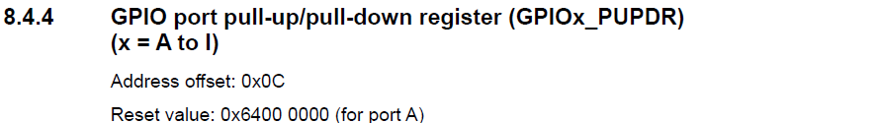
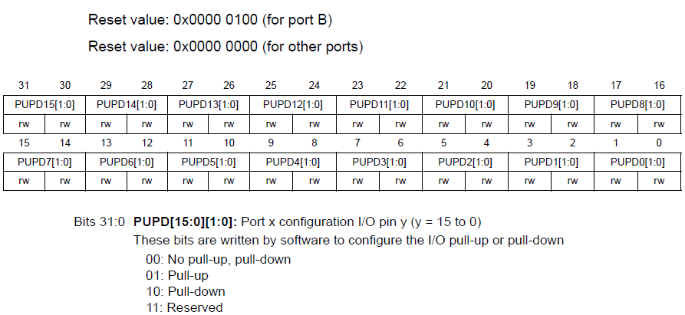
GPIO Pull Up/Down Register
Weak Pull-Up/Pull-Down resistors
Save board real-estate and reduce costs

Slide 29
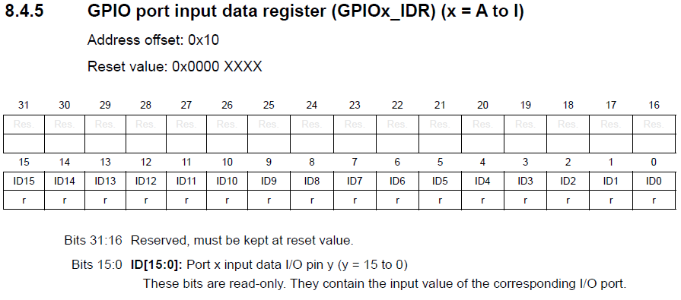
GPIO Input Data Register
Again, only 16-bits are required
When we read this register, we read the state of ALL the bits of the Port
This is one case where bitwise operations may be important

Slide 30
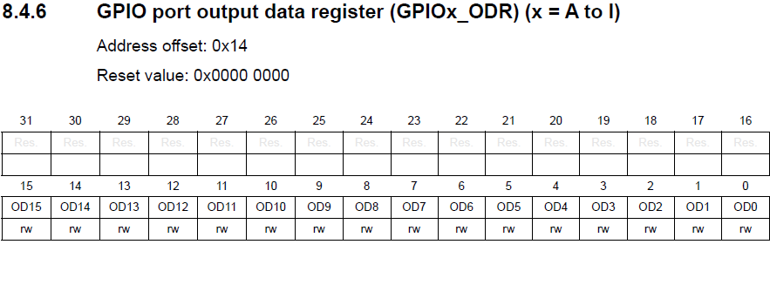
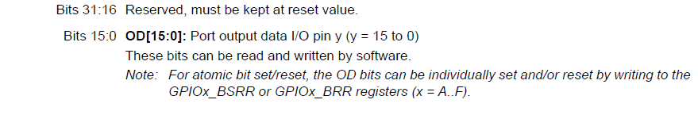
GPIO Output Data Register
For many MCUs setting individual bits involves a read – mask – rewrite
This involves separate instructions and may not be atomic.
For atomic operations the bit set/reset register may be used (next)

Slide 31
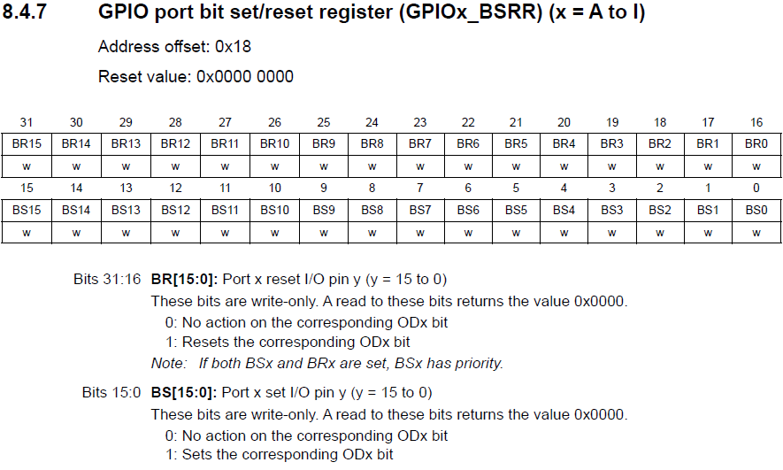
GPIO Bit Set/Reset Register
Why do you think atomic operations are important?

Slide 32
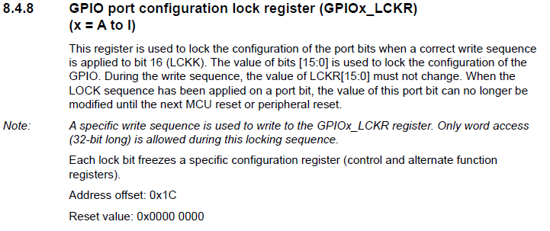
GPIO Configuration Lock Register (1)
This is a feature you might associate with a fairly advanced MCU
Not present on simpler devices
It guards against accidental reconfiguration of a specific port pin

Slide 33

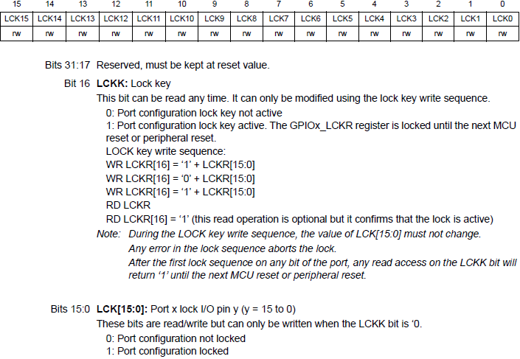
GPIO Configuration Lock Register (2)

Slide 34
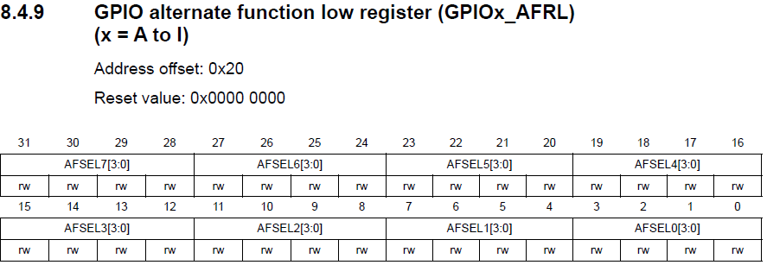
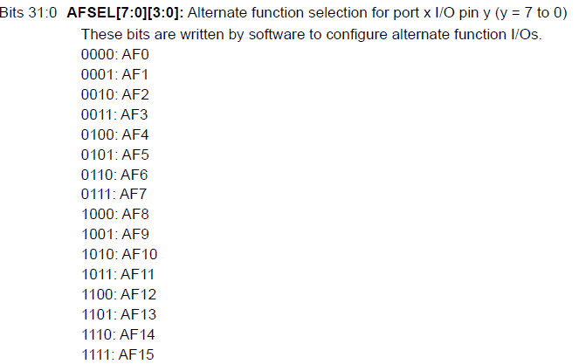
GPIO Alternate Function Registers
4 bits per port pin = 64 bits
Two 32-bit registers
The AF patterns allow the pin
To be used for other functions
Many simpler microcontrollers allow only a single, fixed alternate function per pin

Slide 35
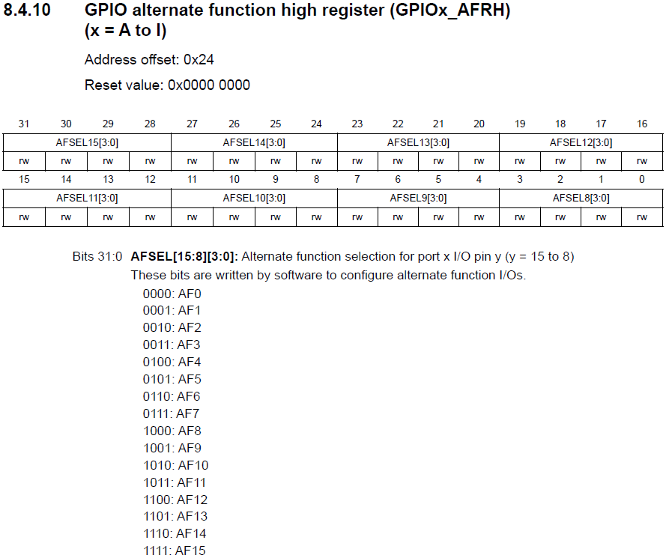
GPIO Alternate Function Registers

Slide 36
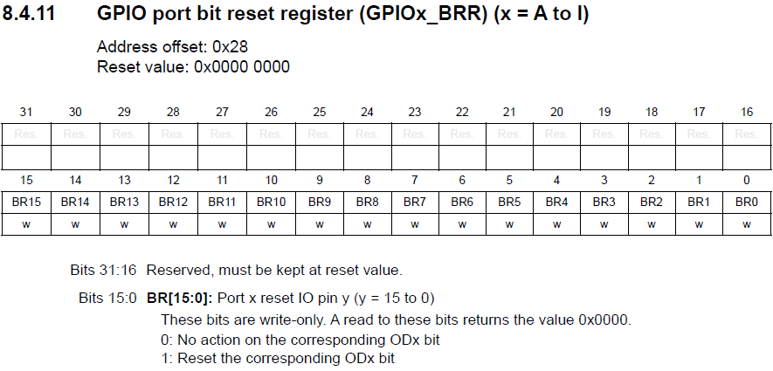
GPIO Port Reset Register
This supports atomic reset of a port pin

Slide 37
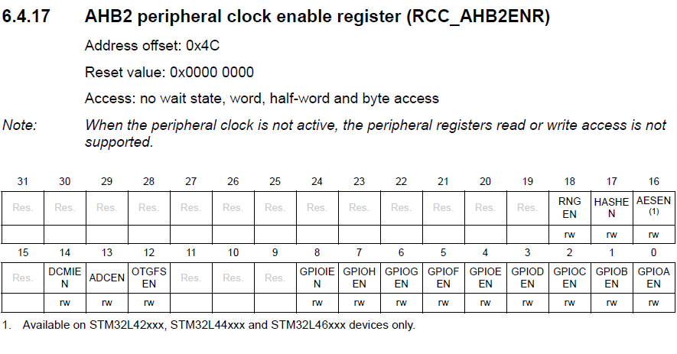
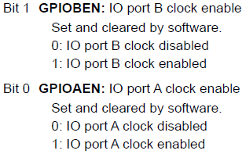
AHB2ENR Register
Recall that GPIOs are on the AHB2 Bus
Other GPIOEN bits are similar

Slide 38
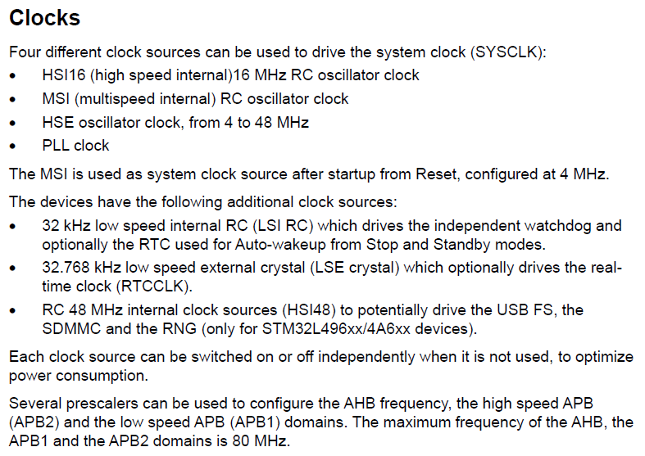
STM32 Clock Sources
The MCU initialisation code is where you would normally set up the option you want to use in your application

Slide 39
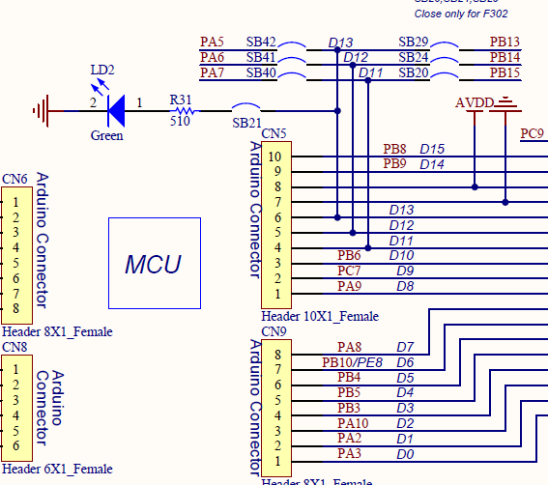
Nucleo64 STM32L476 Green Led
Writing a ‘1’ to
PA5 turns on the LED LD2
Can you think of a circuit in which writing a ‘0’ turns on the LED?

Slide 40
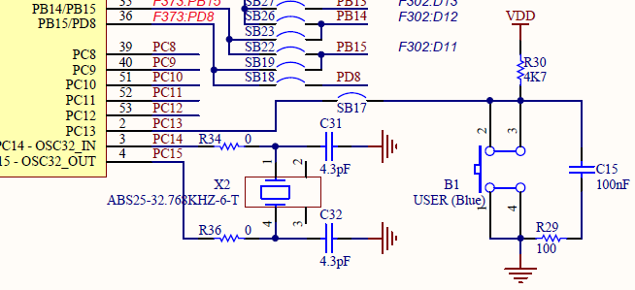
Nucleo64 STM32L476 Blue Button

Slide 41
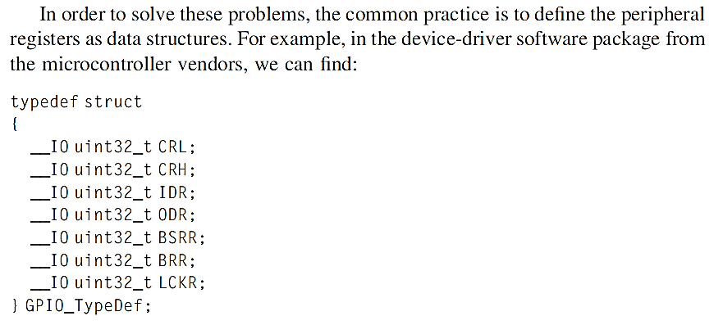
Efficient definition of GPIO registers

Slide 42
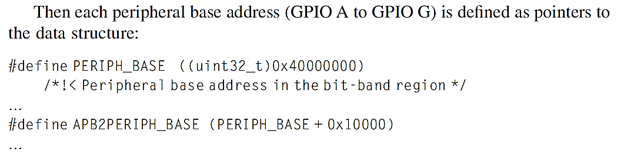
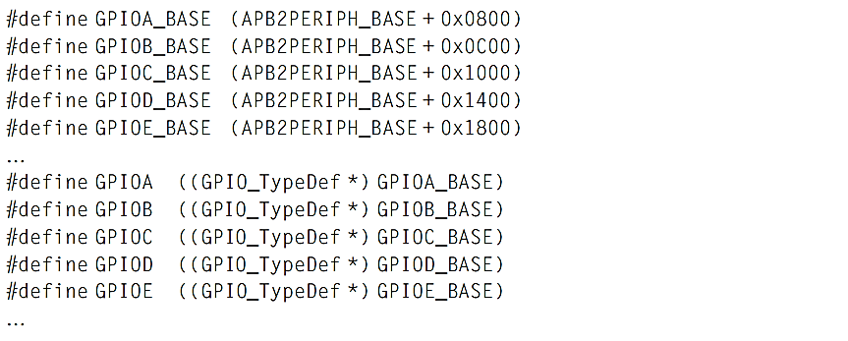
Efficient definition of GPIO registers

Slide 43
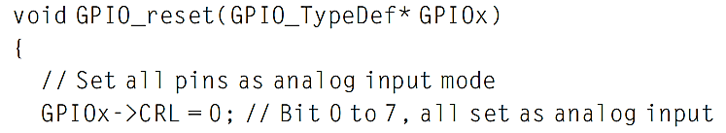
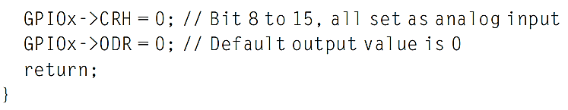
Using the technique
Now we can create functions that can be used for each instance of the peripheral
E,g. the code to reset the GPIO port can be written as:

Slide 44
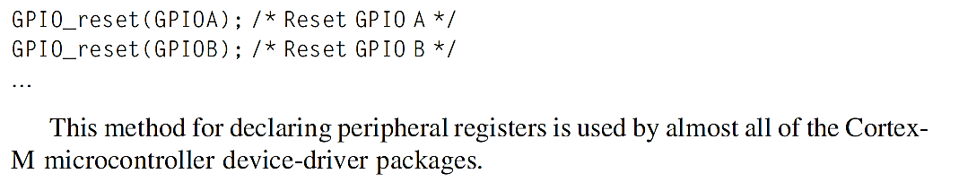
Using the reset function
Use the function by passing the peripheral base pointer to the function:

Slide 45
CMSIS
CMSIS: Cortex Microcontroller Software Interface Standard
A consistent software infrastructure for Cortex-M software developers, aims:
Software reuse
Software compatibility
Ease of use
Toolchain independent
Open: CMSIS core files source code can be downloaded from Github
New CMSIS projects have also been released
eg CMSIS-RTOS, CMSIS-DSP, etc

Slide 46
An example from Mazidi’s book
#include "stm32f4xx.h"
void delayMs(int n);
int main(void) {
RCC->AHB1ENR |= 1; /* enable GPIOA clock */
GPIOA->MODER &= ~0x00000C00; /* clear pin mode */
GPIOA->MODER |= 0x00000400; /* set pin to output mode */
while(1) {
GPIOA->ODR |= 0x00000020; /* turn on LED */
delayMs(500);
GPIOA->ODR &= ~0x00000020; /* turn off LED */
delayMs(500);
}
}
/* 16 MHz SYSCLK */
void delayMs(int n) {
int i;
for (; n > 0; n--)
for (i = 0; i < 3195; i++) ;
}
If we replaced the include file by stm32l4xx.h we might expect this to work.
It doesn’t.
Why not?
How could we fix it?

Slide 47
An example from Mazidi’s book
#include "stm32f4xx.h"
void delayMs(int n);
int main(void) {
RCC->AHB1ENR |= 1; /* enable GPIOA clock */
GPIOA->MODER &= ~0x00000C00; /* clear pin mode */
GPIOA->MODER |= 0x00000400; /* set pin to output mode */
while(1) {
GPIOA->ODR |= 0x00000020; /* turn on LED */
delayMs(500);
GPIOA->ODR &= ~0x00000020; /* turn off LED */
delayMs(500);
}
}
/* 16 MHz SYSCLK */
void delayMs(int n) {
int i;
for (; n > 0; n--)
for (i = 0; i < 3195; i++) ;
}
This is an interesting example
It doesn’t use auto-generated code for initialisation but it does use CMSIS-compatible references to on-chip peripheral registers

Slide 48
Summary
Looked at ARM processor and microcontrollers to see where relevant information comes from
Software tools and IDEs
Software Development Flow for some IDEs
Structures of Embedded Software
Come back to this later
C Data types for embedded development
Microcontroller I/O and software
Come back to this later too

