Slide 1
ED5502 Embedded Software
Lecture 8:
ARMv7-M Cortex Interrupts
STM32 Interrupts
Ciaran MacNamee

Slide 2
What we will cover today
Polling versus Interrupts – general ideas
ARM Cortex M4 Interrupt and Exception handling
ARM Cortex NVIC and Priorities
STM32L476RG interrupts
Some example code

Slide 3
After these lectures you should be able to:
Initialise and use the NVIC and peripheral interrupt control and status registers to create interrupt-driven code

Slide 4
Polling Loops
The processor
Waits until there is data ready for processing
Processes it
Then waits again
Very easy to setup
Works well for simple tasks
Inefficient and power hungry
This approach (including the next slide) is what we have been doing up to now
Very wasteful on time
Notes:
The simplest approach: sit in a loop until something happens. Then do something based on the input event – then repeat the process.
We respond to the event but the microcontroller is completely tied up waiting for the event.

Slide 5
Polling with Multiple Devices
Notes:
This is a variation on a simple polling loop but has many of the same disadvantages.

Slide 6
Interrupt Driven Application
Not necessary to enter Sleep Mode or related low power mode
But we could
Notes:
Interrupt driven applications are much more efficient but can be unpredictable and hard to debug and organise when the number of interrupts increases.
In particular, it can be hard to guarantee timings because the current interrupt has priority.

Slide 7
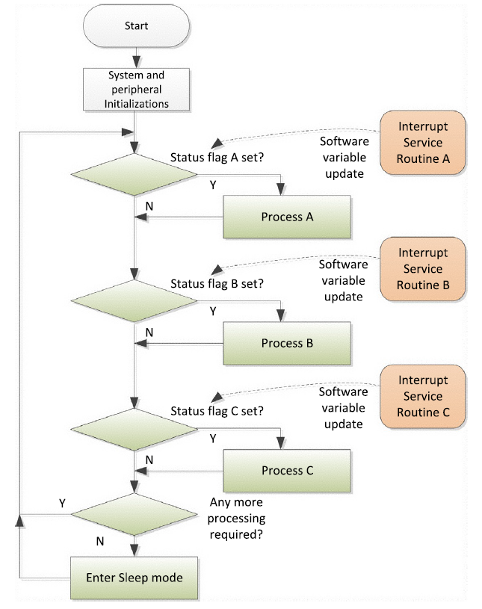
Combined Interrupt and Polling
ISRs should be of short duration because they lock out other ISRs (assuming no pre-emption)
Notes:
This organisation attempts to improve the timing response. ISRs are short, and set status flags, while the main loop processes the less time critical tasks.
This means that the main loop can be very messy, and again timing is hard to predict.

Slide 8
Interrupts and Real Time Systems
So there are many cases in which we need to ensure that when some event occurs it gets immediate attention
Taking the flashing LEDs program as an example, we might want to respond to some new data in the serial port, or maybe the ADC has completed a conversion
Our program has no way to do this, except in a sequential way
Hence we allow the serial port, ADC or some other device to interrupt the current program

Slide 9
Interrupt Driven I/O
An interrupt is a demand for immediate attention: stop what you’re doing and attend to this
E.g. a telephone in everyday life
Interrupts are events typically generated by hardware (e.g., peripherals or external input pins) that cause changes in program flow control outside a normal programmed sequence
(e.g., to provide service to a peripheral)
Computers provide built-in hardware support for interrupt operations
Competition for the fastest response with the least overhead

Slide 10
Interrupts
While all microcontrollers support interrupts, the details vary from one manufacturer to the next, and between MCU families
This means that there is not a fully defined way for programming languages to handle interrupts
There can’t be because the hardware is different
And interrupt handling may vary from compiler to compiler, even for the same language

Slide 11
Interrupts in ARM: NVIC
Cortex-M processors: Nested Vectored Interrupt Controller for interrupt handling
As well as interrupt requests, other events, called “exceptions” need to be serviced
In ARM, an interrupt is a type of exception
Cortex-M exceptions include fault exceptions and system exceptions to support the OS
In general, I try to refer to Exceptions as general way of describing these events and to Interrupts as events coming from on-chip peripherals

Slide 12
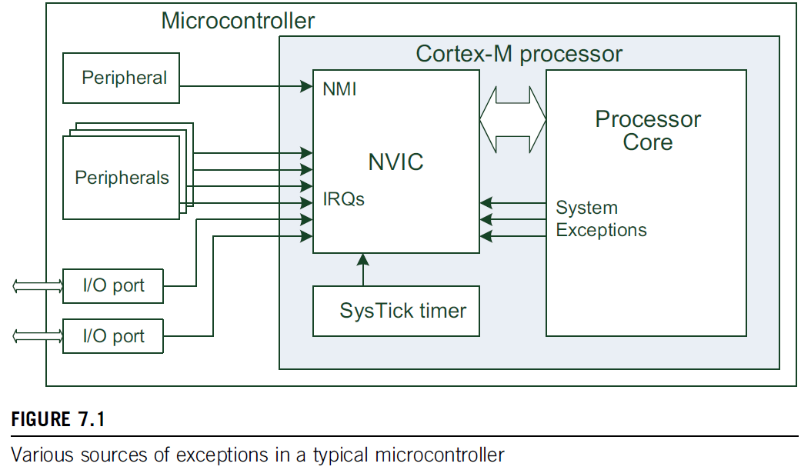
NVIC and exceptions/interrupt sources

Slide 13
Interrupts in ARM: Cortex-M3/M4 NVIC
NVIC supports up to 240 IRQs (Interrupt Requests), Non-Maskable Interrupt (NMI), SysTick (System Tick) timer interrupt, and some system exceptions
Most IRQs come from peripherals, timers, I/O ports, comms interfaces (UART, I2C) etc
NMI usually from peripherals like a watchdog or Brown-Out Detector (BOD)
Remaining exceptions are from the processor core
Interrupts can also be generated using software

Slide 14
Interrupt (or Exception) Handling
A microcontroller has a defined way for an interrupt to stop the current program. It must:
Save some or all the CPU registers (because we’ll come back to the interrupted program)
Vector or find its way to some code that handles the interrupt that has been recognised
Execute the interrupt code (called an Interrupt Service Routine, ISR, or sometimes Exception Handler)
Restore the CPU registers that were saved on entry to the ISR
Finish and return to the interrupted code
Notes:
This is the sequence of operations that occurs when an Interrupt or exception is accepted.
Ideally, after the ISR or Exception Handler has been executed, the code that was interrupted goes on without ‘noticing’ the interruption

Slide 15
Exception (Interrupt) Handlers
In ARM (and other CPUs) the exception sequence must save the status of the interrupted program so that it can be restored after the exception handler is completed
In general this can be done in hardware or by a mixture of hardware and software
Cortex-M:
Some registers are saved on the stack automatically when an exception is accepted, and automatically restored in the exception return sequence
Allows exception handlers to be written as normal C functions with no additional software overhead

Slide 16
Exception Numbering and Priorities
Exceptions and interrupts are numbered
Exceptions 1-15: system (Arm) Exceptions
Exceptions 16 and above are external interrupts
(External to the ARM Cortex, not the MCU)
The exception number identifies each exception
The exception number is fixed, but the priority of the exception may be programmable
Notes:
The exception number identifies each exception: this means that you can know which interrupt is being executed.
This is given in the IPSR (Interrupt Program Service Register)

Slide 17
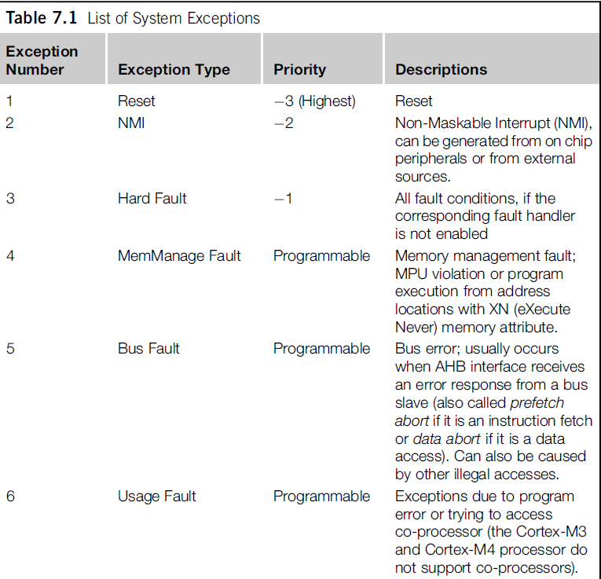

Slide 18
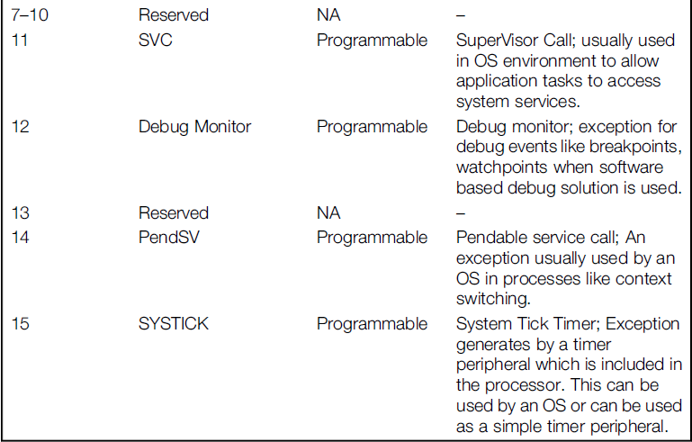
Table continued from previous slide

Slide 19
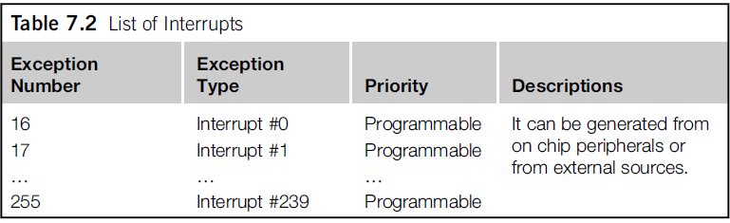
List of Interrupts
These Interrupts come from the STM32 in our case

Slide 20
Cortex-M Exception Priority Levels
The priority of an exception and the current priority of the processor determine if and when an exception is accepted
NB: Nested Exceptions/Interrupts means a higher-priority exception can pre-empt a lower-priority exception
Reset, NMI, and HardFault have fixed priority levels - represented with negative numbers to show they have the highest priority
Other exceptions have programmable priority levels from 0 to 255 – less in practice
Notes:
Note that the higher the priority the smaller the number in priority levels.
The lower the priority the higher the number in priority levels.
.The design of the Cortex-M3 and Cortex-M4 processors support three fixed
highest-priority levels and up to 256 levels of programmable priority (with a
maximum of 128 levels of pre-emption). The actual number of available programmable
priority levels is decided by silicon chip designers. Most Cortex-M3 or
Cortex-M4 chips have fewer supported levels for example, 8, 16, 32, and so on.
This is because having large number of priority levels can increases the complexity of
the NVIC and can increase power consumption and reduce the speed of the design. In
most cases, applications only require a small number of programmable priority levels.

Slide 21
Cortex-M Exception Priority Levels
The priority of an exception and the current priority of the processor determine if and when an exception is accepted
NB: Nested Exceptions/Interrupts means a higher-priority exception can pre-empt a lower-priority exception
Reset, NMI, and HardFault have fixed priority levels - represented with negative numbers to show they have the highest priority
Other exceptions have programmable priority levels from 0 to 255
The default is that all Exceptions have Priority 0
Effectively no Nested Interrupts unless specifically enabled as such
Notes:
Note that the higher the priority the smaller the number in priority levels.
The lower the priority the higher the number in priority levels.
.The design of the Cortex-M3 and Cortex-M4 processors support three fixed
highest-priority levels and up to 256 levels of programmable priority (with a
maximum of 128 levels of pre-emption). The actual number of available programmable
priority levels is decided by silicon chip designers. Most Cortex-M3 or
Cortex-M4 chips have fewer supported levels for example, 8, 16, 32, and so on.
This is because having large number of priority levels can increases the complexity of
the NVIC and can increase power consumption and reduce the speed of the design. In
most cases, applications only require a small number of programmable priority levels.

Slide 22
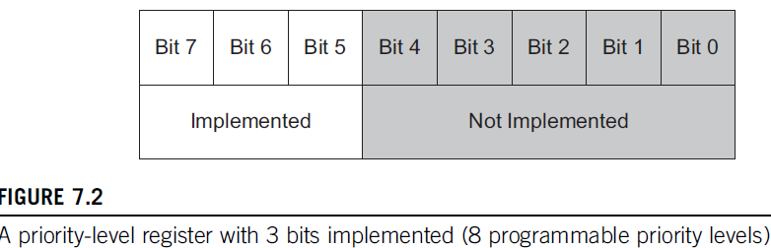
Cortex Priority Levels
Interrupt-priority levels controlled by priority-level registers
Width of 3 bits to 8 bits
3 bits of priority level (below)
Cortex-M also supports sub-priorities for exceptions at the same priority level
Bits 4-0 always read as zero:
Priority Levels: 0x00 (highest priority), 0x20, 0x40,0 .. 0xe0 (lowest)

Slide 23
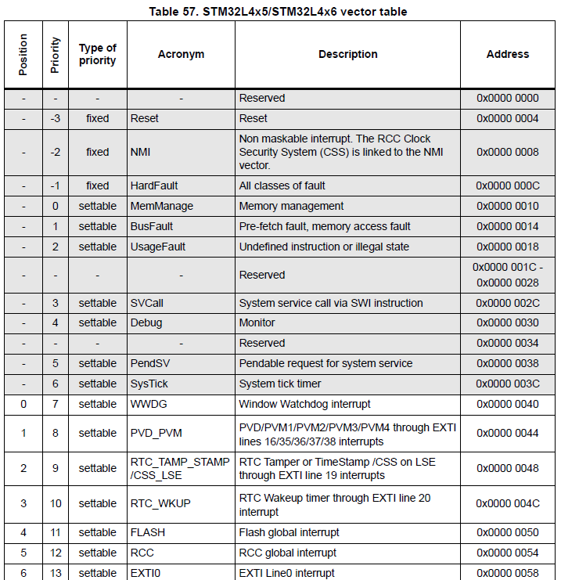
List of Interrupts STM32L476RG
These Interrupts come from the STM32L476RG
Notes:
This is an excerpt from a very long table – see p396 of the Reference Manual

Slide 24
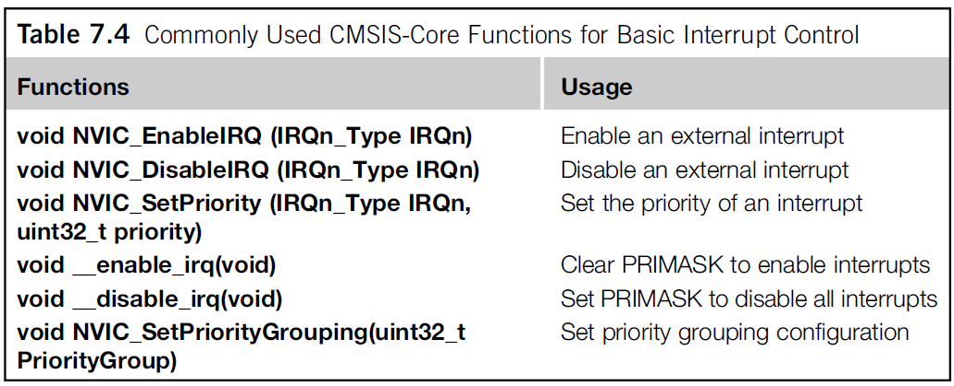
Setting up an Interrupt
Cortex-M have programmable registers to manage interrupts and exceptions
Part of the NVIC and SCB block
You can write to these registers or use CMSIS-Core functions

Slide 25
Interrupt Priorities
In simpler processors exception acceptance disables further interrupts
Cortex-M allows an exception to be accepted even when another exception is executing
Depends on the priorities
Higher priorities have lower priority levels
Some exceptions (eg NMI) have fixed (negative) priority levels
Others have programmable priority levels
Theoretically 0-255 levels

Slide 26
Interrupt Priorities
System Software designers must decide on the Interrupt Priorities
High priority interrupts can interrupt lower priority interrupts or exceptions but not vice versa
We’ll use defaults for now
In simpler processors exception acceptance disables further interrupts
Cortex-M allows an exception to be accepted even when another exception is executing
Depends on the priorities
Higher priorities have lower priority levels
Some exceptions (eg NMI) have fixed (negative) priority levels
Others have programmable priority levels
Theoretically 0-255 levels

Slide 27
Vector Table – Getting to the ISR
The ISR or Exception Handler is the code that runs when an exception is accepted
How does the processor get to this code?
Cortex-M uses a vector table at low memory addresses
Each entry in the table is the start address of the Exception Handler or ISR for that interrupt or exception
(Except 0, which is the initial Stack Pointer!)

Slide 28
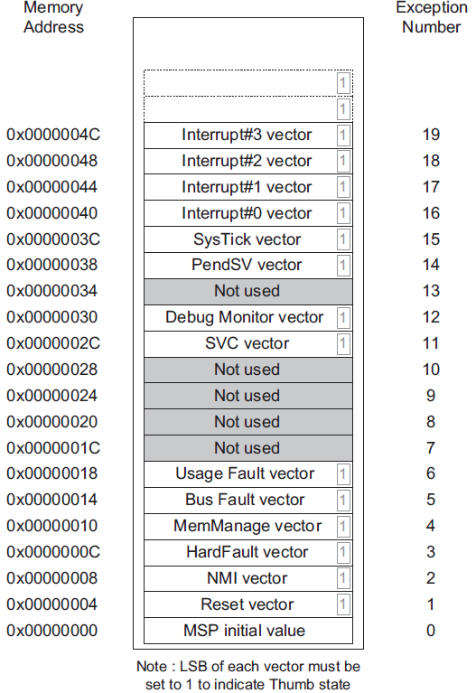
Vector Table – Getting to the ISR
Start address of the Exception Handler or ISR is placed here
We have seen SysTick already
SVC is supervisor call (previously SWI, software interrupt)

Slide 29
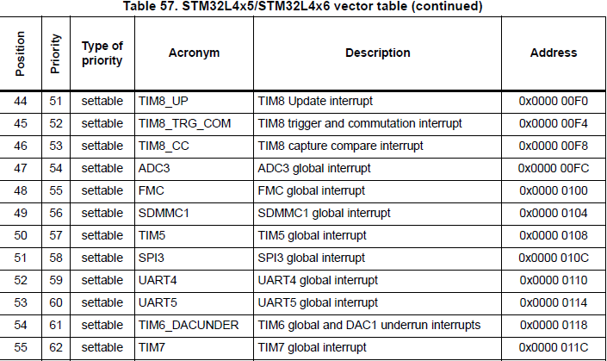
Vector Table – Getting to the ISR
If we were using the Timer8 Capture Compare Interrupt, its ISR start address would go here

Slide 30
Context Saving on an Exception
Exceptions and Interrupts are asynchronous to program execution – can happen anytime
Need to ensure that the interrupted code can resume – it’s essential to save at least some registers when the ISR is accepted
The saved registers include CPSR, PC, LR (Link Register), R12, and R0-R3
Register saving in accordance with the Arm Architectural Procedure Call Standard (AAPCS)
If the ISR uses other registers it must save these too

Slide 31
Cortex-M Interrupt Stack Frame
The key point is that this uses the same register saving/restoring convention used by ARM for calling functions: the Arm Architectural Procedure Call Standard (AAPCS)
This means that ISRs can be written as normal C functions
Unlike other CPUs which need pragmas or other keywords for ISRs
Notes:
These registers are stored by the processor hardware. They’re restored on the return from the interrupt.
If your code uses other registers, you must save those registers (on the stack) and restore them before returning.

Slide 32
Cortex-M Processor Modes
Cortex-M can run in one of two modes: Thread Mode and Handler Mode
Thread Mode: Cortex-M goes into Thread Mode on Reset. Big majority of applications run in thread mode
Handler Mode: Cortex-M switches to Thread Mode on entry to an exception/ISR (except Reset), returns to Thread Mode on return
When returning from Handler Mode, Cortex-M restores the registers saved on ISR entry (see previous slide)
Notes:
The same return instruction is used – but it works differently in different modes.

Slide 33
Cortex-M: Two Stack Pointers
It’s useful to have a stack pointer for the system and one for the thread
PSP (Processor Stack Pointer) – thread mode
MSP (Main Stack Pointer) – Exception handlers (and OS kernel if used)
The ASP bit of the CONTROL register can be used to decide which SP is used as R13

Slide 34
Privileged and Unprivileged Modes
Privileged/Unprivileged Levels allow some registers and some memory to be protected
SysTick, NVIC and some other system resources are only accessible in Privileged Mode
Instructions MSR, MRS can only be executed in Privileged Mode
Exception Handlers and ISRs can only be executed in Privileged Mode
CONTROL Register can only be accessed in Privileged Mode
For small applications we mostly stay in Privileged Mode

Slide 35

Privilege Levels and Processor Modes
Processor Mode | Software | Privilege level
Thread | Applications | Privileged and Unprivileged
Handler | ISR for Exceptions and IRQs | Always Privileged
In Thread mode, use bit 0 of the CONTROL register to select Privileged or Unprivileged
CONTROL REGISTER
nPRIV (Privilege): Defines the Thread mode privilege level 0: Privileged 1: Unprivileged Active Stack Pointer (ASP): Defines the currently active stack pointer (ASP = SPSEL) 0: MSP is the current stack pointer. 1: PSP is the current stack pointer. Floating Point Context Active (FPCA) 0: No floating point context active. 1: Floating point context active.

Slide 36
Practical Applications: GPIO Interrupts
Earlier examples polled the level of an input pin to do some action
Very wasteful on CPU time
So in this example, we allow a change on the GPIO pin to trigger an interrupt
Frees up the CPU
GPIO interrupts come through EXTIx Interrupts, Scattered through the Vector Table

Slide 37
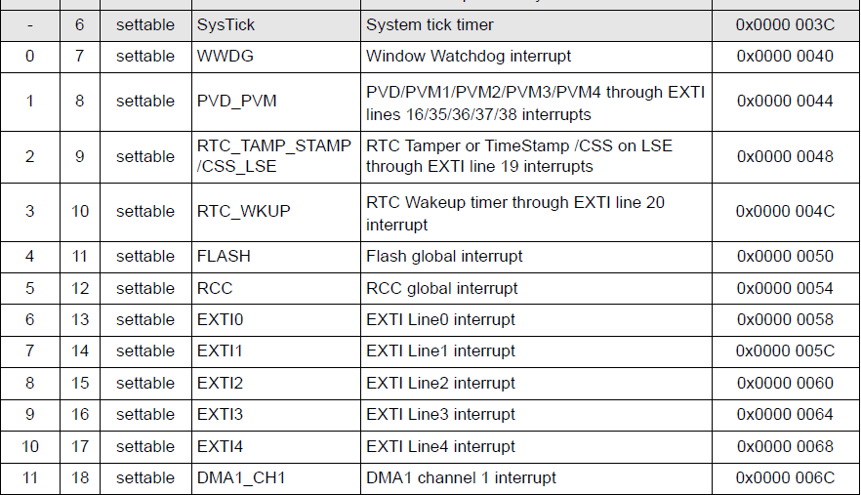


EXTI Interrupts in the Vector Table
EXTIx Interrupts
One each
Groups

Slide 38
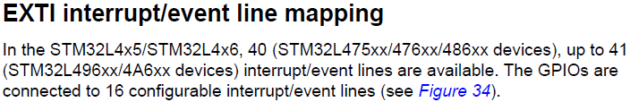
Enabling an EXTI interrupt
Find the right pin
Enable Interrupt Requests from the pin through the peripheral control registers
General (global) interrupt enable through NVIC
Find the Pin:

Slide 39
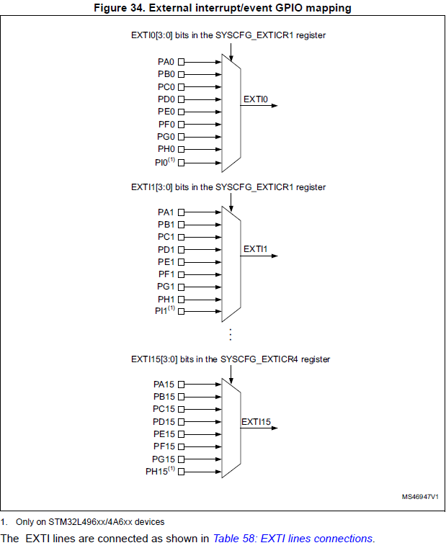
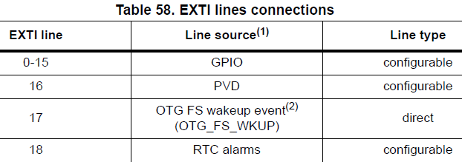
Find the Pin – EXTI mapping
One of PA0, PB0 etc is directed onto EXTI0 according to the setting of EXTI0[3:0] in SYSCFG_EXTCR1
PA1, PB1 etc set by EXTI1[3:0]
Etc
Part of a long table.
EXTI > 16 are used for other purposes

Slide 40
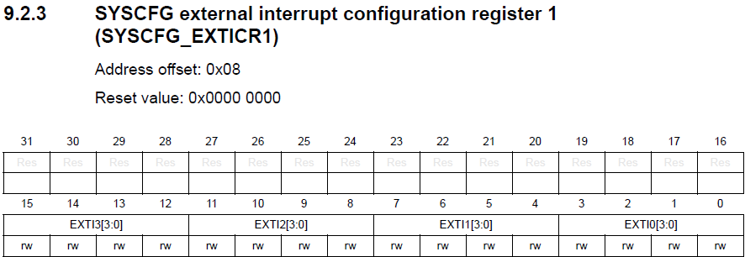
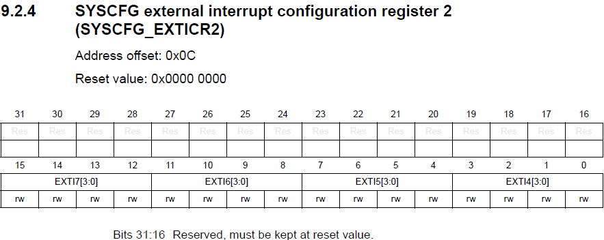
SYSCFG_EXTICR1&2 Registers
Referred to as SYSCFG->EXTICR[0]
Referred to as SYSCFG->EXTICR[1]

Slide 41
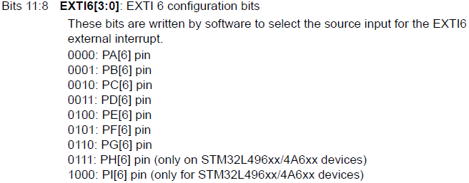
SYSCFG_EXTICR1&2 Registers
Sample EXTI Field
Others are similar
Recall: PA6 is the Shield Pushbutton
SYSCFG->EXTICR[1] &= ~0x00000f00;
In fact PA6 is the default

Slide 42
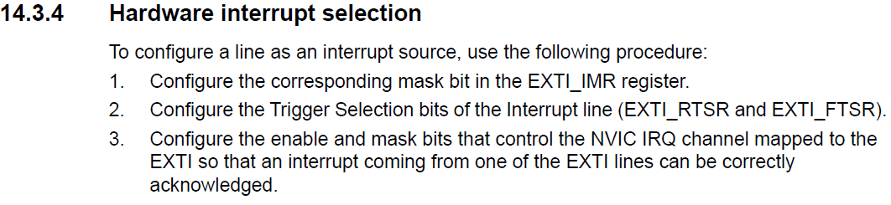
GPIO Pin Initialisation steps
We have directed the input pin to EXTI so next:

Slide 43
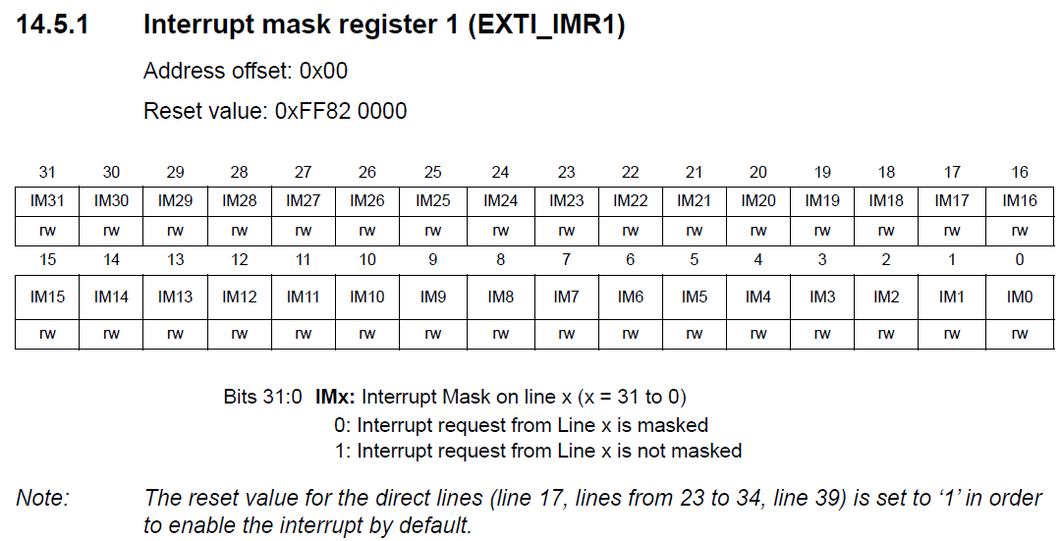
EXTI_IMR1 Register
PA6

Slide 44
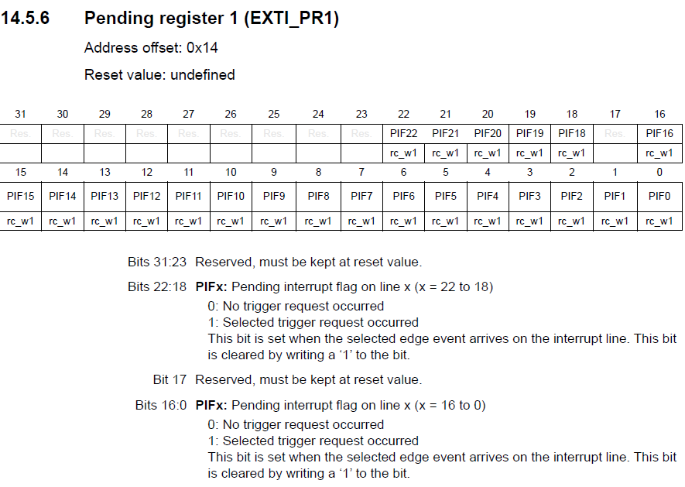
Pending Register
Pending bits indicate an event occurred
If the corresponding mask bit was set, an interrupt request is asserted
Our software may need to clear the bit on exiting the ISR
Not part of the initialisation but probably used in the ISR

Slide 45
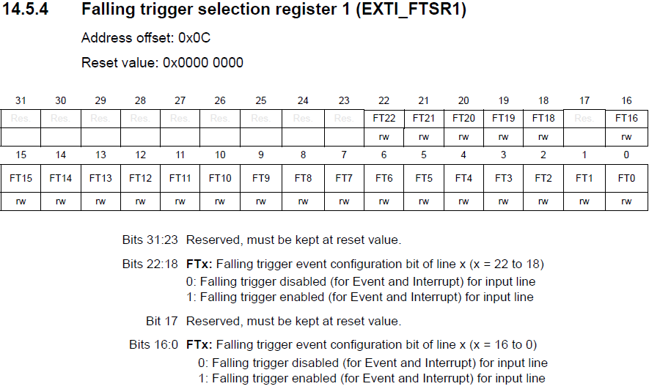
What Pin Change causes IRQ?
You can select a rising or falling edge on the input pin (or both) as the event that triggers and interrupt request

Slide 46

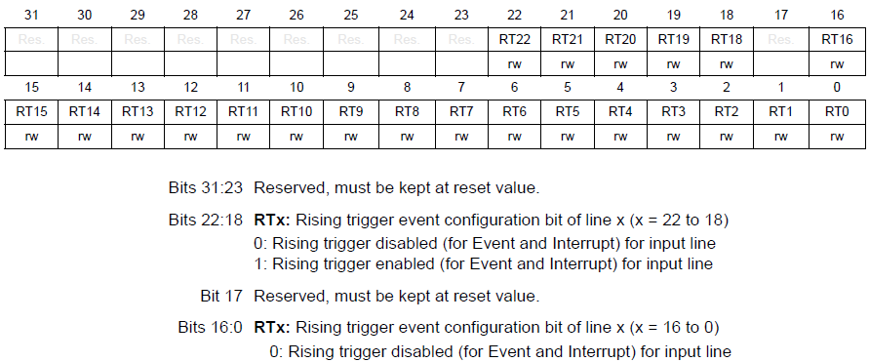
What Pin Change causes IRQ?
You can select a rising or falling edge on the input pin (or both) as the event that triggers and interrupt request
Now we have the events defined
Next step is use the NVIC

Slide 47
NVIC Setting
Nested Vector Interrupt Controller is the overall interrupt controller
Also sets priorities
Each IRQ has an enable bit

Slide 48
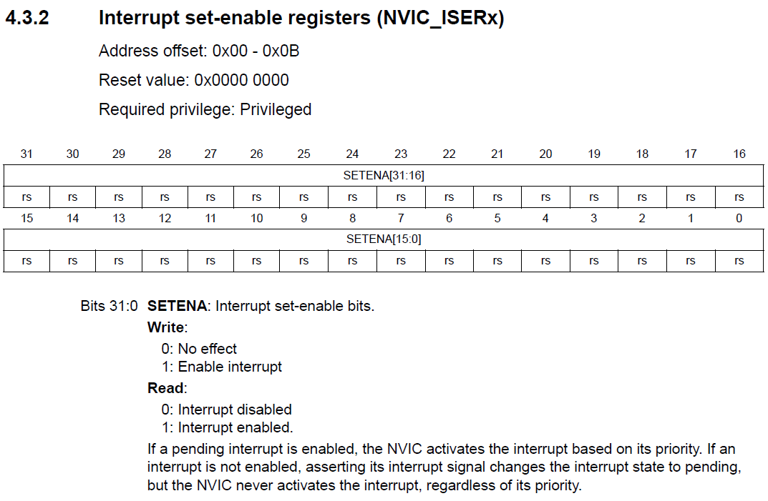
NVIC ISER Registers
This register is described in the 476RG Programming Manual, not the Reference Manual, because it’s part of the Cortex Core
IRQ6

Slide 49
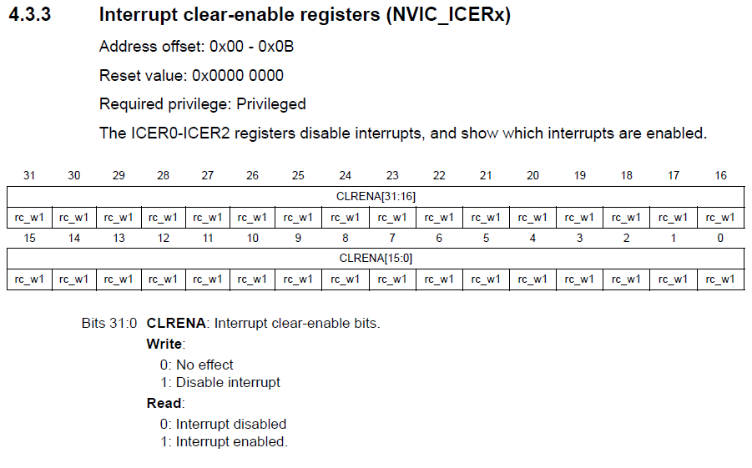
NVIC ICER Registers
IRQ6
Previous slide showed that writing 0 to a bit in ISER has no effect
You have to set a bit in ICER to disable the interrupt

Slide 50
NVIC Setting
This is one case where it’s better to use CMSIS Core functions
NVIC_EnableIRQ(Number);
NVIC_DisableIRQ(Number);
__enable_irq(); // Global interrupt enable
__disable_irq(); // Global interrupt disable
Without global interrupt enable, no interrupt is accepted

Slide 51
Exception Handler (ISR)
ARM allows ISRs to be written as conventional functions
But we need to use the exact names of the IRQ Handler
Allows the linker to place the start address of our interrupt software in the correct place in the Vector Table
Example Program: Mazidi Program 6-1
Also, ported program to L476RG
With CMSIS/CubeMX and without

Slide 52
Summary
Polling vs Interrupt Driven Execution
Interrupts in Arm Cortex-M, NVIC
Interrupt Example using GPIO pins

