Slide 1
ED5502 Embedded Software
Lecture 9:
More STM32 Interrupts: PA6 with CubeMX
USART, Timers, ADC
Ciaran MacNamee

Slide 2
What we will cover today
Look at setting a Pin Change Interrupt using CubeMX
Interrupt Initialisation for USART, Timers, ADCs
Example code with register setting
Example Code using CubeMX Generated Code and HAL interfaces

Slide 3
After these lectures you should be able to:
Initialise and use Interrupts starting with ST32CubeMX
Let’s start with an interrupt using PA6
First Step, start with Board Selector – Nucleo-64 – L4 – STM32L476 Nucleo

Slide 4
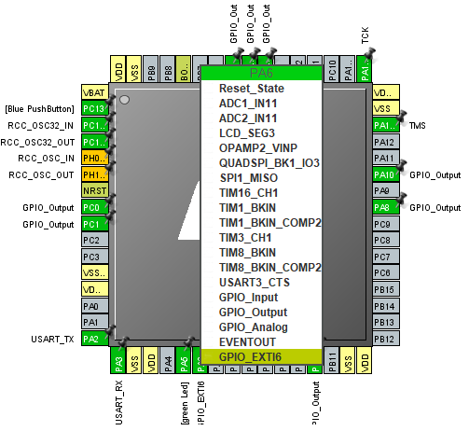
Cube MX : Set the PA6 Pin Mode
PA6 is connected to the Pushbutton on the Shiels we use
We want a falling edge to cause an Interrupt Request
Select GPIO_EXTI6
Note that we have also selected all the necessary digital pins for the LED Array
Not really necessary since we only use one output

Slide 5
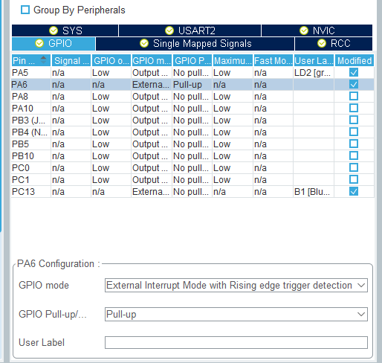
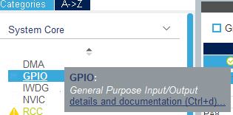
Cube MX : Select GPIO to edit PA6
PA6: Enable Pull-Up

Slide 6
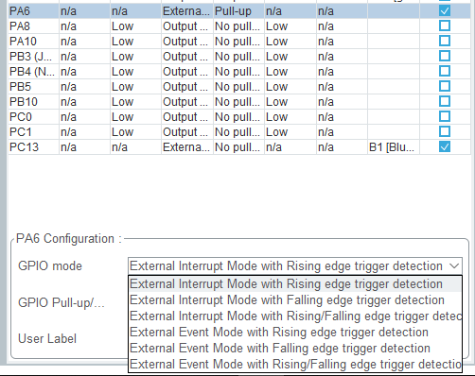
Cube MX : Select PA6 Falling Edge
Use the pull down menu

Slide 7
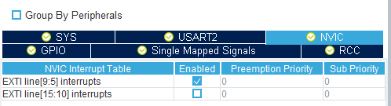
Cube MX : Select NVIC and EXTI
EXTI line [9:15] Group is now selected and Enabled
Note the Preemption Priority
In more complex applications you would expect to give this a higher number
(Lower priority)

Slide 8
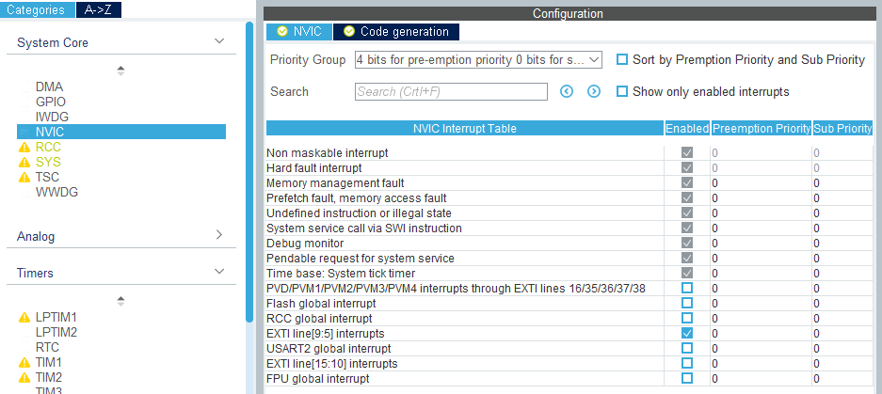
Cube MX : Check NVIC (to be sure)
Note that EXTI line[9:15] interrupts are enabled
Again note that the priority and sub-priority are 0 (default)

Slide 9
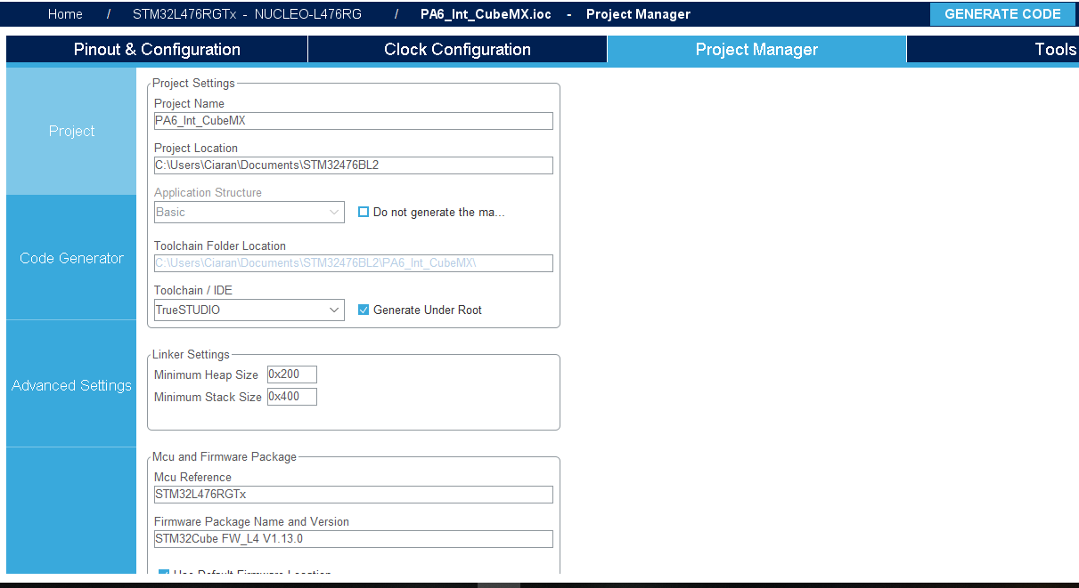
CubeMX: Project Manager
Assign a Project Name and make sure that TrueStudio or Keil (if using) is selected
The Press GENERATE CODE followed by Open Project

Slide 10
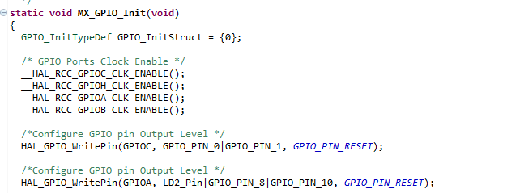
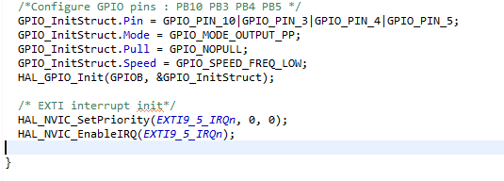
TrueStudio: Generated Code
This is as we have seen before
This is new

Slide 11
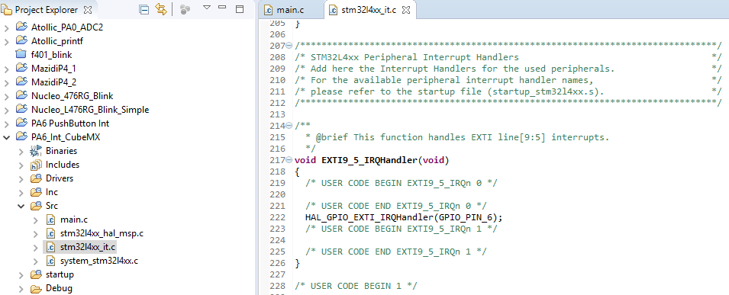
TrueStudio: stm32l4xx_it.c generated
Because we enabled EXTI line[9:15], an interrupt handler is generated

Slide 12
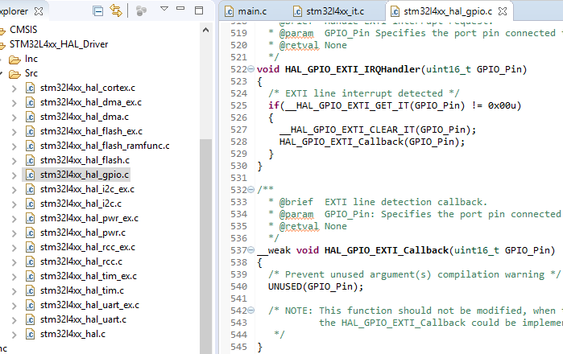
TrueStudio: IRQ Handler and Callback
No need to clear Pending Interrupt in our code
It’s done here
HAL_GPIO_EXTI_Callback is shown as __weak
Means that we can write our own Callback function of the sae name and the linker will use ours instead

Slide 13
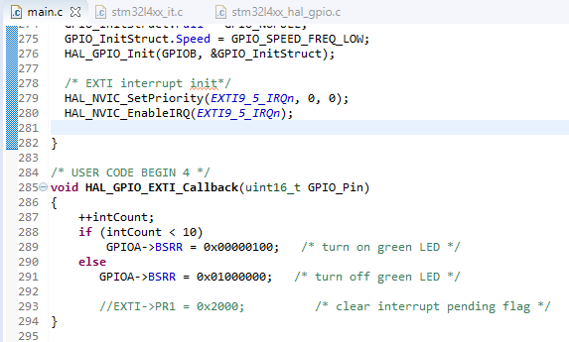
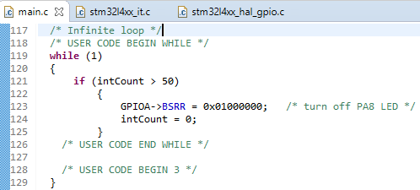
TrueStudio: User Callback and while(1)
No longer need to clear the interrupt pending flag
This example is fairly artificial
But shows interactions

Slide 14
Practical Applications: USART
Earlier USART code simply polled a status bit to see if data had arrived or if the transmit register could have data written to it
Even at 115200 Baud this is very wasteful on CPU time
See example in Sulis

Slide 15
Summary
Practical Examples using CubeMX and register initialisation

