Slide 1
Unleashing Potential of Unsupervised Pre-Training with Intra-Identity Regularization for Person Re-Identification
Zizheng Yang, Xin Jin, Kecheng Zheng, Feng Zhao* University of Science and Technology of China
2022 IEEE/CVF Conference on Computer Vision and Pattern Recognition (CVPR)

Slide 2
01.
Motivation
02.
Method
Contents
03.
Experiments
04.
Conclusion

Slide 3
Part 01
Motivation

Slide 4
1.1 Background
Background
Motivation
Optimization metrics
Limitations:
Initialization with ImageNet weights;
Poor fine-tuning performance and Slow convergence;
Supervised
Fine-grained features
Reasons:
Inapplicable pretraining method;
Large domain gap between ImageNet and ReID datasets;
ReID
Domain Adaptation
Unsupervised
Demand:
Explore a suitable initialization network;
Domain Generalization

Slide 5
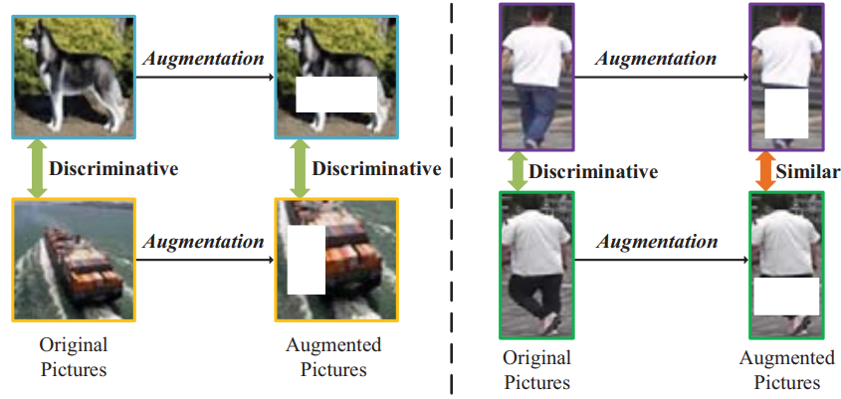
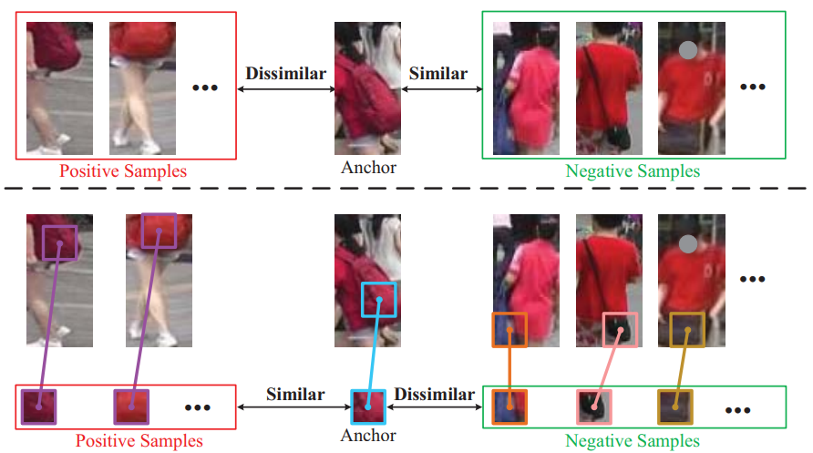
1.2 Motivation
Background
Motivation
MoCo v2
SwAV
UP-ReID b
UP-ReID
Augmented Problem
Problems:
The augmentations in the contrastive learning pipeline usually distort the discriminative clues in person images;
The fine-grained local features of person images are not fully-explored;
Fine-grained Problem

Slide 6
Part 02
Method

Slide 7
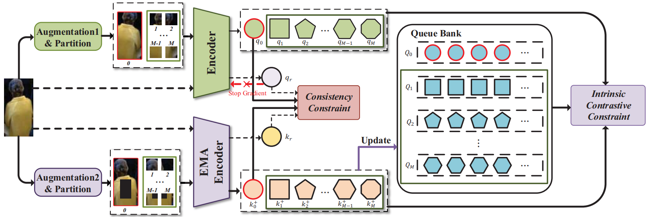
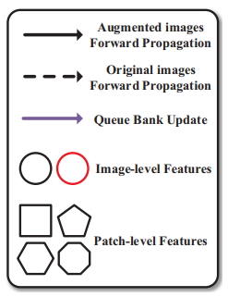
2.1 Network
Network
CC
ICC
HM
UP-ReID

Slide 8
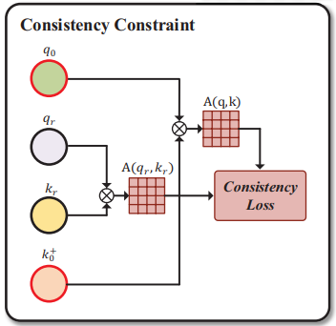
2.2 Consistency Constraint
Network
CC
ICC
HM
Augmented Images
Original Images
Maximum Mean Discrepancy
CC Illustration

Slide 9
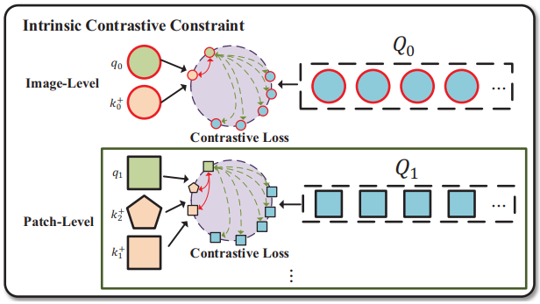
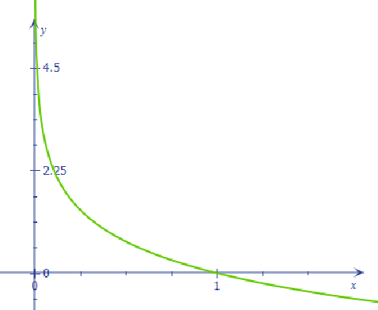
2.3 Intrinsic Contrastive Constraint
Network
CC
ICC
HM
ICC Illustration
y=-ln(x)

Slide 10
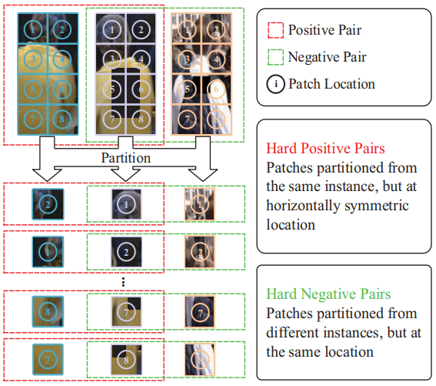
2.4 Hard Mining
Network
CC
ICC
HM
HM Illustration

Slide 11
Part 03
Experiments

Slide 12
3.1 Overview
Supervised
Unsupervised
SOTA
Ablation
Basic Information
Backbond | Resnet50 | Optimizer | SGD
Image size | 256*128 | Mini-batch | 800
Learning rate | 0.1 | Hard mining | 8
Queue bank | 65536 | Momentum | 0.9
Framework | PyTorch | GPUs | 8*2080Ti
Dateset | LUPerson、CUHK03、Market1501、PersonX、MSMT17
Time | 3weeks | Evaluation | mAP、Rank1

Slide 13
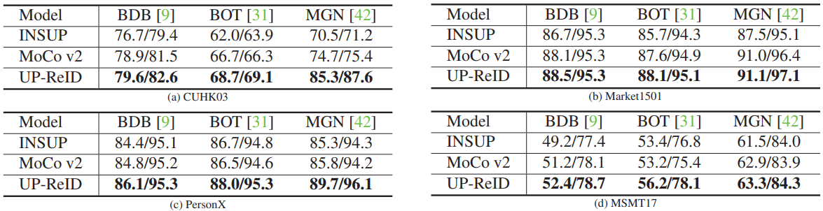
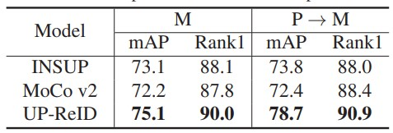
3.2 Experiments
Supervised
Unsupervised
SOTA
Ablation
Improvement on Supervised ReID
Improvement on Unsupervised ReID

Slide 14
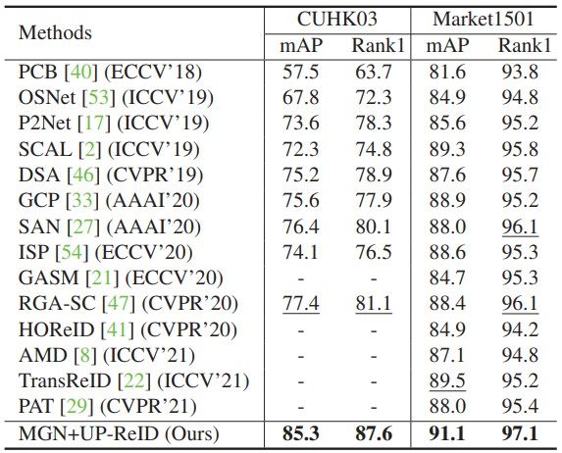
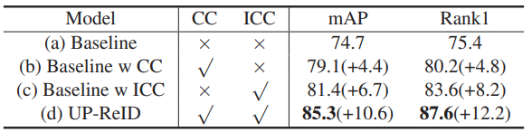

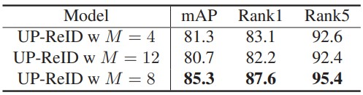
3.2 Experiments
Supervised
Unsupervised
SOTA
Ablation
Comparison with State-of-the-Art Methods
The Impact of CC and ICC
Hard mining comparison

Slide 15
Part 04
Conclusion

Slide 16
4.1 Conclusion
Conclusion
Problem
Conclusion:
A ReID specific pre-training framework UP-ReID;
An intra-identity regularization——a global consistency constraint and an intrinsic contrastive constraint;
A hard mining strategy for a better representation learning;
Problem:
Whether the image augmented method can be further optimized;
No comparison was made with UP-ReID b.

Slide 17
End

