Slide 1
DML SQL II
More complex queries

Slide 2
Subqueries
So far all the constraint implemented using WHERE involve only numbers (or strings) but not relations.
But it is possible to compare the value of an attribute with a relation (IN, EXISTS, ALL, ANY, BETWEEN...)

Slide 3
“Traditional” Subqueries
'Star Wars' cast (movie_id= 1)
SELECT name
FROM actor natural join casting
WHERE movie_id=1;

Slide 4
“Compare” and attribute with a relation
Instead of using a natural join we may compare the actor id with the output of a query
  SELECT name
  FROM actor
  WHERE actor_id =
    (SELECT DISTINCT actor_id
    FROM casting
    WHERE movie_id = 1
    );
actor_id
12345
Run-time error, if subquery returns more than one element

Slide 5
How to use relations in the “where” clause
1. EXISTS R : TRUE if R is an non empty relation
2. s IN R : TRUE if s Є R
3. s op ALL R , op = {<,>,<>,=, …}: TRUE if s is greater than, less than, etc all elements Є R.
4. s op ANY R : TRUE if s is greater , less, … than any element Є R

Slide 6
Operadores en Subconsultas
SELECT ... WHERE ... at < ALL/ANY (subconsulta)
≤ ALL/ANY
> ALL/ANY
≥ ALL/ANY
= ALL/ANY
<> ALL/ANY
atributo

Slide 7
Operadors for Subqueries: IN
Asumiendo que una subconsulta produzca varias tuplas t
Si la tupla t tiene el mismo numero de atributos que una relación R podemos comprobar si t esta contenida en R usando el operador IN
SELECT ... WHERE ... at IN (subconsulta)
se puede usar en conjunción con NOT: SELECT ... WHERE ... at NOT IN …
Forma General:
SELECT ... WHERE ... at IN (subconsulta)‏
donde “at” puede ser tanto un escalar como una tupla.

Slide 8
Example: IN
Harrison Ford’s Movies
1: use cartesian product
SELECT title
FROM actor natural join movie natural join casting
WHERE name = 'Harrison Ford';

Slide 9
Example (Cont)‏
Opción 2: Usando consultas anidadas y el operador IN
SELECT title
FROM movie
WHERE movie_id IN
(SELECT movie_id
FROM casting
WHERE (actor_id) IN
(SELECT actor_id
FROM actor
WHERE name = 'Harrison Ford'
)
);

Slide 10
Example I
Title (and star) of all movies in which 'Julie Andrews' worked
  Movie_id of all movies
  SELECT movie_id
  FROM casting natural join actor
  WHERE name='Julie Andrews';
  Titles and stars
  EXPLAIN
  SELECT title, name
  FROM movie natural join casting natural join actor
  WHERE ord=1
  AND movie_id IN (SELECT movie_id
  FROM casting natural join actor
  WHERE name='Julie Andrews');

Slide 11
Example 2 (Cont)‏
  EXPLAIN
  SELECT title, Actor1.name
  FROM movie, casting Casting1,
  casting Casting2,
  actor Actor1,
  actor Actor2
  WHERE Casting1.movie_id=movie.movie_id
  AND Casting2.movie_id=movie.movie_id
  AND Casting1.actor_id=Actor1.actor_id
  AND Casting2.actor_id=Actor2.actor_id
  AND Casting1.ord=1
  AND Actor2.name='Julie Andrews'
  ;

Slide 12
Subqueries than are evaluated several times
Sometimes you need to evaluate the subquery for each value of the attribute
Let us reuse this query (consistency check)
SELECT Star1.name, Star1.actor_id
FROM actor Star1, actor Star2
  WHERE Star1.name = Star2.name
  AND Star1.actor_id < Star2.actor_id;

Slide 13
Correlated Subqueries
Consistency Check
  SELECT name, actor_id
  FROM actor Star1
  WHERE name = ANY
    (SELECT actor.name
    FROM actor
    WHERE actor.actor_id <
    Star1.actor_id AND
    actor.name = Star1.name
    );

Slide 14
Ejemplosrewrite
Actores who have work with 'Orson Welles'
  Orson welles’ movie_id
  SELECT movie_id
  FROM casting natural join actor
  WHERE name = 'Orson Welles';
  Name of the actor who have work in the above movies
  SELECT name, title
  FROM actor natural join casting natural join movie
  WHERE movie_id IN (SELECT movie_id
  FROM casting natural join actor WHERE name='Orson Welles');

Slide 15
SELECT title, Actor1.name
FROM movie, casting casting1,
casting casting2,
actor Actor1,
actor Actor2
WHERE casting1.movie_id=movie.movie_id
AND casting2.movie_id=movie.movie_id
AND casting1.actor_id=Actor1.actor_id
AND casting2.actor_id=Actor2.actor_id
AND Actor2.name='Orson Welles'
;

Slide 16
Another example
Actors who have worked in a movie before 1930
Re-write as
Find those actors that satisfy the constraint: there is a movie in which they have work and the movie premiere happened before 1930
SELECT DISTINCT name
FROM casting natural join actor
WHERE EXISTS (
SELECT *
from movie
WHERE year < 1930 AND movie.movie_id = casting.movie_id);

Slide 17
SELECT DISTINCT name
FROM casting natural join
actor natural join movie
WHERE
year < 1930;

Slide 18
Subqueries in FROM clause
It is possible to use a subquery as input relation
Must have an alias (postgres)
Movies that have their premiere in 1978 sorted by cast size (number of actor)
SELECT title, Temp.cc
FROM (SELECT movie_id, COUNT(actor_id)
AS cc FROM casting natural join movie
WHERE year=1978
GROUP BY movie_id) AS Temp natural join movie
ORDER BY Temp.cc;
COUNT: devuelve el numero de tuplas

Slide 19
Subconsultas en FROM!!!!
Repetir con view
CREATE VIEW peliculas_1978 AS
SELECT pelicula_id, COUNT(actor_id) AS cc
FROM reparto, pelicula
WHERE agno=1978 AND pelicula_id=id
GROUP BY pelicula_id;
SELECT COUNT(titulo), temp.cc
FROM peliculas_1978 AS temp, pelicula
WHERE pelicula_id=id
ORDER BY temp.cc;

Slide 20
Aggregation Functions
Same as in Relation algebra
  SUM, AVG, MIN, MAX, COUNT
How many entries are in the data base?
SELECT COUNT(*)
  FROM movie;
Remember that SQL does not drop duplications
SELECT COUNT(name) FROM actor;
SELECT COUNT(DISTINCT name)FROM actor;

Slide 21
Grouping Tuples
As in algebra, many times we want to apply the operation to a subsets of tuples
Table with the number of times each actor has been star
We want something that looks like:
name
Count (ord=1)‏
Pedro Pérez
1
Joe Dalton
3
GROUP BY is used for grouping

Slide 22
GROUP BY
SELECT A1, SUM(A2)‏
FROM R1
GROUP BY A1;
IMPORTANT: in SELECT you ONLY may find
  (1) Aggregations
  (2) Attributes that appear in the clause GROUP BY

Slide 23
Example GROUP BYredo
Table with actors sorted by the number of times they are stars (just for those with more than 10 movies)‏
CREATE VIEW ranking AS
SELECT actor_id, count(*) AS stars
FROM casting
WHERE ord=1
GROUP BY actor_id;
SELECT name, stars
FROM actor natural join ranking
WHERE stars > 10
ORDER BY stars;

Slide 24
HAVING
Allows to select subgroups
SELECT x, sum(y)
FROM test1
GROUP BY x
HAVING sum(y) > 3;

Slide 25
SQL query: summary
SELECT
FROM
WHERE
GROUP BY
HAVING
ORDER BY
compulsory
optional

Slide 26
How a query is processed
1. Create relation described in FROM
2. Apply constrains described in WHERE
3. If there is NO “group-by”, project the relation as described in SELECT. Then do ORDER BY. The End.
4. If there is GROUP-BY clause. Group the original relation in subsets
5. Apply HAVING
6. And then SELECT.
7. ORDER BY.

Slide 27
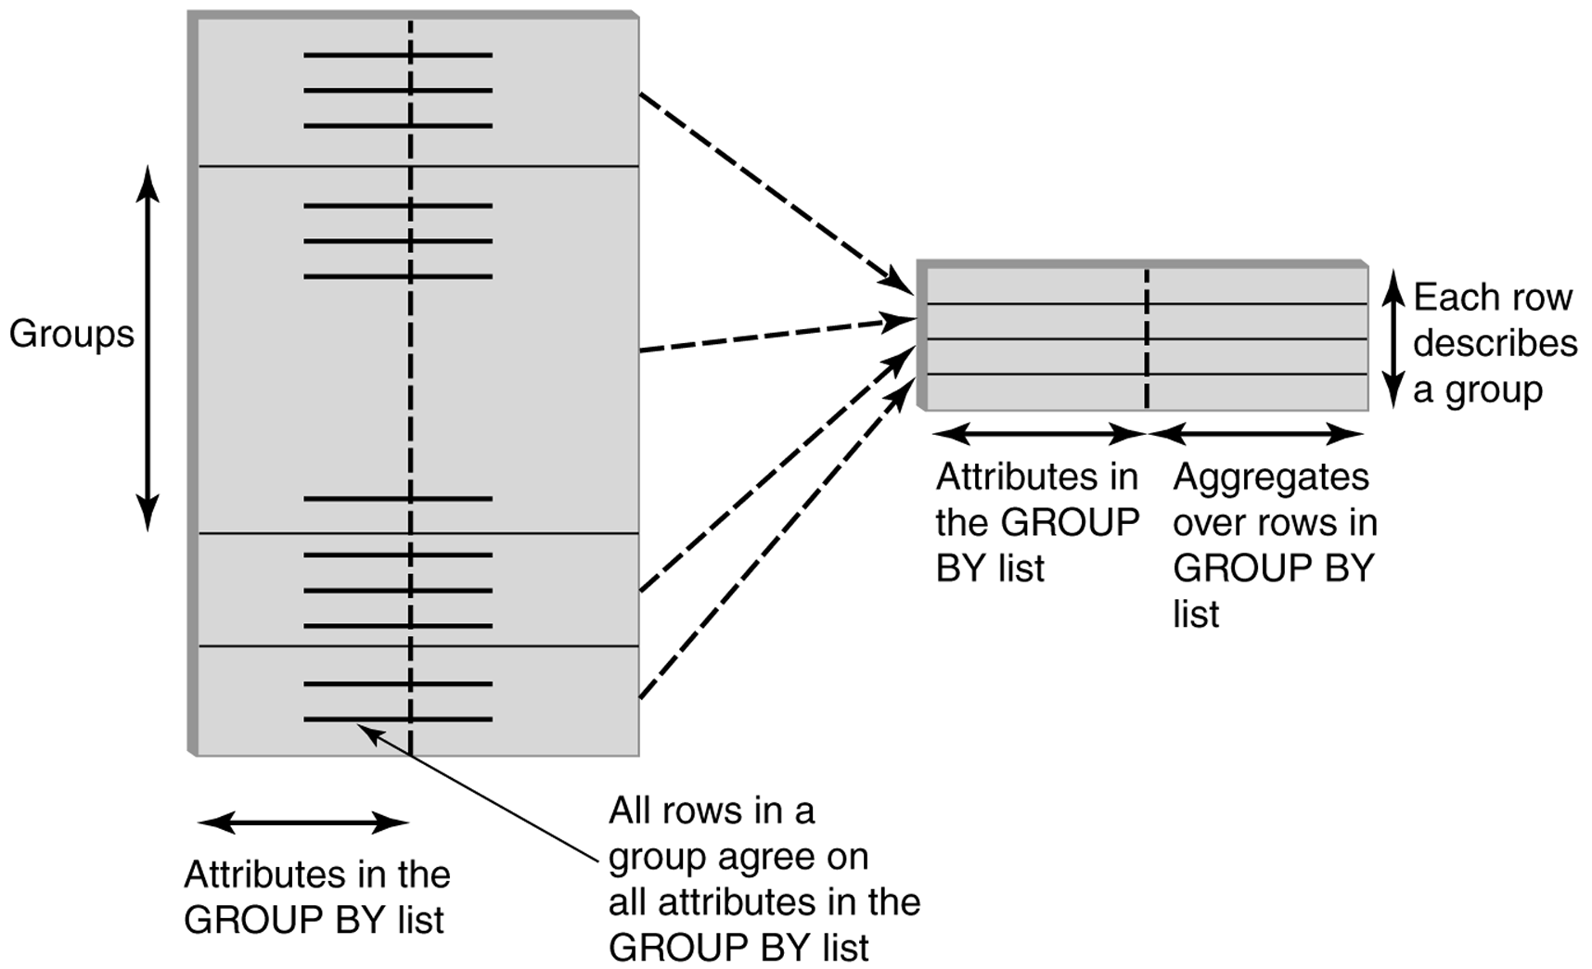
GROUP BY

Slide 28
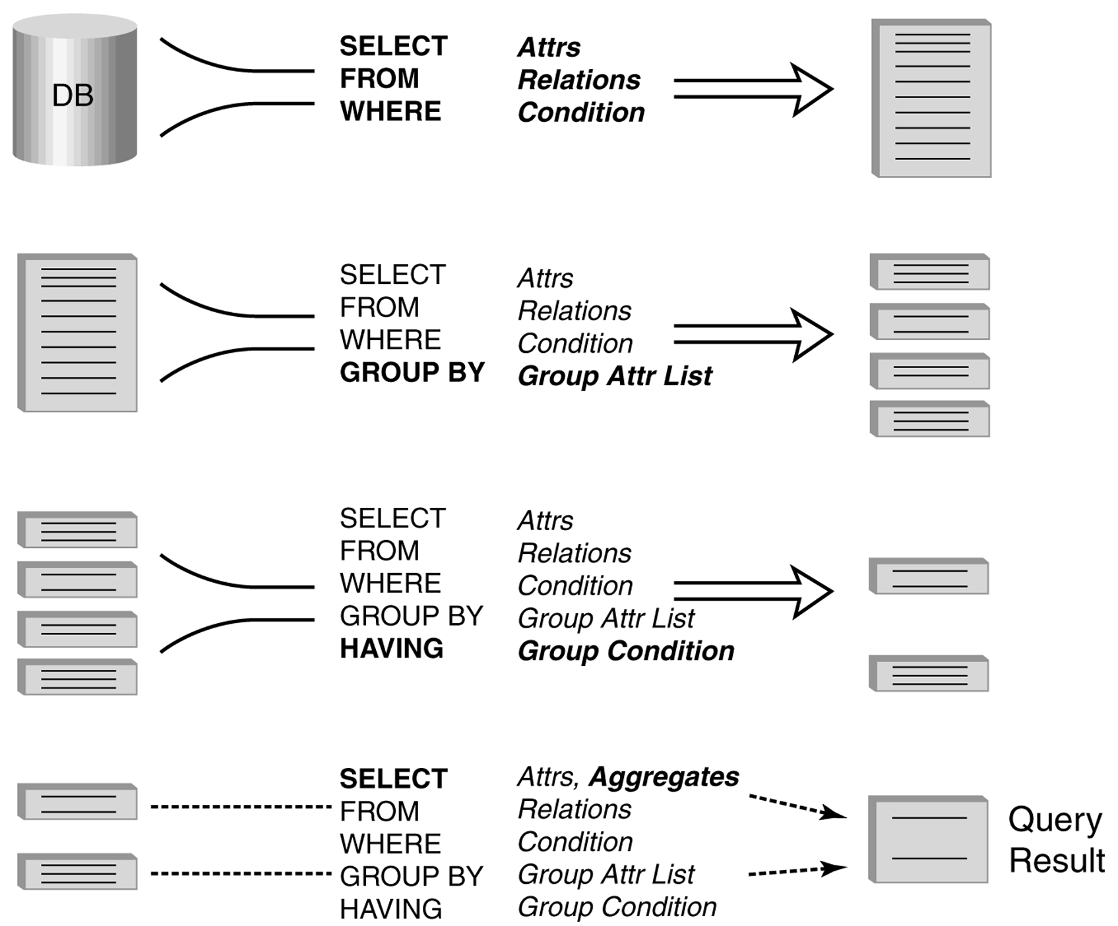
Procesamiento de una consulta con funciones de agregacion

