Slide 1
The Entity-Relationship Model
DataBase Modelling
Notes:
1
The slides for this text are organized into chapters. This lecture covers Chapter 2, on the Entity-Relationship approach to database design.
The important issue of how to map from ER diagrams to relational tables is deferred until the relational model and the integrity constraints it supports have been introduced. ER to relational mapping, together with a discussion of the related SQL commands, is discussed in Chapter 3.

Slide 2
Database Design Process
Requirement collection and analysis
  DB requirements
Conceptual DB design using a high-level model
  Data to store and relationship between them
Logical DB design (data model mapping)
  Columns in each table (if relational model)
Physical DB design
  Internal data structures
Notes:
2

Slide 3
Disclamer
ER design is subjective. There are often many ways to model a given scenario! Analyzing alternatives can be tricky, especially for a large enterprise.
Notes:
13

Slide 4
Overview of Database Design
Conceptual design: (ER Model is used at this stage.)
  What are the entities and relationships in the enterprise?
  What information about these entities and relationships should we store in the database?
  What are the integrity constraints or business rules that hold?
  A database `schema’ in the ER Model can be represented pictorially (ER diagrams).
  An ER diagram can be mapped into a relational schema.
Notes:
2

Slide 5
name
ER Model Basics
ssn
phone
Employees
Entity: Real-world object distinguishable from other objects. An entity is described (in DB) using a set of attributes.
Entity Set: A collection of similar entities. E.g., all employees.
  All entities in an entity set have the same set of attributes.
  Each entity set has a key.
  Each attribute has a domain.
Notes:
3
The slides for this text are organized into several modules. Each lecture contains about enough material for a 1.25 hour class period. (The time estimate is very approximate--it will vary with the instructor, and lectures also differ in length; so use this as a rough guideline.) This covers Lectures 1 and 2 (of 6) in Module (5).
Module (1): Introduction (DBMS, Relational Model)
Module (2): Storage and File Organizations (Disks, Buffering, Indexes)
Module (3): Database Concepts (Relational Queries, DDL/ICs, Views and Security)
Module (4): Relational Implementation (Query Evaluation, Optimization)
Module (5): Database Design (ER Model, Normalization, Physical Design, Tuning)
Module (6): Transaction Processing (Concurrency Control, Recovery)
Module (7): Advanced Topics

Slide 6
name
ER Model Basics
ssn
phone
Employees
Key and key attributes:
  Key attributes: a group of one or more attributes that uniquely identify an entity in the entity set
Super key, candidate key, and primary key
  Super key: a set of attributes that allows to identify and entity uniquely in the entity set
  Candidate key: minimal super key
    There can be many candidate keys
  Primary key: a candidate key chosen by the designer
    Denoted by underlining in ER attributes
Notes:
3
The slides for this text are organized into several modules. Each lecture contains about enough material for a 1.25 hour class period. (The time estimate is very approximate--it will vary with the instructor, and lectures also differ in length; so use this as a rough guideline.) This covers Lectures 1 and 2 (of 6) in Module (5).
Module (1): Introduction (DBMS, Relational Model)
Module (2): Storage and File Organizations (Disks, Buffering, Indexes)
Module (3): Database Concepts (Relational Queries, DDL/ICs, Views and Security)
Module (4): Relational Implementation (Query Evaluation, Optimization)
Module (5): Database Design (ER Model, Normalization, Physical Design, Tuning)
Module (6): Transaction Processing (Concurrency Control, Recovery)
Module (7): Advanced Topics

Slide 7
name
ER Model Basics (Contd.)
ssn
phone
since
Employees
name
dname
super-visor
subor-dinate
ssn
phone
did
budget
Works_In
Reports_To
Employees
Departments
Relationship: Association among two or more entities. e.g., Jack works in Pharmacy department.
Relationship Set: Collection of similar relationships.
  An n-ary relationship set R relates n entity sets E1 ... En; each relationship in R involves entities e1 in E1, ..., en in En
    Same entity set could participate in different relationship sets, or in different “roles” in same set.
Notes:
4

Slide 8
Key Constraints
since
name
dname
ssn
lot
did
budget
Consider Works_In (previous slide): An employee can work in many departments; a dept can have many employees.
In contrast, each dept has at most one manager, according to the key constraint on Manages.
Employees
Manages
Departments
1-to-1
1-to Many
Many-to-1
Many-to-Many
Notes:
6

Slide 9
Example ER
major
Department
offers
faculty
Courses
Professor
teaches
advisor
enrollment
Students
Notes:
2

Slide 10
Exercises
major
Department
offers
Is double major allowed?
Can a student have more than 1 advisor?
Is joint appointment of faculty possible?
Can two profs share to teach the same course?
Can a professor teach more than one course?
Can a professor stay without affiliated with a department?
faculty
Courses
Professor
teaches
advisor
enrollment
Students
Notes:
2

Slide 11
Participation Constraints
Does every department have a manager?
  If so, this is a participation constraint: the participation of Departments in Manages is said to be total (vs. partial).
    Every Departments entity must appear in an instance of the Manages relationship.
since
since
name
name
dname
dname
ssn
did
did
budget
lot
budget
Employees
Manages
Departments
Works_In
since
Notes:
8

Slide 12
Weak Entities
A weak entity can be identified uniquely only by considering the primary key of another (owner) entity.
  Owner entity set and weak entity set must participate in a one-to-many relationship set (one owner, many weak entities).
  Weak entity set must have total participation in this identifying relationship set.
name
ssn
lot
cost
pname
age
Employees
Policy
Dependents
Notes:
10

Slide 13
name
ssn
phone
ISA (`is a’) Hierarchies
Employees
As in C++, attributes are inherited.
If we declare A ISA B, every A entity is also considered to be a B entity.
hours_worked
hourly_wages
ISA
contractid
Hourly_Emps
Contract_Emps
Overlap constraints: Can Joe be an Hourly_Emps as well as a Contract_Emps entity? (default: disallowed; A overlaps B)
Covering constraints: Does every Employees entity also have to be an Hourly_Emps or a Contract_Emps entity? (default: no; A AND B COVER C)
Notes:
12

Slide 14
Conceptual Design Using the ER Model
Design choices:
  Should a concept be modeled as an entity or an attribute?
  Should a concept be modeled as an entity or a relationship?
  Identifying relationships: Binary or ternary? Aggregation?
Constraints in the ER Model:
  A lot of data semantics can (and should) be captured.
  But some constraints cannot be captured in ER diagrams.
Notes:
3

Slide 15
Entity vs. Attribute
Should address be an attribute of Employees or an entity (connected to Employees by a relationship)?
Depends upon the use we want to make of address information, and the semantics of the data:
    If we have several addresses per employee, address must be an entity (since attributes cannot be set-valued).
    If the structure (city, street, etc.) is important, e.g., we want to retrieve employees in a given city, address must be modeled as an entity (since attribute values are atomic).

Slide 16
Entity vs. Attribute (Contd.)
from
to
Works_In4 does not allow an employee to work in a department for two or more periods.
Similar to the problem of wanting to record several addresses for an employee: We want to record several values of the descriptive attributes for each instance of this relationship. Accomplished by introducing new entity set, Duration.
name
dname
ssn
lot
did
budget
Employees
Works_In4
Departments
name
dname
ssn
lot
did
budget
Employees
Works_In4
Departments
from
Duration
to
Notes:
5

Slide 17
Entity vs. Relationship
First ER diagram OK if a manager gets a separate discretionary budget for each dept.
What if a manager gets a discretionary budget that covers all managed depts?
  Redundancy: dbudget stored for each dept managed by manager.
  Misleading: Suggests dbudget associated with department-mgr combination.
since
dbudget
name
dname
ssn
lot
did
budget
Managers
Manages2
Departments
name
ssn
lot
since
dname
Employees
did
budget
Manages2
Departments
ISA
This fixes the
problem!
Managers
dbudget
Notes:
6

Slide 18
Summary of Conceptual Design
Conceptual design follows requirements analysis,
  Yields a high-level description of data to be stored
ER model popular for conceptual design
  Constructs are expressive, close to the way people think about their applications.
Basic constructs: entities, relationships, and attributes (of entities and relationships).
Some additional constructs: weak entities, ISA hierarchies, and aggregation.
Note: There are many variations on ER model.
Notes:
11

Slide 19
Exercise
name
ssn
addr
acct#
balance
What can you say about policy of the bank from the ER diagram?
What can you say about the policy of the company?
Customer
CustAcct
Account
name
ssn
lot
Employees
Manages
Dept
deptid
budget
Notes:
7

Slide 20
Exercise
Project
Item
Factory
What has been purchase, from whom, which factory produced the item

Slide 21
Exercise
Project
Item
order
Factory

Slide 22
Exercise
Project
Item
Order
Factory

Slide 23
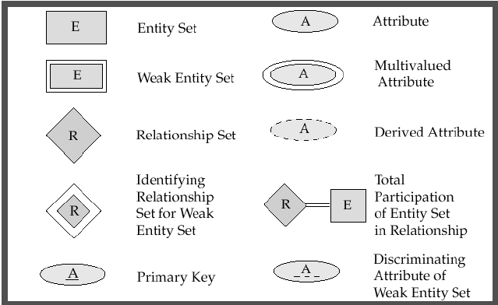
Summary
Página 39, Silberschatz

Slide 24
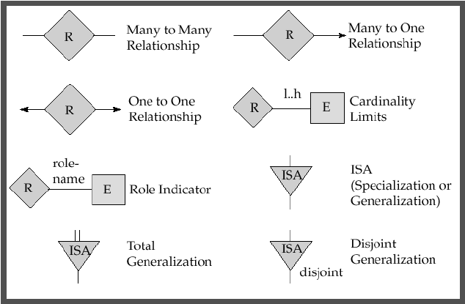
Summary
1
1
1

Slide 25
Use Case example
Arrange Meeting
1. The user chooses the option to arrange a meeting.
2. The system prompts user for the names of attendees.
3. The user types in a list of names.
4. The system checks that the list is valid.
5. The system prompts the user for meeting constraints.
6. The user types in meeting constraints.
7. The system searches the calendars for a date that satisfies the constraints.
8. The system displays a list of potential dates.
9. The user chooses one of the dates.
10. The system writes the meeting into the calendar.
11. The system emails all the meeting participants informing them of them appointment

Slide 26
Exercise
A database will be made to store information about patients in a hospital. On arrival, each patient’s personal details (name, address, and telephone number) are recorded where possible, and they are given an admission number. They are then assigned to a particular ward (Accident and Emergency, Cardiology, Oncology, etc.). In each ward there are a number of doctors and nurses. A patient will be treated by one doctor and several nurses over the course of their stay, and each doctor and nurse may be involved with several patients at any given time

Slide 27
Constructing a ER Model
Identify entities
Remove duplicate entities
Identify attributes
Mark Primary Keys
Define Relationships
Describe cardinality
Remove redundant relationships

