Slide 1

Modelo Relacional
Bases de Datos
Notes:
1
The slides for this text are organized into chapters. This lecture covers Chapter 2, on the Entity-Relationship approach to database design.
The important issue of how to map from ER diagrams to relational tables is deferred until the relational model and the integrity constraints it supports have been introduced. ER to relational mapping, together with a discussion of the related SQL commands, is discussed in Chapter 3.

Slide 2
DATABASE DESIGN PROCESS
Analisis y Requerimientos
Diseño Conceptual
  Diagram E-R
Diseño Lógico
  Modelo RElacional
Diseño Fisico
  Implementacion
Notes:
2

Slide 3
RELATIONAL MODEL
Sets
  collections of items of the same type
  no order
  no duplicates
Mappings
set1
set2
1:many
many:1
1:1
many:many

Slide 4
RELATIONAL MODEL
no duplicate tuples in a relation
  a relation is a set of tuples
no ordering of tuples in a relation
  a relation is a set
attributes of a relation have an implied ordering
  but used as functions and referenced by name, not position
every tuple must have attribute values drawn from all of the domains of the relation or the special value NULL
all a domain’s values and hence attribute’s values are atomic.

Slide 5
COURSE
Courseno
Subject
Lecturer
Machine
CS250
Programming
Lindsey
Sun
CS260
Graphics
Hubbold
Sun
CS270
Micros
Woods
PC
CS290
Verification
Barringer
Sun

Slide 6
COMPARATIVE TERMS
Formal
Oracle
Relation schema
Table schema
Relation
Table
Tuple
Row
Attribute
Column
Domain
Value set
Notation
Course (courseno, subject, equipment)
Student(studno,name,hons)
Enrol(studno,courseno,labmark)

Slide 7
KEYS
- SuperKey
  A set of attributes whose values together uniquely identify a tuple in a relation
- Candidate Key
  - A superkey for which no proper subset is a superkey…a key that is minimal .
  - Can be more than one for a relation
- Primary Key
  - A candidate key chosen to be the main key for the relation.
  - One for each relation
- Keys can be composite

Slide 8
FOREIGN KEY
- a set of attributes in a relation that exactly matches a (primary) key in another relation
  - the names of the attributes don’t have to be the same but must be of the same domain
  - a foreign key in a relation A matching a primary key in a relation B represents a
- many:one relationship between A and B
Student(studno,name,tutor^,year)
Staff(lecturer,roomno,appraiser)

Slide 9
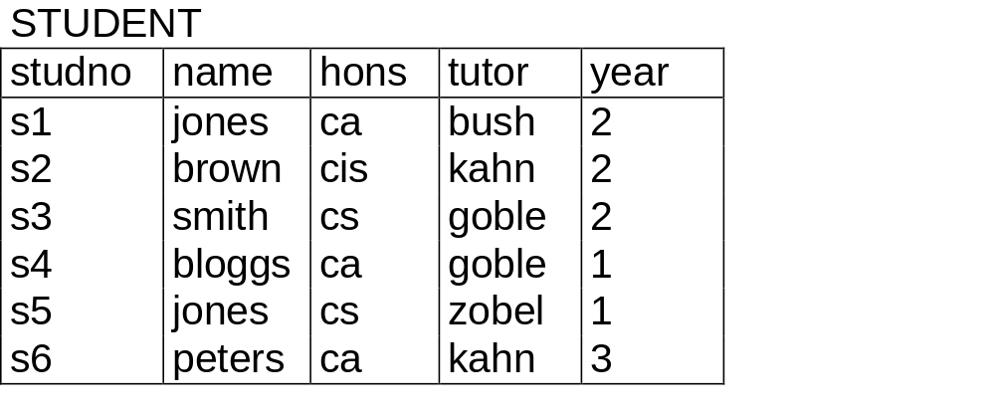
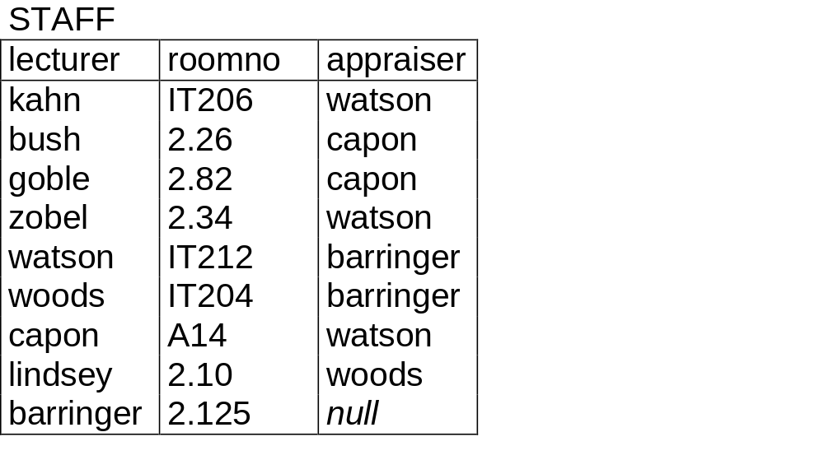

Slide 10
REFERENTIAL INTEGRITY
- Student(studno,name,tutor,year)
- Staff(lecturer,roomno,appraiser)
- CASCADE
  - delete all matching foreign key tuples eg. STUDENT
- RESTRICT
  - can’t delete primary key tuple STAFF whilst a foreign key tuple STUDENT matches
- NULLIFY
  - foreign key STUDENT.tutor set to null if the foreign key ids allowed to take on null

Slide 11
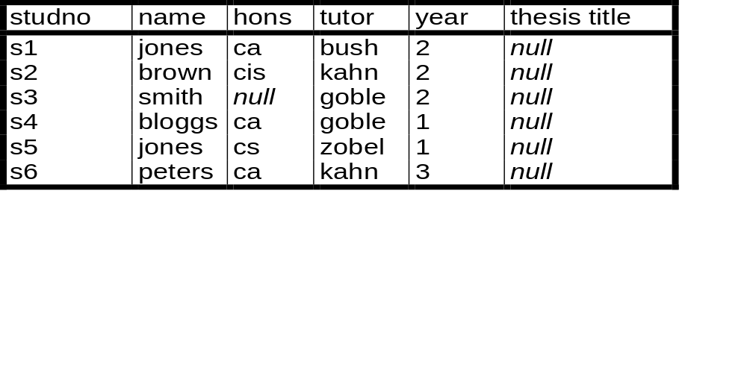
ENTITY INTEGRITY AND NULLS
No part of a key can be null
Attribute values
  Atomic
  Known domain
  Sometimes can be null
THREE categories of null values
1. Not applicable
2. Not known
3. Absent (not recorded)
STUDENT

Slide 12
RELATIONAL MODEL
General
Simple
Flexible
Easy to query declaratively without programming
But.....
  Good design essential
  Integrity essential
  Poor semantics
  Relationships based on ‘value-matching’

Slide 13
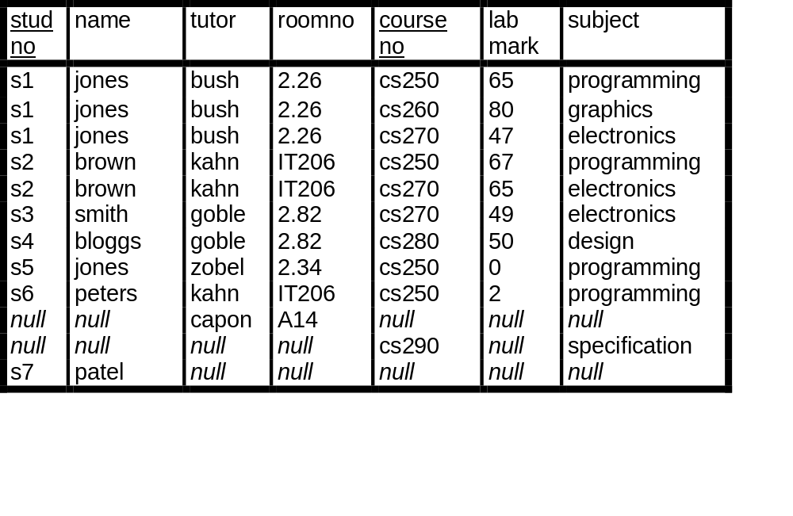
RELATIONAL DESIGN

Slide 14
INFORMAL GUIDELINES
Semantics of the attributes
  easy to explain relation
  doesn’t mix concepts
Reducing the redundant values in tuples
Choosing attribute domains that are atomic
Reducing the null values in tuples
Disallowing spurious tuples

Slide 15
DEFINITIONS
Cartesian Product The cartesian product (×) between n sets is the set of all possible combinations of the elements of those sets.
Domain set of all possible values for an attribute; for attribute A, the domain is represented as dom(A). A domain has a format and a base data type.
Relation Schema denoted by R(A₁, A₂, …, A_{n}), is made up of relation name R and list of attributes A₁, A₂, …, A_{n}.
Relation a subset of the cartesian product of its domains. Given a relation schema R, a relation on that schema r, a set of attributes A₁..A_{n} for that relation then
r(R) ⊆ (dom(A₁) × dom(A₂) × ... × dom(A_{n}))
Attribute a function on a domain for each instance of the mapping or tuple
Attribute Value the result of the attribute function. Each instance of the mapping is represented by one attribute value drawn from each domain or a special NULL value. Given a tuple t and an attribute A for a relation r, t[A]--> a, where a is the attribute’s value for that tuple.

Slide 16
(N)-tuple a set of (n) attribute-value pairs representing a single instance of a relation’s mapping between its domains.
Degree the number of attributes a relation has.
Cardinality a number of tuples a relation has.
Roles several attributes can have the same domain; the attributes indicate different roles in the relation.
Key (SuperKey) a set of attributes whose values together uniquely identify every tuple in a relation. Let t1 and t2 be two tuples on relation r of relation schema R, and sk be a set of attributes whose values are the key for the relation schema R, then t1[sk] ≠ t2[sk].
(Candidate) Key a (super)key that is minimal, i.e. has no proper subsets that still uniquely identify every tuple in a relation. There can be several for one relation.
Primary Key a candidate key chosen to be the main key for the relation. There is only one for each relation.
Foreign Key a candidate key of relation A situated in relation B.
Database a set of relations.

Slide 17
Convertir Diagramas E-R al Modelo Relacional
DATABASE MODELLING
Notes:
1
The slides for this text are organized into chapters. This lecture covers Chapter 2, on the Entity-Relationship approach to database design.
The important issue of how to map from ER diagrams to relational tables is deferred until the relational model and the integrity constraints it supports have been introduced. ER to relational mapping, together with a discussion of the related SQL commands, is discussed in Chapter 3.

Slide 18
Analisis y Recopilación de Requerimientos
Diseño Conceptual
  Diagram E-R
Diseño Lógico
  Modelo Relacional
Diseño Fisico
  Implementacion

Slide 19
Algoritmo para convertir un modelo ER en un modelo relacional

Slide 20
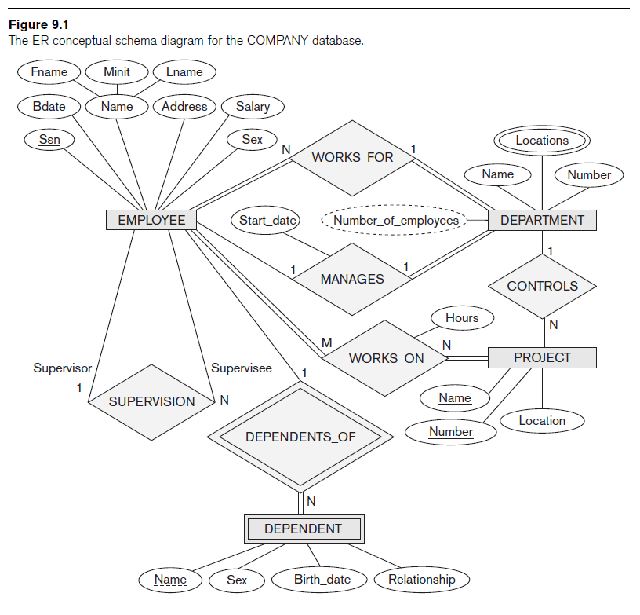
Modelo E-R

Slide 21
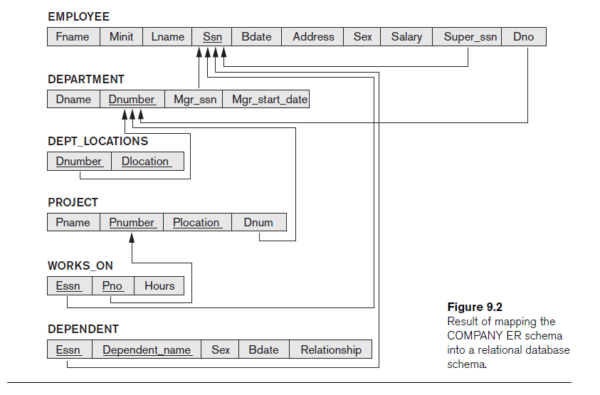
Modelo Relacional

Slide 22
Modelo ER -> Relacional
Paso1: Entidades (no débiles)
  Para cada entidad E cread una relación R que incluya todos los atributos de E
Paso 2: : Entidades Débiles
  Para cada entidad débil E, cread una relacion R e incluid todos los atributos de R
  Añadid la clave primaria de la entidad “fuerte” sobre la que se apoya R.
Relación -> enumeración o lista vs vinculo o correspondencia

Slide 23
Modelo ER -> Relacional
Step 3: Mapeo de relaciones binarias 1:1
Para cada relacion binaria de tipo 1:1 entre las relaciones R1 y R2
  Incluye la clave primaria de R1 en R2.
  Si la relación tiene atributos incluirlos en R2

Slide 24
Modelo ER -> Relacional
Paso 4: Mapeado de Relaciones Binarias 1:N
  Para cada relación 1 a N entre las relaciones R1 y R2
    Identifica el lado N (asumamos que es R2)
    Incluya la clave primaria de R1 en R2
    Incluye los atributos de la relacion en R2 (si los hubiere)

Slide 25
Modelo ER -> Relacional
Paso5: Mapeo de relaciones binarias N:M
  Para cada nueva relacion binaria N:M
    Crea una nueva relacion R
    Añade a R las claves primarias de las relaciones que relaciona
    Añade a R los atributos de la relación (si los hubiere)

Slide 26
Modelo ER -> Relacional
Paso 6: Atributos multivaluados
  Para cada atributo multivaluado de una relación R
    Crea una relación nueva S relacionada N:1 con R
    Continua como para el caso 1:N donde el lado N es el de la relacion S.
Recordad que los atributos deben ser atomicos, si no lo son expandirlos

Slide 27
Modelo ER -> Relacional
Paso 7: Mapeo de relaciones N-arias
  Para cada relacion n-aria
    Crea una nueva relacion R
    Incluye las claves primarias de todas las relaciones que relacione
    Añade los atributos de la relacion

Slide 28
Mapping of Specialization or Generalization
Paso 8: ISA
  Herencia
  Relacion 1:N
  CREATE TABLE cities(
  name text,
  population real,
  altitude int -- (in ft) );
  CREATE TABLE capitals (
  state char(2) ) INHERITS (cities);

Slide 29
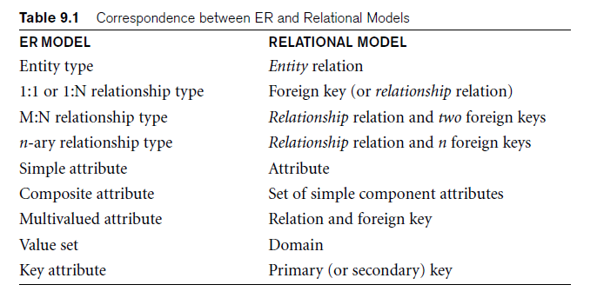
Discussion and Summary of Mapping for ER Model Constructs

Slide 30
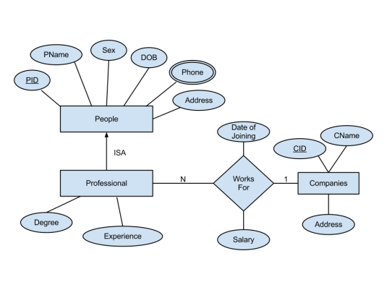

Slide 31
