Slide 1
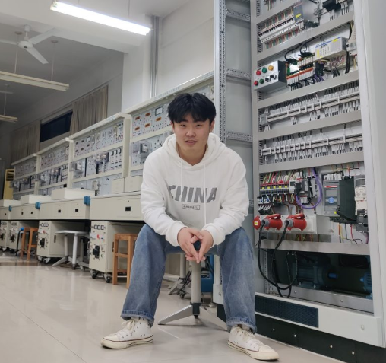

Slide 2
https://neprwmzmkv5rn8z728yfts.streamlit.app/

