Slide 1
Deception Lab

Slide 2
Deception

Slide 3
Little Monkey

Slide 4
Welcome to Deception Lab!

Slide 5
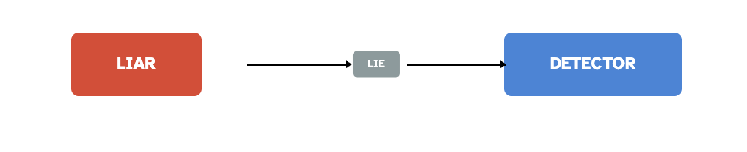
Deception
Definition
A “process by which one individual deliberately attempts to convince another person to accept as true what the liar knows to be false, typically for the liar […] to gain some type of benefit or to avoid loss”
— Vrij (2008, p.15)

Slide 6
Early Approaches
1960s: Emotional leakage
Liars experience guilt/fear → emotions “leak”
Bodily movements leak more than the face
(Ekman & Friesen, 1969)
1980s: Cognitive load
Liars must inhibit truth + invent consistent stories
(Zuckerman et al., 1981; Hartwig et al., 2014)

Slide 7
Judgement Biases
Truth bias
People judge others truthful more often than they are
(Bond & DePaulo, 2006, meta-analysis)
Explanations
Spinozan mind — belief is automatic (Gilbert, 1991)
Truth-Default Theory — default to truth (Levine, 2014)
Adaptive Lie Detector — functional decision-making (Street, 2015)

Slide 8
Accuracy in Lie Detection
No diagnostic cues
No reliable behavioural signal found (DePaulo et al., 2003)
Human performance
~54% accuracy (chance = 50%) (Bond & DePaulo, 2006)
Training, confidence, or profession → little effect (Aamodt & Custer, 2006)

Slide 9
Recent Developments
Active elicitation techniques
Strategic questioning, cognitive load, verifiability
(Nahari, 2019; Vrij & Granhag, 2012)

Slide 10
Defining Lying: The Role of Intention
Intentionality central in most definitions
(Chisholm & Feehan, 1977; DePaulo et al., 2003; Fallis, 2012)
Debates:
Smith (2007): lying = preventing truth, even without intent to mislead
Peterson (1995): intentionality is necessary
Broad definition allows exploration across different contexts

Slide 11
How Often Do People Lie?
Diary studies (DePaulo et al., 1996):
Students reported ~2 lies per day
20–31% of interactions involve deception
Dispersion matters:
Most people tell few/no lies
A small group = “prolific liars” tell most lies
~5% of people → ~50% of lies (Serota et al., 2010, 2021)
Truth is the default: most people tell the truth most of the time

Slide 12
Why Do People Lie? Motives & Taxonomies
Lie aversion:
People often forgo gains to avoid lying (Abeler et al., 2012; Gneezy, 2005)
Motivations: intrinsic honesty, guilt, reputation
Self vs. Other / Gain vs. Loss taxonomy (DePaulo, 1996; Vrij, 2008)
Self-interest vs altruism, advantage vs avoiding loss
Examples:
“Butler lies” to maintain relationships (Hancock, 2009)
More willing to lie for charity vs self (Yin et al., 2017)

Slide 13
Individual & Cultural Influences
Pathological lying: compulsive, not goal-driven
Possible causes: low self-esteem, neurocognitive deficits (Poletti, 2011)
Prolific liars:
Score high in Machiavellianism, manage consistency (Kashy & DePaulo, 1996; El Haj, 2017)
Culture matters:
Collectivist cultures → more likely to lie to protect relationships (Bessarabova, 2014; Park, 2018)
Individualist cultures → prioritise integrity
Moral compass:
Frequent liars not necessarily less moral (Halevy, 2014)

Slide 14
Meso-Level Accounts of Lying
Meso level = liar + recipient interaction
Vrij et al. (2019) review → 3 key accounts:
Moral psychology (Bond & DePaulo, 2006)
Self-presentational theory (DePaulo, 1992; Goffman, 1959)
Interpersonal Deception Theory (IDT) (Buller & Burgoon, 1996)

Slide 15
Moral Psychology Account
People judge others’ lies as immoral but view their own lies as excusable/circumstantial
Cheating research shows:
People forget/justify moral rules when dishonest (Shu et al., 2011; Shalvi et al., 2015)
Distancing from moral responsibility → self-serving evaluations
More research needed (Vrij et al., 2019)

Slide 16
Self-Presentational Theory
Both liars and truth-tellers aim to appear credible (DePaulo, 1992)
Truth-tellers: use eye contact, smiling (e.g., job interviews) (Bolino et al., 2008)
Liars: selective lies to manage impressions (e.g., online dating profiles) (Toma & Hancock, 2010)
Liars describe more strategies for impression management than truth-tellers (Hartwig et al., 2007)
Self-deception: lying to oneself to better convince others (Trivers, 2011)

Slide 17
Interpersonal Deception Theory (IDT)
Focuses on dynamic interaction between liar and recipient
Behaviour is adjusted in real time based on partner feedback (Buller & Burgoon, 1996)
Example: desert survival task (Burgoon et al., 2010)
Real-time discussion → greater trust, more successful deception
Liars often seek to control the conversation (Burgoon et al., 2014)
Neuro evidence: deception engages theory of mind & monitoring of others (Christ et al., 2009)

Slide 18
The Psychological Costs of Lying
Leakage hypothesis (Ekman & Friesen, 1969):
Emotions (fear, anxiety) may “leak” via body more than face
Exception: micro-expressions (Ekman, 1985)
Criticism: truth-tellers may also show anxiety (Vrij et al., 2006; Brennen & Magnussen, 2020)

Slide 19
Deception as Cognitively Effortful
Four-factor theory (Zuckerman et al., 1981):
Cognitive load, emotional experience, behaviour control, physiological arousal
Deception requires:
Inhibiting truth
Constructing coherent false story
Evidence:
fMRI → overlap with executive function areas (Christ et al., 2009)
EEG → greater preparation signals in liars (Dong & Wu, 2010)
Behaviour → longer response latencies; time pressure promotes honesty (Suchotzki et al., 2017)

Slide 20
Cognitive Processes of Lying
Deception = recombining memories, not pure invention (Hume, 1748/2007)
Working memory model (Baddeley, 2007):
Liars draw on specific experiences or general schemas
Predictions:
Liars → more schema-consistent details
Truth-tellers → more schema-inconsistent/irrelevant details
Memory decay affects truth-tellers’ recall over time (Sporer, 2016)

Slide 21

A Week Without Lying

Slide 22
The Liar

Slide 23
Who Lies? Why, To Whom, About What?
The Liar
Distribution: most lies by a minority of prolific liars
Personality correlates: Machiavellianism, narcissism, psychopathy; agreeableness (−)
Contexts: authority vs peers; online vs offline; white lies vs self-serving
depauloLyingEverydayLife1996; shalviJustifiedEthicalityObserving2011

Slide 24
Who is Good at Lying?
The Liar
High Machs/actors/poker players—candidate “good liars” vrijGoodLiars2010
Evidence from large-scale studies veriginLiePrevalenceLie2019

Slide 25
How Do People Lie? Channels & Strategies
The Liar

Slide 26
Channels:
Face
Body
Voice
Text
Strategies:
Faking good/bad
Malingering
Charm
Feigned friendship

Slide 27
Preparation vs spontaneity; leakage vs control

Slide 28
The Experience of Lying
The Liar

Slide 29
Affective
Guilt
Anxiety
“Duper’s delight”
Cognitive
Cognitive load
Self-monitoring
Self-presentation

Slide 30
The Lie-Detector

Slide 31
Detecting Deception
The Lie-Detector
Linguistics: pronouns, negations, specificity, temporal structure
Nonverbal: illustrators, adaptors, gaze (weak/variable indicators)
Physiology: heart rate, skin conductance; constraints & ethics
Modality: Audio, Visual, Audio-visual etc kolkmanDeceptionDetectionImportance

Slide 32
Nonverbal Behaviour
The Lie-Detector

Slide 33
Cues Examined:
Facial expressions: micro-expressions, Duchenne smiles
Body language: adaptors (self-touching), illustrators (hand movements)
Eye gaze: avoidance, blinking, pupil dilation
Posture: shifting, leaning away
Important Note
Nonverbal cues are generally weak and variable indicators of deception

Slide 34
depauloCuesDeceptionMeta1996; ekmanDetectingDeceptionNonverbal2001; vrijNonverbalDeception2008; burgoonNonverbalIndicatorsDeception2008; zuckermanVerbalNonverbalCommunication1981; fiedlerMetaAnalysisVerbal2019

Slide 35
Who is Good at Detecting Lies?
The Lie-Detector
High empathy, social skills, and/or experience?
Training helps, but only to a point
Humans are only slightly better than chance (~54%)
“Truth bias” - we tend to believe people by default
“Wizards” - a small subset of people are very good at detecting lies
bondIndividualDifferencesDeception2006; tenBrinkeLieCatchers2014; denaultMetaAnalysisIndividual2019; levinsonIndividualDifferencesDeception2020

Slide 36
The Experience of Being Lied To
The Lie-Detector

Slide 37
Affective
Betrayal
Anger
Disappointment
Cognitive
Doubt
Rumination
Reevaluation

Slide 38
The Lie

Slide 39
Linguistics
The Lie
Contextualised deception [newmanLyingWords2003; hancockDeceptionAndLinguistic2008; hancockTruthAndDeception2009; tomaLinguisticCuesDeception2015]

Slide 40
Linguistic Cues to Deception
The Lie

Slide 41
Pronouns: fewer first-person pronouns (self-distancing)
Negations: more negations (denial)
Specificity: less specific (avoid details)
Temporal structure: less complex (cognitive load)
Emotion words: more negative emotion (anxiety/guilt)
Social words: fewer social words (avoid social connection)
Cognitive complexity: less complex language (cognitive load)
Certainty: more certainty (convince)
Tentativeness: more tentative (uncertainty)
Diversity: less diverse vocabulary (cognitive load)
Readability: less readable (cognitive load)
Quantity: fewer words (avoid details)
Qualifiers: more qualifiers (uncertainty)
Repetitions: more repetitions (convince)
Distancing: more psychological distancing (self-distancing)

Slide 42
The Context

Slide 43
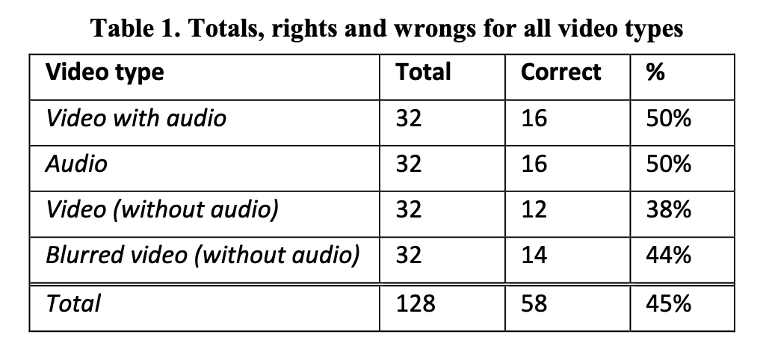
Modality
The Context
Audio, Visual, Audio-visual kolkmanDeceptionDetectionImportance

Slide 44
Modality Effects
The Context
Meta-analyses show small advantage for audio-visual over audio or visual alone
Audio better than visual alone (paralanguage cues)
Visual alone is least effective (nonverbal cues are weak/variable)
Text-based deception detection is also possible (linguistic cues)

Slide 45
Measurement Approaches

Slide 46
Deception Inventories and Measures
Measurement
Lie Acceptability Scale (LAS)
Ennis Lying Scale (ELS)
Deception Strategies Questionnaire (DSQ) - Deeb
Lying in Everyday Situations Scale (LiES) - Hart et al. (2019)
Hart, C. L., Jones, J. M., Terrizzi, Jr., J. A., & Curtis, D. A. (2019). Development of the lying in everyday situations (LiES) scale. American Journal of Psychology, 132(3), 343–352.

Slide 47
Overview
Tools to study lying, self-deception, impression management, and related behaviours.
Include scales, diaries, experimental paradigms, and social desirability measures.
Used in psychology of deception, forensic psychology, and social behaviour research.

Slide 48
Attitudes & Motivation to Lie
Lie Acceptability Scale - Measures how acceptable lying is perceived to be (Oliveira & Levine, 2008).
CEMA-A - Motivation for lying: emotional, social, egoistic, malicious (Armas-Vargas et al., 2023).

Slide 49
Lying in Daily Life
Lying in Everyday Situations (LiES) - Relational vs. vindictive lying (Hart et al., 2019).
DePaulo Lie Diary Method - Participants record all lies/social interactions for 7 days (DePaulo & Kashy, 1998).
Levine’s Prolific Liars 24-Hour Test - Self-report of lies told in the past 24 hours (Serota & Levine, 2014).

Slide 50
Self-Deception & Impression Management
Paulhus Deception Scales (PDS) - Self-deceptive enhancement & impression management (Paulhus, 1998).
Balanced Inventory of Desirable Responding (BIDR) - SDE + IM; short/long versions (Paulhus, 1991).
Self-Deception Questionnaire (SDQ-12) - Mystification & manipulation (Sirvent et al., 2019).
Marlowe–Crowne Social Desirability Scale - Classic control for “faking good” (Crowne & Marlowe, 1960).

Slide 51
Specific Lying Tendencies
LYin Lying Tendency Scale (LTS) - Selfish, altruistic, & social-acceptance lies (Zhou et al., 2024).
Lying Profile Questionnaire - Frequency, ability, negativity, context (Makowski et al., 2021).
Emotional Manipulation Scale - Ability & willingness to emotionally manipulate (Austin et al., 2007; Hyde & Grieve, 2014).

Slide 52
Bullshitting & Paltering
Bullshit Receptivity Scale - Ratings of pseudo-profound statements (Pennycook et al., 2015).
Bullshitting Frequency Scale - How often people bullshit (Littrell et al., 2021).
Scale of Sensitivity to Bullshit - Susceptibility to misleading/pseudo-profound claims (Universidad de Tarapacá team, 2024).
Paltering Paradigm - Use of truthful statements to mislead (Rogers et al., 2017).

Slide 53
Deception Strategies & Detection
Psychological Screening Inventory – Deception Subscales - “Faking good” and “faking bad” (Lanyon, 1993).
Self-Reported Lie Detection Ability - People’s beliefs about their lie detection skill (Fernandes et al., 2023).

Slide 54
Measures of Deception-Related Behaviours
Measurement
Self-report: questionnaires, interviews
Behavioral coding: manual or automated coding of nonverbal cues
Physiological measures: heart rate, skin conductance, EEG, fMRI
Performance measures: accuracy, reaction time, response bias
Linguistic analysis: LIWC, NLP techniques
Machine learning: classifiers trained on multimodal data

Slide 55
Relevant Constructs

Slide 56
Personality Constructs
Individual Differences

Slide 57
Core Traits:
The Dark Triad: Machiavellianism, Narcissism, Psychopathy
Big Five: low Agreeableness, high Extraversion
HEXACO Model: Honesty-Humility, Emotionality, etc.
Cognitive & Social:
Emotional Intelligence
Social Skills
Cognitive Ability
Self-Monitoring
Empathy
Moral & Motivational:
Moral Disengagement
Moral Foundations
Social Dominance Orientation
Authoritarianism
Trust Propensity
Behavioral:
Sensation Seeking
Impulsivity
Gullibility

Slide 58
Cognitive Constructs
Cognitive Processes
Working Memory: capacity during deception
Executive Function: inhibition and control
Theory of Mind: perspective-taking abilities
Cognitive Load: mental effort required
Attention: focus and monitoring
Decision Making: risk assessment and planning

Slide 59
Research Designs

Slide 60
Experimental Paradigms
Methods
Cheating tasks: dice/coin, matrices - Shalvi et al. (2011) [shalviJustifiedEthicalityObserving2011]
Mock-crime with interviews: forensic context
“Deception Olympics” style sender-receiver games
Poker hands: strategic deception
False Opinion Paradigm: attitude misrepresentation
Faking friendship micro-interactions: social deception
Lie diaries (1 week): naturalistic recording
AI vs human detectors: on transcripts, audio, video

Slide 61
Experimental Paradigms (continued)
Methods
Key Research Questions:
Emotion displays during deception (Guilt, Anxiety, Cognitive Load & Delight)
Personality & deception success
Context effects on detection accuracy
Training and expertise development

Slide 62
Qualitative Approaches
Methods
Classic Study: DePaulo et al. (1996) everyday lie diaries [depauloLyingEverydayLife1996]
Thematic analysis: of lie content and context
Narrative analysis: of lie structure and function
Discourse analysis: of lie construction and reception
Ethnographic observation: of lying behavior in natural settings
Case studies: of prolific liars or lie detection experts
Interviews: with liars and lie detectors about experiences and strategies

Slide 63
Measures of Performance
Assessment

Slide 64
Detection:
Accuracy (% correct)
Confidence ratings
Sensitivity (hit rate)
Specificity (correct rejection rate)
Signal detection theory (d’, c)
Production:
Success rate (% undetected)
Believability ratings
Confidence ratings
Consistency measures

Slide 65
AI as Judge
Technology
Approaches:
Text models score linguistic cues on transcripts
Computer vision for facial dynamics and gaze
Multimodal integration of signals
Caveats: dataset bias, context dependency, ethical concerns, generalization limitations

Slide 66
Your Mini-Dissertation

Slide 67
Candidate Topics for Mini-Dissertations

Slide 68
1. Lie Diaries
Design: 7-day daily diary of lies told/heard.
Key variables: frequency, target, motive, stakes.
Analysis: distribution, within-person vs between-person differences.

Slide 69
2. Mock-Crime + Interview
Design: random assignment to commit/not commit a mock theft; standardized interviews.
Measures: statement detail, inconsistencies, observer accuracy.
Analysis: ROC for detector performance; cue validity.

Slide 70
3. Faking Friendship
Design: brief interactions with instructed “fake closeness.”
Measures: perceived closeness, linguistic accommodation.
Analysis: blinded coder ratings vs self-report.

Slide 71
4. AI vs Human Detection
Design: transcripts scored by a text model and by humans.
Measures: accuracy, calibration, bias.
Analysis: compare AUCs; error analysis.

Slide 72
5. Emotion During Deception
Design: report guilt/anxiety/pleasure; optional physiological proxies.
Analysis: mixed models for within-person changes.

Slide 73
Questions?
Let’s discuss your ideas!

