Slide 1
Lecture01
Lecture topic Dr Gordon Wright

Slide 2
New Section Sunday

Slide 3
Fucker Does
Wanker Doesnt’

Slide 4
Section heading 2007

Slide 5
ABCDES

Slide 6
Test Slide
List One
Item A
Item B
Item C
List Two
Item X
Item Y
Item Z

Slide 7
Quarto enables collaborating across coding comfort levels
Notes:
Quarto enables collaborating across coding comfort levels, which means it’s a friendly tool Also means we can broaden our idea of collaborators substantially and earlier.
And, then RStudio IDE Visual Editor further lowers barriers
I’ll do one final demo here - Friendly for new learners, also for experienced users.
Think about how you might use this yourself, and teach a colleague

Slide 8
Slide heading
<footer class="footer"> <div class="persistent"> <strong>Slides:</strong> <a href="https://bit.ly/thenext50">bit.ly/thenext50</a> &bull; <strong>Contact:</strong> <a href="https://www.linkedin.com/in/planetoftheweb">LinkedIn</a> | <a href="https://www.linkedin.com/learning/instructors/ray-villalobos">courses</a> | <a href="https://twitter.com/planetoftheweb">@planetoftheweb</a> | <a href="https://github.com/planetoftheweb">github</a> </div> <div class="smaller">Use arrows to navigate, esc for overview</div> </footer>
Text here. You can use the mark tag to highlight things in some formats. 2007
level 3 heading
text
level 4 heading
text

Slide 9
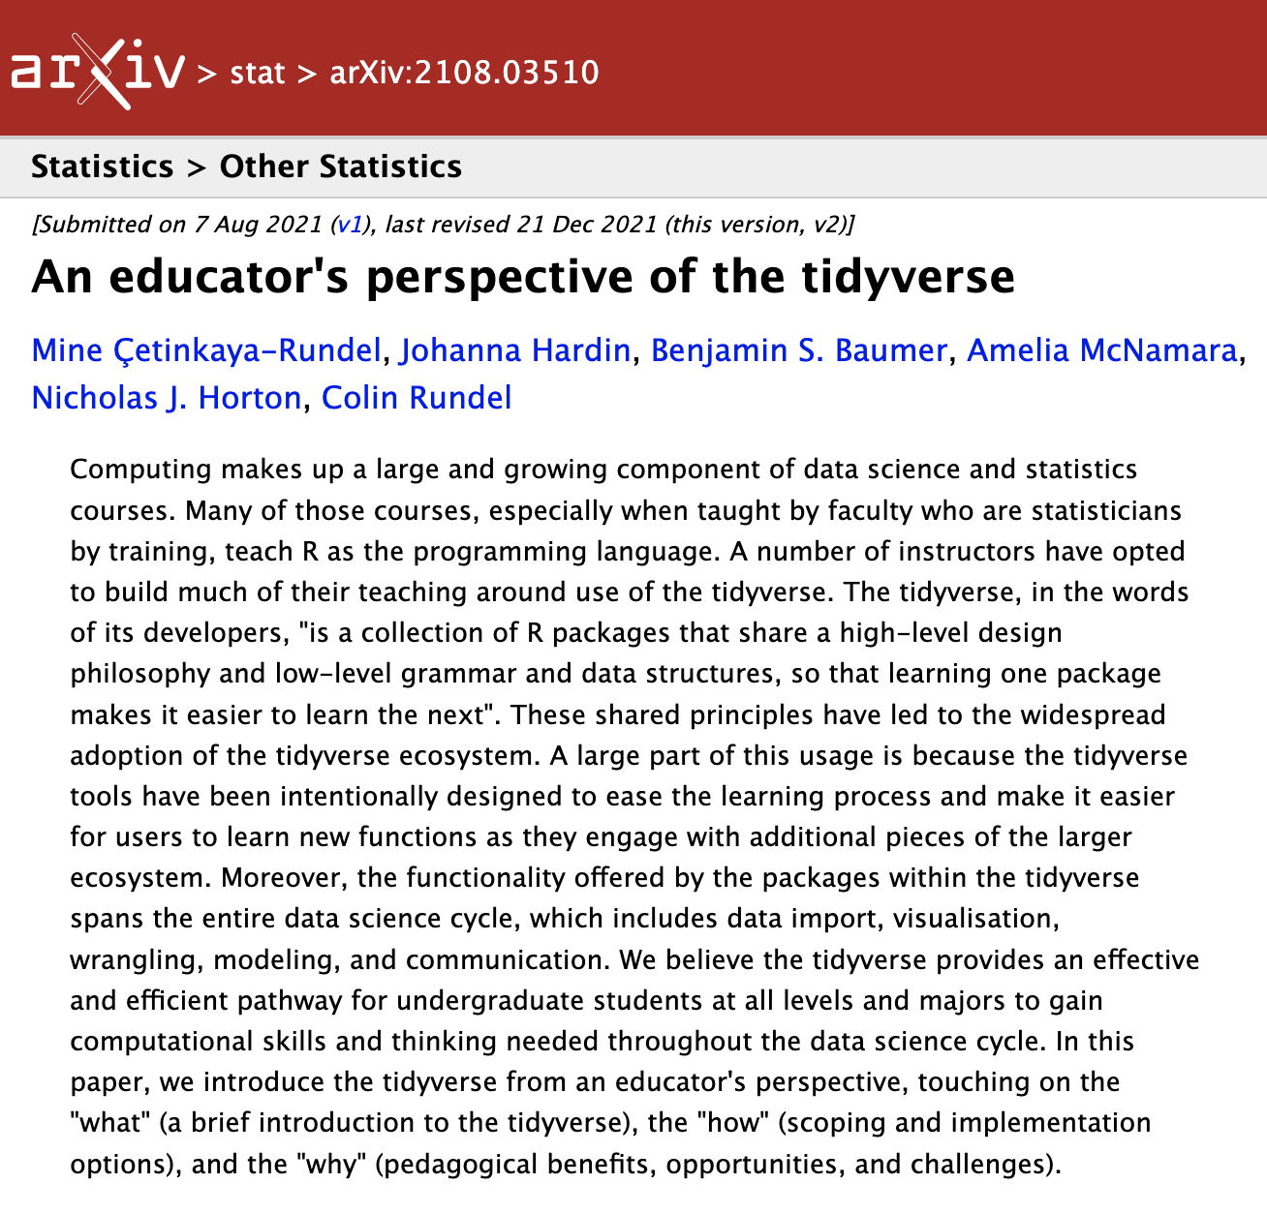
New slide heading

Slide 10
Incremental lists
Put in code fence
Using three colons

Slide 11
Slide Title
Txt - bullet - bullet 2

Slide 12
Emoji
🤩 Totes work, except in PDF output, boo.

Slide 13
References
(Andorsky, 2020; Datu et al., 2021; King, 2021; Rice et al., 2021)

Slide 14
Speaker notes
Include speaker notes in another fenced code block.
Notes:
Like this.

Slide 15
Columns
Put your contents in column code blocks
To make them show up in two columns

Slide 16
New Heading 1 2007

Slide 17
Fade in
Highlight red
Fade in, then out
Slide up while fading in
Notes:
Fade out

Slide 18
References

Slide 19
Andorsky, N. (2020). Decoding the why: How behavioral science is driving the next generation of product design.
Datu, J. A. D., McInerney, D. M., Żemojtel-Piotrowska, M., Hitokoto, H., & Datu, N. D. (2021). Is grittiness next to happiness? Examining the association of triarchic model of grit dimensions with well-being outcomes. Journal of Happiness Studies, 22(2), 981–1009. https://doi.org/10.1007/s10902-020-00260-6
King, M. (2021). Social chemistry: Decoding the patterns of human connection. Dutton.
Rice, L., Alquist, J. L., Penuliar, M., Donato, F. V., & Price, M. M. (2021). Engaging students in a research methods writing lab online. Teaching of Psychology, 48(1), 18–25. https://doi.org/10.1177/0098628320959954

