Slide 1
Mini-Dissertation Write-up Guide
Part 02 - Methods Section Dr. Gordon Wright

Slide 2
Writing the Methods Section for Your Mini-Dissertation in APA 7 Format

Slide 3
Talking Methods
In this chapter, you will learn how to craft a comprehensive and clear Methods section for your mini-dissertation. The Methods section is not just a procedural description but a showcase of your meticulous planning and execution of research, adhering to the principles of Open Science by also attaching an Open Materials submission (to be covered later in detail).

Slide 4
Method
Error type | Example
1. Use of numbers | Failing to use numerals for 10 and above
2. Hyphenation | Failing to hyphenate compound adjectives that precede a noun (e.g., “role playing technique” should be “role-playing technique”)
3. Use of et al. | Failing to use it in a reference
4. Headings | Not capitalizing headings correctly
5. Use of since | Using since to mean because
6. Tables and figures | Not formatting them in APA style; repeating information that is already given in the text
7. Use of commas | Failing to use a comma before and or or in a series of three or more elements
8. Use of abbreviations | Failing to spell out a term completely before introducing an abbreviation for it
9. Spacing | Not consistently double-spacing between lines
10. Use of & in references | Using & in the text or and in parentheses
The [method section] is where you describe how you conducted your study. An important principle for writing a method section is that it should be clear and detailed enough that other researchers could replicate the study by following your “recipe.” This means that it must describe all the important elements of the study—basic demographic characteristics of the participants, how they were recruited, whether they were randomly assigned, how the variables were manipulated or measured, how counterbalancing was accomplished, and so on. At the same time, it should avoid irrelevant details such as the fact that the study was conducted in Classroom 37B of the Industrial Technology Building or that the questionnaire was double-sided and completed using mechanical pencils.
The method section begins immediately after the introduction ends with the heading “Method” (not “Methods”) centered on the page. Immediately after this is the subheading “Participants,” left justified and in italics. The participants subsection indicates how many participants there were, the number of women and men, some indication of their age, other demographics that may be relevant to the study, and how they were recruited, including any incentives given for participation.
APA Style and the Values of Psychology
Robert Madigan and his colleagues have argued that APA style has a purpose that often goes unrecognized (Madigan et al., 1995). Specifically, it promotes psychologists’ scientific values and assumptions. From this perspective, many features of APA style that at first seem arbitrary actually make good sense. Following are several features of APA-style writing and the scientific values or assumptions they reflect.
LEARNING OBJECTIVES
Define APA style and list several of its most important characteristics.
Identify three levels of APA style and give examples of each.
Identify multiple sources of information about APA style.
Purpose of the Methods Section
The Methods section is crucial for allowing others to replicate your study, ensuring the reliability and validity of your research findings.
A well-documented Methods section demonstrates your thorough understanding of research methodologies, earning you credibility and potentially higher marks.
Research is complete only when the results are shared with the scientific community.
— American Psychological Association
Overview of APA 7 Formatting
APA 7 emphasizes clarity, precision, and a bias-free language in research writing. The simple way of understanding if a Methods section is complete and effective is to ask yourself, “Could Gordon take my Methods section (and Open Materials) and replicate my study perfectly?”. Don’t include obvious information, such as the colour of ink in pens or stuff I could figure out. Just the important information!
Consistency in formatting, such as headings, font, and citation style (APA7), is key. If you are unclear on the appropriate format, either use the template Gordon has provided, or refer to apastyle.org for numerous examples.
Use past tense to describe the methods used: “Participants were asked…”, “The study used…”. You have completed the study after all.
A previous edition of the Publication Manual strongly discouraged the use of the term subjects (except for nonhumans) and strongly encouraged the use of participants instead. The current edition, however, acknowledges that subjects can still be appropriate in referring to human participants in areas in which it has traditionally been used (e.g., basic memory research). But it also encourages the use of more specific terms when possible: college students, children, respondents, and so on.
The third level of APA style can be referred to as [low-level style] (which is covered in Chapter 6 through Chapter 10 of the Publication Manual.) Low-level style includes all the specific guidelines pertaining to spelling, grammar, references and reference citations, numbers and statistics, figures and tables, and so on. There are so many low-level guidelines that even experienced professionals need to consult the Publication Manual from time to time. Table @ref(tab:errors) contains some of the most common types of APA style errors based on an analysis of manuscripts submitted to one professional journal over a 6-year period (Onwuegbuzie et al., 2010). These errors were committed by professional researchers but are probably similar to those that students commit the most too. See also Note “Online APA Style Resources” in this section and, of course, the Publication Manual itself.
Top 10 APA-Style Errors.

Slide 5
Online APA Style Resources
The best source of information on APA style is the Publication Manual itself. However, there are also many good websites on APA style, which do an excellent job of presenting the basics for beginning researchers. Here are two of them.
APA Style: http://www.apastyle.apa.org
Purdue Online Writing Lab: https://owl.purdue.edu/owl/research_and_citation/apa_style/apa_style_introduction.html

Slide 6
Participants
In this section, describe who participated in your study, how they were selected or recruited, and any demographic information relevant to your research question. If you used a nice poster, that would look great in your Open Materials submission.
Begin by reporting sample characteristics, sampling procedures, and sample size. Include demographic characteristics and be precise to aid estimation of generalizability. Use bias-free language and specify any incentives for participation.
Please be clear if you took advantage of any research participation schemes or synthetic or fabricated data provided by Gordon.
Sample Description
Provide details like age, gender, ethnicity, or other relevant characteristics.
Example: “The study comprised 100 undergraduate students (50% female, 50% male), aged 18-25, from a South London University.”
You may also wish to include how many participants were excluded for missing data (if any).
Ethical Considerations
Explain how participants gave informed consent and how you protected their privacy. You will be able to demonstrate anonymisation of the data in the Open Data (to be covered later!)
Mention the ethical approval received from the Goldsmiths Ethics Committee. Don’t break anonymity by including an unredacted copy in any supplementary materials!

Slide 7
Materials
This section covers the tools, questionnaires, or any equipment used in your research. The goal is to describe the tools and techniques used for measuring ALL relevant variables. Include questionnaire or survey measures, and detail any instruments or task used, like hardware, software, or tests. Don’t repeat information, so if you Procedure section includes the correct step by step information on. say, a task, refer to it by name here maybe, and detail it in the procedure. Or if you think there is value in detailing it here, just refer to it by name in the procedure section.
Instruments and Reliability
Describe each tool used and its purpose in your research.
Discuss the reliability and validity of these tools. It might be worth looking back to your introduction to see if it is worth including any findings associated with the tests you have used. Most people don’t cover the merits of the choice of measurement tools when reviewing previous research.
Example: “The Big Five Personality Test (reference in APA format), with a Cronbach’s alpha of .82, was used to assess [x, y] personality traits”
Open Materials
Briefly note that detailed discussion on Open Materials is covered in a different section, but highlight their importance in enhancing replicability and transparency of research.
Example: “Details on the questionnaires used, including their full text, are provided in the Open Materials section.”

Slide 8
Procedure
Detail every step taken in your research, especially how you implemented the 2x2 ANOVA, to allow for replication.
Detailed Description
Start from the initial setup and move through to the data collection phase.
For a 2x2 ANOVA, specify the factors (independent variables) and their levels.
Example: “Participants were randomly assigned to one of four groups (2x2 design: Factor A [Level 1, Level 2], Factor B [Level 1, Level 2]). The response time was measured following the presentation of stimuli.”
Pilot Studies
If applicable, describe any pilot study and its influence on the main study.
Example: “A pilot study with 20 participants was conducted to test the feasibility of the experimental design. Based on the pilot results, minor adjustments were made to the instructions given to participants.”

Slide 9
Design
Explain the research design and clarify the variables involved in your study.
You have 2 IVs and a single continuous DV. It is important to present how your IVs were categorised, so if you used a median split to turn a continuous measure into a categorical IV - make that clear here.
Research Design
Emphasize that your study is quantitative and primarily uses a 2x2 ANOVA design.
You will have used a between-groups design, a repeated-measures design or a mixed design, make this clear, and if mixed, which IV is which!
It can be a good idea to explain why this design was chosen for your research question.
Variables
Define your independent variables (the two factors in your ANOVA - each with 2 levels) and your dependent variable (what you measured).
Example: “The independent variables were age group (young, old using a median split on Age [median 25 yrs]) and treatment type (treatment, control). The dependent variable was memory recall accuracy (percentage correct).”

Slide 10
Keeping design and procedure separate!
What is the difference between design and procedure? The design of a study is its overall structure. What were the independent and dependent variables? Was the independent variable manipulated, and if so, was it manipulated between or within subjects? How were the variables operationally defined? The procedure is how the study was carried out. It often works well to describe the procedure in terms of what the participants did rather than what the researchers did. For example, the participants gave their informed consent, read a set of instructions, completed a block of four practice trials, completed a block of 20 test trials, completed two questionnaires, and were debriefed and excused.

Slide 11
Data Preparation (optional section if merited)
If you had any complex preprocessing steps, of which you were proud, such as ‘coding’ of responses, or calculating Implicit measures or Stroop results, discuss how you processed that. .
Statistical Analysis will be covered in the Results section
This will comprise Descriptive Stats, Inferential stats (including Assumptions tests and post-hoc tests), as well as tables and figures. You do not need to include any of these things in the methods section.
Open Materials and Open Data (to be covered later)
Mention that Open Materials and Open Data will be included and so can be referred to. Let the reader know that they are available, like appendices.
Example: “The anonymised dataset generated from this study, along with the Materials necessary to replicate the study, are available in the Open Data & Open Materials supplements, ensuring transparency and reproducibility of the findings.”
Ethical Compliance
Describe the process of obtaining ethical clearance and how you adhered to ethical guidelines throughout the study.
Example: “Ethical clearance was obtained from the XYZ University Ethics Committee, and all research activities were conducted in accordance with appropriate Ethics committee and BPS guidance.”

Slide 12
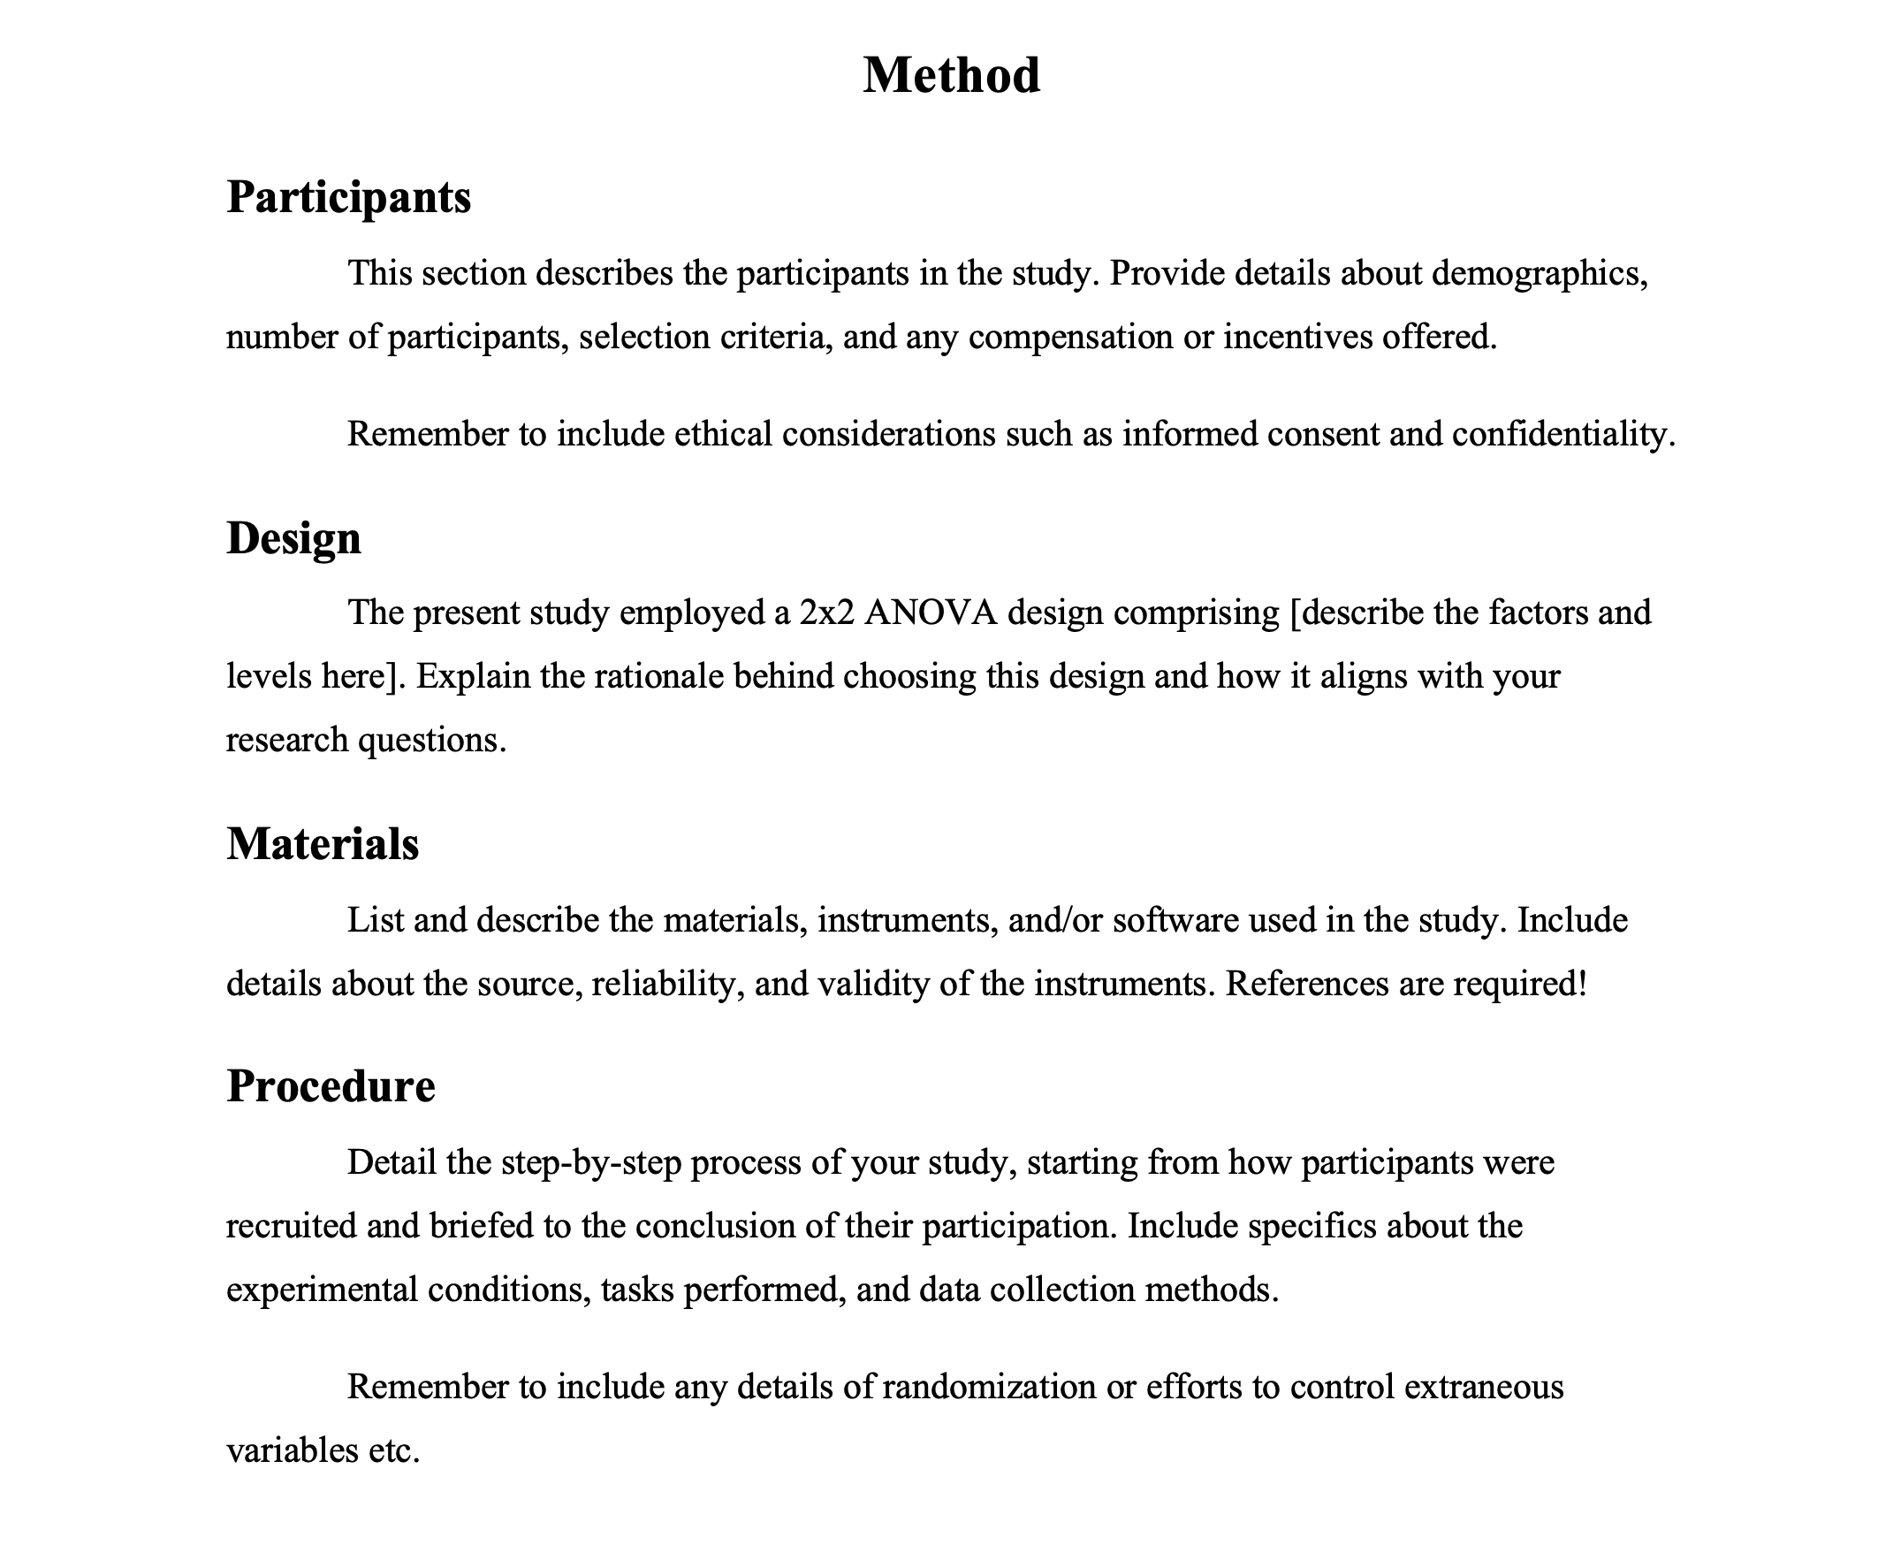
Writing Style and Formatting
Guidelines for effectively communicating your methods in line with APA 7 standards.
Tips for Writing
Use simple, understandable language and explain specific terms.
Write in Active Voice.
Titles of subsections can be italicized and centered.
Additional subsections, like “Equipment,” can be added if necessary.
Ensure information sources are credible.
Include only relevant information and omit details that don’t affect the experiment’s replication.
Write in Past Tense.
Carefully edit and proofread to avoid errors.
Common Mistakes to Avoid
Overloading with unnecessary details that do not contribute to replicability.
Failing to use bias-free language.
Not being precise in the description of materials and procedures, including references or sources.
Incorrect use of APA formatting and style, especially in headings and subheadings.
Methods Section Awesomeness Checklist
1. Formatting and Structure
☐ Main heading (“Methods”) is centered, bold, and capitalized.
☐ Subheadings (e.g., “Participants,” “Materials,” “Procedure”) are left-aligned, bold, and in title case.
2. Participants
☐ Detailed description of participant characteristics (age, gender, ethnicity, etc.).
☐ Explanation of sampling procedures and selection criteria.
☐ Reporting of sample size and explanation of how it was determined.
☐ Mention of any compensation or incentives for participation.
☐ Use of bias-free language.
3. Materials
☐ Comprehensive list of materials, tools, and equipment used.
☐ Detailed description of measures and instruments (including versions of software, etc.).
☐ Explanation of the reliability and validity of measurement tools.
4. Procedure
☐ Step-by-step description of the experimental procedure.
☐ Explanation of data collection methods.
☐ Details on research design and methodologies used.
☐ Description of data analysis procedures and statistical tests applied.
5. Clarity and Precision
☐ All terms and concepts are clearly defined.
☐ The section is written in active voice and past tense.
☐ Content is relevant and directly related to the study’s replication.
6. APA Compliance
☐ Adherence to APA style in headings, citations, and overall formatting.
☐ Correct use of APA format for figures, tables, and appendices (if any).
7. Editing and Proofreading
☐ The section is thoroughly proofread for grammar, spelling, and punctuation errors.
☐ All information is accurate and up-to-date.
☐ The writing is concise and free of unnecessary details.
8. Ethical Considerations
☐ Mention of ethical approval (if applicable).
☐ Assurances of participant confidentiality and data handling.

Slide 13
Madigan, R., Johnson, S., & Linton, P. (1995). The language of psychology: APA style as epistemology. American Psychologist, 50(6), 428.
Onwuegbuzie, A. J., Combs, J. P., Slate, J. R., & Frels, R. K. (2010). Evidence-based guidelines for avoiding the most common APA errors in journal article submissions. Research in the Schools, 16(2), ix–xxxvi.

