Slide 1
Lab 06: Online or Face-to-face?
Let’s get building Dr. Gordon Wright

Slide 2
Overview of today’s lab activities
Review the Ethics Page on the VLE
Sign up for a Qualtrics account here https://goldpsych.eu.qualtrics.com/login
Review the Template Qualtrics file for an example Information sheet, consent and debrief
Exciting progress so far!
You’ve identified an exciting area of research and critically evaluated a relevant paper.
Time to put all that hard work and careful thought into practice.
Between now and the end of term, you will build and obtain ethical approval for your studies.
We are all in the process of marking Critical Proposals, and we are seeing some wonderful application of the topics and concepts raised in the module so far.
Some of you are making impressive claims about what you are going to do. Fantastic!
Don’t push too hard, yet!
Please remember, this is supposed to be a modest size project, with focus on following the steps from initial idea, critique, development, Ethics, data collection and preparation, analysis and write-up.
We don’t want any single step to be too daunting or labour-intensive. We want you to enjoy the process as much as possible, and think carefully about each step.
The Mini-Dissertation ‘rules’
Your ultimate individually written up Mini-Dissertation project MUST conform to the following definitive rules:
2x2 ANOVA design with 2 categorical IVs (each with 2 levels) and a
single continuous DV
You must obtain ethical approval and prove individual involvement in
the process of application
You must make a sample size estimation / Power calculation
You must collect data online and individually contribute to group
data collection efforts
Your Mini-Dissertation final submission must comprise:
Submission Requirements
a 2500 word APA7 empirical paper with a critical reflection and complete reference list
Open Data - a single, cleaned, clearly-labelled data set in Excel format
Open Materials - a complete, replication-ready materials document detailing materials relevant to your submission

Slide 3
Running Experiments online or face to face
Comparing Experiment Modalities
Online Surveys and Experiments
Qualtrics - For surveys, stimulus presentation that don’t require accurate timing
Gorilla.sc - For ‘experimental’ tasks with complex stimulus > presentation or that require response time measures or push-button > responses etc.
Face-to-Face Experiments

Slide 4
Online Surveys and Experiments with Qualtrics
Overview
A powerful tool for creating and distributing online surveys
Widely used in psychological research
We have an institutional licence and so it is FREE
No specialist support - has excellent online support

Slide 5
Pros of Qualtrics
Accessibility
Reach a wide, diverse audience (if necessary)
Accessible by anyone with a phone or laptop etc
Cost-Effective
Low ‘cost’ compared to face-to-face
Data Management
Automated data collection, scoring and storage
Relatively easy to analyze and export data - but not always simple
Customization
Highly customizable surveys and experiments (video, photos, audio, vignettes)
Supports various question types and logic

Slide 6
Cons of Qualtrics
Limited Human Interaction
Lack of personal interaction can affect responses
You put a huge amount of trust in the participant
Not always easy to manage ethical challenges properly
Technical Issues
Dependence on internet connectivity and user tech skills
An error in the build and you are in trouble ####
Response Authenticity
Higher risk of dishonest or inattentive responses (maybe?) #### Sampling Bias
Potential for non-representative samples

Slide 7
Introduction to experiments using Gorilla.sc
Gorilla.sc: highly controlled online Psychological Research
A comprehensive online tool for behavioral research
Facilitates creation, deployment, and analysis of experiments

Slide 8
Core Features of Gorilla.sc
User-Friendly Interface
Intuitive design for researchers of all levels
Drag-and-drop experiment builder
Requires ‘tokens’ to run
You will need to apply for ‘tokens’ to apply for ethics, and to run the study.
There is usually a limited supply as there is a cost associated with this.
Versatile Experiment Design
Supports a wide range of experimental paradigms
Customizable to suit various research needs

Slide 9
Experiment Creation with Gorilla.sc
Building Blocks
Use ‘widgets’ and ‘tasks’ to construct experiments
Easily integrate surveys, quizzes, and cognitive tasks
Advanced Customization
Incorporate complex experimental logic
Customize with CSS and JavaScript for unique requirements

Slide 10
Data Collection and Analysis
Real-Time Data Collection
Gather data securely and efficiently
Access participant responses in real-time
Analytical Tools
Built-in tools for basic data analysis
Export data for advanced analysis in other software e.g. SPSS

Slide 11
Collaboration and Sharing
Team Collaboration
Share experiments and data with team members
Collaborate on experiment design and analysis
Participant Recruitment
Still needs to be managed via sources outside of Gorilla

Slide 12
Gorilla.sc in Psychological Research
Broad Application
Suitable for cognitive, social, and clinical psychology
Ideal for remote and large-scale studies
Impact on Mini-Dissertations
Increases the reach of psychological studies requiring complex stimulus or timing
Not easy to get up and running with this tool
No specialist support - has excellent templates and online support

Slide 13
Face-to-Face Experiments
Overview
Traditional method of conducting experiments
Involves direct interaction with participants

Slide 14
Pros of Face-to-Face Experiments
Enhanced Interaction
Direct human interaction enriches data quality
Controlled Environment
Better control over experimental conditions
Immediate Feedback
Opportunity for immediate clarification and feedback
Participant Authenticity
Lower risk of false responses (maybe?)

Slide 15
Cons of Face-to-Face Experiments
Higher Costs
Greater resource and time investment (maybe?)
Limited Reach
Restricted to participants’ geographical location
Time-Consuming
Scheduling and conducting sessions takes time
Potential Biases
Risk of experimenter or social desirability biases

Slide 16
Conclusion
Choosing the Right Method
Depends on research goals, resources, and target population
Both methods offer unique advantages and challenges
Tailoring to Research Needs
Consider the nature of your study and participant accessibility
Balance between quality, ‘cost’, and reach

Slide 17
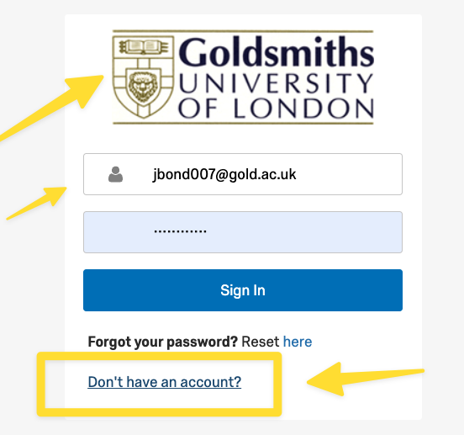
Questions?
Lab activities
Qualtrics (Many of you will use this!)
Log in to an account with your Goldsmiths ID!!
Find the login on the VLE
https://goldpsych.eu.qualtrics.com/login

Slide 18
10% of you will apply for the wrong type of account and be stuck for 2 weeks
Familiarise yourself with the Ethics Application process
Consider the steps required to bring your study to life! (the rest)
References

