Slide 1
Lab 14: Open Data
Goal: 100% Replicability - Again! Dr. Gordon Wright

Slide 2
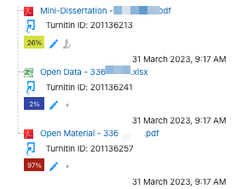
Overview of today’s lab activities
Keep on collecting data
Register your interest for the Year 1 Lab invasion on Thursday (Thursday 1st Feb)
Start thinking about Data Analysis and processing
Open Data requirements
Data Collection
Please take part in the Study Swap and email Gordon with any new studies coming online - THIS WILL BE SHARED WITH FIRST YEAR LAB GROUPS
See what a Mini-Dissertation submission looks like
1 - The Mini-Diss itself
2 - **Open Data (e.g. Excel)
3 - Open Materials (e.g. pdf)

Slide 3
Review the Mini-Dissertation Writing Guide ch04 - Data Prep & Open Data
Sharing your data is compulsory and although just dumping your dataset into your submission will be fine, a good submission will include modest efforts to enhance the understanding of the data

