Slide 1
Lecture 14: Research Methods & Employability
Now is the time to think ahead Dr. Gordon Wright

Slide 2
Weeks ahead
This week - Year 1 Lab Invasion on Thursday
Lab 14 - Analysis Planning and Open Data
Lab 15 - Data Export, preprocessing & Overview of APA Results section
Lab 16 - Data Analysis - Three Flavours of ANOVA (+ Assumptions & Post-hoc tests)
Lab 17 - Results write-up, Table, Figures & style

Slide 3
Careers

Slide 4

Careers in Psych and Alternative Careers

Slide 5
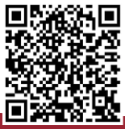
Please register

Slide 6
https://goldsmiths.targetconnect.net/unauth?leap=true&currentUserLocale=en_GB

Slide 7
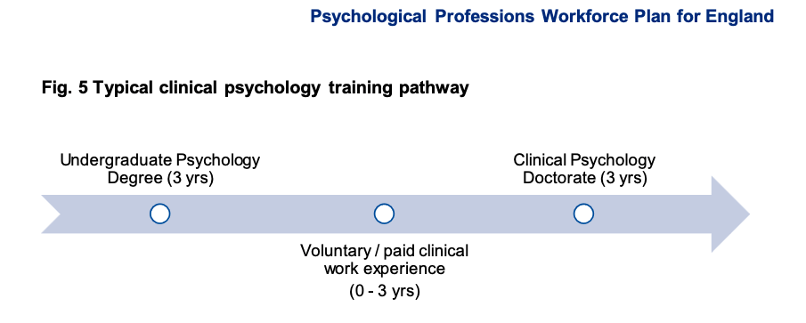
Clinical Pathway - 20,000 Psych Graduates/year

Slide 8
Known Challenges
Limited opportunity to gain ‘on the job’ experience
Highly competitive and uncertain
The vast majority of Psych careers require an MSc. Like another 3rd year (±5 modules (inc. RM and a dissertation). Usually 2 days per week FT.

Slide 9
Embracing Innovative Research Methods
Explore Qualitative Research: Engage deeply with qualitative research methods. Develop skills in ethnography, narrative analysis, and discourse analysis to bring fresh perspectives to clinical psychology.
Methodological Innovation: Foster a creative approach to research methods. Break away from conventional techniques and develop novel research strategies that address complex psychological issues.
Utilize Theoretical Frameworks: Integrate diverse theoretical perspectives such as feminism, poststructuralism, psychoanalysis, and Marxism into your research. This interdisciplinary approach can enrich your understanding and application of clinical psychology.

Slide 10
Developing a Unique Professional Identity
Political and Ethical Awareness: Cultivate an awareness of the moral and political dimensions of psychology. Understand how your work can contribute to societal change and uphold ethical standards in research.
Reflexivity and Critical Thinking: Practice reflexivity in your work. Be critical of your biases and assumptions, and understand how they influence your research and clinical practice.
Advocacy and Empowerment: Position yourself as an advocate for marginalized communities. Use your skills to empower individuals and groups, contributing to social justice through clinical psychology.

Slide 11
Crafting a Standout Identity and Personal Statement
Professional Presence: Join Linkedin, attend seminars or conferences, advertise your research skills/interest, join volunteer organisations
Tailored CVs: Customize your CV for each application. Highlight relevant coursework, projects, and research experiences that align with clinical psychology.
Impactful Personal Statements: Convey your passion for psychology and your commitment to pursuing a career in clinical psychology. Reflect on experiences that shaped your interest and how they prepare you for this field.
Showcase Skills and Achievements: Clearly articulate your skills, especially in research methods, critical thinking, and communication. Include any awards, presentations, or publications to demonstrate your competence and dedication.

Slide 12
References
References can be a powerful addition to any application, or a weakness
References should align with the content of your application
A referee needs to be able to speak to Academic ability, Professional Skills, Team Work, Extra-Curricular/Voluntary work

Slide 13
You can be working on all of these things NOW!

Slide 14
Summer in Second Year
GRIP and Departmental Bursaries
Opportunities to do voluntary work
Other options

Slide 15
Here’s what they don’t tell you and maybe you don’t want to hear
The next step on any Psych career is a Masters.
Therefore, getting on the right programme is the key.
It’s about Academic merit and the little extras.
The best applicants I interview have a ‘Research Narrative’ (Relevant Y3 Dissertation and Proposed MSc Dissertation).
And enough ‘experience’ to illustrate effort and engagement with the field.

Slide 16
Final words on the Psych careers
Don’t think of it as a ‘different’ domain to where you are now.
Experience can be in the lab, or on a research project with vague relevance!
Samaritans, CirclesUk, any of the virtual helplines etc. All very flexible to your time

Slide 17
Alternative Careers (with HR Hiring rounds)
Put effort into the application process and prepare for the interviews carefully.
Illustrate your skills (with examples) and break down all the things you have learned here.
Try to get a reference that highlights the same skills you are mentioning.

Slide 18
Marketable Skills of a Psychology Graduate
DATA-SKILLS: Ability to analyze and interpret data, identifying patterns and drawing logical conclusions from DATA.
Research Skills: Proficiency in designing, conducting, and analyzing research, including both quantitative and qualitative methods.
Communication: Strong verbal and written skills for effectively conveying complex psychological concepts to diverse audiences.
Empathy and Interpersonal Skills: Exceptional understanding of human behavior and the capacity to empathize with clients from varied needs etc.
Problem-Solving Abilities: Aptitude for identifying problems, generating solutions, and implementing effective strategies in Project Management.
Ethical and Cultural Awareness: Deep understanding of ethical considerations in psychology and sensitivity to cultural differences.

Slide 19
Alternative Careers (without HR Hiring rounds)
If there is a human involved, then your Psych background is valuable. Make it count!
Network and sell your idea/perspective/skills
Build a portfolio or a profile
Knock on doors and try to understand the industry
Science the sh*t out of it!

Slide 20
Last words
Don’t be in a hurry
If you are in a hurry, be strategic and devious
Try to understand yourself (as much as you can)
Talk to as many people as you can!

