Slide 1
Lecture 03: Being Critical
An intellectual virtue Dr. Gordon Wright

Slide 2
Key topics today
The week ahead
Personal Tutor Meeting about MD this week
also Weeks 8 (ethics), 13 (write-up prep), 17 (Stats)
Critical Proposal overview and tips
Lab preview - Your Critical Proposal Target Paper

Slide 3
Personal Tutor Meeting Week 3
This week (week 3) you have 50 minutes with your Personal Tutor to discuss the Mini-Dissertation.
Tip
Your Personal Tutor is ANOTHER source of guidance and support.
Give them the information they need to best help you on this journey.
Dear PTs, “Next week, you are given no information whatsoever, and are asked to turn up to your session with nothing other than perhaps a pen and paper, a big smile, and anticipation of lots of exciting research in the making.”

Slide 4
Future PT Sessions devoted to the MD
Week 8 - Check on status of Ethics application, and troubleshooting
Week 13 - Session to support Analysis Planning and Writing up/Submission preparation
Week 17 - Result interpretation, and any concerns arising in the final phase of the MD

Slide 5
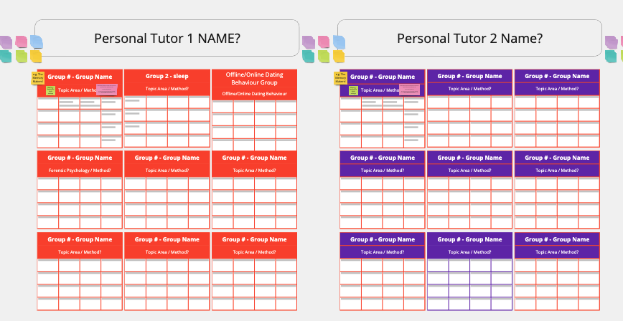
Please fill in a group on your Lab Miro Board.
Even just your names… Help us to help you. Please.

Slide 6
Any Questions?

Slide 7
Being critical and evaluating the work of others

Slide 8
This is a topic and skill you’ve already been shown

Slide 9


Slide 10
Review these materials and consider your performance of the assessment, and any feedback

Slide 11
This year Critical Analysis has a ‘point’
The objective of the Critical Proposal is that you start to deploy the tools you have practiced in the service of your Mini-Dissertations.
A ‘practical’ exercise, which we are giving feedback to once… but that you will do multiple times for your Mini-Dissertation.
GOAL: to develop some aspect of your study design or methodology.
You will probably follow this process ‘a few times’ for your final year dissertation!

Slide 12
The Four ‘Big’ Validities
Internal Validity: The degree to which an experiment accurately assesses variable relationships without interference from confounding factors.
External Validity: The degree to which study results can be applied to different populations or settings, indicating generalizability.
Construct Validity: The evaluation of whether a test effectively measures the intended theoretical construct using multiple indicators.
Statistical Validity: The assessment of whether statistical methods used in data analysis yield accurate conclusions from the data.
https://opentext.wsu.edu/carriecuttler/chapter/experimentation-and-validity/

Slide 13
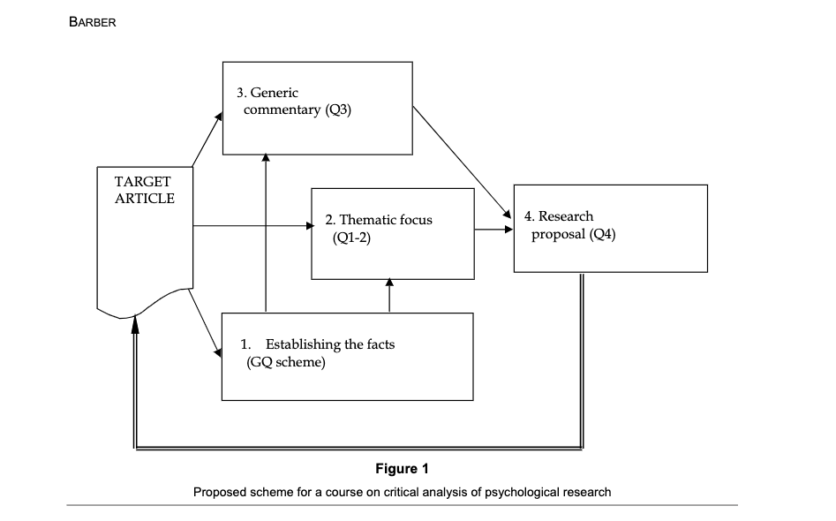
Reading list items (Barber 2002; 2004)

Slide 14
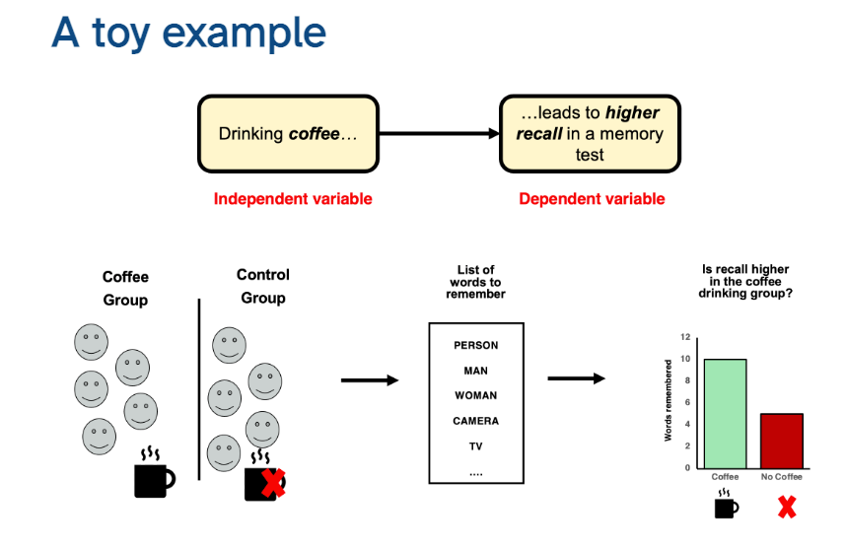
Let’s look at the example from last week

Slide 15
How do I do it? [one approach]
Review literature on a key part of your ‘puzzle’ (an IV, a ‘tool’, the DV etc)
Apply critical evaluation to carefully chosen paper(s)
Consider how it might realistically guide or inform your own research
Identify a procedure to partially replicate, replicate, or replicate and extend/improve
Detail how that takes shape and reflect on your confidence, skill base, perception of value

Slide 16
or
You could approach it strategically as a group.
Identify areas to take ownership of, then divide and conquer!
Or fly solo and agree to later apply the same process to a mutually beneficial part of your study

Slide 17
Critical Proposal Support

Slide 18
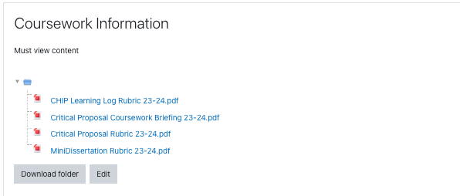
Briefing and Rubric

Slide 19
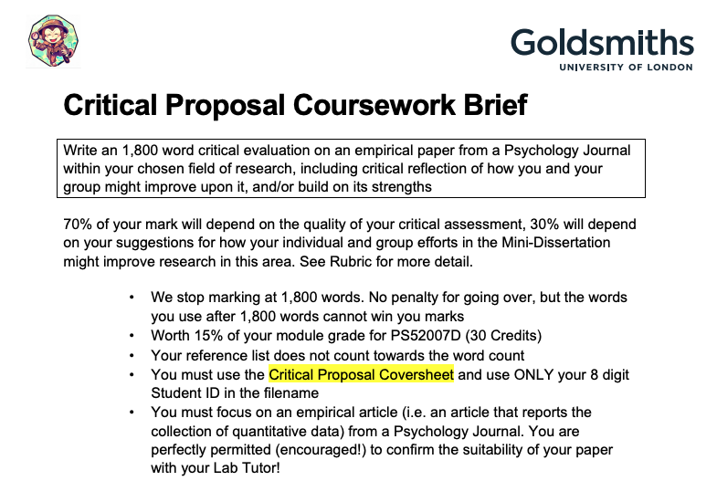
Briefing

Slide 20
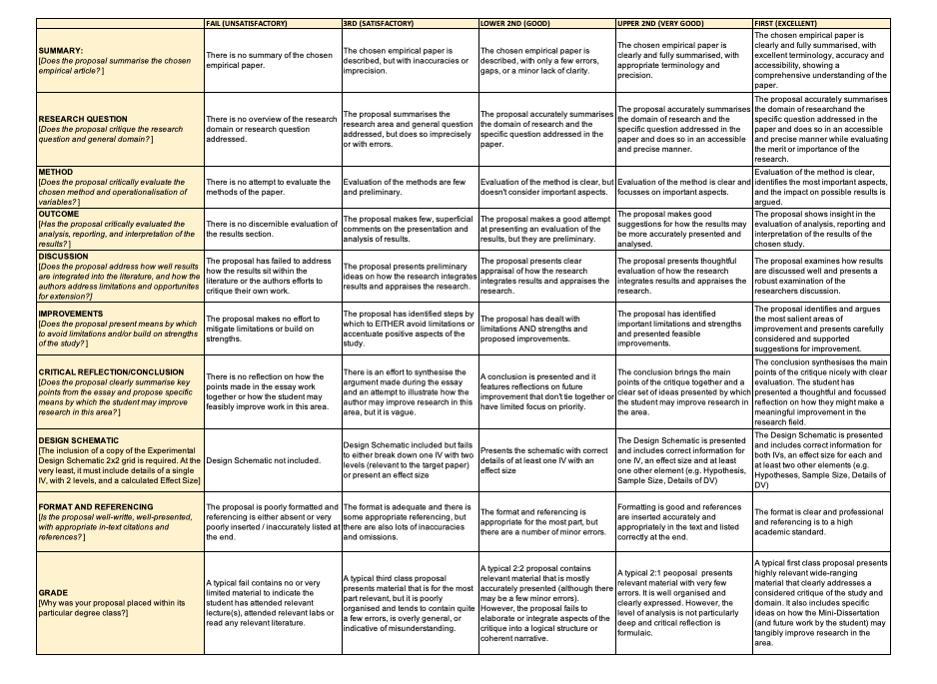
Rubric

Slide 21
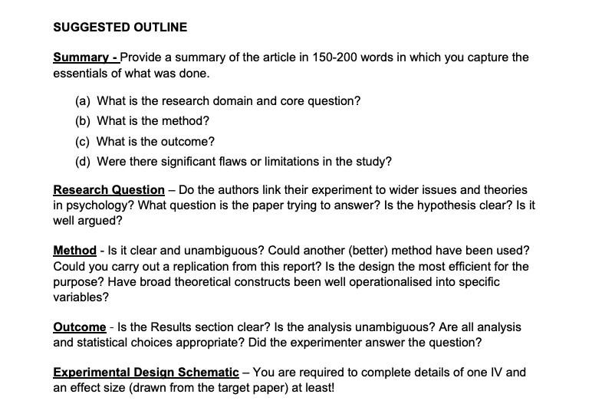
Please follow the suggested outline

Slide 22
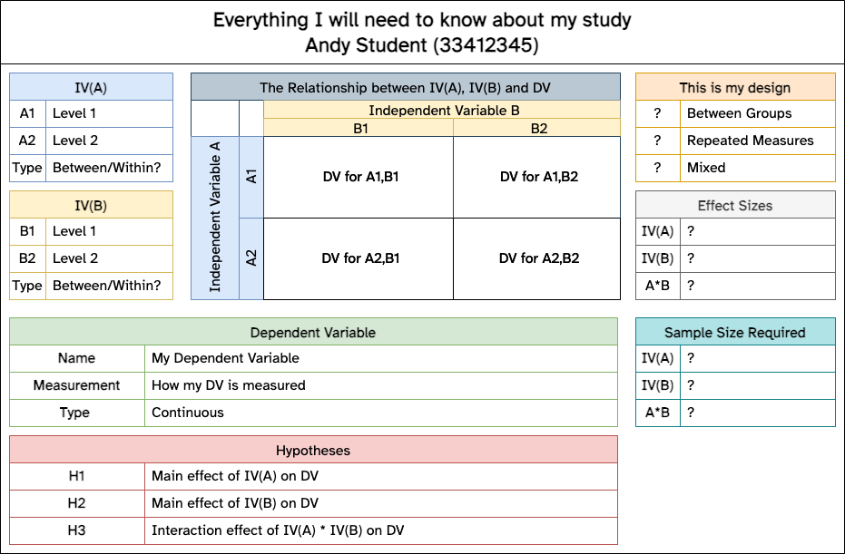
Design information

Slide 23
More tips
Please review the “SUGGESTED ESSAY OUTLINE” in the coursework briefing
No need to follow it roboticly, be strategic & selective in terms of details
Selection of a ‘good’ paper to focus on is an integral part of the assessment!
Do you think the first google result will be a fruitful paper? No, of course you don’t!
Use your Lab Tutor and me to get a sense of confidence. Early.
Tell us how you are searching and what you are looking for
Confirm the paper with us in a lab session [Priority given for this]

Slide 24
Even more tips
Use some of the tools presented in the previous lab activity to help track down a suitable paper
Give yourself time to read, review, re-read and select your juiciest points
Avoid any discussion of methodologies that cannot inform your study directly
e.g. Clinical diagnostic procedures, fMRI technicalities, Criminal Record or Case Study review procedures

Slide 25
You can (will) use LOTS of this in your MD!
This isn’t a sidetrack exercise. It’s a critical step in your project
Note your references, note your main points, be organised

Slide 26
Weeks 4 & 5
Talking about Variables and the 3 ‘flavours’ of ANOVA in week 4
Week 5 is ‘power calculations’ and opportunity to discuss CP
But we will be moving on and the CP will be part of your independent study
Same opportunities for RASA submissions/summer deferrals & resubmissions

Slide 27
Questions?

