Slide 1
Lecture 06: Online and face-to-face testing
Running good studies Dr. Gordon Wright

Slide 2
Week 6, Let’s go!
Social Psychology Essay Tutorial this week
Have you done your reading and prepared?
A word on attendance and independent study

Slide 3
Any Questions?

Slide 4
The Weeks ahead
Every group needs to apply for (and receive) ethical approval prior to the Winter Break. - Review the Ethics Page on the VLE - The same process you will use next year - 1 application per group - pre-approved by Lab Tutors - Planning is required and turnaround is 1 week - We deep dive ethics next week (week 7) - but review the materials in advance

Slide 5
It’s time to get practical

Slide 6
‘Operationalisation’ of variables
Operationalisation of variables requires a consideration of the reliability and validity of the method of operationalisation.
Operationalisation of variables also requires specification of the scale of measurement: nominal, ordinal, interval, or ratio.
Finally, operationalisation of variables can also specify details of the measurement procedure.
See Howitt and Cramer Chapter 3.3 (Box Research Example - Condon & Crano 1988)

Slide 7
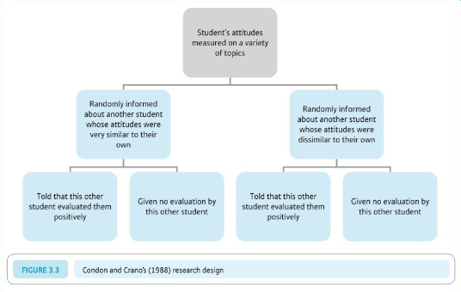
Attitude similarity and interpersonal attraction

Slide 8
Their DV (consider pros and cons)
This person would like (dislike) me
This person would like (dislike) working with me in an experiment

Slide 9
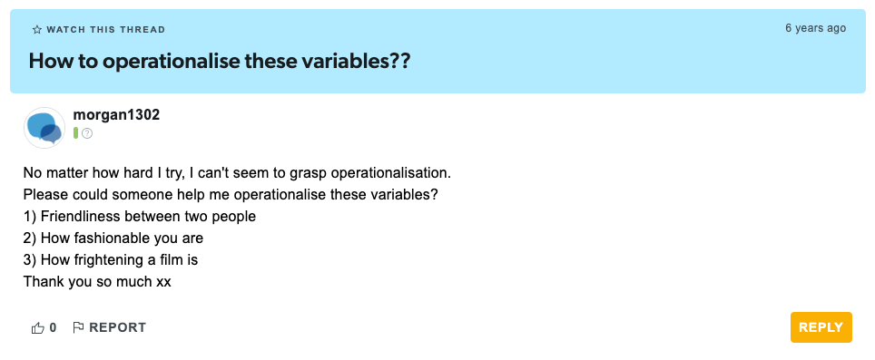
The Student Room (question)

Slide 10
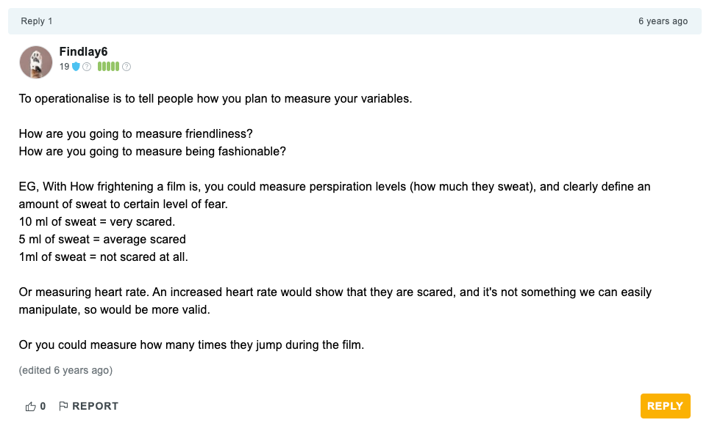
The Student Room (answer 1)

Slide 11
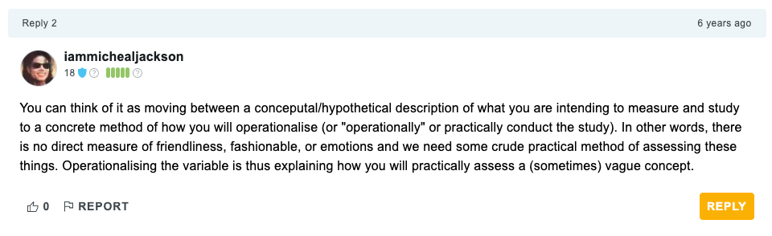
The Student Room (answer 2)

Slide 12
Of great importance that you reflect on this for your MD too
How have you defined your variables of interest?
IVs and DVs
How have you measured or categorised your variables of interest?
e.g. Social Media use
Gender
Frequency or low/high extraversion

Slide 13
The research process
Note
Develop research aims
Specify research questions/hypotheses related to these aims
Identify relevant constructs and concepts
Translate constructs and concepts into variables (i.e., a logical set of characteristics/features)
Translate variables into measurements (i.e., the quantification of characteristics/features)

Slide 14
Quantitative Research
A systematic examination of relationships between variables
. . .
‘Variables’ are ‘translated’ from concepts, constructs or phenomena
. . .
Could be critiqued as ‘reductionist’

Slide 15
Types of Variable
Independent Variable
Experimental - The variable I manipulate
Non-Experimental / Quasi-Experimental - Comparison between pre-existing groups
Dependent Variable
The variable you measure, that you propose to be influenced by a manpulation of the IVs
The [D]ata{.shout}

Slide 16
Types of Measurement
Nominal/Categorical
Male/Female/…
Vegan / Vegetarian
Smoker/Non-Smoker

Slide 17
Types of Measurement
Ordinal
Numbers representing a rank position in a group
Not representative of an actual definite number/score/value - without information about the ‘gap’ between numbers
First, second, third
Tallest/Shortest

Slide 18
Types of Measurement
Interval
Numbers represent equal units giving information about the ‘gap’ between numbers
Temperature
Psychological Scales

Slide 19
Types of Measurement
Ratio
Interval measurements with an absolute zero, of equal units,
Weight
Length
Time/Reaction time*

Slide 20
Median Splits
‘Cutting’ a distribution in half at the mid-point - with 50% on each side of the cut

Slide 21
Median Splits can be considered problematic
Beware!
We often suggest a median split to dichotomise a continuous variable, e.g. for the purposes of creating a 2 level IV.
It’s a useful exercise in calculating a ‘computed variable’ in SPSS or Jamovi
It is NOT best-practice usually. Why not?
It is a key learning outcome that you are able to perform a standardised analysis, specifically, the 2x2 ANOVA with any necessary assumption checks and post-hocs + plots

Slide 22
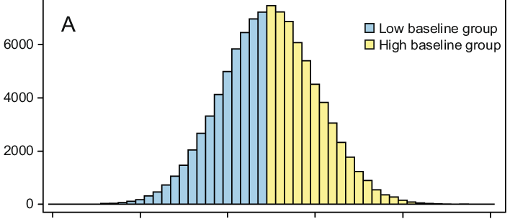
Think about this

Slide 23
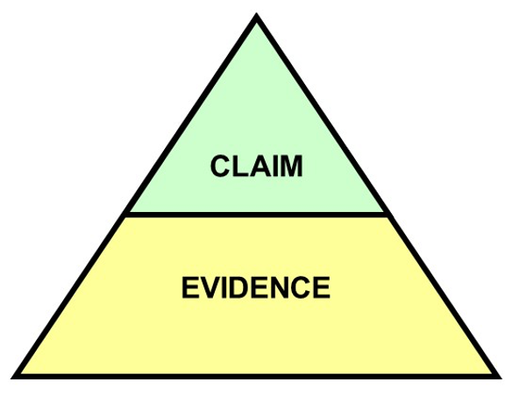
Operationalisation, measurement and definitions impact…

Slide 24
Summary of part 1
You should think carefully about:
How you define your variables - this is probably a part of the introduction that students DON’T think about enough
How you measure or categorise your variables (IVs and DVs) - this is probably the single thing I look at first when peer-reviewing research!
How well your manipulation does what it claims to. Does you manipulation bring the thing it proposed to to life well?

Slide 25
Running Experiments online or face to face

Slide 26
Comparing Experiment Modalities
Online Surveys and Experiments
Qualtrics - For surveys, stimulus presentation that don’t require accurate timing
Gorilla.sc - For ‘experimental’ tasks with complex stimulus > presentation or that require response time measures or push-button > responses etc.
Face-to-Face Experiments

Slide 27
Online Surveys and Experiments with Qualtrics
Overview
A powerful tool for creating and distributing online surveys
Widely used in psychological research
We have an institutional licence and so it is FREE
No specialist support - has excellent online support

Slide 28
Pros of Qualtrics
Accessibility
Reach a wide, diverse audience (if necessary)
Accessible by anyone with a phone or laptop etc
Cost-Effective
Low ‘cost’ compared to face-to-face
Data Management
Automated data collection, scoring and storage
Relatively easy to analyze and export data - but not always simple
Customization
Highly customizable surveys and experiments (video, photos, audio, vignettes)
Supports various question types and logic

Slide 29
Cons of Qualtrics
Limited Human Interaction
Lack of personal interaction can affect responses
You put a huge amount of trust in the participant
Not always easy to manage ethical challenges properly
Technical Issues
Dependence on internet connectivity and user tech skills
An error in the build and you are in trouble ####

Slide 30
Cons of Qualtrics (continued)
Response Authenticity
Higher risk of dishonest or inattentive responses (maybe?)
Sampling Bias
Potential for non-representative samples

Slide 31
Introduction to experiments using Gorilla.sc
Gorilla.sc: highly controlled online Psychological Research
A comprehensive online tool for behavioral research
Facilitates creation, deployment, and analysis of experiments

Slide 32
Core Features of Gorilla.sc
User-Friendly Interface
Intuitive design for researchers of all levels
Drag-and-drop experiment builder
Requires ‘tokens’ to run
You will need to apply for ‘tokens’ to apply for ethics, and to run the study.
There is usually a limited supply as there is a cost associated with this.
Versatile Experiment Design
Supports a wide range of experimental paradigms
Customizable to suit various research needs

Slide 33
Experiment Creation with Gorilla.sc
Building Blocks
Use ‘widgets’ and ‘tasks’ to construct experiments
Easily integrate surveys, quizzes, and cognitive tasks
Advanced Customization
Incorporate complex experimental logic
Customize with CSS and JavaScript for unique requirements

Slide 34
Data Collection and Analysis
Real-Time Data Collection
Gather data securely and efficiently
Access participant responses in real-time
Analytical Tools
Built-in tools for basic data analysis
Export data for advanced analysis in other software e.g. SPSS

Slide 35
Collaboration and Sharing
Team Collaboration
Share experiments and data with team members
Collaborate on experiment design and analysis
Participant Recruitment
Still needs to be managed via sources outside of Gorilla

Slide 36
Gorilla.sc in Psychological Research
Broad Application
Suitable for cognitive, social, and clinical psychology
Ideal for remote and large-scale studies
Impact on Mini-Dissertations
Increases the reach of psychological studies requiring complex stimulus or timing
Not easy to get up and running with this tool
No specialist support - has excellent templates and online support

Slide 37
Face-to-Face Experiments
Overview
Traditional method of conducting experiments
Involves direct interaction with participants

Slide 38
Pros of Face-to-Face Experiments
Enhanced Interaction
Direct human interaction enriches data quality
Controlled Environment
Better control over experimental conditions
Immediate Feedback
Opportunity for immediate clarification and feedback
Participant Authenticity
Lower risk of false responses (maybe?)

Slide 39
Cons of Face-to-Face Experiments
Higher Costs
Greater resource and time investment (maybe?)
Limited Reach
Restricted to participants’ geographical location
Time-Consuming
Scheduling and conducting sessions takes time
Potential Biases
Risk of experimenter or social desirability biases

Slide 40
Conclusion
Choosing the Right Method
Depends on research goals, resources, and target population
Both methods offer unique advantages and challenges
Tailoring to Research Needs
Consider the nature of your study and participant accessibility
Balance between quality, ‘cost’, and reach

Slide 41
Questions?

Slide 42
Lab activities
Qualtrics (Many of you will use this!)
Log in to an account with your Goldsmiths ID!!
10% of you will apply for the wrong type of account and be stuck for 2 weeks
Familiarise yourself with the Ethics Application process
Consider the steps required to bring your study to life!

Slide 43
References

