Slide 1
Lecture 13: Philosophy of Science
An initial overview Dr. Gordon Wright

Slide 2
Is Psychology a Science?
The Ongoing Debate
Positivism in Psychology: Traditional view supporting quantitative methods, treating human behavior as stable, measurable facts.
Qualitative Shift: A focus on dynamic, ever-changing aspects of human behavior, challenging the idea of fixed patterns, and possibly facts!
Source: (parker2011?)
The Role of Qualitative Research
Qualitative vs. Quantitative: The debate isn’t about the validity of quantification but the quality of its application in psychology.
Where is Psychology’s non-stick frying pan? (Banyard, 2015)
Advancing Scientific Debate: Qualitative research is at the forefront of discussions about the nature of scientific inquiry in psychology.
Source: (Parker, 2004)

Slide 3
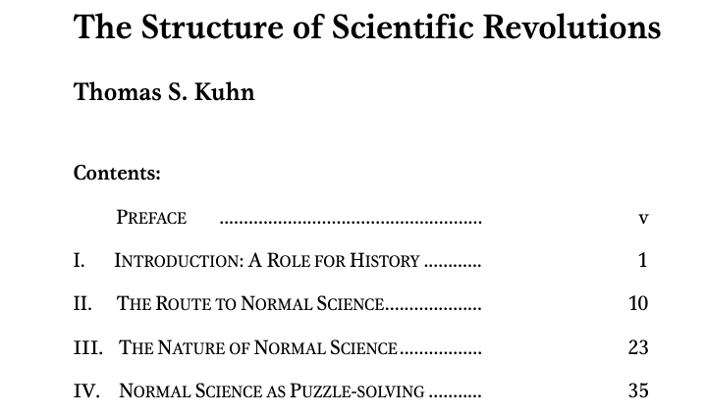
The Structure of Scientific Revolutions

Slide 4
Kuhn - Structure
Paradigm Shifts
Thomas Kuhn’s Theory: Science progresses through paradigm shifts rather than linear accumulation of knowledge.
Application in Psychology: Shifts from behaviorism to cognitive psychology, and then to more integrated approaches.
The Kuhn Cycle - Thomas Kuhn's Brilliant Model of How Scientific Fields Progress
The Kuhn Cycle - Thomas Kuhn's Brilliant Model of How Scientific Fields Progress
Implications for Psychological Research
Changing Research Methods: Embracing diverse methodologies reflecting evolving paradigms in psychology.
Interdisciplinary Influence: Incorporating insights from philosophy, sociology, and neuroscience into psychological research.
Psychology as a ‘Soft Science’
Psychology compared to pre-scientific stages of sciences
The debate over applying ‘the scientific method’ in psychology
The importance of being phenomenon-centered and problem-centered
Misalignment of methods with research questions
Uher (2021)

Slide 5
Conclusion?
Psychology and Science
Dynamic and Evolving: Psychology, like other sciences, undergoes paradigm shifts and methodological evolution.
Beyond Traditional Boundaries: The discipline is increasingly recognizing the value of qualitative, subjective, and diverse approaches to understanding the human mind and behavior.

Slide 6
Karl Popper and Falsification
The Principle of Falsification
Karl Popper’s Contribution: Emphasized the importance of falsifiability in scientific theories.
Falsification vs. Verification: Popper argued that scientific theories can never be completely verified, but they can be falsified.
Impact on Psychology: Encourages rigorous testing of hypotheses and openness to disconfirming evidence in psychological research.
Critiques and Legacy
Practical Challenges: Difficulties in applying falsification principle in complex fields like psychology.
Enduring Influence: Popper’s ideas continue to influence scientific methodology and philosophical discussions in psychology.

Slide 7
Epistemology
Epistemology
Definition: The study of knowledge – its nature, origin, and limits.
Relevance to Psychology: Helps in understanding how we acquire knowledge about human behavior and mental processes.
How do we know what we know, or get to know something new?

Slide 8

Understanding the Ideographic/Nomothetic Divide

Slide 9
Ideographic Approach
Focus: Emphasizes the unique aspects of individual cases or phenomena.
Methodology: Often uses qualitative methods, such as case studies, to explore complex, subjective experiences.
Goal: To understand the depth and complexity of individual experiences.
Nomothetic Approach
Focus: Seeks to identify general laws and patterns that apply across multiple cases.
Methodology: Employs quantitative methods, like experiments and surveys, to gather data on larger populations.
Goal: To formulate generalizations and broad theories applicable to many.

Slide 10
Implications in Psychological Research
Balancing Perspectives
Integrating Approaches: Both ideographic and nomothetic methods offer valuable insights; combining them can lead to a more holistic understanding of psychological phenomena.
Challenges in Quantitative Research: The need to acknowledge and address the reflexive capacity of human beings and the meaningful nature of data from aggregated descriptions of behavior.
Innovative Research Possibilities: Opportunities for innovative research that addresses these challenges, respecting the particularities of individual cases within broader patterns.
(Robinson, 2012)

Slide 11
Why should we care about this question?
The Esteem of Science
Science’s high regard in society and academia
The assumption that the scientific method leads to reliable results
The challenge in defining ‘scientific method’ and its transferability
Chalmers, 2014 What is this thing called Science?

Slide 12
Conclusion: Rethinking Scientific Method in Psychology
Recognizing the influence of subjective experiences on observation
Understanding the interplay between facts, theory, and conceptual frameworks
The challenge of applying a rigid scientific method to human behavior and experiences

Slide 13
Abstract
Psychology’s struggle with foundational concepts: mind and behavior
Lack of unified theoretical framework
Classification as a ‘soft science’
Need for diverse methodologies and systematic integration
Galtonian nomothetic methodology’s limitations
[Uher, 2020]

Slide 14
Lack of Proper Terms and Definitions
Discordant and ambiguous definitions in psychology
Overlap between psychology, neuroscience, and philosophy
Proliferation of terms and constructs
Deeply fragmented theoretical landscape
[Uher, 2020]

Slide 15
Lack of Conceptual Integration
Diversity of epistemologies, paradigms, and methodologies
Absence of a unified theory in psychology
Challenges with evolutionary psychology as an integrative framework
Speculative nature of evolutionary explorations in psychology
[Uher, 2020]

Slide 16
Psychology as a ‘Soft Science’
Psychology compared to pre-scientific stages of sciences
The debate over applying ‘the scientific method’ in psychology
The importance of being phenomenon-centered and problem-centered
Misalignment of methods with research questions
[Uher, 2020]

Slide 17
Experience in Psychology
The dual aspects of experience: objective content and subjective apprehension
Contrast between natural sciences and psychological approaches
Psychology’s focus on immediate subjective experience
The role of agency, volition, value orientation, and teleology
[Uher, 2020]

Slide 18
Constructs in Science and Everyday Psychology
Challenges posed by the transient nature of experience
The interplay of constructs with everyday knowledge and language
The entification of constructs and overlooking their constructed nature
Differentiation between psychical and psychological phenomena
[Uher, 2020]

Slide 19
Psychology’s Exceptional Position
Psychology at the intersection of sciences and philosophy
Exploration of diverse phenomena across human life
Requirement for a plurality of methodologies and epistemologies
Psychology as a non-unitary science due to its wide-ranging study phenomena
[Uher, 2020]

Slide 20
Idiographic and Nomothetic Strategies
The uniqueness of immediate experience
The use of idiographic strategies for exploring individual cases
Limitations of Galtonian nomothetic methodology
The impact of natural-science principles on psychological research
[Uher, 2020]

Slide 21
Moving Beyond Conceptual Deadlock
Introduction of the Transdisciplinary Philosophy-of-Science Paradigm (TPS-Paradigm)
Aiming for critical reflection and development of new theories
Integration of concepts from various disciplines
Focus on the individual as the central unit of analysis
[Uher, 2020]

Slide 22
Philosophical Framework of the TPS-Paradigm
Three sets of presuppositions about research on individuals
Human limitations in perception and conceptualization
Concept of individuals as complex, open, and nested systems
Application of complementarity in methodology
[Uher, 2020]

Slide 23
Metatheoretical Framework
Formalization of phenomena’s accessibility to human perception
Differentiation of various kinds of phenomena related to individuals
Integration and development of concepts across fields
Exploration of psychical phenomena and their connections
[Uher, 2020]

Slide 24
Methodological Framework
Concepts for matching methodology with phenomena
Development of methods for comparing individuals
Analysis of data generation and measurement practices
Application of metrological principles in psychological research
[Uher, 2020]

Slide 25
References
Banyard, P. (2015). Where is psychology’s non-stick frying pan? In BPS. https://www.bps.org.uk/psychologist/where-psychologys-non-stick-frying-pan
Parker, I. (2004). Qualitative psychology: Introducing radical research. McGraw-Hill Education (UK).
Robinson, O. C. (2012). Looking back: A war of words. In BPS. https://www.bps.org.uk/psychologist/looking-back-war-words
Uher, J. (2021). Psychology’s Status as a Science: Peculiarities and Intrinsic Challenges. Moving Beyond its Current Deadlock Towards Conceptual Integration. Integrative Psychological and Behavioral Science, 55(1), 212–224. https://doi.org/10.1007/s12124-020-09545-0

