Slide 1
Lecture 00: Induction Week
Slightly expanded induction information Dr. Gordon Wright

Slide 2
Induction Overview

Slide 3
Welcome back and welcome to Research Methods!

Slide 4
This year you become Scientists!
This year, in Research Methods, you will perform your first piece of REAL psychological research
In groups, you will:
Identify an area of psychological research
Review and critique the literature in this area
Develop a testable hypothesis
Design a 2x2 ANOVA experiment unique to you (within your group study)
Obtain Ethical Approval for your experiment
Collect REAL data
Analyse these data
Write up the results in APA format

Slide 5
A full overview will be given in the first lecture!
Do not worry! It’s going to be a great adventure!

Slide 6
A ‘warm up’ for your Y3 Dissertation
The same 20-week timeline
The same skills and techniques you will need
Careful step-by-step guidance and support in the lab setting
Scaled-down experiments and write-ups
The security of working in a group
Tips and advice from world-class researchers
Opportunity to think carefully about your final year Dissertation, and how to crush it!!

Slide 7
Support and guidance
Gordon Wright (Module Coordinator and floating Enthusiast in Chief)
6 gobsmackingly amazing Lab Tutors
Your Personal Tutor and your PT group
AND EACH OTHER!!
This is a team-sport

Slide 8
me
I will be in every Research Methods lecture and I have a Student Hour from 1-2(tbc) every Monday.
Available at g.wright@gold.ac.uk
I genuinely couldn’t imagine anything I would rather do that this. Please talk to me and help me get to know you!

Slide 9
Module weighting and assessment
Research Methods has a 30 credit weighting, meaning that the Mini-Dissertation contributes 10x the developmental essay. Keep that in mind.
To pass, you must pass all 3 assessment elements:
Critical Proposal 1,800 words (15%)
Mini-Dissertation 2,500 words (70%)
CHIP Learning Log 1,200 words (15%)

Slide 10
A friendly warning
Warning
All coursework is INDIVIDUAL and subject to normal plagiarism and collusion rules. AI can (and likely should) be used for many aspects of the research process, and these will be indicated and guidance offered. However, the use of Generative AI to produce written work that you submit is not acceptable. Don’t make the mistake of falling for the superficially charming output of even the more advanced LLMs, it will not follow the requirements we impose, and it could hallucinate, and how would you know? Don’t risk it.

Slide 11
Module structure
1 x 1 hr Lecture per week (Monday 11-12 PSH LG02 (winter term))
1 x 2 hr Lab per week (Tuesday - see personal timetable)
4 x Personal Tutor meetings across the year

Slide 12
Weekly Structure
Each week there will be a very brief Overview to set out the main topics and to give you a set of milestones or preparatory activities designed to keep you on track.
Lecture (slides available as a Reveal Slideshow via Quarto and as pdf, docx, and if you wish for anything else, please just ask.)

Slide 13
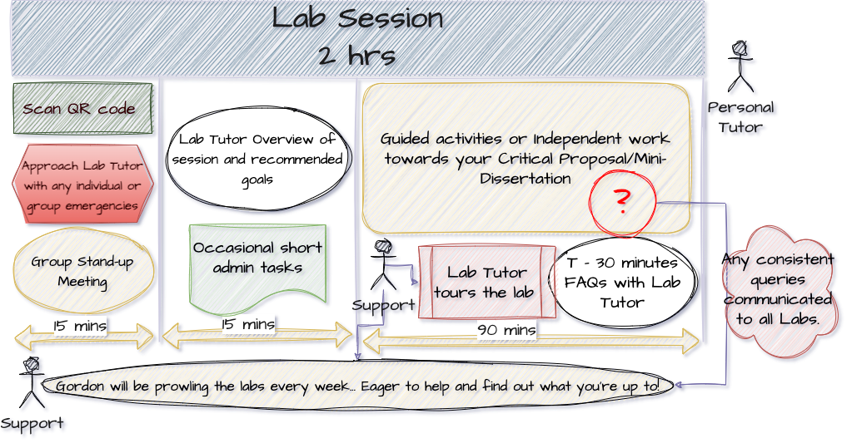
Labs
Lab structure

Slide 14
Lab Notebook - find a solution that works for you, but make sure that you have it every week, so a cloud-based system would be best. You will be expected to show notes of your progress to your Lab Tutor
Lots can be achieved in the labs, but independent study and coordinated group work will be required. We will be asking about this aspect of the process regularly.

Slide 15

DangerZone
“You’ll never say hello to you, Until you get it on the red line overload. You’ll never know what you can do, Until you get it up as high as you can go!”
Dangerzone - Loggins, K.
All hail the Kenny!

Slide 16
Highway to the Dangerzone
DangerZone are opportunities to consider aspects of research procedure beyond the level expected for this year, but ‘on the table’ for next year and any future research endeavours.
They are research-based in a loose sense - they will include programming, literature search and management, academic and knowledge management tools, tips and hacks that might (or might not) be of interest or useful.
If the term is going well, they might even be fun. All ideas welcome.

Slide 17
Coursework
The courseworks ALL require critical reflection and meta-cognitive practice. This will be discussed in a number of lectures, but it contributes to effective learning and your integration of the skills and experience of doing this research exercise.

Slide 18
Time management and teamwork
..will both be required.
I ask you to see both as an opportunity to develop these important skills.
You will see we have some ideas to make this more relevant to careers and employability
It is easier to ‘keep up than to catch up’.

Slide 19
Resources
We will be releasing a series of valuable resources to help you through every step of the process
These will have value for your final year dissertation too.
Contribution to and comment on these is welcome and hoped for!
Open Educational Resources will be used extensively, and most core readings are available online via the library.

Slide 20
Before Lab 1, please…
Add an email signature to your college email, including your student number, programme, lab tutor, and personal tutor. It will speed up responses to any emails you send to staff.

Slide 21
Thank you for your time
And have an amazing year!
The Research Methods Team

