Slide 1
Lab 13: Open Materials
Goal: 100% Replicability Dr. Gordon Wright

Slide 2
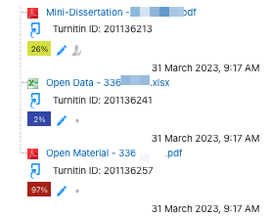
Overview of today’s lab activities
Keep on collecting data
Understand the Submission Requirements for your Mini-Dissertation
Start considering what goes in to your Mini-Dissertation
Data Collection
Please take part in the Study Swap and email Gordon with any new studies coming online
See what a Mini-Dissertation submission looks like
1 - The Mini-Diss itself
2 - Open Data (e.g. Excel)
3 - Open Materials (e.g. pdf)

Slide 3
Review the Mini-Dissertation Writing Guide ch03 - Open Materials
You are able to start assembling the Open Materials (as well as writing your Method section) as soon as you have ethical approval!

