Slide 1
Lecture 15: Chip, QA & Recap
Reading Week next week Dr. Gordon Wright

Slide 2
A number of topics to cover today
With the goal of clearing the decks before Reading Week
Thank you to everyone who contributed so wonderfully on Thursday
Review existing materials available to you for the Mini-Dissertation
Labs tomorrow will be focused on finalising data collection and a data audit
CHIP topics

Slide 3
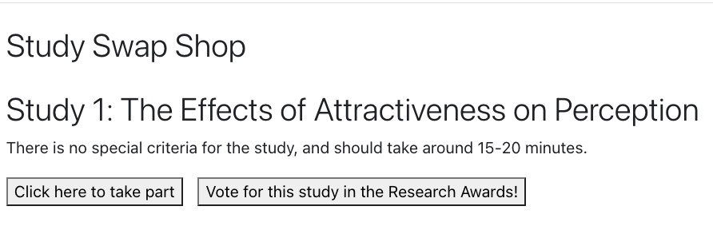
Thank you
I was really pleased to see you all contribute to Thursday and the First Years are all very grateful
. . .
Some of you might have noticed that there was an extra option available to the First Years…

Slide 4
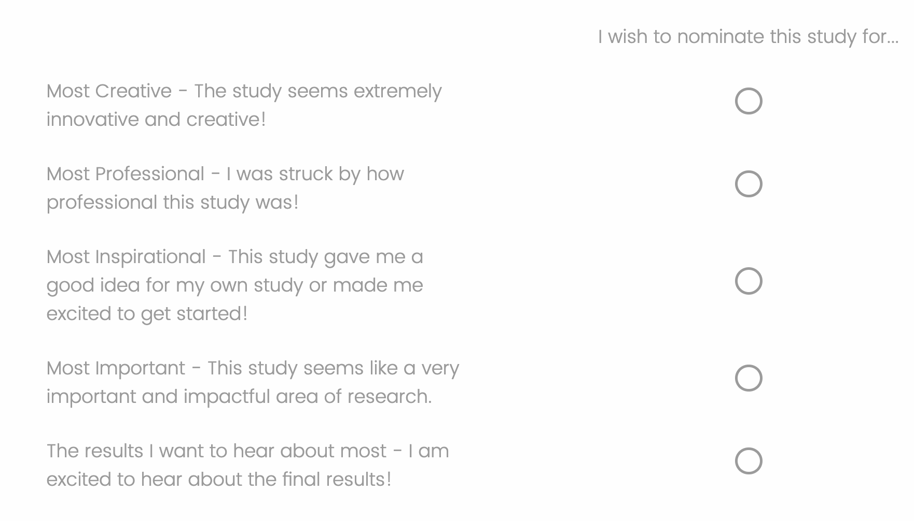
Results will be announced in the last lecture!

Slide 5
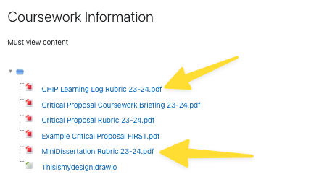
I just want to recap the materials available on the VLE

Slide 6
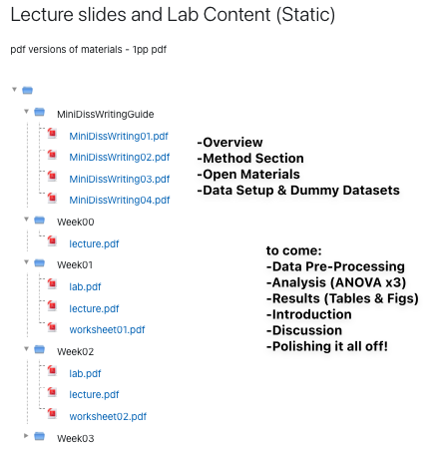
Mini-Dissertation Writing Guides

Slide 7
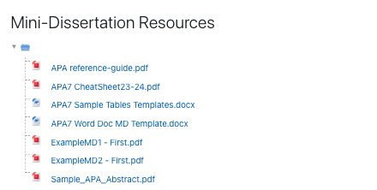
Mini-Dissertation Resources

Slide 8
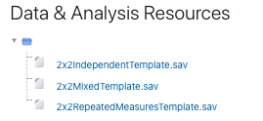
Data Analysis
Remember, PS52005C Design & Analysis is where you are taught ANOVA

Slide 9
Labs tomorrow

Slide 10
I ask for your help
I shall be circulating performing a data sudit
So please turn up if you can
Be ready to give me a status on your data collection efforts and plans for stopping
We will decide if I need to fabricate data for you
Please put a message on Whatsapp

Slide 11
Now let’s quickly discuss CHIP

Slide 12
CHIP Assignment(s)
Coursework piece designed to allow you to engage reflexively with the ‘big picture’ of your degree
Think about how these issues link into psychology as a discipline, and how they relate to your own thoughts about what psychology is or should be
Two ‘reflective accounts’ of max 600 words each (Not including obligatory reference list)
Marks are awarded for reflection, evidence of learning and bring topics together. Please see marking criteria for both accounts.
Not looking for a restatement of the facts in the lectures etc.
They are designed to be personal and reflective – embrace this aspect!

Slide 13
Reflective Account 1
Essay 1 is based on the content of ONE of the topics and should adopt at least two of the following 6 ‘perspectives’.
As a STUDENT of psychology
As a TRAINEE psychologist
In relation to a RESEARCH application in your future
As an HISTORIAN of psychology
Reporting on the culture or PRACTICE of psychology as it currently exists here or across cultures
As a critic or supporter of psychology’s status as a SCIENCE

Slide 14
Reflective Account 1 tips
Ask a specific question – and answer it.
Intro, body, conclusion structure.
Reflect on the topic and give your own opinion as to the answer!
Present a journey in your learning or appreciation of the topic
Ensure your answer is argued using examples
Use evidence in your argument from a range of sources, ideally do some strategic wider reading
Present and reference it well

Slide 15
Reflective Account 2
Essay 2 should focus on at least one of the OTHER topics covered in the course.
This answer should focus on a primary reading and then any further reading you have done (strongly encouraged).
You must identify that primary reading explicitly in the essay itself.
You should not simply restate what the authors thought or found, but rather briefly summarise and build
Think about your perspective on the issues.
What do you think about this debate or issue? We want to know!
And what do you think are interesting directions for psychologists to take this debate or issue in the future?

Slide 16
Reflective Account 2 tips
Explicitly identify a single initial reading and build upon that.
Discuss a debate or issue that you think is interesting or important
Give your own opinion and how this has developed or changed as a result of the lecture, the course more widely, and/or the reading.
Argue your opinion explicitly, own it and back it up with examples
Use evidence in your argument from a range of sources, ideally do some strategic wider reading
Present and reference it well

Slide 17
Overlapping content
You can combine across different topics in Essay 2 (e.g., you could talk about Evolution and Consciousness, or Inclusivity and Science), and thinking about links between topics is strongly encouraged.
However, the material covered in Essay 2 must be different from Essay 1. Students will be penalised for covering identical topics.

Slide 18
Details
Due: Friday, 12 April 2024, 12:00 Noon - about 3 weeks after the end of term
n.b. Mini-Dissertation Due: Friday, 22 March 2024, 12:00 Noon
Both answers should be written in essay-style prose (e.g., with APA references where you refer to sources) put in a single document and submitted to the coursework submission page.
Max 600 words per answer (references not included in word count)
Remember that this only accounts for a smaller portion of the module grade (15%). Should hopefully be an enjoyable way to reflect on issues on the course you found interesting.

Slide 19

Is this a CHIP-able topic?

Slide 20
Any Questions?

