Slide 1
Lab 16: Get Analysing… if you can!
Data Audit and Stopping plans Dr. Gordon Wright

Slide 2
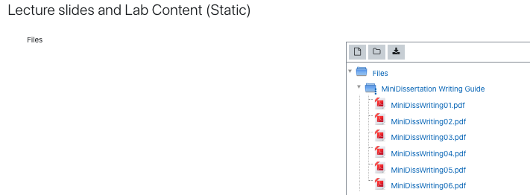
Overview of today’s lab activities
Get Analysing!
Ask for any help you need
Analysis Resources

Slide 3
Keep up the good work!

