Slide 1
Lecture 16: Weeks 16 - 20(22)
Dr. Gordon Wright

Slide 2
Nothing too heavy today
The last 5 weeks are very reactive to your progress through the MD & CHIP log
Plenty of time available to answer questions, especially the Labs each week.

Slide 3
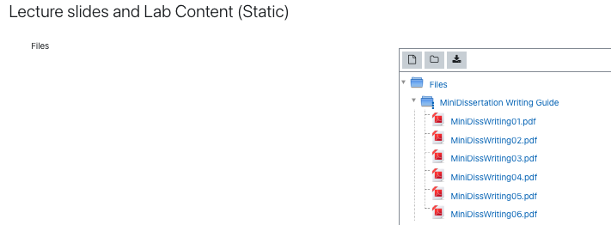
Make sure to use the MiniDiss Writing Guide Resources
#6 is Data Analysis
Remember that all your PS52005C Resources are also available

Slide 4
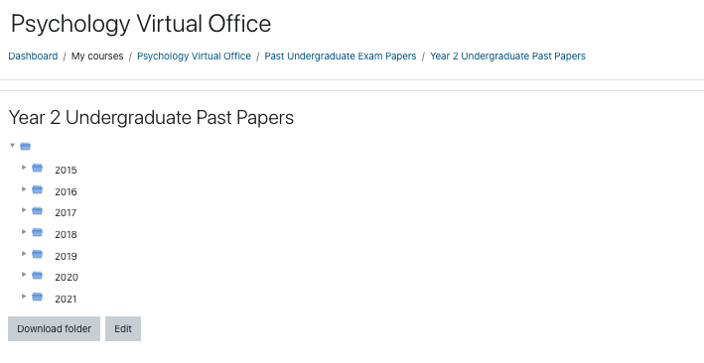
Psychology Virtual Office for Past Exam Papers

Slide 5
FAQ
At this point in the year, it is common for questions to come up.
Please consider asking these questions on the Forum, for the benefit of others.

Slide 6
Any questions now?

