Slide 1
Lecture 07: Psychometrics
Scale Reliability and Validity Dr. Gordon Wright

Slide 2
This week
Social Psychology submission due
2 parts to the lab > Ethics II - the Goldsmiths Portal > Reliability and Validity recap materials

Slide 3
Any Questions?

Slide 4
Key topics today

Slide 5
How do we measure or assess psychological concepts and constructs?

Slide 6
Psychometrics; the science of psychological assessment.
General reader: Breakwell, Smith & Wright (2012) – Chapter 7 (available via reading list free online)

Slide 7
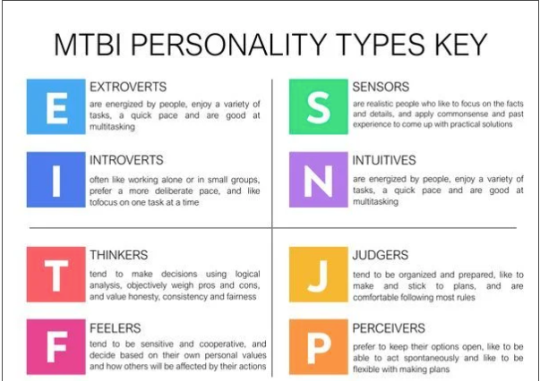
What Myers-Briggs type are you?

Slide 8
Myers-Briggs…
– Based on Jung’s non-scientific ideas about personality
– The four dimensions are binary. But most characteristics are normally distributed
– Very poor test-retest reliability.
– Almost no research support.
– Company behind the test CPP makes $20 million a year from it. Has little incentive to start from scratch!
https://www.vox.com/2014/7/15/5881947/myersbriggs-personality-test-meaningless

Slide 9
What is psychometrics?
– Meaning from Greek origin: ‘measuring the soul’
– Psychometrics is the field of study concerned with the theory and technique of psychological measurement, which includes the measurement of knowledge, abilities, attitudes, and personality traits
– Refers to all areas of psychology concerned with psychological measurement (methods of testing and substantive findings)
– Two major research tasks:
– (i) the construction of instruments and procedures for measurement;
– (ii) the development and refinement of theoretical approaches to measurement

Slide 10
A brief history of psychometrics
– Charles Darwin’s (1809–1882) Origin of the Species impacts scientific thinking in 19 th century
– Evolution (anthropology) combined with quantification (allure of numbers)
– Francis Galton (1822–1911) builds on cousin Darwin’s ideas with measurement and statistics

Slide 11
A brief history of psychometrics
– Galton developed the theory underpinning correlation and regression
– Used this theory to try to explain the heritability of human ability and achievement (amongst many other things)
– Developed a lab and tests for many concepts e.g. prayer, boredom, beauty

Slide 12
What is a psychometric test?
Sample of affect, behaviour, cognition etc
Obtained under standardized conditions
Scored using rules that provide allow for comparison of individuals
Ideally, we would like:
Multiple samples
Multiple situations (contexts, several occasions)
Multiple methods

Slide 13
But you can’t always get what you want…
Often, must measure individuals on
One occasion
Timed/ restricted conditions
So must use efficient methods
Many opportunities (multiple choice tests)
Objective scoring (no judgment involved)
Adaptive item selection

Slide 14
Differences between a psychometric test and a general survey
Scientific rationale
Careful item development and test construction
Objective
Standardised
Instructions
Scoring procedure
Reliable
Valid

Slide 15
Clinical uses of psychometric tests
Describe current functioning
Further investigate impressions from less formal evaluation approaches
Identify therapeutic needs
Aid in differential diagnosis of disorder
Monitor treatment over time to monitor success and identify new treatment needs
Provide empathetic feedback

Slide 16
Occupational uses of psychometric tests
Initial hiring
Job selection
Team development
Career counseling
Training readiness
Succession planning
Performance assessment
Promotion

Slide 17
Educational uses of psychometric tests
Counseling
School exams
University entrance exams
Course exams
Learning disabilities

Slide 18
Types of psychometric tests
Maximum performance test (can do)
Intelligence tests (basic reasoning ability common to a variety of intellectual tasks)
Attainment tests (mastery tests, e.g., your exams, certification testing)
Typical performance test (will do)
Personality tests (ways of thinking, feeling and behaving)
Careers and interests tests
– Different answer demands: effort versus candid truth
– Context dependent

Slide 19
Examples of maximum performance items (ability)
Odd one out
Tree, Man, Paper, Mouse
Next in sequence
1, 1, 2, 3, 5, 8…

Slide 20
Spatial reasoning
First 3 form a series,
Which comes next A, B or C ?

Slide 21

Stimulus

Slide 22
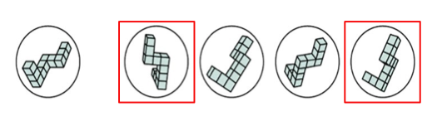
Image rotation task

Slide 23
Examples of typical performance items
Rate on a scale from 1 to 5 how true this is of you
(Costa & McCrae, 1992, Big Five)
Once I find the right way to do something, I stick to it
Dichotomous yes/ no answers
(Eysenck & Eysenck, 1976, Giant 3):
I am the life of a party
Forced choice
(Zuckerman, 1979, Sensation Seeking Scale)
A: I like "wild" uninhibited parties
B: I prefer quiet parties with good conversation

Slide 24
Properties of Psychometric tests
Properties of psychometric tests
Two important properties of psychometric tests
Reliability
–The consistency with which a test measures the construct
Validity
–The degree to which a test actually measures what it claims to measure “accuracy”

Slide 25
Essential properties: Validity
A test is valid if it assesses what it claims to measure
The validity of an assessment strategy is the extent to which the strategy yields a reasonably accurate estimation of the characteristic or phenomenon in question.
Many steps to achieve validity (including concurrent validity, predictive validity, construct validity and face validity)

Slide 26
Essential properties: Reliability
Test retest reliability
– Rule of thumb r between the two test times , 3 months apart > 0.7 (just under 50% agreement)
– Test re-test reliability is not perfect – never reaches 1: beware real changes!
Internal consistency reliability
– Internal consistency is the degree to which all items are measuring the same construct
– Cronbach’s Alpha should be greater than .70 for scales with items > 10

Slide 27
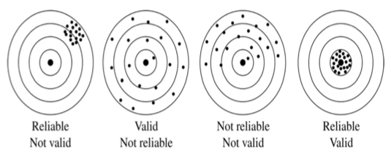
Reliability and Validity
I like to think of them as Consistency and Accuracy

Slide 28
Different types of tests - raters
Behavioral observation (observer-rated)
– People scored according to behaviors observed by a rater
– Used frequently in work and clinical settings (e.g. Performance appraisal)
Self-report
– Subjects indicate their level of agreement or preference concerning statements reflecting attitudes or behaviors
– Response distortion is a problem (e.g. faking a personality test)

Slide 29
Standardizing psychometric test scores
The raw score on many psychometric tests is based on an arbitrary scale
To give the scores meaning, we compare a person’s scores to a meaningful comparison group
Statistical basis: Normal distribution
Most human traits approximate to normal curve
–Largest number of cases cluster in centre
–Area under curve can be closely specified from mean and standard

Slide 30
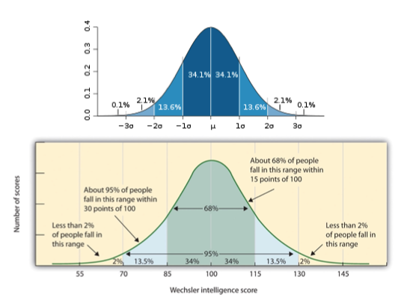
Intelligence

Slide 31
Next week…
We might go about developing our own Psychometric Test.. if you want.

Slide 32
References

