Slide 1
Lab 07 Worksheet
Ethics II and Psychometric Properties

Slide 2
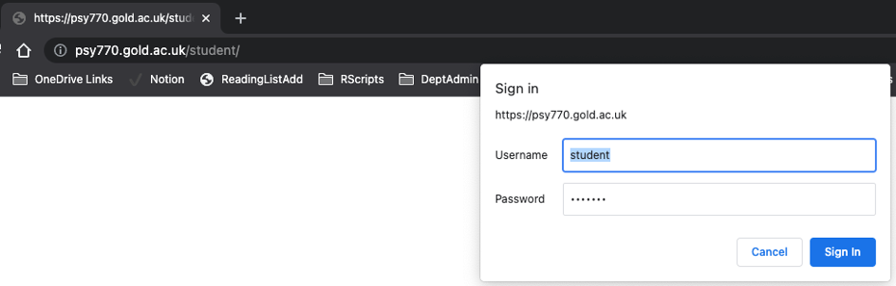
Ethics II & Reliability and Validity
This week has two major areas of focus - a deeper dive on the Ethics Application Portal, including information that will be required, and to recap Psychometric Reliability and Validity.
By the end of the session, you will have:
This week is focussed on the following overarching learning objectives
Be fully prepared to submit a successful Ethics Application
Understand and be able to critically assess the strengths and limitations of psychological measures in terms of their reliability and validity.
Two main parts of the lab this week
Activities for this week
☐ Ethics Portal information deep dive
☐ Psychometric Reliability and Validity
Ethics II
Familiarise yourself with the important Ethics resources available on the VLE. These include general Research guidelines, but some specific to online research too (should you plan to work online only).
Successfully logging in to the Research Ethics portal and reviewing all the information you will be required to submit in support of your ethics application. By being aware of this, you can offset any problems.
Please pay close attention to detail
Any errors will result in an application being returned and a resubmission will be required.
The Ethics Committee VLE page. https://learn.gold.ac.uk/course/view.php?id=17220
Resources on the Research Methods VLE page https://learn.gold.ac.uk/mod/page/view.php?id=1410090
British Psychological Society Code of Human Research Ethics
This document outlines the general principles of ethical research with human participants.
British Psychological Society Ethics guidelines for internet mediated research (Online Research)
This document details requirements for online testing
General Data Protection Regulation - GDPR - What is ‘personal data’
GDPR is legislation which protects participant data and must be adhered to at all times. If you propose to collect ‘personal data’ (see link for definition) it brings with it the responsibility to treat it with the utmost integrity and security.
Applying for Ethical Approval via the Goldsmiths Ethics Committee
All Undergraduate and Postgraduate student projects (e.g., Y2 UG Mini-Dissertation, Y3 project, MSc project, PhD research) are submitted via the online ethics system.
For the Mini-Dissertation, you need to complete an ethical application for each individual study advertised to participants. If a single study is the combined efforts of multiple students, and collects data for a number of Mini-Dissertations, it only need ethical approval once, but you must list ALL students involved. All students should be familiar with the ethical considerations of their study and have been involved in the process of making the application.
Every individual student must have applied for ethics, or have been named on an ethics application, in order to pass the module.
ACCESSING THE SYSTEM
The ethics system can be accessed through the departmental student dashboard: https://psy770.gold.ac.uk/student There are two steps to log in.
When you click on the link a pop-up box will appear, you need to enter the following:
Username: student
Password: goldpsy
You will then be asked to use your normal username and password to access your personal ethics portal:

Slide 3
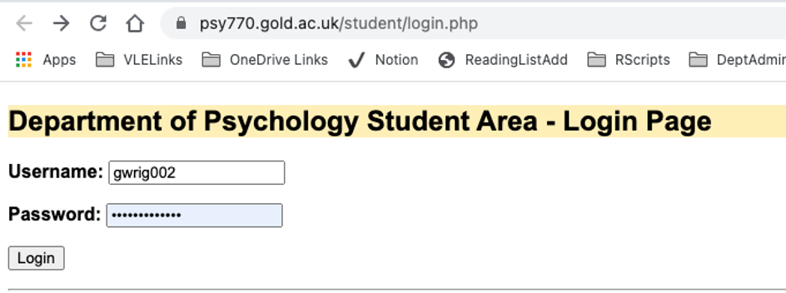

Slide 4
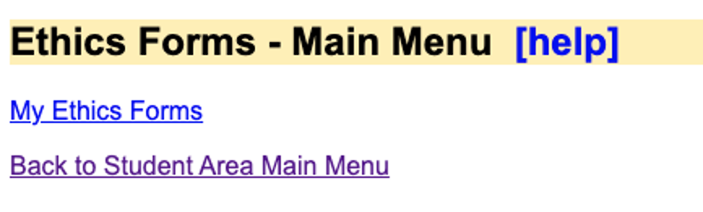

Slide 5
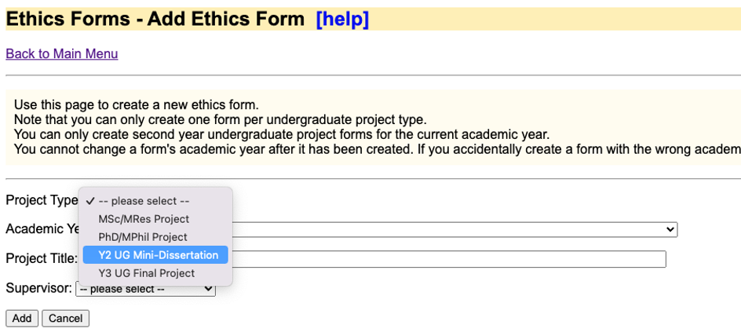

Slide 6
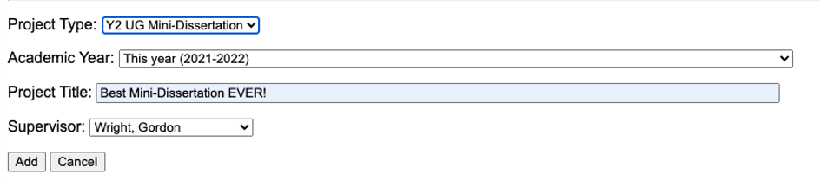
Select the appropriate project type, choose the current year, and give the application a meaningful name (unlike Best Mini-Dissertation EVER!). Consider something along the lines of ‘The effect of personality and chronotype on Imposter Syndrome in higher education’. Informative and clear.
Your ‘Supervisor’ will be your Lab Tutor.

Slide 7
Once you have done this, your application will be available to edit, view, upload supporting documents, view comments, view messages from the committee or your supervisor, or delete (if necessary).

Slide 8
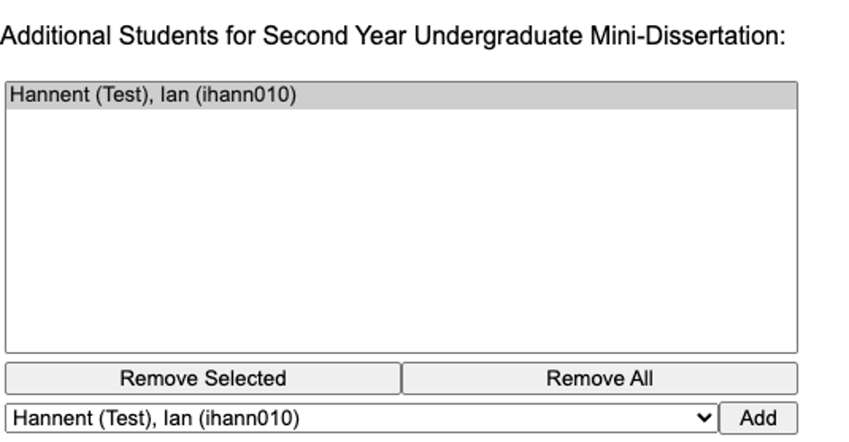
Click edit to start completing the form. The first item you will see is ‘co-applicants’. It is normal that a single student may take the lead on drafting the ethics application, but all students who will obtain data from the task must be listed. Please make sure that this is complete. In order to pass the module, all students must be listed in a successful ethics application.
I have added Ian Hannent (our Department Systems Engineer) as my co-applicant. Do this for all the students for whom the proposed study will provide data, and only those students. You can find a list of current students in the dropdown box.
Please contact your lab tutor if your name does not appear on the list!

Slide 9
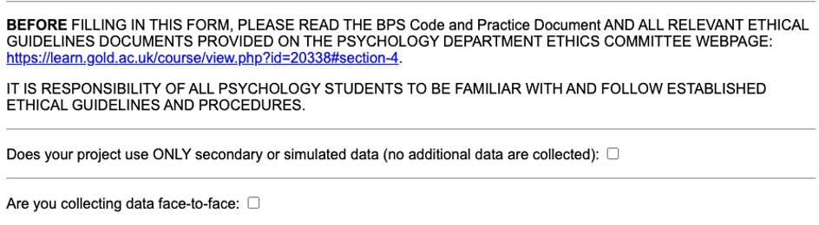

Slide 10
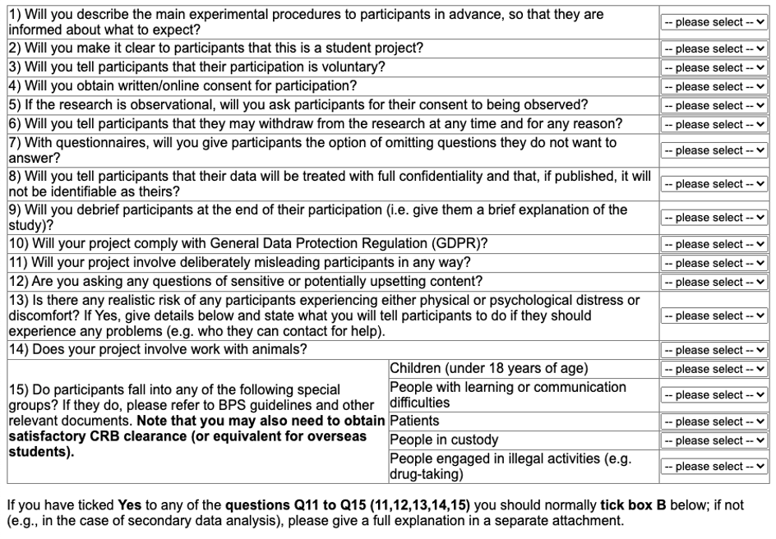
You are then presented with 15 questions to which you must respond Yes, No or Not Applicable (N/A). Please read these carefully and respond correctly.
By responding Yes to any questions beyond question 11 will usually require you to complete a ’Box B’ application, meaning that extra information will be required to ensure full compliance and safety. YOU SHOULD NOT MAKE A CATEGORY B APPLICATION. If you feel that you need to answer YES to any question after 11… Reconsider.

Slide 11
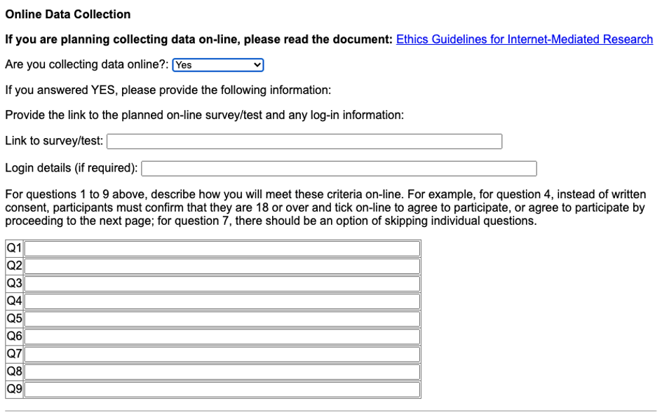
It is common that you may conceal a little about the study in the information sheet in order to avoid contaminating results. This is misleading a participant, in that it is NOT fully informed consent. This can however be offset by giving a very clear debrief and telling the participant what you did and why in that debrief. I believe this is one of the more common queries. In second place is a query as to what constitutes distress or discomfort.
If the topic of your research raises a topic or concept that may in any way be upsetting or worrying to a participant, address this very clearly in the debrief. I do work on deception and psychopathy, and either of those topics could be upsetting to an individual who has been victim to deceit, or who hears about psychopaths for the first time. I would always give a very clear source of further information AND support that participants can follow up if they need. I believe this is just good practice.
When the Online Data Collection box is selected, you will see the following questions.
As noted in the lab slides, you have to submit a link to a COMPLETE, published version of your task for review if you plan to collect data solely online.
For questions 1 – 9 you must give a short answer as to how these objectives will be achieved.

Slide 12
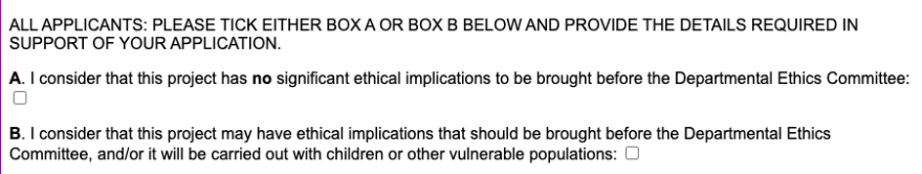
Select A if you consider your application without any ethical concerns - For the purposes of your Mini-Dissertation, you are required to submit a category A application. As noted above. If you feel you are entering Category B territory - think again.

Slide 13
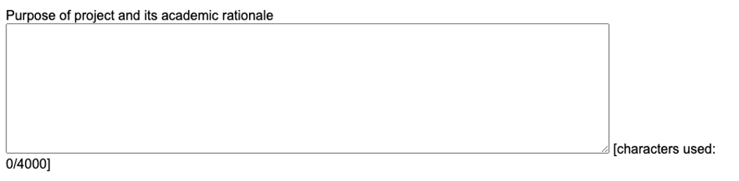
Provide short, but detailed responses to the questions below. These are not ‘marked’ but failure to give complete information will result in a request for resubmission.
What you are trying to find out and the justification for asking the question. An ethical research project has a worthwhile and meaningful objective.

Slide 14
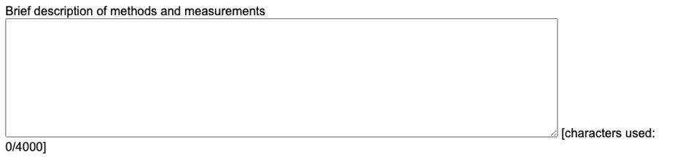
Give an overview of the various parts of your study, perhaps in order to help the reviewer, with details of the measures involved. If you are using a standardised questionnaire, say so WITH REFERENCE. If you have created questions yourself, say so.

Slide 15
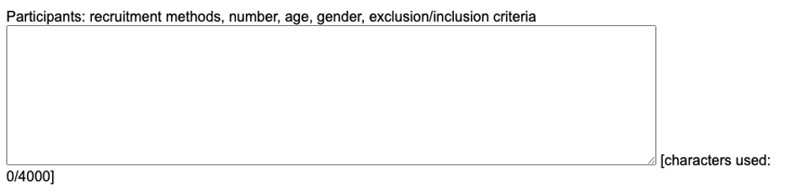
Insert a short summary of your power calculation and estimated sample size. Give specific details of how you propose to advertise the study and where and any pre-requisites around demographics or exclusion/inclusion criteria. Please be specific. If you wish to advertise your study on social media please specify the types of channels or audiences being targeted in case it may be problematic. For example, recruiting participants of a particular characteristic by entering an online community uninvited may be upsetting to its members. Consider any potentially damaging effects for would-be participants, even from just an invitation to participate in research.

Slide 16
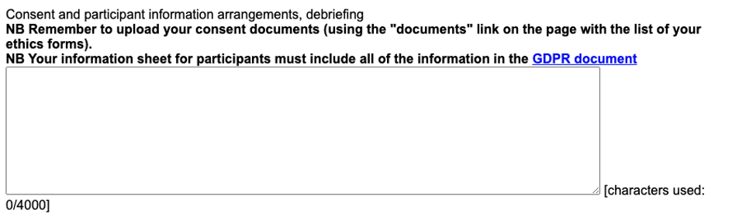
Please reiterate here the process of informed consent, debriefing and any use of identifying information (such as email addresses or identifiers).

Slide 17
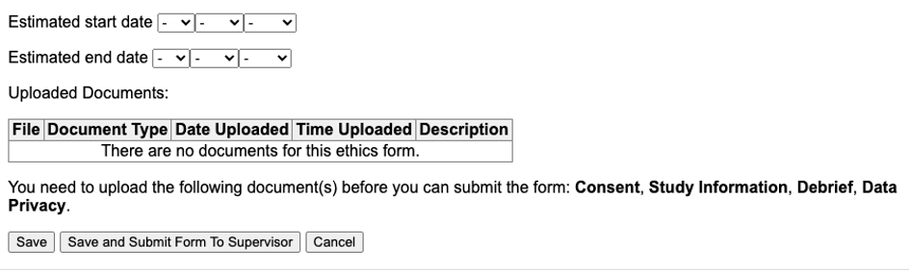
Include the dates as relevant and upload copies of the Information Sheet, Informed Consent questions, GDPR and debrief. This should be IDENTICAL to the information in your online task (if you use one), so copy it from there into separate word documents. This will be stored on file.

Slide 18
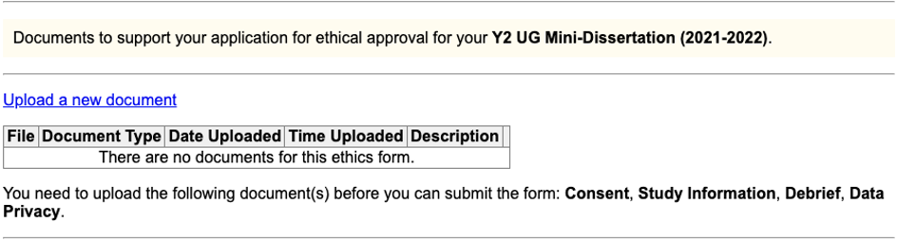

Slide 19
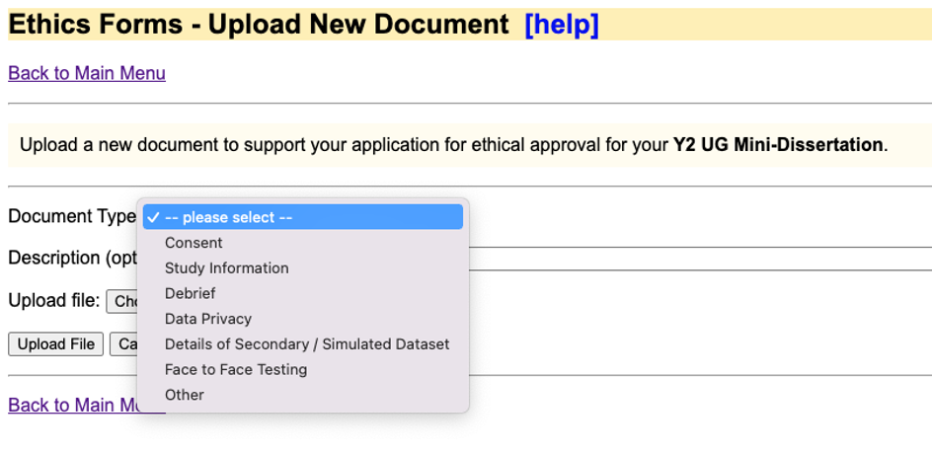

Slide 20
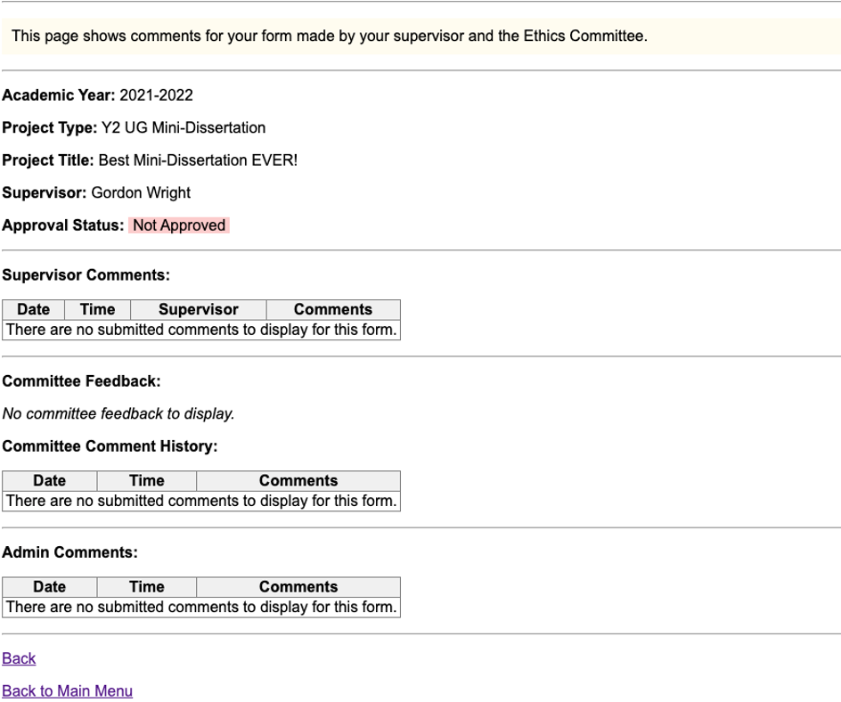
You can save the form at any time and come back to it. Once you have completed all the questions and uploaded the documents, you will be able to submit the form using the Submit button at the bottom of the form.
WHAT HAPPENS NEXT
Once submitted the form goes to your supervisor (lab Tutor) to review, and the status changes to ‘With Supervisor’.
You will not be able to edit the form at this stage. Your supervisor will then review the form, and will send you a message through this system if any changes are needed. It is important that all messages about this form are sent through the system, to avoid confusion.
If the supervisor has requested changes they will send the form back to you, the status changes to ‘With Student’ and you will be able to edit and then submit again.
Once the supervisor has approved the form, the status will change to ‘Being Processed by Ethics Committee’.
Any amendments will be requested by the Committee through this system, and the form will be returned to you for amendment.
Once approval has been granted an automatic email will be sent to you. There is nothing we can do to hurry applications. Turnaround is anticipated to be 1 week, but obviously, if everyone submits on the same day, this is impossible. If you have been waiting for more than 2 weeks, please alert your lab tutor.

Slide 21
A recap on Reliability and Validity
This is some wider reading - not an activity per se
Any Research Methods textbook will cover these 4 validites and 4 reliabilities (and more) in excruciating detail, but below are some general thoughts to help you think about this important topic
Remember - your mini-dissertation doesn’t need to incorporate all of these, but you should be thinking carefully about ensuring quality along these dimensions in your Final Year Dissertation.
More targetted critical evaluation
Assessment tools can exhibit various types of validity, each vital in distinct research contexts - try to establish which is important in your particular research domain. Below are four terms commonly used in quantitative research which, in my opinion, are also highly applicable to numerous qualitative research methodologies (although likely not referred to using the same terms):

Slide 22
Types of Validity in Research Assessment
Face Validity
Face validity refers to the degree to which an assessment method appears to be effective in measuring a specific characteristic at first glance. This form of validity is useful for gaining participant cooperation in research. However, it relies solely on subjective judgment and is not a reliable standalone indicator of an assessment’s accuracy in measuring the intended characteristic.
Content Validity
Content validity measures how well an assessment tool or procedure captures the entire scope and depth of the characteristic being evaluated. It is particularly relevant when assessing achievements, usually through a set of specific questions or practical tasks. An assessment has high content validity if it adequately represents various aspects of the content area and necessitates behaviors and skills essential to that area.
Criterion Validity
Criterion validity assesses how well the outcomes of a strategy correlate with another related characteristic (the criterion). For instance, a personality test for measuring shyness or extroversion demonstrates criterion validity if it aligns with other measures of sociability. Similarly, a method for gauging a salesperson’s effectiveness should correlate with actual sales made. When the criterion is evaluated later in time, this form of validity is also known as predictive validity.
Construct Validity
Construct validity pertains to the extent to which an assessment strategy provides reliable results for a characteristic that is not directly observable but inferred from behavior or output patterns (known as a construct). Constructs like motivation, creativity, racial prejudice, and happiness cannot be directly observed. Hence, researchers must gather evidence that their methods accurately assess these constructs through behavior observation, questioning, task presentation, or evaluation of created products.

Slide 23
Strategies for Establishing and Enhancing the Validity of Assessment Tools
In research, it’s essential to persuade fellow scholars of the validity of your assessment strategies for your specific objectives. Occasionally, this validation might already be established by prior studies, allowing you to reference their work in your literature review or methods section. However, there are times when you need to independently validate your assessment methods. Below are some methods researchers commonly employ to substantiate the effectiveness of their chosen assessment strategies:
Ensuring Comprehensive Representation: When developing structured assessments, whether paper-and-pencil, computer-based, or performance-based, it’s crucial to ensure that they encompass the entire range and depth of the characteristic under study. This is particularly important when content validity is the main focus. The assessment tool should mirror the entire spectrum and complexity of the domain or characteristic in question. For instance, educational researchers aiming to develop an effective achievement test for a specific content area might start by creating a table of specifications. This table might list the specific topics and behaviors (like factual knowledge, problem-solving skills, critical thinking) indicative of achievement in that area. Each cell in the grid denotes the importance of each topic-behavior combination, guiding the development of questions or tasks in appropriate proportions to each item on the list or catalogue.
Adopting a Multitrait–Multimethod Approach: This might be beyond the scope of the mini-dissertation, but if you propose to examine a concept in depth for your final year dissertation, this approach is potentially merited. It involves assessing two or more traits using multiple methods. It’s the psychometric equivalent of the old advice to measure twice and cut once (maybe?). Simply put, different assessments of a single trait should correlate strongly, while the same method used for different traits should not. For instance, in studying high school students, a researcher might evaluate constructs like academic and social motivation using both self-report questionnaires and teacher observation checklists. Statistical analyses should show high correlations between the different measures of academic motivation and similarly for social motivation. However, measures assessing different traits (e.g., academic versus social motivation) through the same method (e.g., self-report questionnaires) should not demonstrate a high correlation, nor should this be the case with different methods assessing the same trait.
Alignment with a Conceptual Framework: A conceptual framework, or nomological network, is a network of interconnected concepts that potentially explain a studied phenomenon. When your assessment strategy, especially one focused on qualitative data that resists complex statistical analysis, aligns with a specific conceptual framework, it can significantly bolster its relevance and effectiveness.
Pilot Testing: This is particularly relevant to the mini-dissertation! Before fully implementing an assessment strategy, particularly if it’s not a pre-validated instrument, conducting pilot tests with a smaller subset of your target group (people, animals, artifacts, etc.) is crucial. This preliminary testing allows you to identify and rectify any glaring or potential issues in your strategy, enhancing its effectiveness and reliability.
Expert Panel Review: Sometimes referred to as the Delphi Method - Involving a panel of experts to review and critique your assessment tool or strategy is a practice even seasoned researchers adopt. These experts, knowledgeable in the relevant field, for example Clinicians in the case of a clinical application or construct, provide valuable insights into the validity of the assessment for measuring a specific characteristic. They can also suggest improvements, such as additional criteria for checklists or alternative questions and phrasings for interviews or questionnaires. This step ensures that your assessment strategy is thoroughly vetted and optimized for accuracy and relevance.

Slide 24
Forms of Reliability in Assessment Strategies
Reliability in assessment strategies manifests in various forms, each relevant to different types of assessments. Here are four commonly used forms of Reliability:
Interrater Reliability: This is the degree to which multiple evaluators agree in their judgments when assessing the same product or performance.
Test–Retest Reliability: This measures the consistency of results from a single assessment tool when applied to the same individuals over a short period.
Equivalent-Forms Reliability: This refers to the consistency in results when two different versions of the same assessment tool (like two forms of a test) are used. Some people like to try Split-half reliability, where you simply see if both halves of a measure are equally accurate - or rather, give similar results.
Internal Consistency Reliability: This looks at how consistently different items or tasks within a single assessment method yield similar results.
Important Points About Reliability
Reliability as a Prerequisite for Validity: An assessment strategy can only be valid if it is also reliable. Accurate assessment depends on consistent measurement, meaning enhancing reliability can potentially increase validity.
Reliability Does Not Guarantee Accuracy: While necessary, reliability alone doesn’t ensure the accuracy of an assessment. For example, consistently measuring head circumference as an indicator of intelligence might be reliable but lacks validity since head size doesn’t reflect intelligence.
Determining Reliability Mathematically
To determine reliability, numerical data is essential. For instance, in observational research, the agreement percentage between two assistants categorizing data can indicate reliability. A 95% agreement suggests high reliability, while a 50% rate is concerning. In certain quantitative research, more complex statistical analyses are used, involving correlation coefficients to measure the degree of similarity in assessment results. You might use this if your mini-dissertation involved behavioural coding or observation techniques.
Enhancing Reliability (and Indirectly Validity)
Defining Clear Criteria: Especially in assessments requiring subjective judgment, defining specific criteria for categorizing or rating is crucial. Concrete, illustrative examples can clarify categories, such as different types of aggression in behavioral studies. This might take the form of a code-book.
Standardization in Structured Instruments: Consistency in content, format, and evaluation criteria is key. However, adjustments may be needed for participants with disabilities to ensure validity.
Rater Training for Consistency: When subjective judgments are involved, training raters to apply criteria uniformly enhances both reliability and validity. Revisions to the strategy for greater rater consistency might also be necessary as part of the piloting programme.
Remember, this is all aiming to deliver the most accurate, and high-resolution data possible. I think it is intuitive to see this in action - a natural drive for precision, but this applies to online tools also. Please pilot. Please verify your data are in a proper format when you export it, or prepare to analyse it. Mistakes are not a problem this year (within reason), but will be upsetting next year!

