Slide 1
Lab 00: No lab in Welcome Week
But just a big HELLO! Dr. Gordon Wright

Slide 2
This is not the Lab you are looking for.

Slide 3
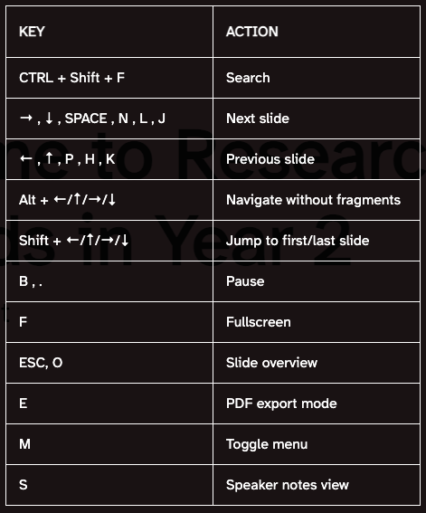
Tips on RevealJS Slideshows (like this)
These slides are created in Quarto, an academic publishing system built by the makers of R (Posit). We will talk about R, RStudio and Python a little bit this year.
Note
Slides, worksheets and the Website for the Module are all written using this system.
It automatically creates pdf, pptx, docs, html (and more) versions of the material, and is accessible and can combine complex calculations and written work, whether journal articles, presentations, or websites. You will see lots of this in action this year, but it is the new gold-standard for scientific publishing and teaching material production, and I have been using it for the last couple of years.
If you wonder how to work the slideshows that appear in the VLE like this yourself, here is a cheatsheet. You can navigate with the Arrow keys, and you can get an overview or go fullscreen with O and F respectively. Give it a shot if you are viewing this embedded in the VLE, or choose the RevealJS format in the right hand menu if you are on the website!
I shall be using these exact materials in the lectures and labs, so please feel free to ask any questions, or to ask for any changes.

Slide 4
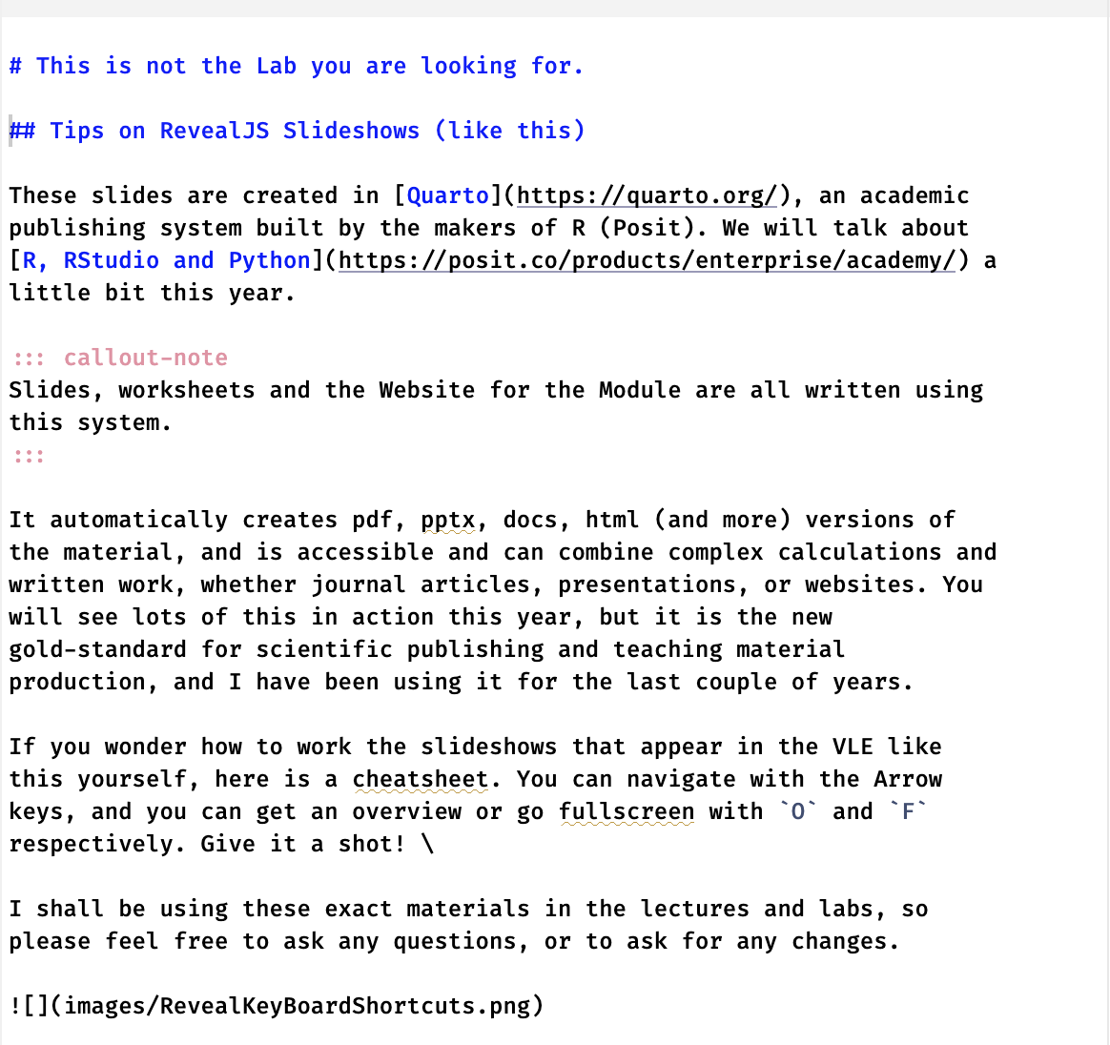
Accessibility is important
Because this system uses markdown (text files) as input, rather than proprietary software formats like PowerPoint, it can be translated and transferred very easily.
The first couple of slides looked like this when I wrote them, and I can update them on my phone if I want and publish them to the website automatically in all formats.

Slide 5
The font I am using
The font I am using is called “Atkinson Hyperlegible” and was developed by the Braille Institute in 2022 to make materials more easily viewed by anyone with impaired vision, dyslexia, or with screen-readers. Have a look here Atkinson Hyperlegible

Slide 6
Colours
I am colour blind and so I have used an app to assess the contrast for all colours used on the site and the materials I produce. I have chosen Viva Magenta as the hero colour for the Lecture Slides and the Website - it was Pantone Colour of the year in 2023. The Lab slides use Veri Peri (Colour of the year 2022).

Slide 7
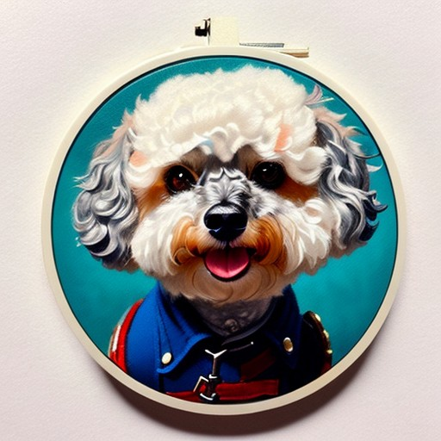
Apologies for pictures of Dougal
Once we get up and running with the year, I shall bring Dougal (my dog) in to visit, assuming nobody objects. He’s a good boy and I can’t resist sharing a couple of AI generated pictures of him.
Sir Dougal

Slide 8

SpaceCatDougal!

Slide 9

Dougal with a laser gun!

Slide 10
References

