Slide 1
Lecture 04: Finding your Psychology
MeSearch or Research? Dr. Gordon Wright

Slide 2
Key topics today
The week ahead (week 4)
Personal Tutor Meeting about Mini-Dissertations - ooops
Critical Proposal due next week (week 5)
Design & Analysis Quiz due next week (week 5)
Research as a human enterprise
Lab preview - Keep pressing on with Critical Proposal (due week 5)
Try to nail down your variables and your design ON THE PAGE!

Slide 3
Personal Tutor Meeting Week 4
This week (week 4) your PT session is all about your Mini-Dissertation
Tip
Please familiarise yourself with well-being services available in college
https://www.gold.ac.uk/students/wellbeing/wellbeing-service/

Slide 4
Any Questions?

Slide 5
Let your freak flag fly! {.background “red”}

Slide 6
Whaaa?
You can have a sepremely individual ‘take’ on Psychology?
The Psychology you need or want for the future?
A career path with hundreds of different routes?
or is it more personal than that?

Slide 7
Do you need a ‘passion’ in Psychology?
We (staff) talk about this sometimes.
Is it critical that you find a topic of interest to you?
Does it help? Does it hinder?
Is it possible to be a Psychologist without a personal stake?

Slide 8
It’s not all about what you do. I want you to think about HOW you do it.

Slide 9

Around us a crisis is unfolding

Slide 10

Psychology is grossly misunderstood

Slide 11
Next week
The Replication Crisis and our ongoing response - Open Science
The practice of Psychology we encourage in you!

Slide 12

Research & me-search

Slide 13
(altenmuller2021?)

Slide 14
Reflexivity
Reflexivity and the psychologist
Reflexivity generally refers to the examination of one’s own beliefs, judgments and practices during the research process and how these may have influenced the research.
An integral part of the Qualitative ‘tradition’
(morawski2005?)

Slide 15
Inclusive Research
Inclusive research is a term that was coined in the early twenty-first century to embrace participatory and emancipatory approaches to research with people with learning/intellectual disabilities (Walmsley, 2001)
Inclusive research embraces participatory and emancipatory approaches to research.
Its characteristics are that it: · Is owned (not necessarily initiated) by lay people · Furthers the interests of lay people, researchers are on their side · Is collaborative · Enables lay people to exercise control over process and outcomes · Produces outputs that are accessible.

Slide 16
context
Research situated within the wider rights movement.
“Nothing about us without us” (Aspis, 2000).
a slogan of the disabled people’s movement, has been applied to research as well as other areas.
“exclusivity not only touches but also contorts and diminishes all aspects of psychological science” (Ledgerwood et al., 2022, p.2).
(ledgerwood2022?)

Slide 17

OSF (Open Science Foundation)
OSF | When Research is Mesearch: How Researchers' Motivation to Pursue a Topic Affects Laypeople's Trust in Science https://osf.io/phfq3/

Slide 18
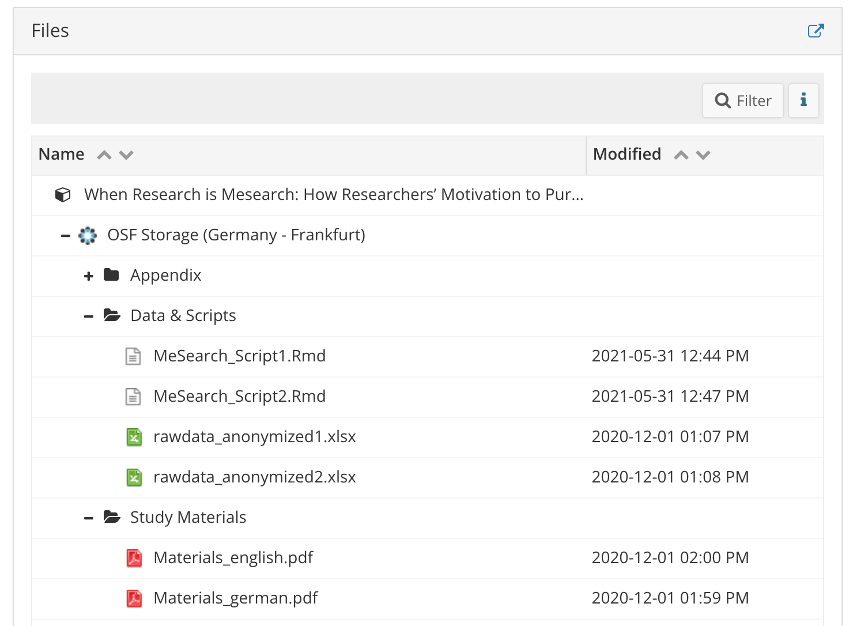
Open Data and Open Materials

Slide 19
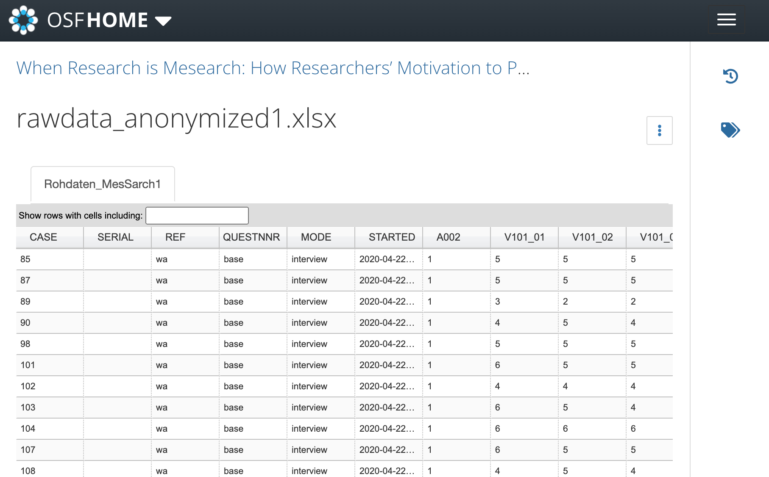
Open Data

Slide 20
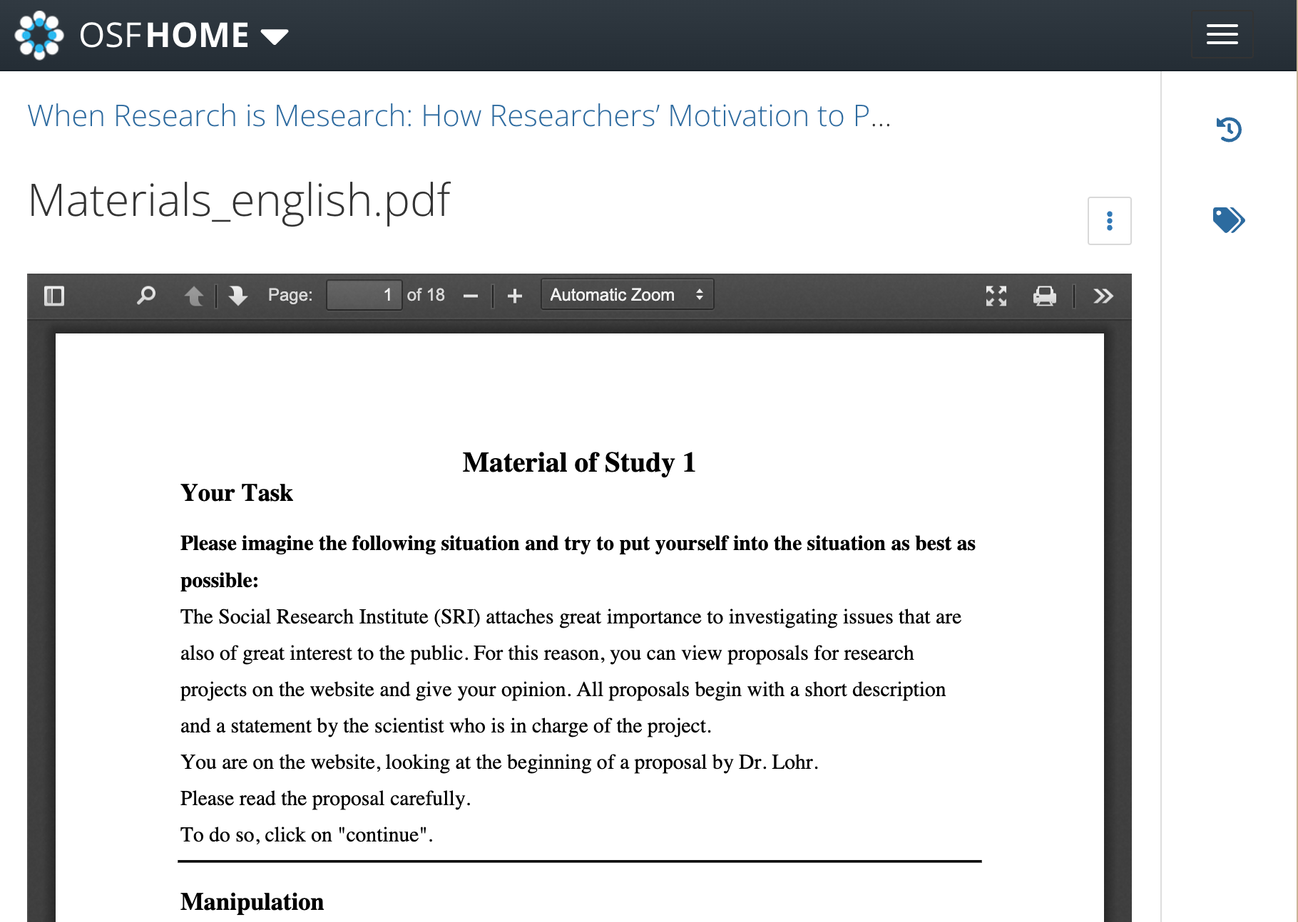
Open Materials

Slide 21

Psyarxiv
(conry-murray2022?)

Slide 22
Questions?

Slide 23
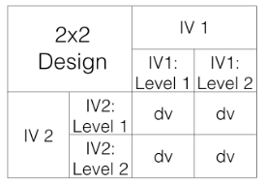
Lab activities
Keep working!
Formalise your individual design

Slide 24
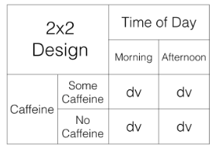
More specific

Slide 25
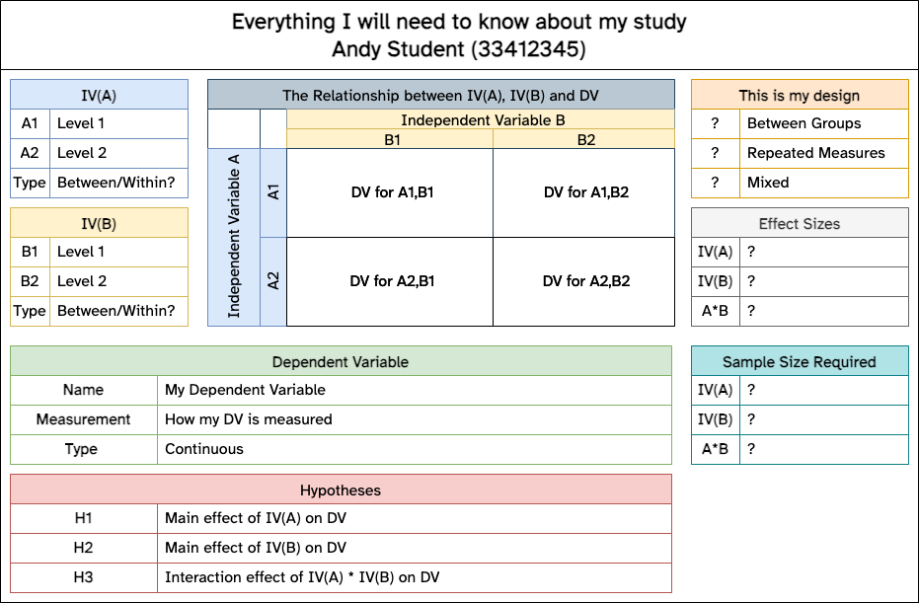
This is my design

Slide 26
Notation
We use a notation system to refer to these designs:
2x2 = Two-way ANOVA. There are two IVS, the first IV has two levels, the second IV has 2 levels. There are a total of 4 conditions, 2x2 = 4.
2x3 = Two-way ANOVA. There are two IVs, the first IV has two levels, the second IV has three levels. There are a total of 6 conditions, 2x3 = 6
4x4 = Two-way ANOVA. There are two IVs, the first IV has 4 levels, the second IV has 4 levels. There are a total of 16 conditions, 4x4=16
2x3x2 = Three-way ANOVA.There are a total of three IVs. The first IV has 2 levels. The second IV has 3 levels. The third IV has 2 levels. There are a total of 12 conditions. 2x3x2 = 12.

Slide 27
Review
Crump, M. J. C., Navarro, D. J., & Suzuki, J. (2019, June 5). Answering Questions with Data (Textbook): Introductory Statistics for Psychology Students. https://doi.org/10.17605/OSF.IO/JZE52
CC BY SA 4.0
https://crumplab.com/statistics/07-ANOVA.html
https://crumplab.com/statistics/10-MixedANOVA.html#x2-designs

Slide 28
3 ‘flavours’ of 2x2 ANOVA
2bx2b - Between-subjects/Factorial ANOVA
2wx2w - Within-subject/Repeated Measures ANOVA
2bx2w or 2wx2b - Mixed ANOVA
You will be using one of these (all supported by SPSS Exercises 1 & 2)
JAMOVI is a reasonable alternative to SPSS (R is even better - much more value as a skill)

Slide 29
The 3 effects possible in a 2x2 ANOVA
Main effect of IV1
Main effect of IV2
Interaction of IV1*IV2

Slide 30
therefore 8 possible ‘outcomes’ of a 2x2 ANOVA
no IV1 main effect, no IV2 main effect, no interaction
IV1 main effect, no IV2 main effect, no interaction
IV1 main effect, no IV2 main effect, interaction
IV1 main effect, IV2 main effect, no interaction
IV1 main effect, IV2 main effect, interaction
no IV1 main effect, IV2 main effect, no interaction
no IV1 main effect, IV2 main effect, interaction
no IV1 main effect, no IV2 main effect, interaction

Slide 31
graph key
1 = there was a main effect for IV1.
~1 = there was not a main effect for IV1
2 = there was a main effect for IV2
~2 = there was not a main effect of IV2
1x2 = there was an interaction
~1x2 = there was not an interaction

Slide 32
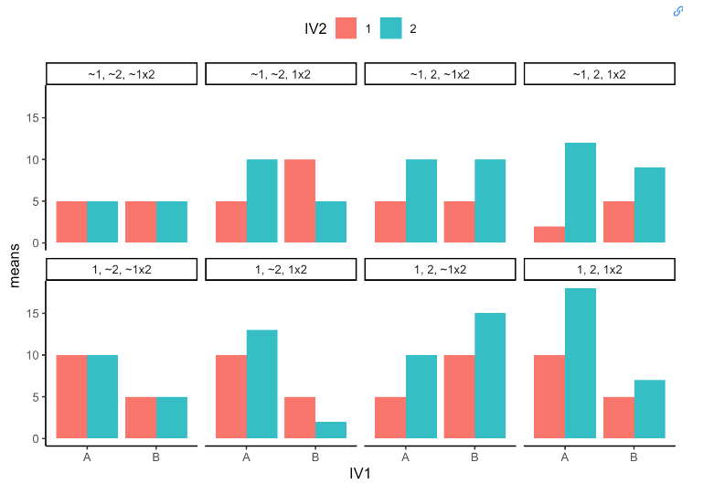
Bar charts

Slide 33
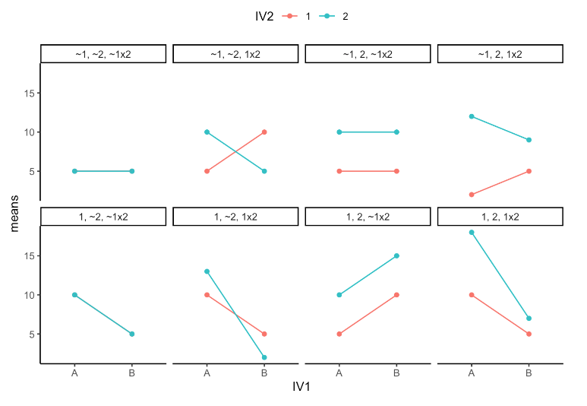
Line plots

Slide 34
References
Walmsley, J. (2001). Normalisation, Emancipatory Research and Inclusive Research in Learning Disability. Disability & Society, 16(2), 187–205. https://doi.org/10.1080/09687590120035807
Walmsley, J. (2001). Normalisation, Emancipatory Research and Inclusive Research in Learning Disability. Disability & Society, 16(2), 187–205. https://doi.org/10.1080/09687590120035807

