Slide 1
Lab 11: Data Collection
Welcome back Dr. Gordon Wright

Slide 2
Overview of today’s lab activities
If you wish to use the Study Swap, for sharing your study with the rest of Year 2, please send the relevant information to Gordon
Start recruiting participants or participating. If you have not yet got Ethical Approval, do not worry.
Review the first chapter of the Dissertation Write-up Guide and start planning the rest of term.
Study Swap

Slide 3
Study Swap Shop
Please try to actively recruit for your studies, whether in person or online.
We are happy to host a list of links on the VLE, so that you can take part in studies designed by other groups. This is on an honour-basis. Please take part in as many as you are able.
If you wish your study to be listed send the following information to Gordon.
Study Swap example
Send a short informative title, the anticipated duration of your task, any inclusion or exclusion criteria, and the URL.

Slide 4

Start recruiting (or participating)
The labs (as usual) are flexible working time. Please feel free to ask your colleagues to take part in your study, or take part in studies yourself.
Remember, by seeing what other students did under the same constraints as you will be a useful learning experience. If you have any questions or queries, or if you feel that there are elements you wish to know more about, contact the researcher.
Maybe think about collecting any good ideas, or nice debriefs etc. Why start from scratch next year?
Mini-Dissertation Write-up Guide
Over the next 10 weeks, a comprehensive set of guidelines will be provided, focusing on APA7 format, report writing, data export, prep and analysis, as well as curation of Open Materials and Open Data.
It’s never too early to start writing.

Slide 5
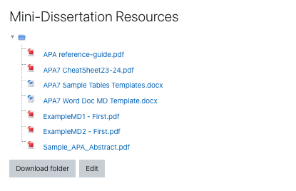
Existing resources on the VLE

Slide 6
If you don’t know what to do today, why not open up the word doc template and save it to your OneDrive. It’s never too early to start writing.

