Slide 1
Welcome to Research Methods in Year 2
Dr. Gordon Wright

Slide 2
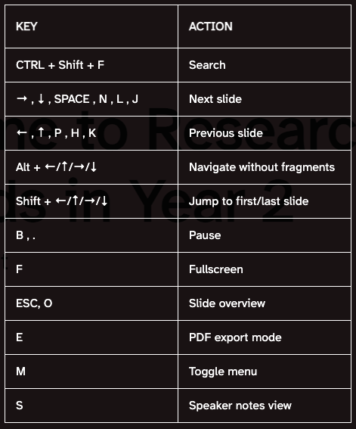
Title of Lecture

Slide 3
subtitle of lecture
text
Slide 2
test
Slide three
testings

Slide 4
PART 1 With code
2 column layout - source

Slide 5
original stuff
Stuff

Slide 6
2 column layout -visual

Slide 7
initial stuff
more stuff

Slide 8
3 column layout - source
Columns
::: columns ::: {.column width=“30%”} :::
(greenspan?) 2009 model is a cornerstone in gullibility research and even inspired the creation of the only existing gullibility scale (Teunisse et al., 2020). But let’s not mince words: the model lacks empirical backbone, having never been subjected to validity or reliability tests. Greenspan identifies four key players in the drama of gullibility: situation, cognition, personality, and state. Situation is all about the deceiver’s skill in crafting a compelling tale. Cognition tackles the victim’s mental state—think cognitive load or mood. State zeroes in on the victim’s physical and mental readiness to critically engage, while personality zooms in on trust and agreeableness.
3 column layout - source
Columns

Slide 9
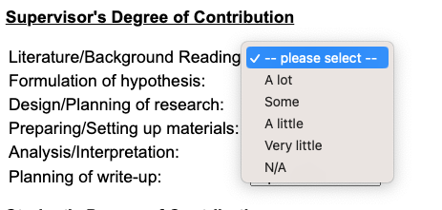
Greenspan’s 2009 model is a cornerstone in gullibility research and even inspired the creation of the only existing gullibility scale (Teunisse et al., 2020).

Slide 10
🗣 Content
This is what will be discussed today.
Always good to explain the agenda so audience can have clear expectations.
Therse are animated bullet points:
📜 Point one
🧫 Point two
🚀 Point three
…You ca
Fragments
Incremental text display and animation with fragments:
Fade in
Slide up while fading in
Slide left while fading in
Fade in then semi out
. . .
Strike
Highlight red
Learn more: Fragments
Learn more: Chalkboard
Slide Backgrounds
Set the background attribute on a slide to change the background color (all CSS color formats are supported).
Different background transitions are available via the background-transition option.
Learn more: Slide Backgrounds
Media Backgrounds
You can also use the following as a slide background:
An image: background-image
A video: background-video
An iframe: background-iframe
Learn more: Media Backgrounds
Absolute Position
Position images or other elements at precise locations
Learn more: Absolute Position
Auto-Animate
Automatically animate matching elements across slides with Auto-Animate.
Learn more: Auto-Animate
Auto-Animate
Automatically animate matching elements across slides with Auto-Animate.
Learn more: Auto-Animate

