Slide 1
Lab 03: Critical Proposal
Targetting your Target Paper Dr. Gordon Wright

Slide 2
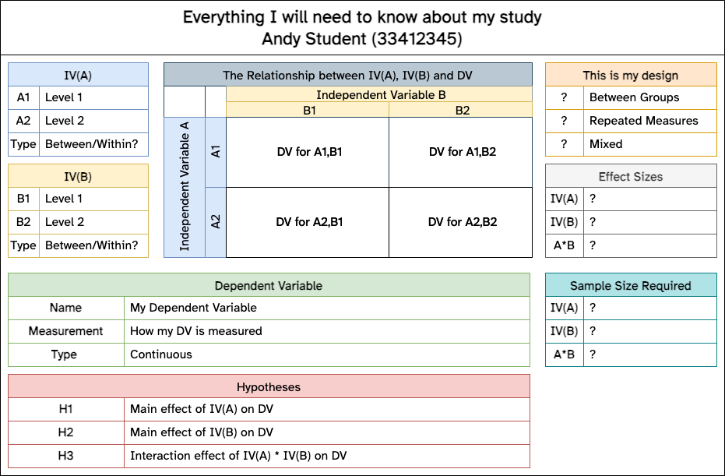
Overview of Lab 03
Note
The objective of today is to immerse yourself in the ‘Research Methods’ of your Critical Proposal Target Paper
This may seem like an ‘academic’ exercise now.. but it is not!
Reading
• Being able to read a single paper carefully and critically is an important skill
• Being able to synthesise multiple papers and appreciate similarities and differences is crucial
• Building on this effort to identify ‘gaps’ or ways to build on strengths
Today
Note
Think more carefully about each of the following aspects and jot down some ideas for your Critical Proposal:
1. Design of the study
2. Participants and recruitment
3. Materials
4. Procedure
And you will need to identify an Effect Size (again) - why not highlight it now!
Remember
Tip
You can show your Lab Tutor the paper you propose to use for your Critical Proposal… DO SO!
It needs to be a peer-reviewed empirical paper from the Psychology literature that presents a quantitative study, includes methods (Design, Participants, Materials) and analyses the data. Failure to follow these rules will impact your mark.
Design Schematic
You will be required to complete elements of this diagram and include it in your Critical Proposal. How much of it could you think about completing now? (The template can be downloaded on the VLE in the Coursework Information section, and edited at www.draw.io)

