Slide 1
Lab02
Dr. Gordon Wright

Slide 2
Today’s activities
Complete the Pulse
Finalise your groups (3 or 4 people, all from same Personal Tutorial group)
Submit a list of names to your Lab Tutor
Discuss any problems you are facing
Agree a broad general focus for your group research and write it in your lab notebook
This is now functioning and available in the right hand margin of the VLE page. It’s an experiment, so please give feedback!
Start establishing how you are going to work as a team and identifying milestones

Slide 3
Teamwork & Project Management ideas

Slide 4
Apply “Scrum’ process?
In short, it’s a transparent, accountable, transparent and pragmatic approach to project delivery.

Slide 5
Key Project Milestones

Slide 6
Teamwork & Project Management ideas

Slide 7
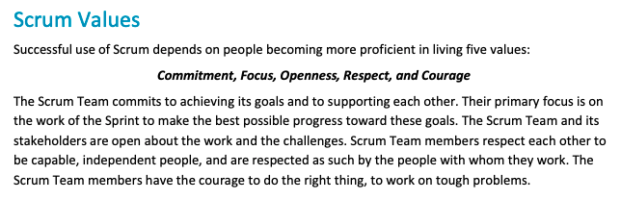
Apply “Scrum’ process?

Slide 8
In short, it’s a transparent, accountable, transparent and pragmatic approach to project delivery.

Slide 9
Scrum-style 'stand-up' meetings at the start of each lab?
3 questions for your short 'stand-up meeting' every week. No more than 10 minutes.
Can be done face to face or easily online in advance or with remote colleagues (e.g. via WhatsApp)
What have you done since the last lab session? (Progress)
What will you be doing before the next lab session? (Plan)
Can you identify any obstacles to achieving the plan? (Problems)
If anything arises in point 3… Engage with your Lab Tutor during the session and resolve it!
*"Scrum" is a project management approach used extensively in the tech and media sectors

Slide 10
Key Project Milestones

Slide 11
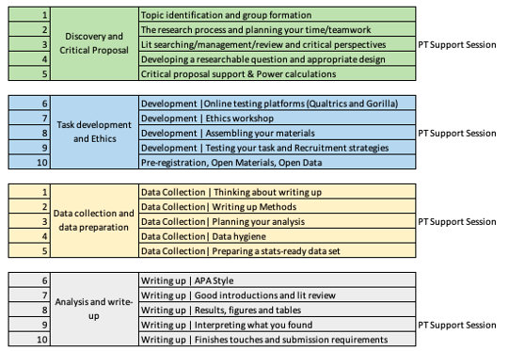
Milestones(4 key phases of activity)

Slide 12
The unmissables
Submission of Critical Proposal by 10am 4th November
Ethics submission prior to end of Term 1
Requires fully developed task and materials inc. Information Sheet, Informed Consent, Debriefing Materials
Lab Tutors must sign off all ethics applications (1 week turnaround) and they could very likely return it to you for changes
Ethical Approval will be 'fast-tracked' but can take 1-2 weeks
Data collection can begin as soon as you have Ethical Approval
Data collection will be halted at Reading Week in Term 2
Mini-Dissertation deadline 10am 31st March 2023

Slide 13
Think about the rest of your coursework
Try to anticipate when you will have busy times in the year and plan ahead
Do you have any personal obligations that will affect your availability?

Slide 14
Think about your average week
When will you do your independent study?
When will you meet as a group?
What will you do if you miss class due to illness?

Slide 15
Your first MD Personal Tutor Session is next week
You will need to present your general topic area, and any thoughts around how you are going to do the research.
Your personal tutor will be able to help you think about the realities of doing the work, but signalling the general area and type of research you want to do is most useful.
How will you do this most effectively?
What visual aids will you use?
Will you identify references?
Will you plan or prepare? You've got 50 minutes for all your groups…

Slide 16
Personal Tutor management
Your Personal Tutor will be a HUGE help this year. Make sure they get the best information possible right at the start.
Do you think it might be a good idea to work as an entire Personal Tutor group and put something together to help your PT manage potential information overload?
A document with group name, topic and team members?
Maybe a shared folder with some illustrative papers?
What about a brief powerpoint with 1 slide per group that your PT can use moving forwards?

Slide 17
Over to you!

