Slide 1
Lab06
Online, Offline Data Collection & Ethics Dr. Gordon Wright

Slide 2
3 key activities today, guided by the slides below:
1) Get yourself a Qualtrics account and follow the instructions to upload a template survey
2) Read the Ethics Information (with a view to understanding what you will be required to do for an application
3) Start to identify the pieces of your study, and start to think about how you propose to deliver them

Slide 3
Activity 1 (5 mins) - Open a Qualtrics Account

Slide 4
Qualtrics
Qualtrics is a survey delivery platform. You will have used it lots as a participant. Time to get on the creative side.
Important
Please go to this link: https://goldpsych.eu.qualtrics.com/ and click on ‘Don’t have an account?’
Please go only to this link: https://goldpsych.eu.qualtrics.com/ and click on ‘Don’t have an account?’
Please use your college email address (jbond007@gold.ac.uk) - NO ACCESS CODE NEEDED
To get the full functionality, you MUST use your college login.

Slide 5
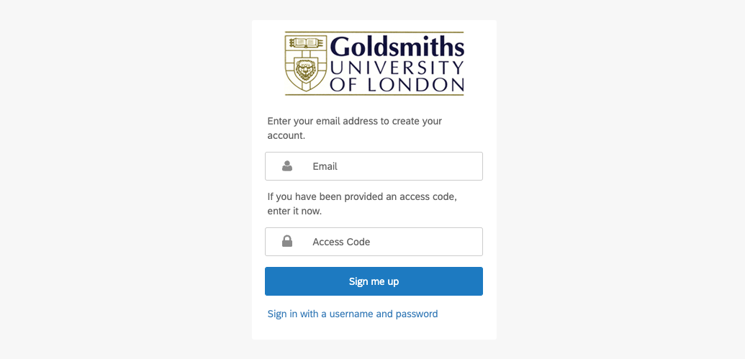
Please make sure it looks like this…

Slide 6
Qualtrics use cases

Slide 7
If you are using questionnaires/surveys only, Qualtrics is for you.
You can present images, video, audio and text. You can ask all sorts of types of questions.
You can randomise blocks and questions within blocks.
It’s also pretty darned easy to get up and running with.

Slide 8
Start a new Qualtrics Project (a new survey)
Start your project with the following instructions though.
Load the Template Survey
Copy the target of this link to your downloads Download .qsf file
It will NOT open on it’s own. You need to open your Qualtrics account and
Create New Project
Click very top option “Survey”
Click “Get started” in the bottom righthand corner
Give your project a groovy but informative name
When asked “How do you want to start your survey?” select “Import a QSF file”
Click “choose file” and upload the template you downloaded above.

Slide 9
Qualtrics support
Qualtrics recently changed layout, so I haven’t had a chance to record a set of tutorials, but the channel listed on the next page is very good.
https://www.youtube.com/channel/UCg4v1FnvUdelgDJl2MckF5w
And the support pages are extensive and the help I use most.
https://www.qualtrics.com/support/survey-platform/survey-module/survey-module-overview/
https://learn.gold.ac.uk/course/view.php?id=24607#section-10

Slide 10
Gorilla Experiment Platform

Slide 11
www.Gorilla.sc
Gorilla is the best way to run experiments where timing is critical to the millisecond level, or if you need to collect participant keypresses or mouse clicks, rather than text-based questions.
You can obtain a free account using your Goldsmiths email account.
You’ve already been given the link to Demos and Classic templates, but here it is again
https://app.gorilla.sc/support/samples
The support videos and support team are excellent.

Slide 12
Activity 2 - Ethics preview (10 mins)

Slide 13
This is the link to the Ethics Committee page.
https://learn.gold.ac.uk/course/view.php?id=20338
All Undergraduate projects apply through the Ethics Application Portal.
Ethics Application page
https://psy770.gold.ac.uk/student
Username: student Password: goldpsy

Slide 14
Detailed guidance on filling in the application
Student Guide to filling in the Ethics Application
https://learn.gold.ac.uk/mod/resource/view.php?id=985014

Slide 15
Ethics Application timings
You can apply at any point from now on. But you should not apply any later than week 9.
Your application goes first to your Lab Tutor for approval, and you should communicate with them, so that they can act on it promptly, but they are able to take up to a week for unexpected applications.
You should expect feedback on your application (approval, request for additional information etc.) within 2 weeks from submission to the Ethics Committee (by your Lab Tutor), but Mini-Dissertations are prioritised and could/should be MUCH quicker (± 1 week).
If your application has ethical considerations (it should NOT), it will need to be reviewed by two Ethics committee members. You will receive approval status and any request for further information ONLY once both committee members reviewed the application.

Slide 16
Face to face studies
If your study is likely going to be face to face, please talk to your Lab Tutor about how to plan for this. It might be that you want to collect questionnaire responses on a laptop, or in advance, so that you don’t have to type in the responses yourself.
For ethics, you need to supply a detailed description of the tools and methods you propose to use, and the paperwork that will be used. This should comprehensively cover the Information/Informed consent procedure, the task, the stimulus used, the procedure, and debrief materials.
All recruitment materials need to be provided too.
You need to use the templates below, all available (with examples) on the Ethics VLE page.

Slide 17
Participation in Y2 MiniDissertation projects
You will be expected to take part in MiniDissertation projects consistently and effortfully. This will be monitored via the SONA system and we will preferentially support students in their data collection efforts who demonstrate a willingness to participate in studies run by others.
It is an opportunity for you to experience the other types of studies your colleagues have created. It could be enough to give you the idea you were looking for for your final year dissertation!

Slide 18
The golden rule
Aim to provide all the necessary information in the Ethics submission to prevent the form being returned for further revision by your Lab Tutor or the Ethics Committee. Each re-submission of the form will take up to 2 weeks to process.
Do it right, do it once. Work together, proof-read and try to implement all the guidance offered.

Slide 19
Planning the next 5 weeks

Slide 20
For the rest of the lab
Please start to work together to determine what you need to do to get to the point where you are confident to submit a complete Ethics application.
For ONLINE studies, you need to have built the data collection tool/task BEFORE you apply for ethics. It is reviewed as part of the application.
You will likely need to find questionnaires, task materials such as Stimulus items. You will need to plan who is going to do what, and by when. Try to make sure everyone is familiar with all aspects of the study… Chances are you will need to write it up!
Document your plan and ask your Lab Tutor for advice. Try to be productive.

