Slide 1
Lecture09
Review of Mini-Dissertation and CHIP Learning Log Dr Gordon Wright

Slide 2
Overview

Slide 3
The week ahead
The week ahead (week 9)
W9 Personal Tutor session ‘Checking in’
Any general concerns or queries
Mini-Dissertation Ethics status
W10 Cognitive Essay Tutorial
Psych Society Pub Quiz on Wednesday 7:30 (SU)
Labs - Ethics, Ethics, Ethics

Slide 4
Reflective Practice

Slide 5
Metacognition
The process of thinking about ones own thinking
. . .
Most usually with reference to ‘learning’

Slide 6
Critical Proposal
. . .
In the most part, the Critical Proposal showed a very high quality of work
. . .
Clear engagement with the process of research.
. . .
Important
You were required to present a ‘critical reflection’
. . .

Slide 7
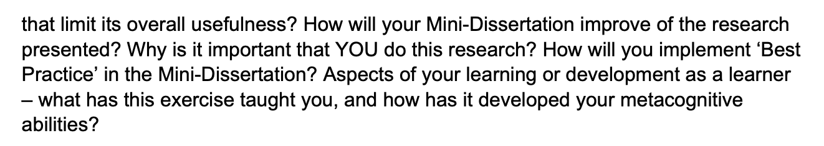
Critical Proposal Briefing

Slide 8
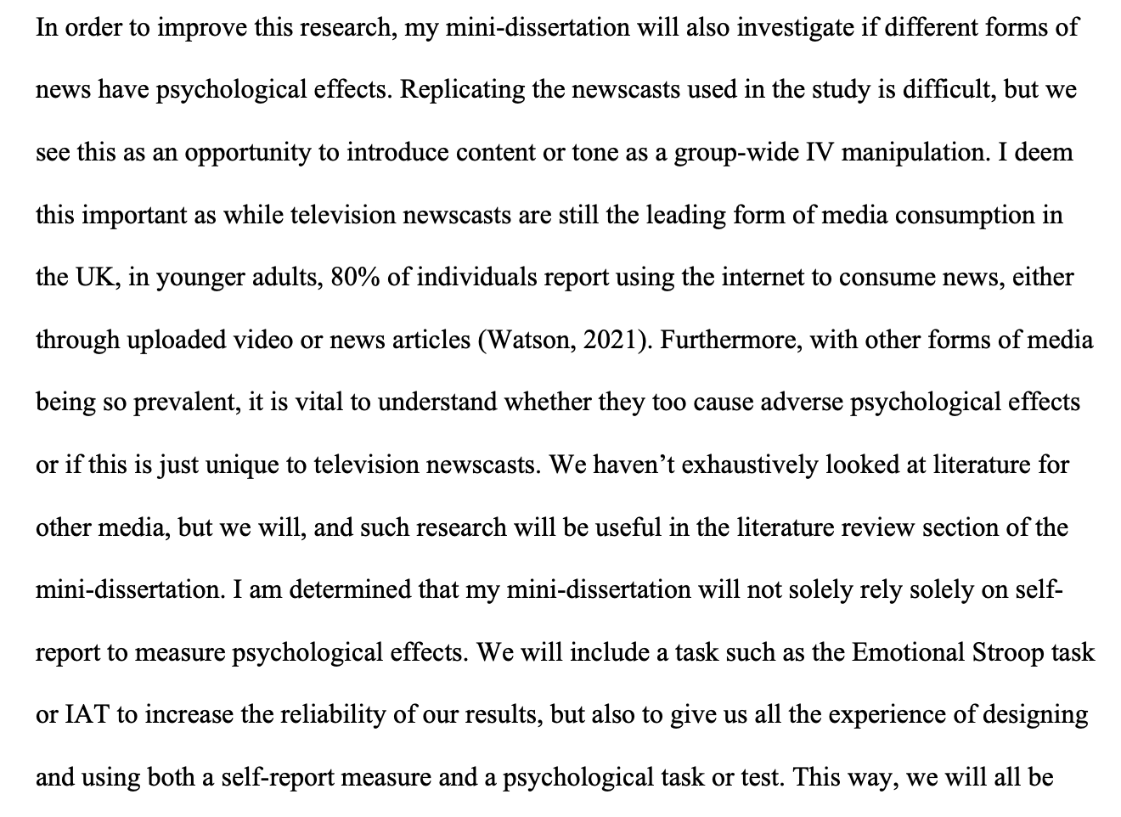
The example given

Slide 9
Mini-Dissertation also requires a ‘Reflective Account’
An integral part of the assignment
Worth valuable marks

Slide 10
While we are on the topic
Your ultimate individually written up Mini-Dissertation project MUST conform to the following definitive rules:
2x2 ANOVA design with 2 categorical IVs (each with 2 levels) and a single continuous DV
You must obtain ethical approval and prove individual involvement in the process of application
You must make a sample size estimation / Power calculation
You must collect real and individually contribute to group and cohort data collection efforts

Slide 11


Slide 12


Slide 13


Slide 14
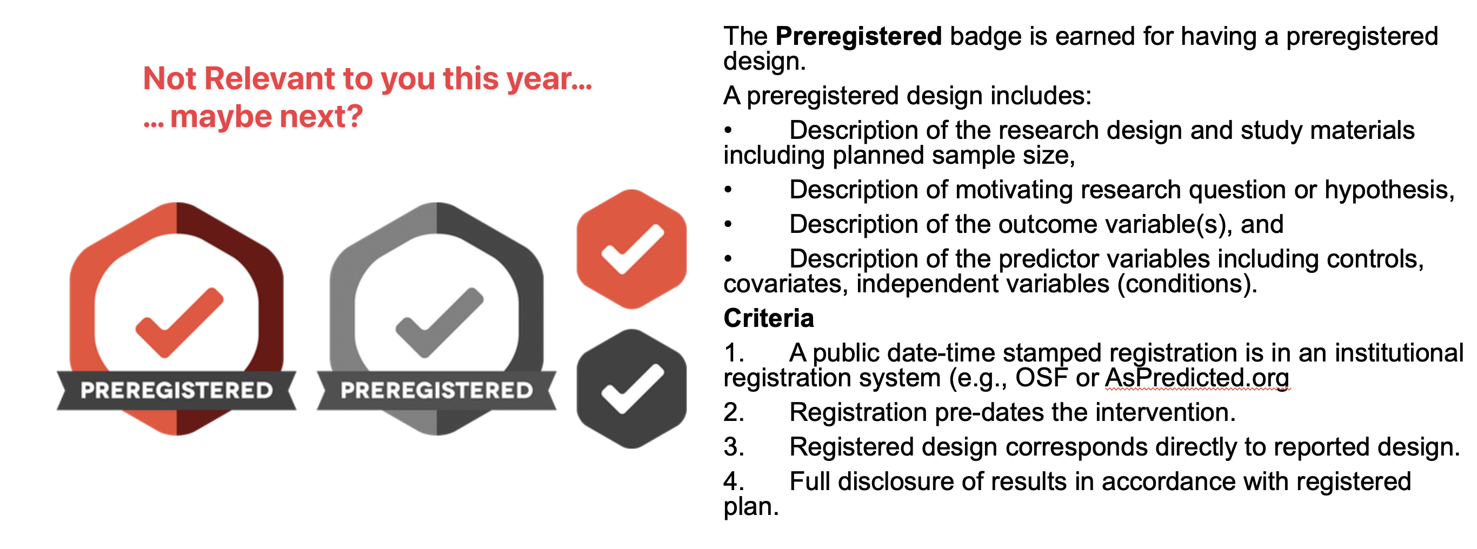

Slide 15
CHIP Learning Log

Slide 16
Designed to introduce you to
Conceptual and Historical Issues in Psychology
Big picture stuff!
The topics of focus this year are:
Science – 2 lectures from Professor Joydeep Bhattacharya
Inclusivity – 2 lectures from Dr Tegan Penton
Evolution – 2 lectures from Professor Alice Gregory
Consciousness – 2 lectures from Professor Joydeep Bhattacharya
All topics that cut across any individual area of psychology

Slide 17
Assignment
Coursework piece designed to allow you to engage reflexively with the ‘big picture’ of your degree
Think about how these issues link into psychology as a discipline, and how they relate to your own thoughts about what psychology is or should be
Two essays of max 700 words each
Marks are awarded for reflection, evidence of learning and bring topics together. Please see marking criteria for both essays.
Not looking for a restatement of the facts in the lectures etc.
They are designed to be personal and reflective – embrace this aspect!

Slide 18
Essay 1
Essay 1 is based on the content of ONE of the FOUR topics and should adopt at least two of the following 6 ‘perspectives’.
a. STU - Your interests or experience as a student of psychology
b. TRN - Your role as a trainee psychologist
c. RES - A planned research project in or after your degree
d. HIS - The history of Psychology and related disciplines;
e. BAK - The cultural background to Psychology;
f. SCI - Assumptions about science and how it relates to psychology

Slide 19
Essay 1 tips
Ask a specific question – and answer it.
Intro, body, conclusion structure.
Reflect on the topic and give your own opinion as to the answer!
Present a journey in your learning or appreciation of the topic
Ensure your answer is argued using examples
Use evidence in your argument from a range of sources, ideally do some strategic wider reading
Present and reference it well

Slide 20
Essay 2
Essay 2 should focus on at least one of the OTHER topics covered in the course.
This answer should focus on a primary reading associated with the lectures and then any further reading you have done (strongly encouraged).
You must identify that primary reading explicitly in the essay itself.
You should not simply restate what the authors thought or found, but rather briefly summarise the point that stimulated your interest in the reading and use that as a springboard to discuss the topic or issue.
Think about your perspective on the issues.
What do you think about this debate or issue? We want to know!
And what do you think are interesting directions for psychologists to take this debate or issue in the future?

Slide 21
Essay 2 tips
Explicitly identify a single initial reading and build upon that.
Discuss a debate or issue that you think is interesting or important
Give your own opinion and how this has developed or changed as a result of the lecture, the course more widely, and/or the reading.
Argue your opinion explicitly, own it and back it up with examples
Use evidence in your argument from a range of sources, ideally do some strategic wider reading
Present and reference it well

Slide 22
Overlapping content
You can combine across different topics in Essay 2 (e.g., you could talk about Evolution and Consciousness, or Inclusivity and Science), and thinking about links between topics is strongly encouraged.
However, the material covered in Essay 2 must be different from Essay 1. Students will be penalised for covering identical topics.

Slide 23
stuff
Due about weeks after the end of term
Both answers should be written in essay-style prose (e.g., with APA references where you refer to sources) put in a single document and submitted to the coursework submission page.
Max 700 words per answer (references not included in word count)
Remember that this only accounts for a smaller portion of the module grade (15%). Should hopefully be an enjoyable way to reflect on issues on the course you found interesting.

Slide 24
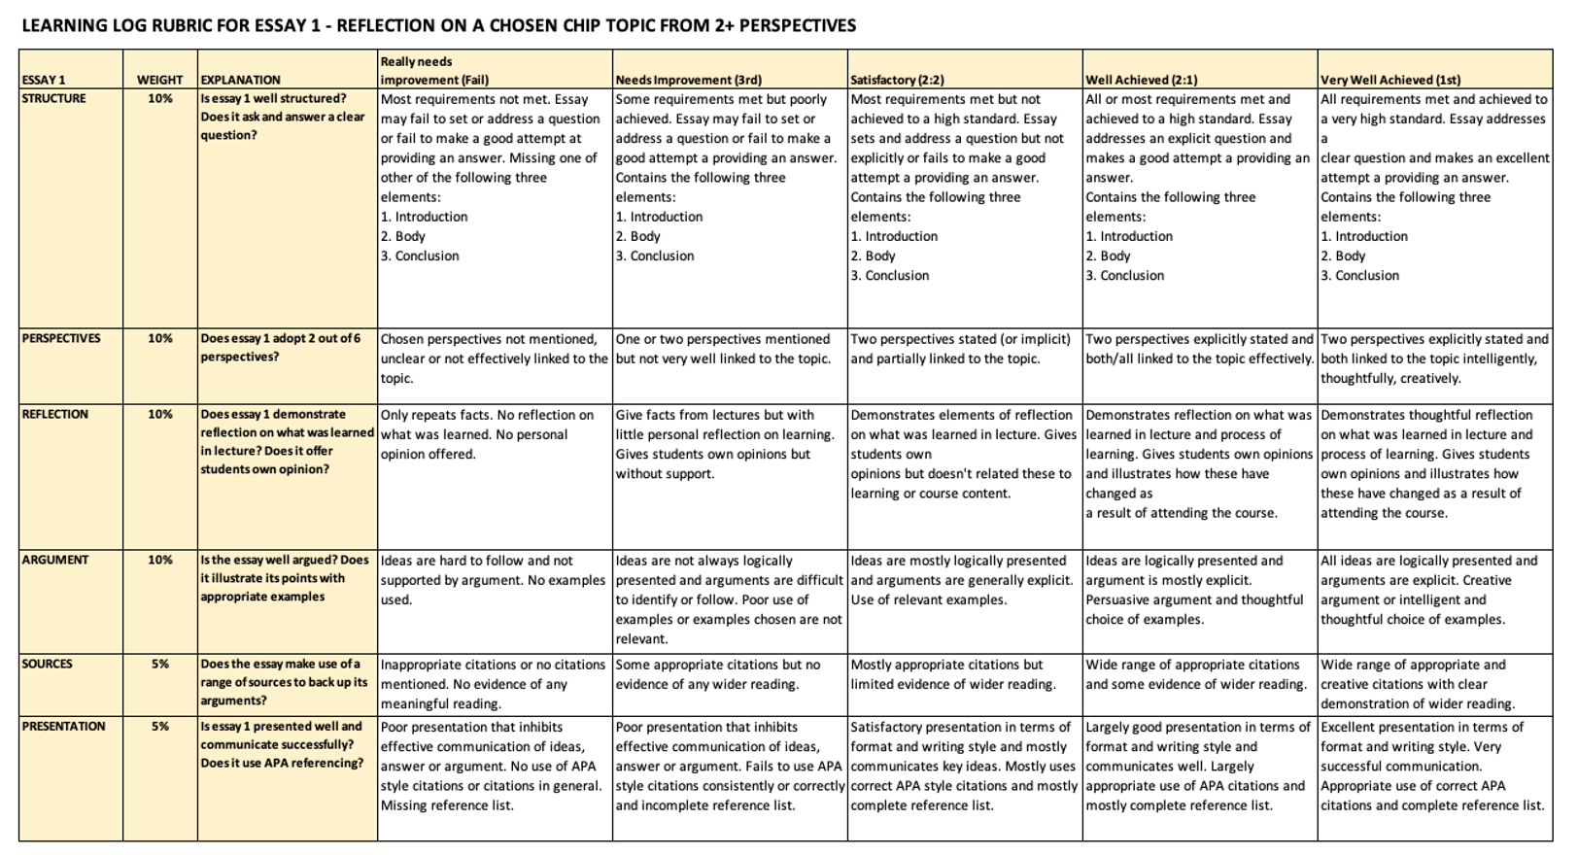
Essay 1

Slide 25
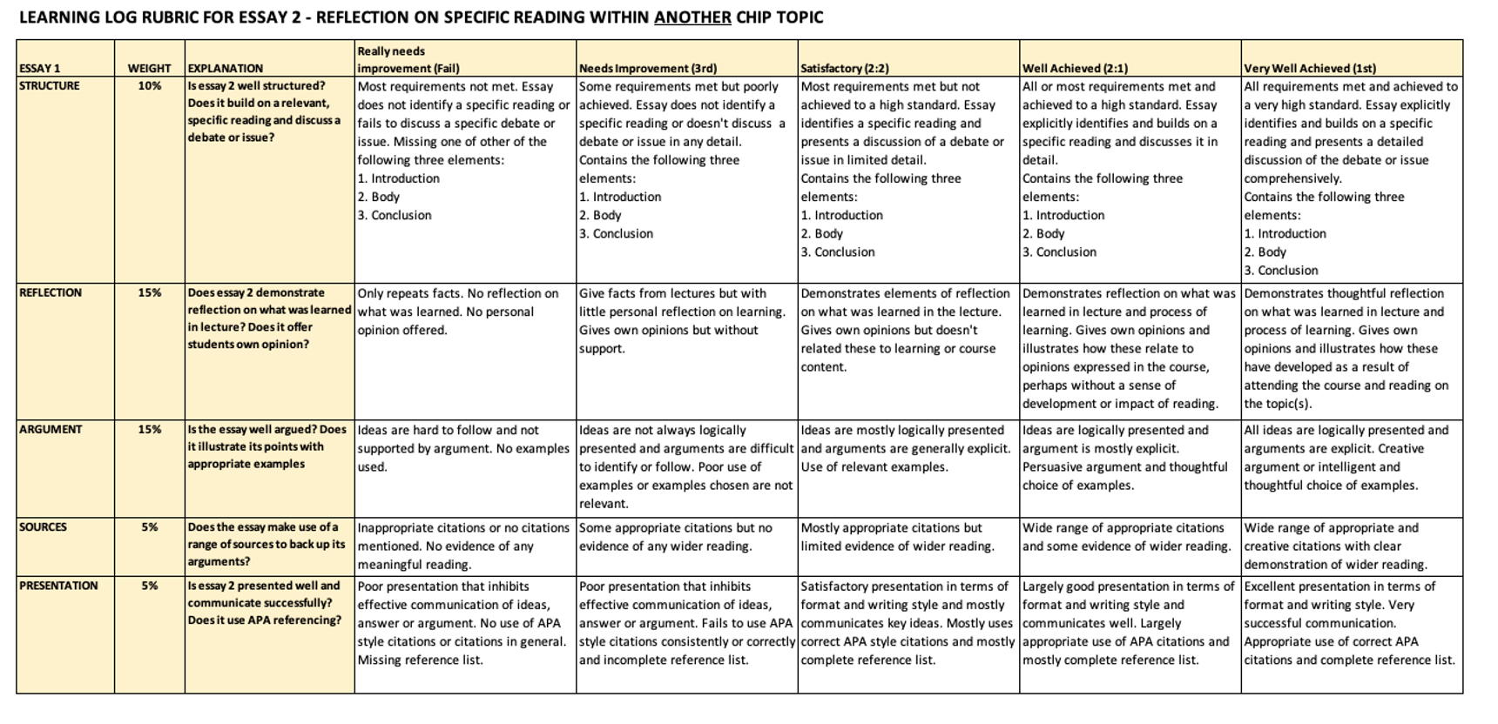
Essay 2

Slide 26
Have a great week!

