Slide 1
Deviously seeking Duping Delight in the Darkness
Welcome to the LittleMonkeyLab Dr Gordon Wright aka DrDeception

Slide 2
Overview

Slide 3
Your research here at Goldsmiths
Opportunities ahead of you
Share some tips and tricks
Start the credit task
BREAK - 10-15 mins
A brief overview of my research
Today’s Target Paper
Questions

Slide 4
“MyPsychology”

Slide 5
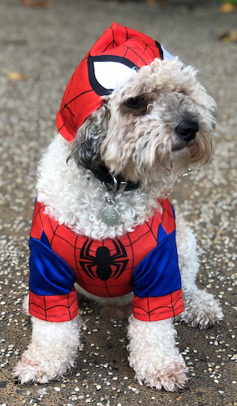
A brief introduction
Dr. Gordon Wright - Lecturer in Psychology & Dougal

Slide 6
Little monkey Video

Slide 7
Video

Slide 8
Some easy research!

Slide 9
BBC Horizon: The Honesty Experiment

Slide 10
MyPsychology

Slide 11
Your aspirations?

Slide 12
Your research ‘career’ ahead of you
RPS
EE
MD
Summer Bursary
Y3 Diss
1+3
(MSc)
(PhD) or Doctorate.

Slide 13
Skills pay bills
Research skills and data science skills
Employability

Slide 14
Research interest
Browzine
IPIP scales

Slide 15
Lit review
Zotero
Research Rabbit
Special Issues/Annual Reviews

