Slide 1
Lab 01: Group formation and Topic Brainstorm!
Let’s jump right in Dr. Gordon Wright

Slide 3
Welcome to the Research Methods Labs

Slide 4
My role as Lab Tutor
To help you every step of the way
Your first point of contact for questions or queries on Research Methods
To share my passion for research and the experience I have gained
To show how I have learned to find answers and solve problems
To challenge you to achieve your best this year and next

Slide 5
Not
To do the work for you
To chase you or to make you do your work (attendance and coursework is compulsory!)
To tell anybody how to behave either individually or in your groups

Slide 6
100% of our focus in the lab
We are here to be your guide and mentor in the lab
Outside of lab hours, your point of contact is Gordon
If you have an emergency, your Personal Tutor or Gordon are your primary contacts

Slide 7
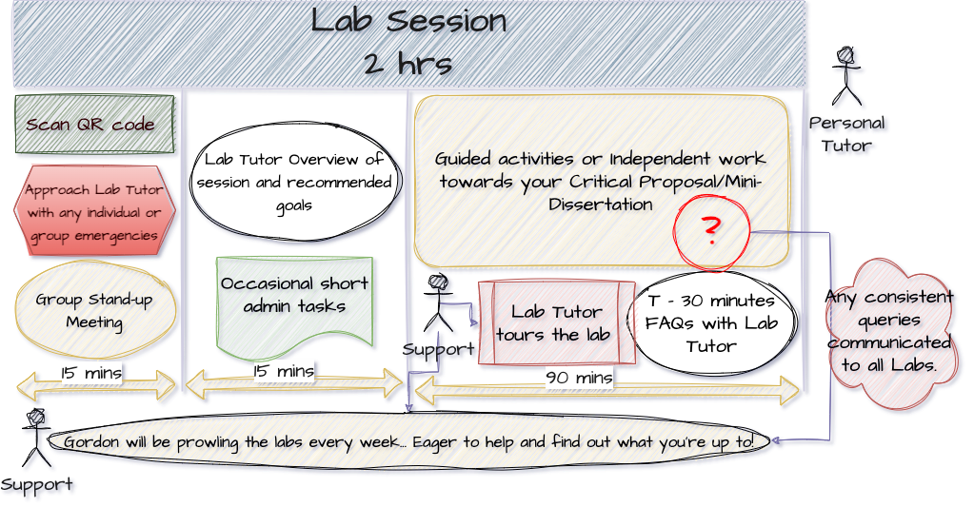
Lab structure
This should be familiar to you now. Any questions?

Slide 8
Goals for today/this week
The immediate goals for this session, and for this week (including your independent study time)
Identify potential group members and have this confirmed by the start of Lab 2
Identify potential research topics and methodologies you might use
Clarify any questions that may persist
After today, we move on and start doing work. Any more time spent on these tasks is wasted time.
You should be almost sorted by the end of the session today, at least with a short-list of topics, methods, or potential team-mates, and prepared to use independent study time to finalise your group (for sure) or to continue thinking about topics & methods.
Next week will be Literature search support for this module and the Personality Essay (Double Whammy!) and discussing Effect Sizes and how to calculate and convert them. A requirement for the week 3 Essay Submission! (Triple Whammy?)

Slide 9
The rules of the Mini-Dissertation game
Your ultimate individual Mini-Dissertation project MUST conform to the following definitive rules:
2x2 ANOVA design with 2 categorical IVs (each with 2 levels) and a single continuous DV
You must obtain ethical approval and prove individual involvement in the process of application
You must make a sample size estimation / Power calculation
You must individually and collaboratively contribute to group data collection efforts
Your Mini-Dissertation final submission must comprise:
a 2500 word APA7 empirical paper with a critical reflection and complete reference list
a single, cleaned, clearly-labelled data set in Excel format (or similar) - Open Data
a complete, replication-ready materials document detailing materials relevant to your submission - Open Materials

Slide 10
Critical Proposal
There is a detailed brief on the Critical Proposal (Due Week 5) on the VLE.
It will be the focus of week 3 in both Lecture and Lab, but requires you to identify an empirical paper on your research topic, so more on that in due course.

Slide 11
Activities for today.
These labs are driven by you. The only things that will EVER be compulsory are short administrative tasks on a roughly fortnightly basis (group progress update) and the next activity. Otherwise you can use the time as you see fit either alone or in your group, but we know that there is wisdom in the crowd for coming up with topic ideas, identifying cool research ideas and setting the tone for the year ahead.

Slide 12
Let’s get going.
Lab Challenge! [15 mins]
Research Skill Audit
Topic Speed Dating
Methods Matching
Goal Alignment and Group Ethos

Slide 13
Lab Challenge
To be introduced by the Lab Tutor. hehe!

Slide 14
Research Skill Audit
By assessing your current confidence level, you will be able to think strategically about the 20 weeks ahead.

Slide 15
Topic Speed Dating
The worksheet will provide some tips and ideas for finding a topic to research. Even if you think you’ve nailed it, let’s discuss it.

Slide 16
Methods Matching
It is easy to only think about online questionnaires. It may be some of the only research you’ve done, but frankly, it would be a shame to not think more expansively. Some ideas will be discussed, and a discussion about the Lab Challenge might prompt some ideas.

Slide 17
Goal Alignment and Group Ethos
Another aspect of effective Group work is Goal Alignment. Even if you are working with your best buddy, they may want to just get in and out, while you want to immerse yourself in the task ahead.
This would be a conflict that is potentially dangerous. Think about your goals, your aspirations, and then consider how your might formalise these in to a set of guidelines.
Please do take the time to do this. Being able to point to a set of principles (for your group or for the whole lab) may smooth the process or be of help in resolving difficulties.

Slide 18
References

