Slide 1
Lecture04
Research, me-search & Inclusivity Dr Gordon Wright

Slide 2
Key topics today
The week ahead (week 4)
Personal Tutor Meeting about well-being
Critical Proposal overview and tips
Lab preview - Literature search and management
Your Critical Proposal Target Paper

Slide 3
Personal Tutor Meeting Week 4
This week (week 4) your PT session is all about well-being
Tip
Please familiarise yourself with well-being services available in college
https://www.gold.ac.uk/students/wellbeing/wellbeing-service/

Slide 4
Any Questions?

Slide 5
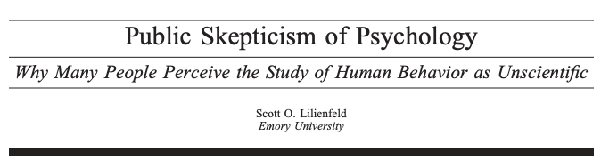
A crisis

Slide 6
Later lectures
The Reproducibility Crisis and the response - Open Science

Slide 7
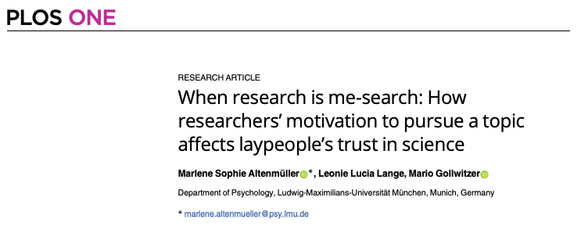
Research & me-search

Slide 8
(Altenmüller et al., 2021)

Slide 9
another
Reflexivity and the psychologist
(Morawski, 2005)

Slide 10
Inclusive Research
Inclusive research is a term that was coined in the early twenty first century to embrace participatory and emancipatory approaches to research with people with learning/intellectual disabilities (Walmsley 2001)
Inclusive research embraces participatory and emancipatory approaches to research. Its characteristics are that it: · Is owned (not necessarily initiated) by lay people · Furthers the interests of lay people, researchers are on their side · Is collaborative · Enables lay people to exercise control over process and outcomes · Produces outputs that are accessible. (adapted from Walmsley and Johnson 2003)

Slide 11
context
wider rights movement. Nothing about us without us (Aspis 2000), a slogan of the disabled people’s movement, has been applied to research as well as other areas.
exclusivity not only touches but also contorts and diminishes all aspects of psychological science.
Ledgerwood et al. (2022)

Slide 12
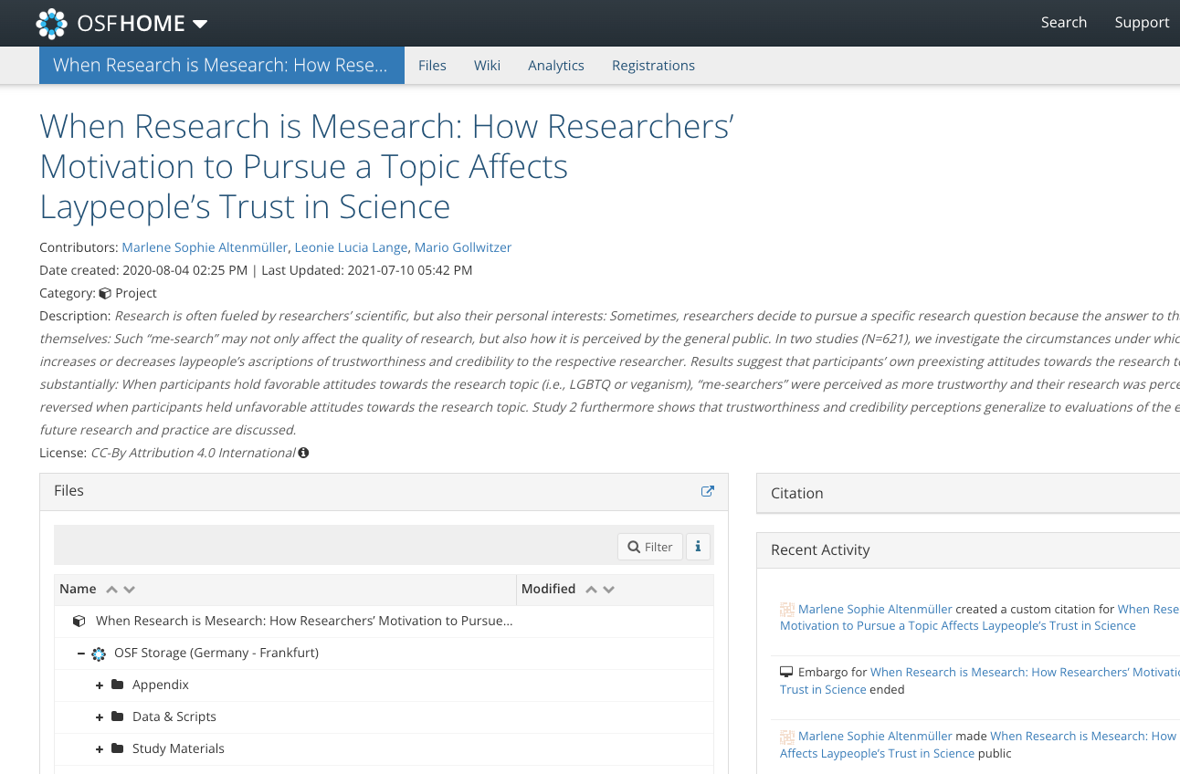
OSF

Slide 13
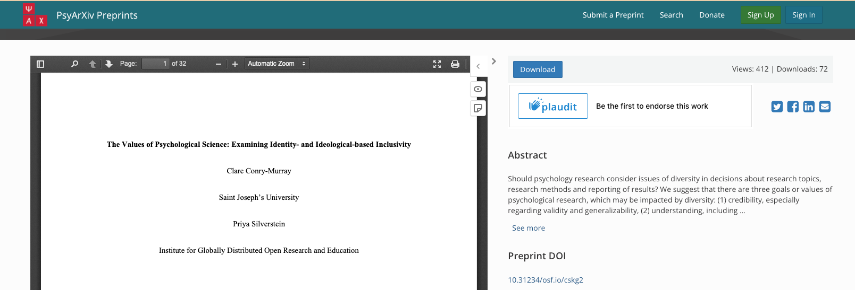
Psyarxiv
Conry-Murray & Silverstein (n.d.)

Slide 14
Questions?

Slide 15
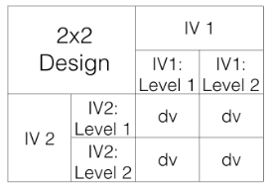
Lab activities
Keep working!

Slide 16
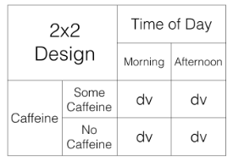

Slide 17
Notation
We use a notation system to refer to these designs:
2x2 = Two-way ANOVA. There are two IVS, the first IV has two levels, the second IV has 2 levels. There are a total of 4 conditions, 2x2 = 4.
2x3 = Two-way ANOVA. There are two IVs, the first IV has two levels, the second IV has three levels. There are a total of 6 conditions, 2x3 = 6
3x2 = Two-way ANOVA. There are two IVs, the first IV has three levels, the second IV has two levels. There are a total of 6 conditions, 3x2=6.
4x4 = Two-way ANOVA. There are two IVs, the first IV has 4 levels, the second IV has 4 levels. There are a total of 16 condition, 4x4=16
2x3x2 = Three-way ANOVA.There are a total of three IVs. The first IV has 2 levels. The second IV has 3 levels. The third IV has 2 levels. There are a total of 12 condition. 2x3x2 = 12.

Slide 18
Review
Crump, M. J. C., Navarro, D. J., & Suzuki, J. (2019, June 5). Answering Questions with Data (Textbook): Introductory Statistics for Psychology Students. https://doi.org/10.17605/OSF.IO/JZE52
CC BY SA 4.0
https://crumplab.com/statistics/07-ANOVA.html
https://crumplab.com/statistics/10-MixedANOVA.html#x2-designs
no IV1 main effect, no IV2 main effect, no interaction
IV1 main effect, no IV2 main effect, no interaction
IV1 main effect, no IV2 main effect, interaction
IV1 main effect, IV2 main effect, no interaction
IV1 main effect, IV2 main effect, interaction
no IV1 main effect, IV2 main effect, no interaction
no IV1 main effect, IV2 main effect, interaction
no IV1 main effect, no IV2 main effect, interaction

Slide 19
graphs
1 = there was a main effect for IV1.
~1 = there was not a main effect for IV1
2 = there was a main effect for IV2
~2 = there was not a main effect of IV2
1x2 = there was an interaction
~1x2 = there was not an interaction

Slide 20
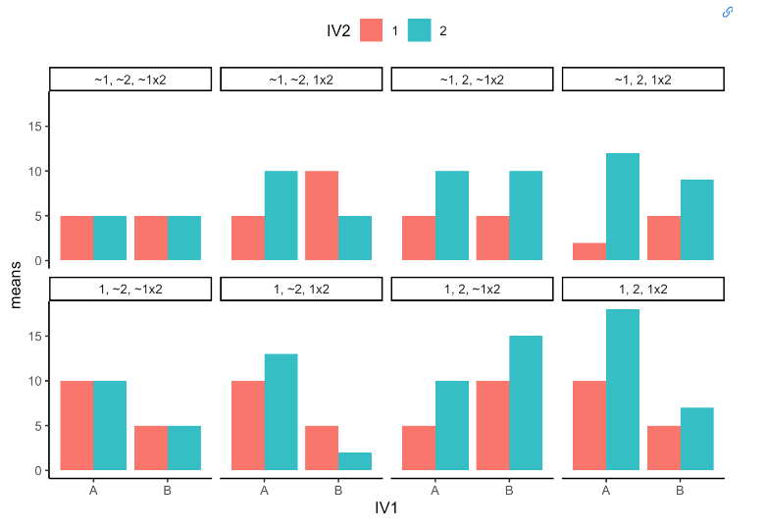
graphs

Slide 21
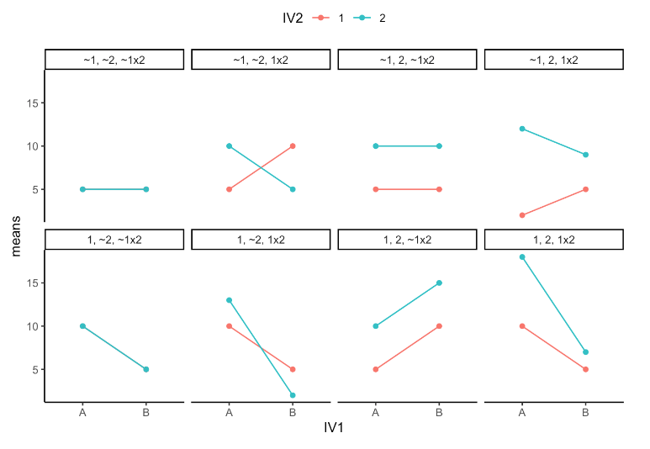
graphs 2

Slide 22
Altenmüller, M. S., Lange, L. L., & Gollwitzer, M. (2021). When research is me-search: How researchers’ motivation to pursue a topic affects laypeople’s trust in science. PLoS ONE, 16(7), e0253911. https://doi.org/10.1371/journal.pone.0253911
Conry-Murray, C., & Silverstein, P. (n.d.). The role of values in psychological science: Examining identity-based inclusivity. https://doi.org/10.31234/osf.io/cskg2
Ledgerwood, A., Hudson, S. T. J., Lewis, N. A., Maddox, K. B., Pickett, C. L., Remedios, J. D., Cheryan, S., Diekman, A. B., Dutra, N. B., Goh, J. X., & al., et. (2022). The pandemic as a portal: Reimagining psychological science as truly open and inclusive. Perspectives on Psychological Science, 17(4), 937–959. https://doi.org/10.1177/17456916211036654
Morawski, J. G. (2005). Reflexivity and the psychologist. History of the Human Sciences, 18(4), 77–105. https://doi.org/10.1177/0952695105058472

