Slide 1
Lab03
Literature Search and CP Target Paper selection Dr. Gordon Wright

Slide 2
Today’s activities
Complete the Pulse (2 topics - 5 mins Max)
Consider how to approach the Critical Proposal to best effect
Start identifying candidate papers
Use the tools suggested below (or share others!)
Show it to LTs and/or Gordon - get specific!

Slide 3
Literature searching

Slide 4
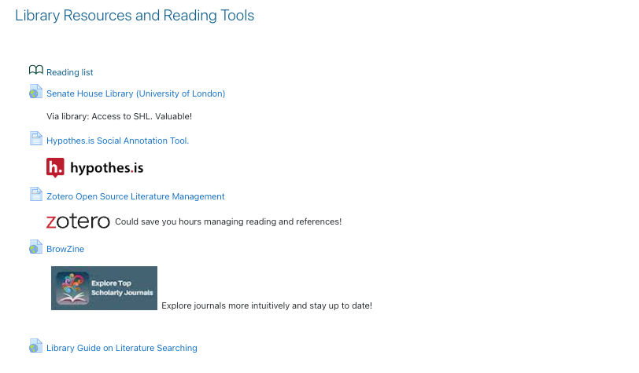
Library resources

Slide 5
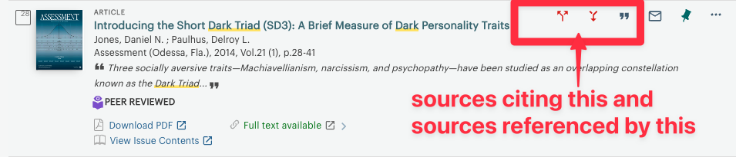
Pay particular attention to forward and backwards search in the library

Slide 6
Interlibrary loan
If you can’t get access to a paper that you think is crucial, consider an interlibrary loan.
https://www.gold.ac.uk/library/using/finding-resources/inter-library-loans/
But there is no reason access to a single paper ought to slow you down.

Slide 7
I’ve already mentioned
Zotero for managing your reading and creating references in APA7 format
https://www.zotero.org/
https://www.zotero.org/download/
Good intro tutorial (13 mins - could save hours!)
https://www.youtube.com/watch?v=JG7Uq_JFDzE

Slide 8
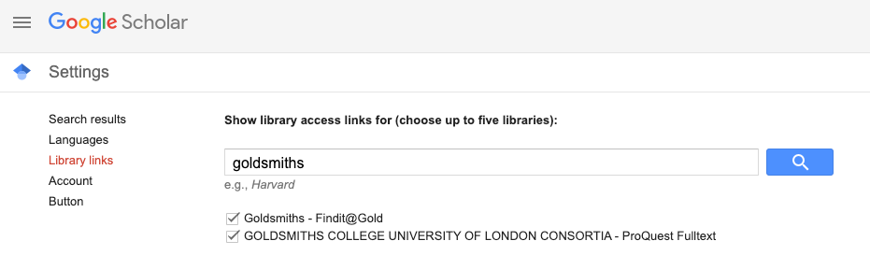
Upgrade your Google Scholar
If you have a google account and go to Google Scholar settings
https://scholar.google.co.uk/scholar_settings

Slide 9
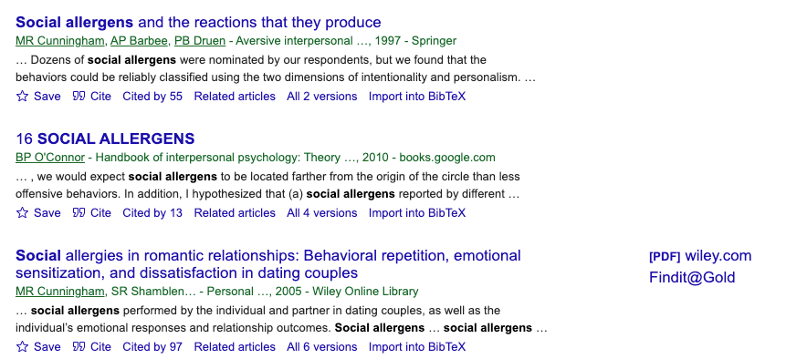
ta da!
if available via the library you will see Findit@Gold

Slide 10
Semantic Scholar (free google type database)
https://www.semanticscholar.org/

Slide 11
Give these ai tools a shot (free versions can be limited)
Connected papers
https://www.connectedpapers.com/
Research Rabbit
https://www.researchrabbit.ai/
Also Citation Gecko, Litmaps
They all help you look at connections between published papers based on topics and citations

Slide 12
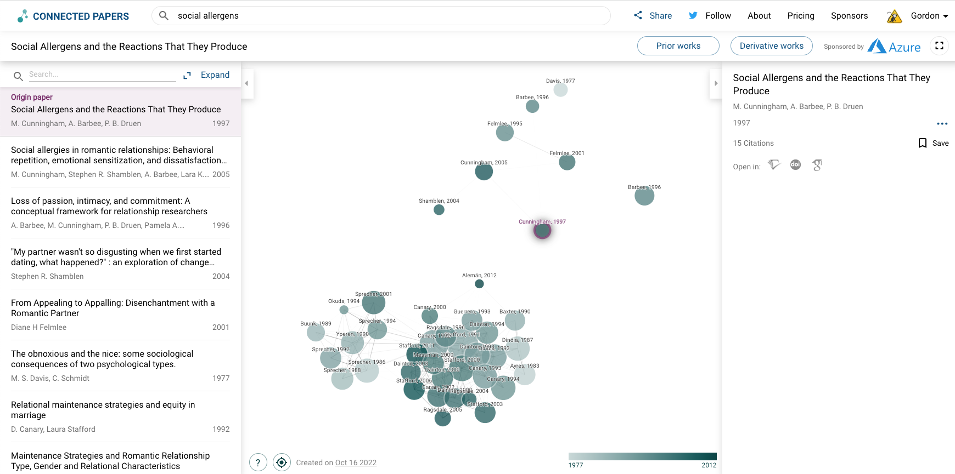
Connected papers

Slide 13
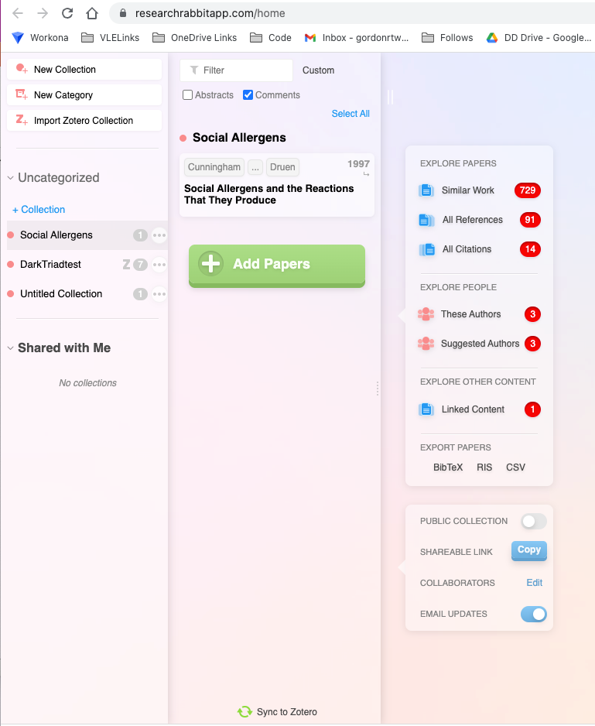
Research Rabbit

Slide 14
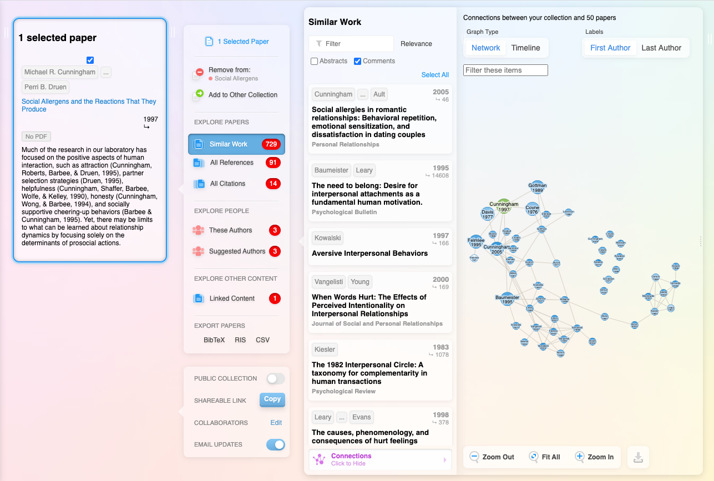

Slide 15
Also consider
Joining Researchgate .. you are a researcher now too! You can often find grey literature here
https://www.researchgate.net/
Or following researchers on Twitter. Lots of good lists of Psych Researchers
https://www.scholarcy.com/ An AI summariser
My Favourite
https://www.lateral.io/ An AI informed literature review tool

Slide 16
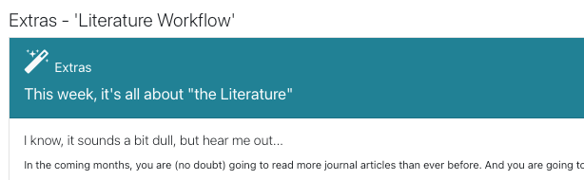
And have a look back at the Week 1 Extras

Slide 17
Give BrowZine a shot. It’s how I review recent new publications on the bus!

Slide 18
Have fun!

