Slide 1
Lab04
Variables, Design & Notation Dr. Gordon Wright

Slide 2
Getting clarity on your variables

Slide 3
Individual mini-dissertations
Must conform to a 2x2 ANOVA with a single continuous DV

Slide 4
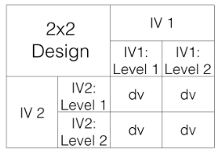
Lab activities
Formalise your individual design

Slide 5
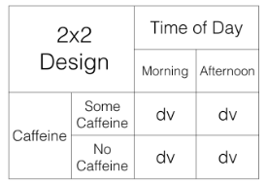
More specific

Slide 6
Notation
We use a notation system to refer to these designs:
2x2 = Two-way ANOVA. There are two IVS, the first IV has two levels, the second IV has 2 levels. There are a total of 4 conditions, 2x2 = 4.
2x3 = Two-way ANOVA. There are two IVs, the first IV has two levels, the second IV has three levels. There are a total of 6 conditions, 2x3 = 6
4x4 = Two-way ANOVA. There are two IVs, the first IV has 4 levels, the second IV has 4 levels. There are a total of 16 condition, 4x4=16
2x3x2 = Three-way ANOVA.There are a total of three IVs. The first IV has 2 levels. The second IV has 3 levels. The third IV has 2 levels. There are a total of 12 condition. 2x3x2 = 12.

Slide 7
3 ‘flavours’ of 2x2 ANOVA
2bx2b - Between-subjects/Factorial ANOVA
2wx2w - Within-subject/Repeated Measures ANOVA
2bx2w or 2wx2b - Mixed ANOVA
You will be using one of these (all supported by SPSS Exercise 1 and 2)
JAMOVI is a reasonable alternative to SPSS (also supported in Exercise 1 and 2)

Slide 8
The 3 effects possible in a 2x2 ANOVA
Main effect of IV1
Main effect of IV2
Interaction of IV1*IV2

Slide 9
therefore 8 possible ‘outcomes’ of a 2x2 ANOVA
no IV1 main effect, no IV2 main effect, no interaction
IV1 main effect, no IV2 main effect, no interaction
IV1 main effect, no IV2 main effect, interaction
IV1 main effect, IV2 main effect, no interaction
IV1 main effect, IV2 main effect, interaction
no IV1 main effect, IV2 main effect, no interaction
no IV1 main effect, IV2 main effect, interaction
no IV1 main effect, no IV2 main effect, interaction

Slide 10
graph key for following charts
1 = there was a main effect for IV1.
~1 = there was not a main effect for IV1
2 = there was a main effect for IV2
~2 = there was not a main effect of IV2
1x2 = there was an interaction
~1x2 = there was not an interaction

Slide 11
Bar charts
https://crumplab.com/statistics/10-MixedANOVA.html#fig-10bar22

Slide 12
Line plots
https://crumplab.com/statistics/10-MixedANOVA.html#fig-10lines22

