Slide 1
Deviously seeking Duping Delight in the Darkness
Welcome to the LittleMonkeyLab Dr Gordon Wright aka DrDeception

Slide 2
Overview

Slide 3
Your research here at Goldsmiths and some opportunities that lie ahead
Share some tips and tricks
Start the Research Participation Scheme task for today
BREAK - 10-15 mins
A brief overview of my research
Today’s Target Paper
Questions

Slide 4
“MyPsychology”

Slide 5
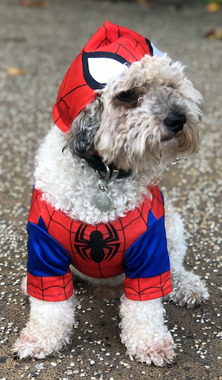
A brief introduction to me
Dr. Gordon Wright
Lecturer in Psychology
MC - Y2 Research Methods
g.wright@gold.ac.uk
& Dougal (insta: DougalMania)

Slide 6
But who are you?
What do I need to know?
Why did you choose to study at Goldsmiths?
Why Psychology?
What do you hope to do with your Psychology degree?

Slide 7
MyPsychology
‘MyPsychology’ is an idea I introduce in Y2 Research Methods
The idea that there is no ‘one size fits all’ psychology
It’s entirely as unique as you are
Topics | Methods | Application | Journey

Slide 8
Why does that matter now?
This module is designed to try to give you a glimpse of psychological research
Research Participation Scheme - what’s the point there?
PS51010C - Extended Essay

Slide 9
LittleMonkeyLab

Slide 10
Video

Slide 11
Some easy research!

Slide 12
BBC Horizon: The Honesty Experiment

Slide 13
MyPsychology

Slide 15
Your research ‘career’ ahead of you
RPS
EE
MD
Summer Bursary
Y3 Diss
1+3
(MSc)
(PhD) or Doctorate.

Slide 16
Skills pay bills
Research skills and data science skills
Employability

Slide 17
Research interest
Browzine
IPIP scales

Slide 18
Lit review
Zotero
Research Rabbit
Special Issues/Annual Reviews

Slide 19
References

