Slide 1
Lab 10: Preview to next term
Lots of fun ahead Dr. Gordon Wright

Slide 2
Welcome to Lab 10
Today’s Focus: Finalise your ethics applications
Looking ahead to term 2!
Study Swap: Opens in week 11 and you learn by doing!
Goal: Learn from peers by participating in each other’s studies.
Why?: Experience the challenges and creativity under shared constraints.

Slide 3
Compulsory Participation
How It Works
Everyone Participates: All second-year students will take part in each other’s studies.
Participation Cap: There will be a maximum number of required participations.
Flexibility: You are encouraged to join more studies if interested.

Slide 4
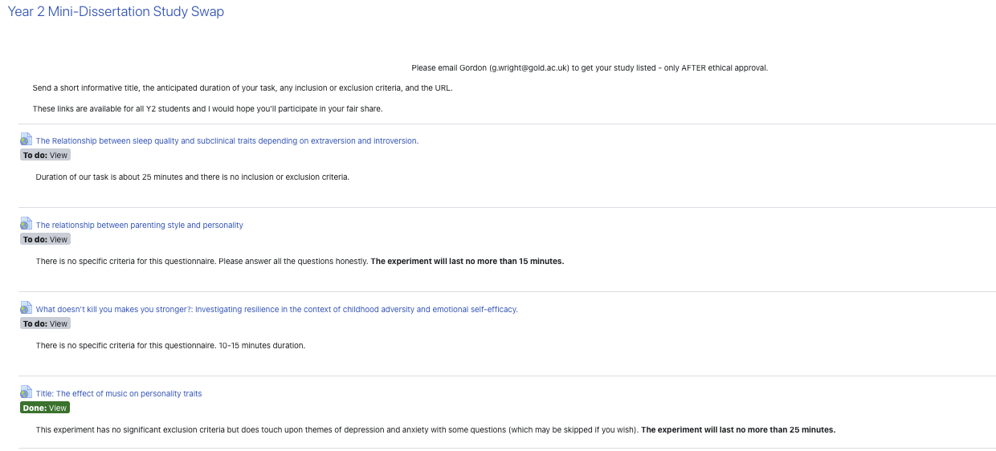
Why Participate?
Key Learning Outcomes
Shared Constraints: See how peers solve similar research challenges.
Research Insight: Learn what works and what doesn’t from others’ approaches.
Improved Design Thinking: Refine your study delivery ideas for future projects.
Learning by Doing
Understand All Moving Parts:
Study design choices
Data collection methods
Participant management
Ethical considerations
Learning by Doing
Think Critically About Delivery:
How will you run your study next year?
What methods will you avoid or adopt?
How do study conditions affect data quality?
Summary
Participate: Engage with as many studies as possible.
Observe: Learn from different designs and execution strategies.
Reflect: Apply insights to future research projects.
Ask Questions: Use labs and forums for feedback and clarification.
Participation will be monitored!

Slide 5
Thank You!
Be curious, be engaged, and learn by doing!
Have a great break and see you next term!

