Slide 1
Lecture 02: Asking good questions and gathering evidence
Being Scientific Dr. Gordon Wright

Slide 3
Attendance QR Code HERE

Slide 4
Key topics today
A tour of the VLE
A quick overview of the 3 Coursework Elements (very brief)
The research process you are beginning
Effect sizes
Lab preview - Literature, and making it your friend

Slide 5
The week ahead
This week (week 2) you have your Personality Essay Tutorial
“Insert info”
title
Deadline 10am Friday x
Feedback on/by x

Slide 6
Perennial CHIP topics
I want to briefly draw your attention to the third (final) piece of coursework for this module, the so-called ‘CHIP Learning Log’
The earlier we flag topics and introduce little glimmers of content, the easier that will be.

Slide 7
1 - What is Science?

Slide 8
An amazing opportunity to consider this critical question while you do your Mini-Dissertation
Here is a thought-provoking initial overview - Open Educational Resource
Diener, E. (2022). Why science?. In R. Biswas-Diener & E. Diener (Eds), Noba textbook series: Psychology. Champaign, IL: DEF publishers. http://noba.to/qu4abpzy

Slide 9
2 - Artificial Intelligence - Promise or Peril?

Slide 10
Until recently, this was a fairly philosophical question
This year, you are probably using AI on a daily or weekly basis. I don’t need to give you 1980’s movie references to show you how we thought computers were going to take over the world and enslave the human race, we can just look out the window!

Slide 11
CHIP topic approval process
Lectures identified with CHIP in the title e.g. weeks 16-20 [They change yearly!]
I am open to other topics, but they must fit the following brief, and you are welcome to check in the Forum.
A concept or debate within Psychology
A historical issue or controversy
A methodology or approach and its promises or limitations
A distinctive or divisive topic
A modern innovation or applied challenge
https://www2.open.ac.uk/openlearn/CHIPs/

Slide 12
I can’t make bricks without clay!

Slide 13
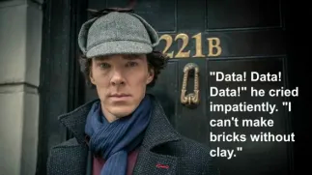
A psychologist? A scientist?

Slide 14
In this instance, Sherlock is talking about the need for data prior to solving a case. You can’t do science without data.

Slide 15
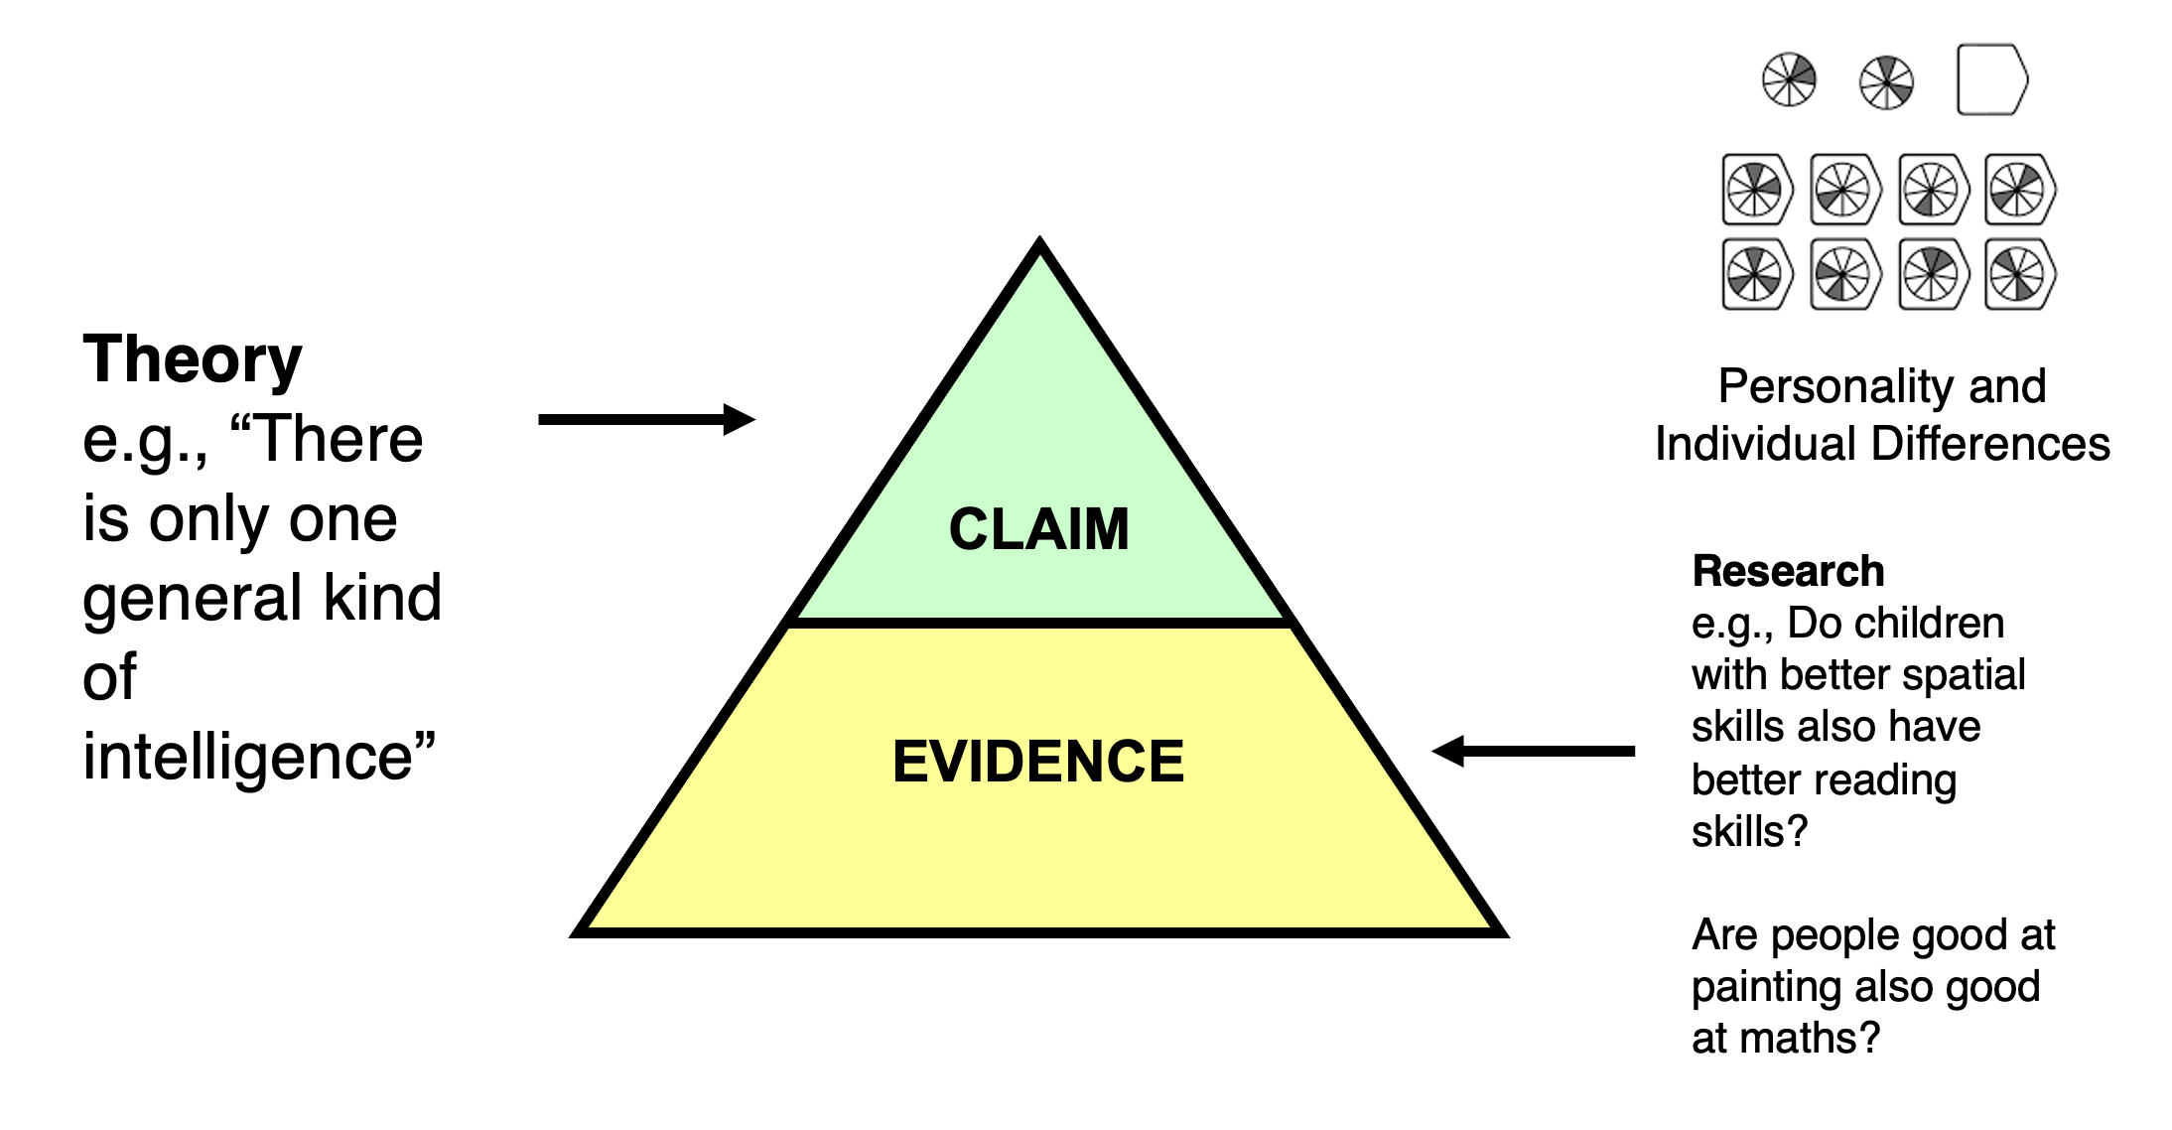
Scientists base their ‘claims’ on EVIDENCE

Slide 16
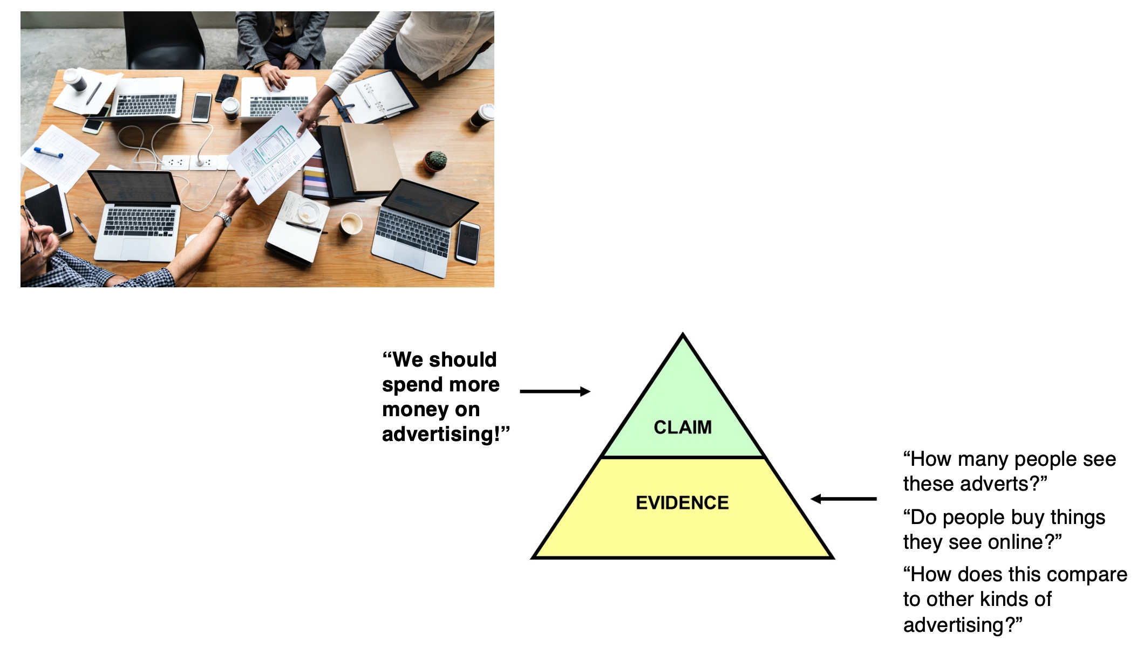
Evidence quality = claim quality!

Slide 17
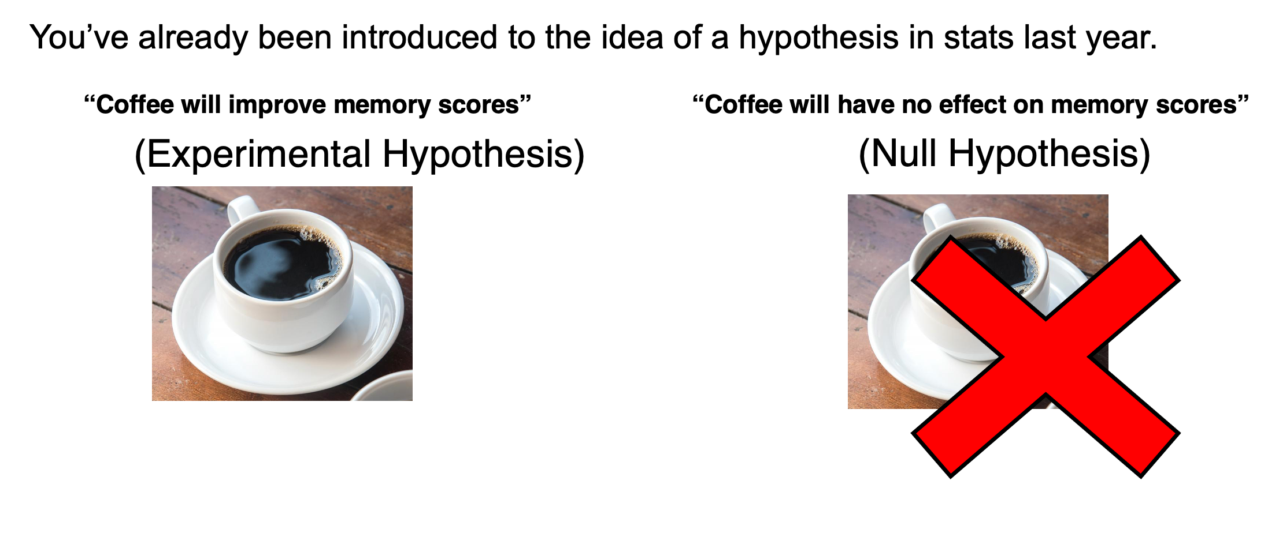
It starts with a hypothesis

Slide 18
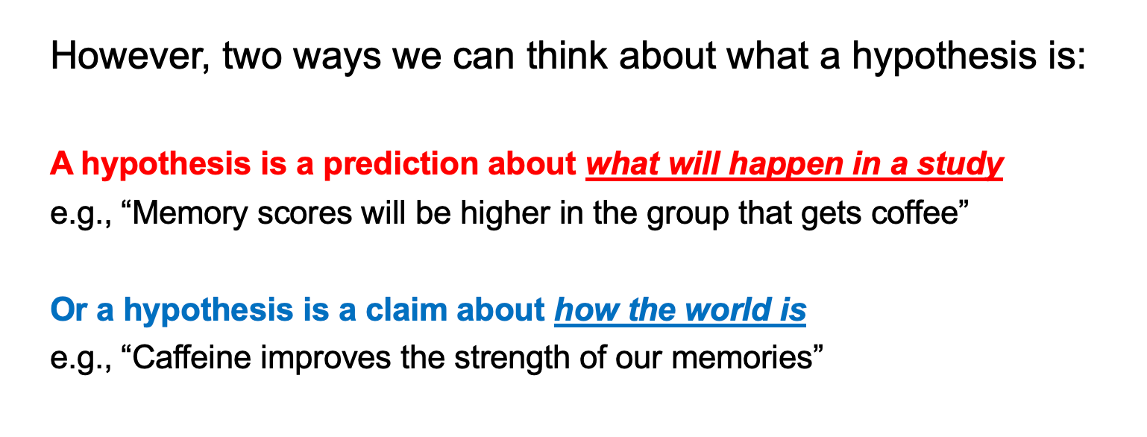
recap on hypotheses

Slide 19
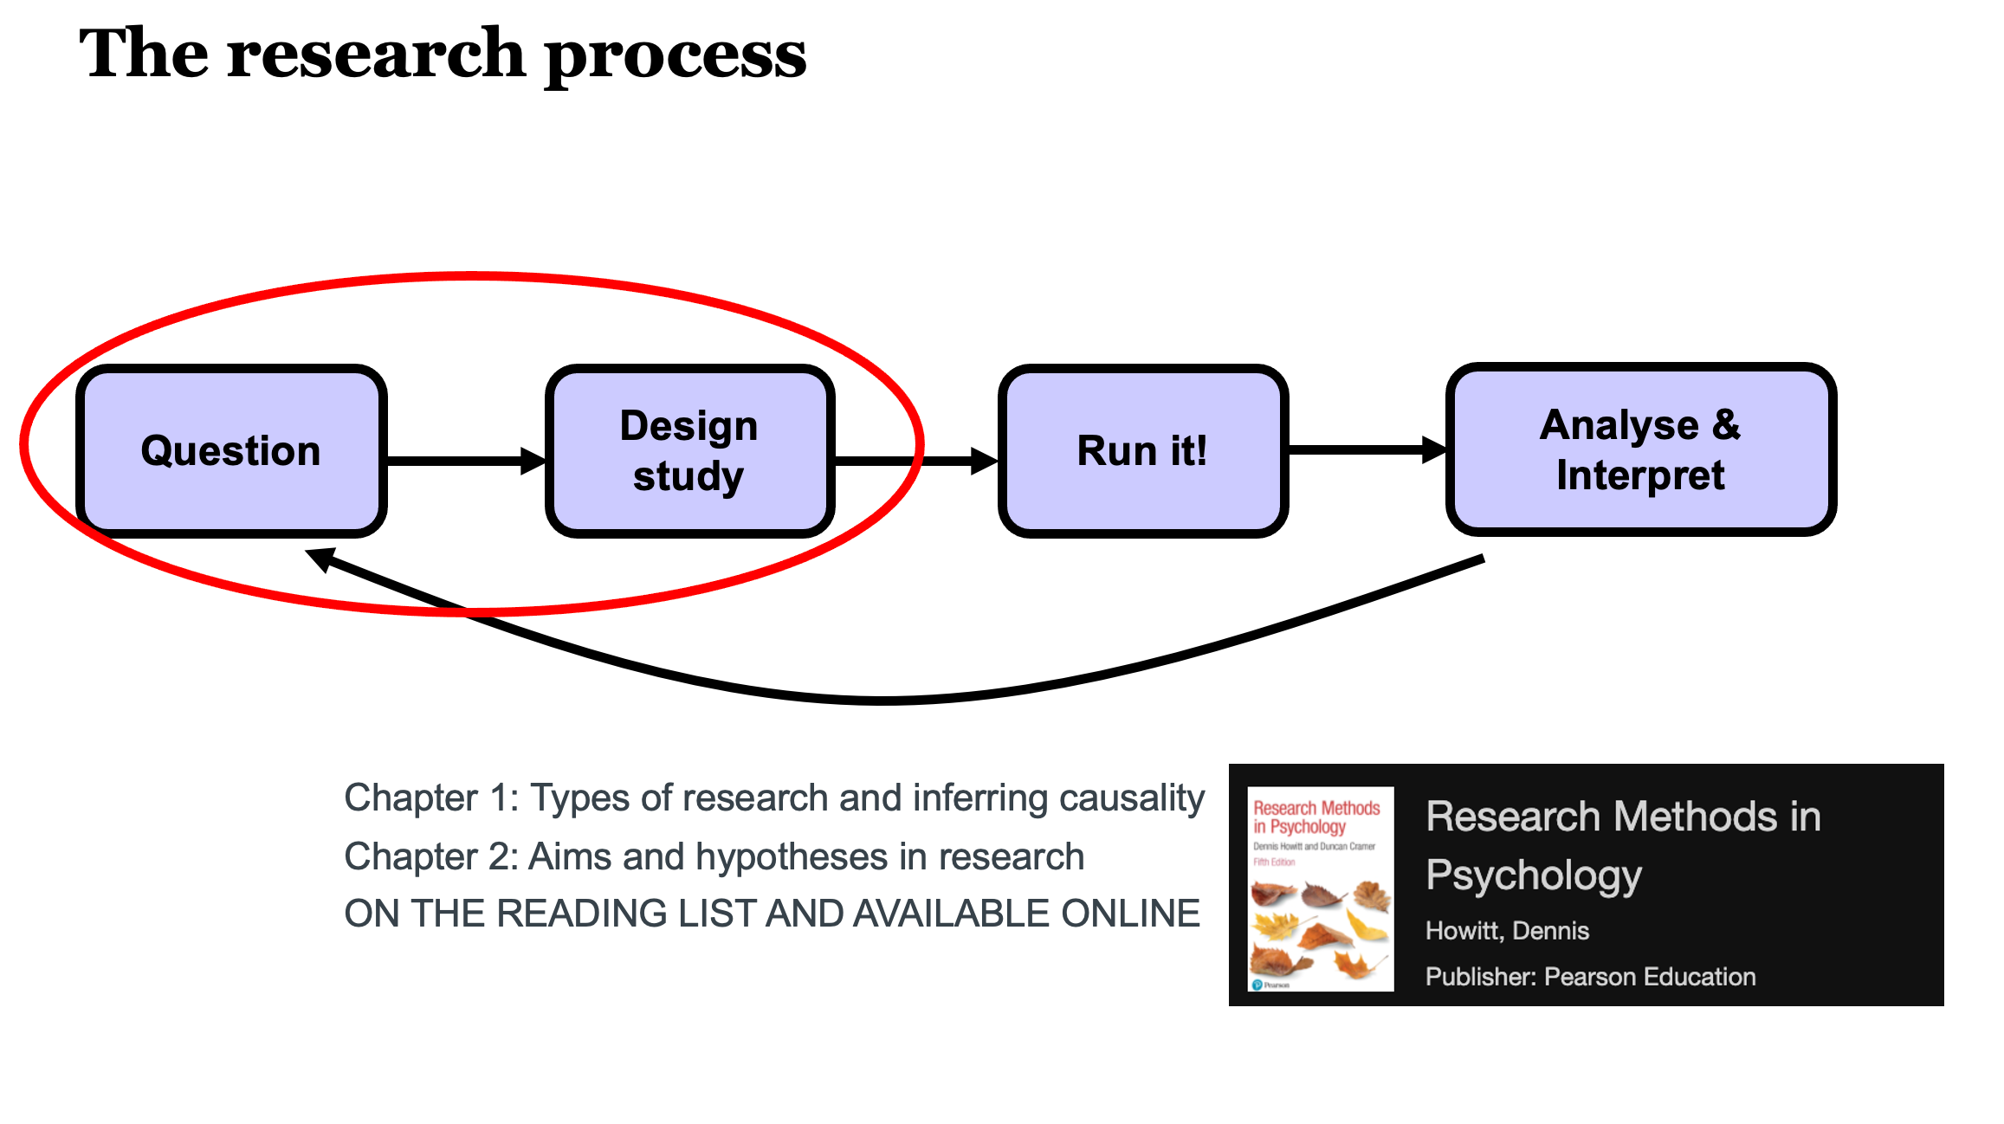
The research process

Slide 20
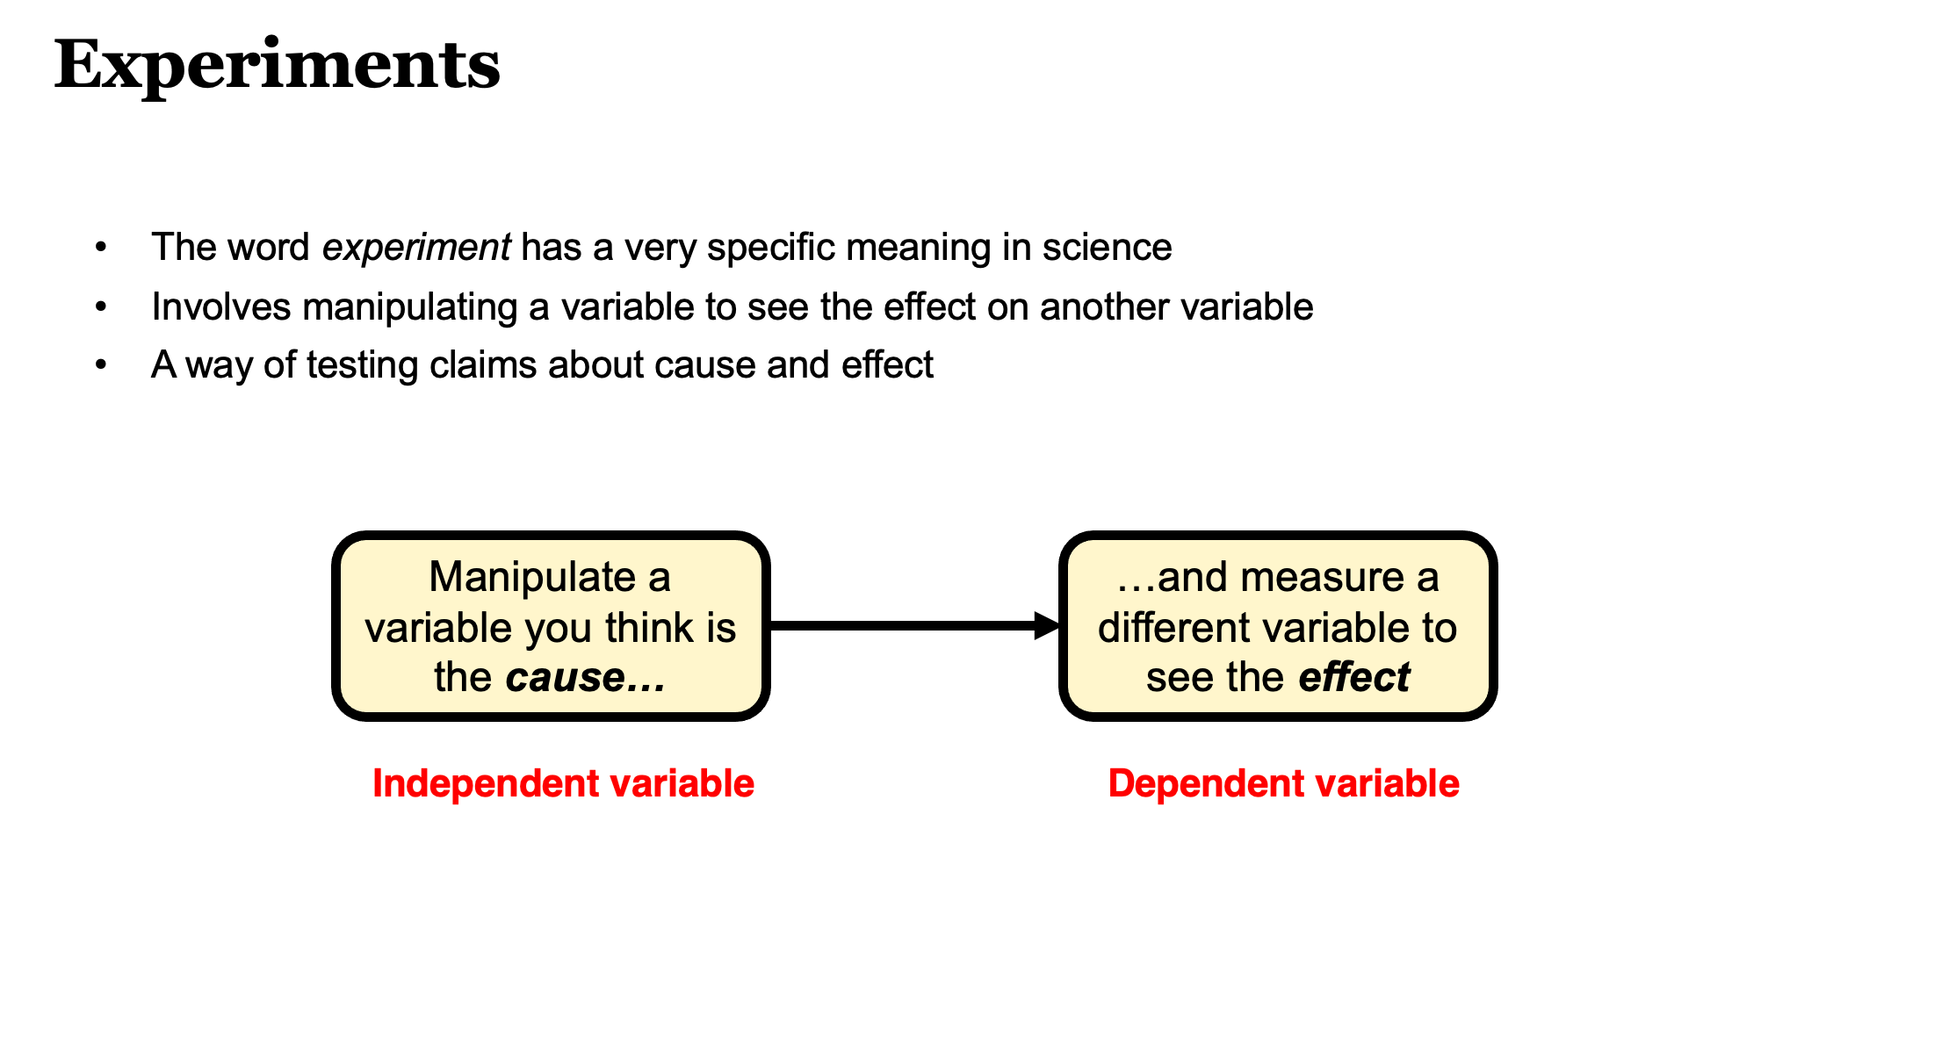
The simplicity of an experiment

Slide 21
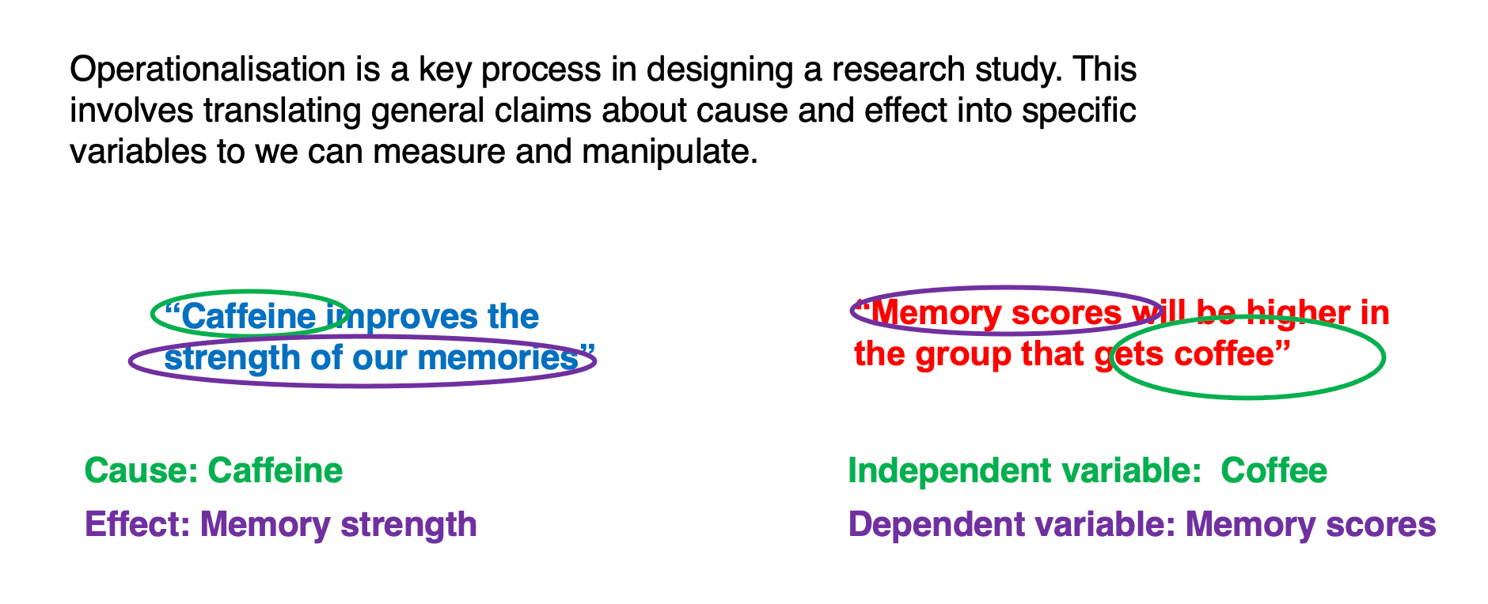
Operationalisation

Slide 22
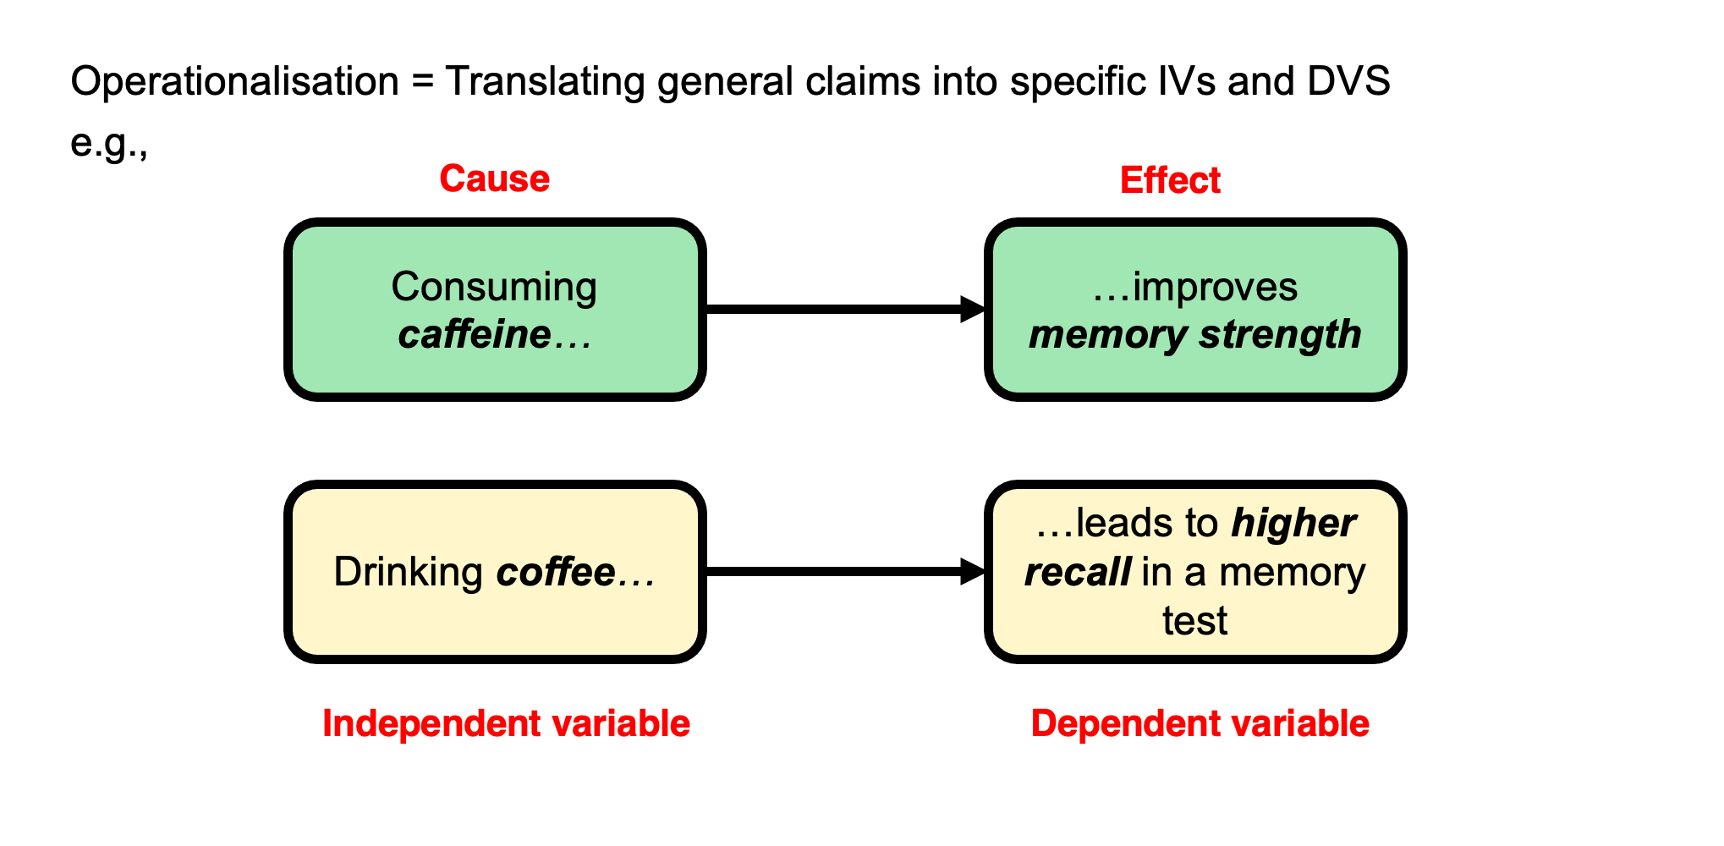
The challenge of operationalisation

Slide 23
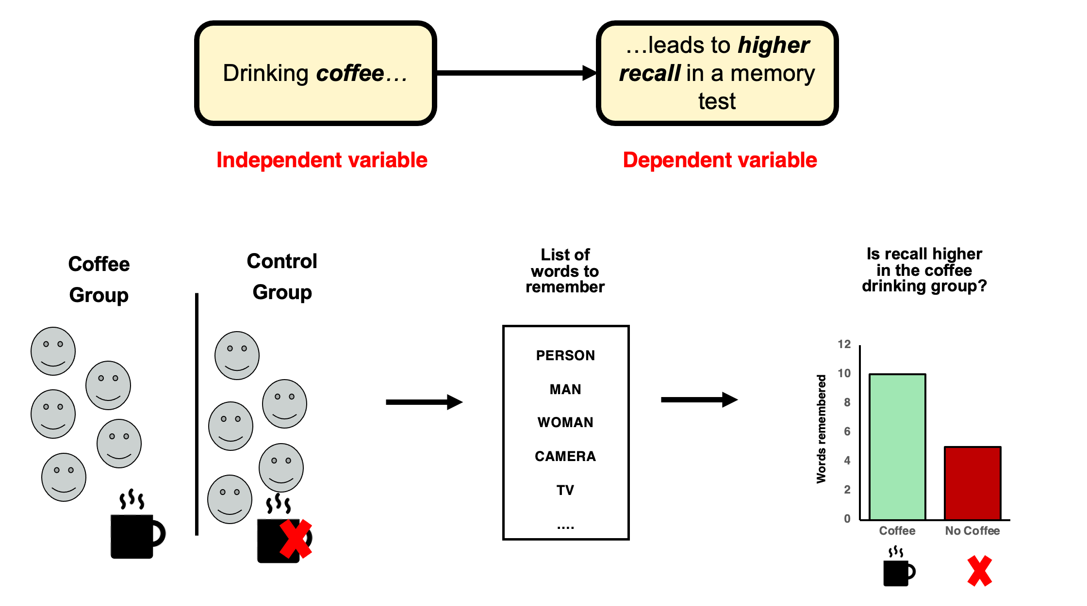
A toy example

Slide 24
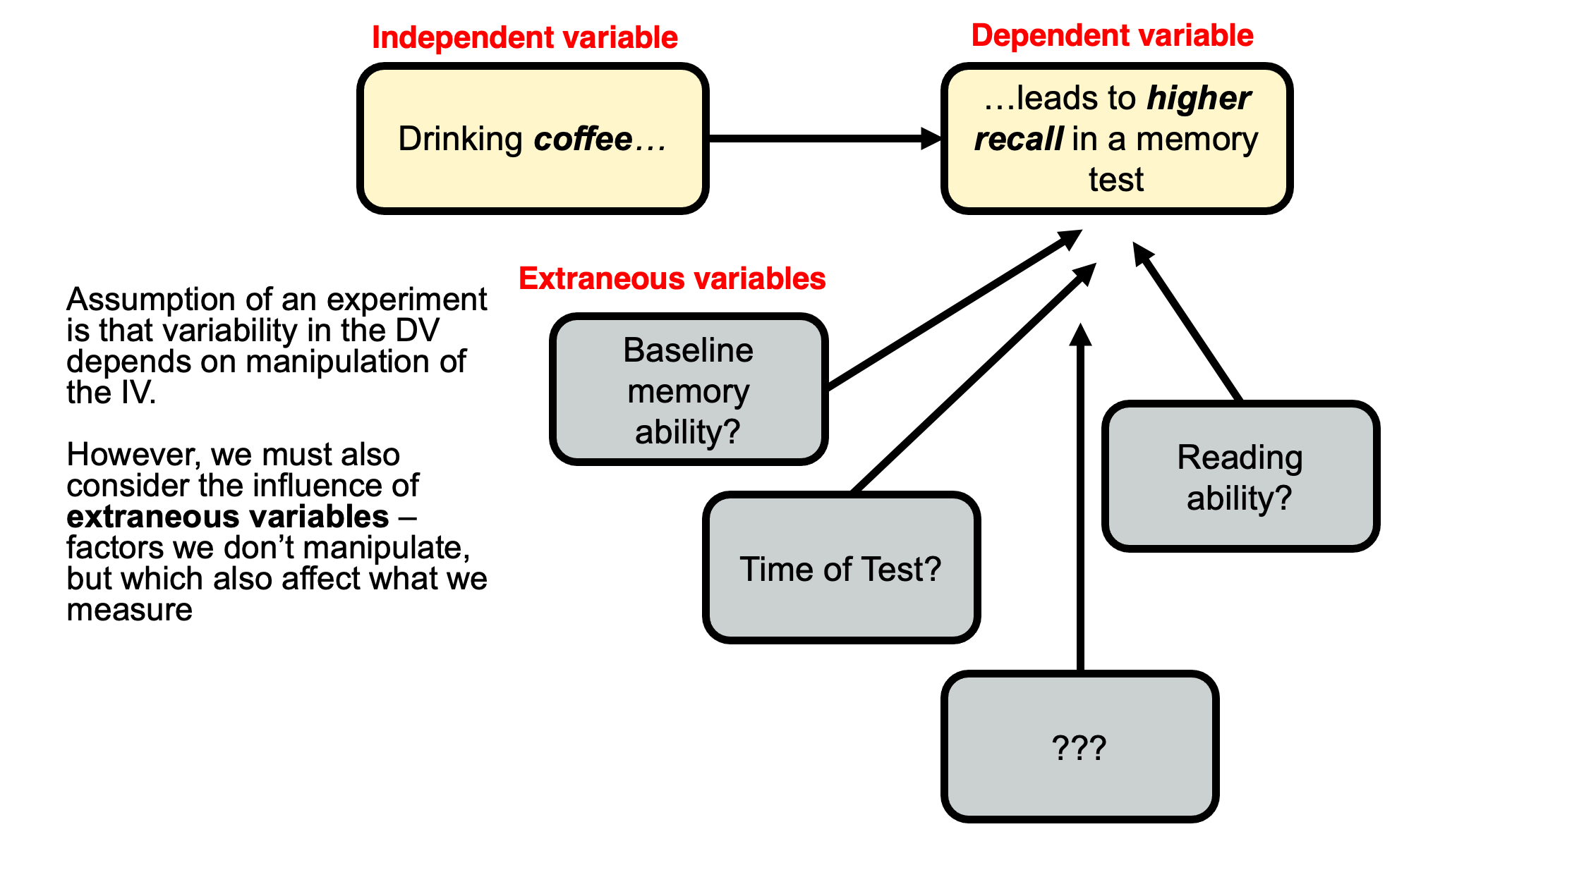
Extraneous variables

Slide 25
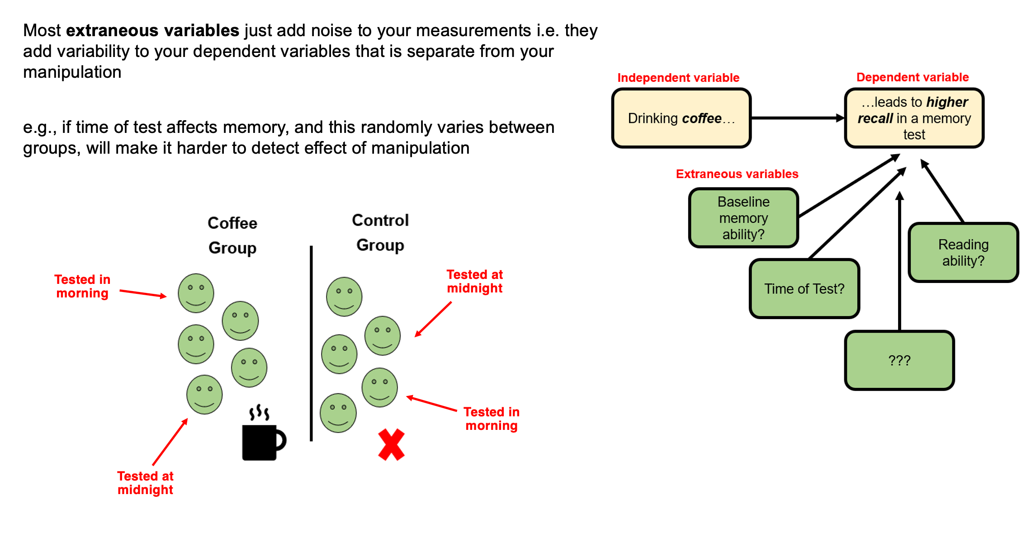
Usually…

Slide 26
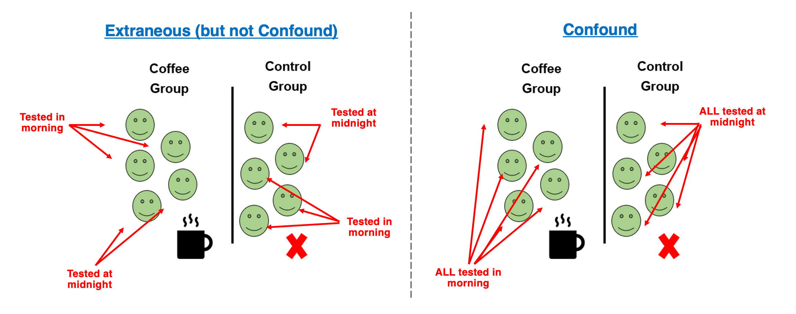
but occasionally…
you hear of ‘confounds’ or ‘confounding variables’
A confounding variable is an extraneous variable that systematically varies with one of your independent variables. These are rare, but nothing can save the experiment.

Slide 27
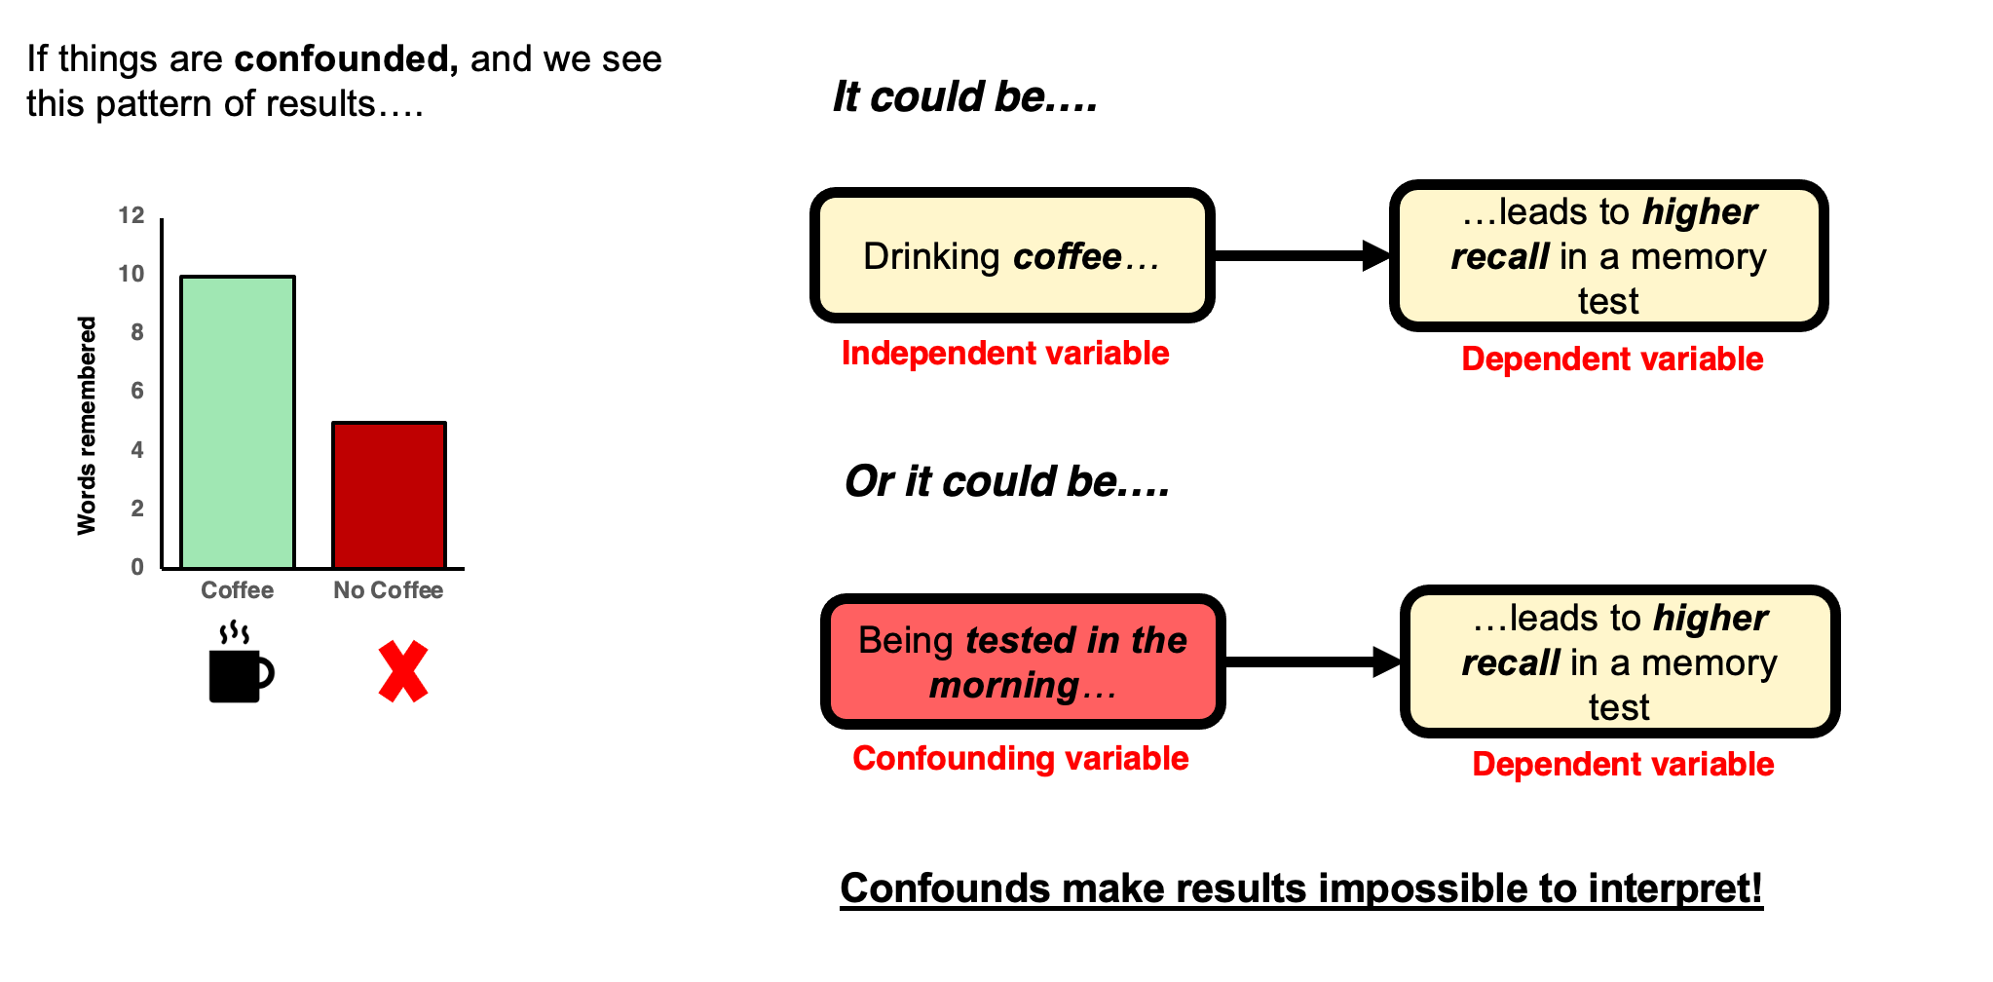
An impossible interpretation

Slide 28
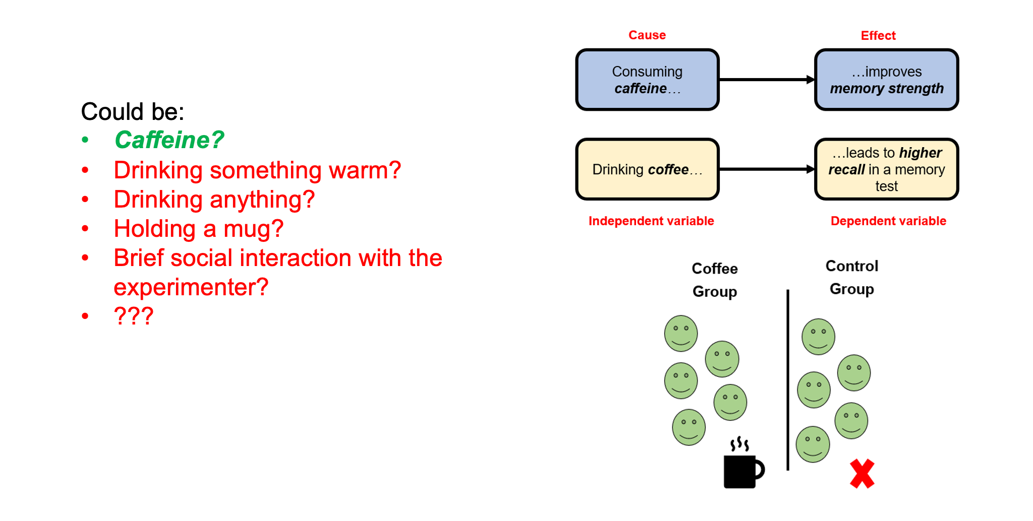
Manipulations almost always introduce potential confounds

Slide 29
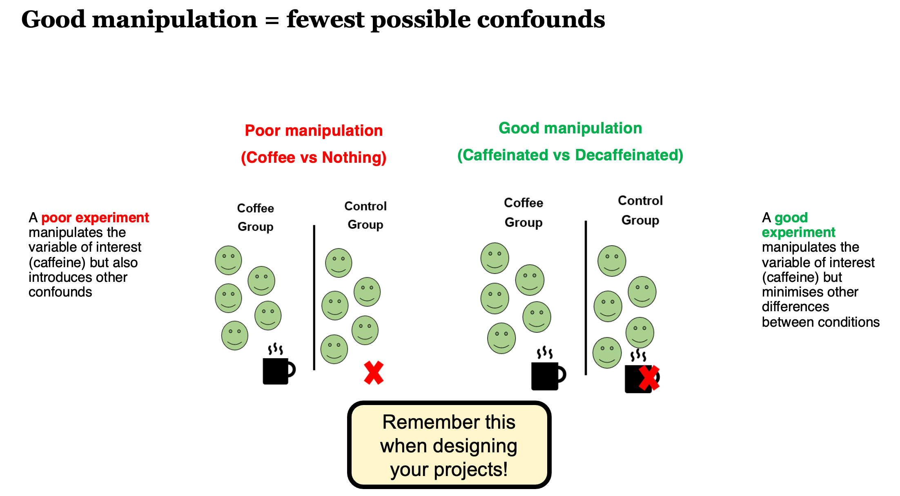
Experimental skill + careful thought + piloting + randomness!

Slide 30
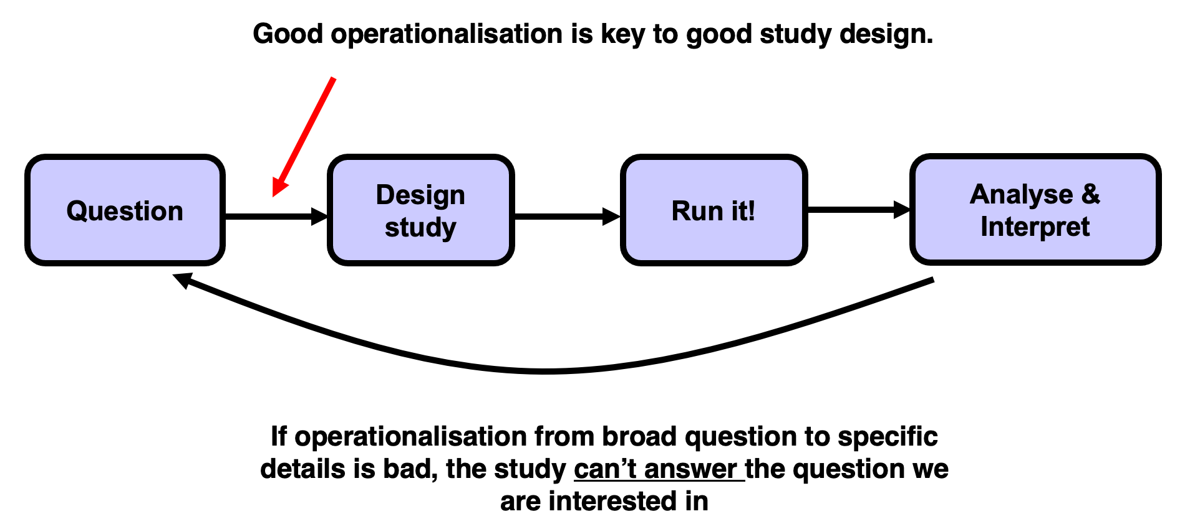
The importance of operationalising your variables well

Slide 31
Reading along
I highly recommend reading along with the general topics we cover in the first few weeks.
Research Methods in Psychology by Dennis Howitt and Duncan Cramer is excellent. Chapter 2 in that book (right at the top of the module reading list and here) deals with Hypotheses and aims of research, essentially what we cover this week, and Chapter 1 deals with the basics and golden rules of research design and designing good experiments.

Slide 32
Another interpretation of “I can’t make bricks without clay!”

Slide 33
Garbage in, Garbage out
Last year someone selected a ‘target paper’ for their Critical Proposal [next week’s lecture topic] from a Sociology Journal - it presented a ‘thought experiment’.
No data, no methodology, no participants, no actual experiment.
How do you think they did?

Slide 34
The literature you read will drive the quality of your output
This applies to the study you design for your Mini-Dissertation
This applies to your Module Essays
This applies to your Critical Proposal
It is NOT a question of QUANTITY
It is very much a question of QUALITY
It is a function of QUALITY and QUANTITY

Slide 35
Lab 2 is about Literature Search and Management

Slide 36
Effect Sizes

Slide 37
A measure of the Effect (MOTE)
Effect sizes represent the magnitude of a relationship between variables, for example between a Manipulation and the Dependent Variable.
It’s like the ‘strength’ of your pill, or intervention, or manipulation.
Do not run an experiment that is designed to fail - you must believe a manipulation will have an ‘Effect’
If the manipulation works, then there will be an Effect
The Effect Size is just how big that visible effect was.

Slide 38
Let’s imagine the simplest example possible
An independent t-test. Working Memory Capacity.
I have a magic pill to increase working memory capacity.
7 ± 2 is the Miller Law. Let’s read this as normal mean working memory capacity for a group of humans is mean 7 units with a standard deviation of 2 units.
Let’s say my pill was tried on a group of humans, and when we measured their mean working memory capacity it was 11 units with a standard deviation of 2 units. Wowsers!
That’s an effect size of d=2. Simply put, Cohen’s d is always presented in units equivalent to 1 standard deviation. So 11 is 2 SDs higher than 7.
Calculating Effect Sizes (shinyapps.io)

