Slide 1
Lecture 04: Selecting tools and methods
Start building the toolbox Dr. Gordon Wright

Slide 2
Key topics today
The week ahead (week 4)
Personal Tutor Meeting about Mini-Dissertations
Critical Proposal due next week (week 5)
Design & Analysis Quiz due next week (week 5)
Personal Tutor Meeting Week 4
This week (week 4) your PT session is all about your Mini-Dissertation
Tip
Please familiarise yourself with well-being services available in college
https://www.gold.ac.uk/students/wellbeing/wellbeing-service/

Slide 3
Any Questions?

Slide 4
Critical Proposal
There is an example of a previous first class submission, with annotations, available on the VLE in the Critical Proposal Coursework section of the VLE. Please read it carefully and attend to the comments.

Slide 5
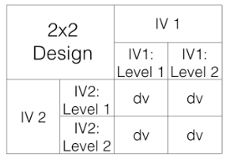
A quick word on the MD Research Topic & Designs
Your individual Mini-Dissertation project MUST conform to the following definitive rules:
2x2 ANOVA design with 2 categorical IVs (each with 2 levels) and a single continuous DV
MORE ON THIS NEXT WEEK!
You must obtain ethical approval and show individual involvement in the process of application
You must make a sample size estimation / Power calculation
You must contribute to group recruitment and data collection efforts either online or in-person
Mini-Dissertation Submission
Your Mini-Dissertation final submission must comprise ALL of the following COMPULSORY elements:
a 2,500 word APA7 empirical paper with a complete reference list and appendices
Open Data - a single, cleaned, clearly-labelled data set
Open Materials - a complete, replication-ready materials package detailing materials relevant to your individual write-up
A reflective account covering the Mini-Dissertation (not a moan about your group or strikes or having to do research)
Recap of 2x2
3 ‘flavours’ of 2x2 ANOVA
2bx2b - Between-subjects/Factorial ANOVA
2wx2w - Within-subject/Repeated Measures ANOVA
2bx2w or 2wx2b - Mixed ANOVA
Formalise your individual design

Slide 6
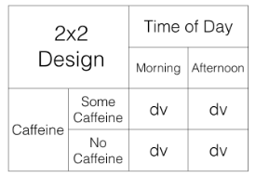
More specific

Slide 7
How you blend 2x2 designs as a group
Let’s say your group was interested in Academic Self-Handicapping and features of personality and academic background contributing to this phenomenon.
It makes sense that the bulk of the efforts of your group go in to measuring Academic Self-Handicapping.
Individual 2x2
The effect of Conscientiousness and Self-Efficacy on Academic Self-Handicapping
The effect of Independent Variable A and Independent Variable B on a continuous Dependent Variable
Conscientiousness IV(A1) Low or IV(A2) high - Independent Variable IV(A)
Self-Efficacy IV(B1) Low or IV(B2) high - Independent Variable IV(B)
Academic Self-Handicapping (ASH score, ‘continuous’ Dependent Variable DV)
What about the other 2 people in the group?
Rest of the group:
The effect of IV(A) and IV(B) on Academic Self-Handicapping
Other Personality Traits (e.g. Procrastination, Neuroticism)
Other attributes (e.g. A-Level Psychology, Maths Anxiety, Academic Role Model)
Not too complicated, right?
Can you see the economies of effort and implicit support opportunities?
Overall data collection
IV(A) Conscientiousness Questionnaire
IV(B) Self-Efficacy Measure
(DV) Academic Self-Handicapping Test
(+) Procrastination as IV(B) (Person 2 complete)
(~) Person 3 Procrastination - IV(A)/Self-Efficacy - IV(B) & ASH (Person 3 done)
If you develop a more elaborate ‘task’
such as a memory test, with easy and difficult stimuli sets
This is a 2-level IV already (let’s call it IV(B)
Group members could either
Swap in different personality measures or attributes as IV(B)
OR look at different DVs (Accuracy, Error, Confidence, Speed, reported difficulty)
OR you could overlay another IV - to introduce practice (but this may slightly separate datasets meaning more data would be required (could be conceived as a poorer or better planned design!)
Do not expect yourself to be able to solve this now
Once we come back after reading week, and we start building, you will know more about your chosen topic.
You will have an idea of preferred methods
Your PT and LT will be able to refine and discuss ideas
The Build and Ethics Submission are both points which we can be utterly certain your design works and is achievable
This is why you need to talk, keep notes, and should be strategic with the Critical Proposal

Slide 8
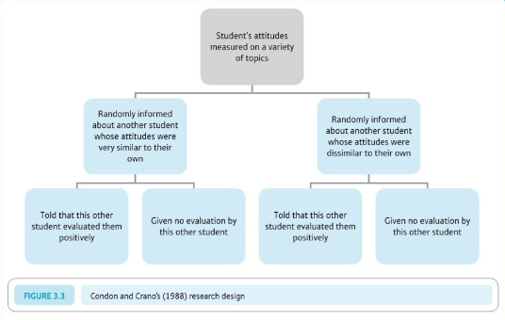
It’s almost time to get practical
‘Operationalisation’ of variables
Operationalisation of variables requires a consideration of the reliability and validity of the method of operationalisation.
Operationalisation of variables also requires specification of the scale of measurement: nominal, ordinal, interval, or ratio.
Finally, operationalisation of variables can also specify details of the measurement procedure.
See Howitt and Cramer Chapter 3.3 (Box Research Example - Condon & Crano 1988)
Attitude similarity and interpersonal attraction

Slide 9
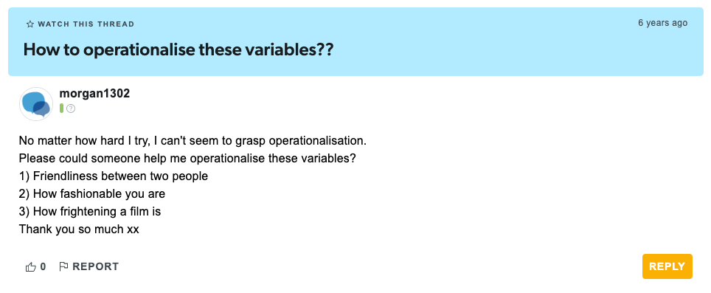
Their DV (consider pros and cons)
This person would like (dislike) me
This person would like (dislike) working with me in an experiment
The Student Room (question)

Slide 10
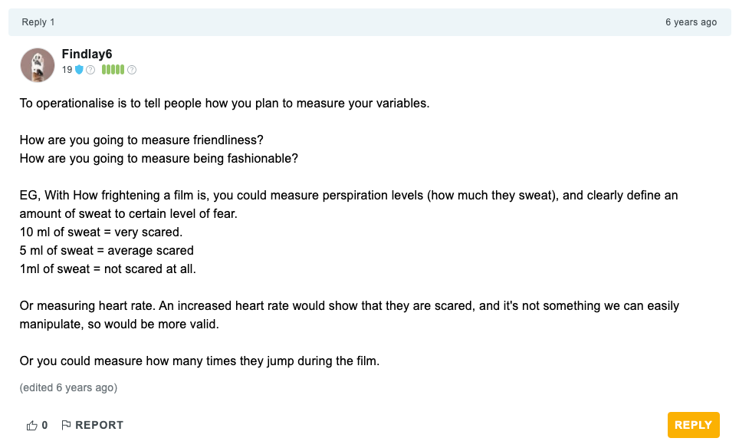
The Student Room (answer 1)

Slide 11
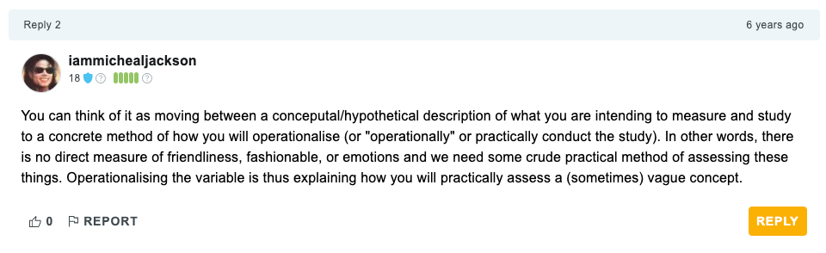
The Student Room (answer 2)

Slide 12
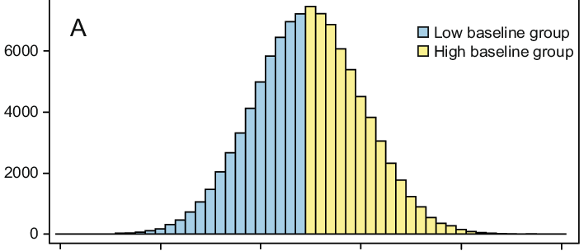
Of great importance that you reflect on this for your MD too
How have you defined your variables of interest?
IVs and DVs
How have you measured or categorised your variables of interest?
e.g. Social Media use
Gender
Frequency or low/high extraversion
The research process
Note
Develop research aims
Specify research questions/hypotheses related to these aims
Identify relevant constructs and concepts
Translate constructs and concepts into variables (i.e., a logical set of characteristics/features)
Translate variables into measurements (i.e., the quantification of characteristics/features)
Quantitative Research
A systematic examination of relationships between variables
. . .
‘Variables’ are ‘translated’ from concepts, constructs or phenomena
. . .
Could be critiqued as ‘reductionist’
Types of Variable
Independent Variable
Experimental - The variable I manipulate
Non-Experimental / Quasi-Experimental - Comparison between pre-existing groups
Dependent Variable
The variable you measure, that you propose to be influenced by a manpulation of the IVs
The [D]ata{.shout}
Types of Measurement
Nominal/Categorical
Male/Female/…
Vegan / Vegetarian
Smoker/Non-Smoker
Types of Measurement
Ordinal
Numbers representing a rank position in a group
Not representative of an actual definite number/score/value - without information about the ‘gap’ between numbers
First, second, third
Tallest/Shortest
Types of Measurement
Interval
Numbers represent equal units giving information about the ‘gap’ between numbers
Temperature
Psychological Scales
Types of Measurement
Ratio
Interval measurements with an absolute zero, of equal units,
Weight
Length
Time/Reaction time*
Median Splits
‘Cutting’ a distribution in half at the mid-point - with 50% on each side of the cut
Median Splits can be considered problematic
Beware!
We often suggest a median split to dichotomise a continuous variable, e.g. for the purposes of creating a 2 level IV.
It’s a useful exercise in calculating a ‘computed variable’ in SPSS or Jamovi
It is NOT best-practice usually. Why not?
It is a key learning outcome that you are able to perform a standardised analysis, specifically, the 2x2 ANOVA with any necessary assumption checks and post-hocs + plots
Think about this

Slide 13
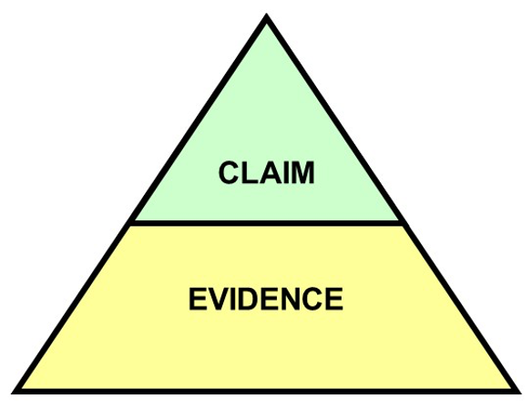
Operationalisation, measurement and definitions impact…

Slide 14
Summary
You should think carefully about:
How you define your variables - this is probably a part of the introduction that students DON’T think about enough
How you measure or categorise your variables (IVs and DVs) - this is probably the single thing I look at first when peer-reviewing research!
How well your manipulation does what it claims to. Does you manipulation bring the thing it proposed to to life well?

Slide 15
Running Experiments online or face to face
Comparing Experiment Modalities
Online Surveys and Experiments
Qualtrics - For surveys, stimulus presentation that don’t require accurate timing
Gorilla.sc - For ‘experimental’ tasks with complex stimulus > presentation or that require response time measures or push-button > responses etc.
Face-to-Face Experiments

Slide 16
Online Surveys and Experiments with Qualtrics
Overview
A powerful tool for creating and distributing online surveys
Widely used in psychological research
We have an institutional licence and so it is FREE
No specialist support - has excellent online support

Slide 17
Pros of Qualtrics (or online surveys)
Accessibility
Reach a wide, diverse audience (if necessary)
Accessible by anyone with a phone or laptop etc
Cost-Effective
Low ‘cost’ compared to face-to-face
Data Management
Automated data collection, scoring and storage
Relatively easy to analyze and export data - but not always simple
Customization
Highly customizable surveys and experiments (video, photos, audio, vignettes)
Supports various question types and logic

Slide 18
Cons of Qualtrics
Limited Human Interaction
Lack of personal interaction can affect responses
You put a huge amount of trust in the participant
Not always easy to manage ethical challenges properly
Technical Issues
Dependence on internet connectivity and user tech skills
An error in the build and you are in trouble ####
Cons of Qualtrics (continued)
Response Authenticity
Higher risk of dishonest or inattentive responses (maybe?)
Sampling Bias
Potential for non-representative samples

Slide 19
Introduction to experiments using Gorilla.sc
Gorilla.sc: highly controlled online Psychological Research
A comprehensive online tool for behavioral research
Facilitates creation, deployment, and analysis of experiments

Slide 20
Core Features of Gorilla.sc
User-Friendly Interface
Intuitive design for researchers of all levels
Drag-and-drop experiment builder
Requires ‘tokens’ to run
You will need to apply for ‘tokens’ to apply for ethics, and to run the study.
There is usually a limited supply as there is a cost associated with this.
Versatile Experiment Design
Supports a wide range of experimental paradigms
Customizable to suit various research needs

Slide 21
Experiment Creation with Gorilla.sc
Building Blocks
Use ‘widgets’ and ‘tasks’ to construct experiments
Easily integrate surveys, quizzes, and cognitive tasks
Advanced Customization
Incorporate complex experimental logic
Customize with CSS and JavaScript for unique requirements

Slide 22
Data Collection and Analysis
Real-Time Data Collection
Gather data securely and efficiently
Access participant responses in real-time
Analytical Tools
Built-in tools for basic data analysis
Export data for advanced analysis in other software e.g. SPSS

Slide 23
Collaboration and Sharing
Team Collaboration
Share experiments and data with team members
Collaborate on experiment design and analysis
Participant Recruitment
Still needs to be managed via sources outside of Gorilla

Slide 24
Gorilla.sc in Psychological Research
Broad Application
Suitable for cognitive, social, and clinical psychology
Ideal for remote and large-scale studies
Impact on Mini-Dissertations
Increases the reach of psychological studies requiring complex stimulus or timing
Not easy to get up and running with this tool
No specialist support - has excellent templates and online support

Slide 25
Face-to-Face Experiments
Overview
Traditional method of conducting experiments
Involves direct interaction with participants

Slide 26
Pros of Face-to-Face Experiments
Enhanced Interaction
Direct human interaction enriches data quality
Controlled Environment
Better control over experimental conditions
Immediate Feedback
Opportunity for immediate clarification and feedback
Participant Authenticity
Lower risk of false responses (maybe?)

Slide 27
Cons of Face-to-Face Experiments
Higher Costs
Greater resource and time investment (maybe?)
Limited Reach
Restricted to participants’ geographical location
Time-Consuming
Scheduling and conducting sessions takes time
Potential Biases
Risk of experimenter or social desirability biases

Slide 28
Conclusion
Choosing the Right Method
Depends on research goals, resources, and target population
Both methods offer unique advantages and challenges
Tailoring to Research Needs
Consider the nature of your study and participant accessibility
Balance between quality, ‘cost’, and reach

Slide 29
Lab Activities
Critical Proposal Target Paper ‘approval’
Ask you Lab Tutor for ‘thumbs up/down’
Prepare for Personal Tutor Meeting
Get ready to present your initial group membership, area of interest and CP papers to your Personal Tutor
If you PT comes before the lab… Better think about that ASAP!
See if you can start identifying candidate methods
Talk amongst your group and discuss the merits of particular methods and discuss this with your LT and PT

Slide 30
Questions?

