Slide 1
Lecture06
Operationalising variables and bringing concepts to life Dr Gordon Wright

Slide 2
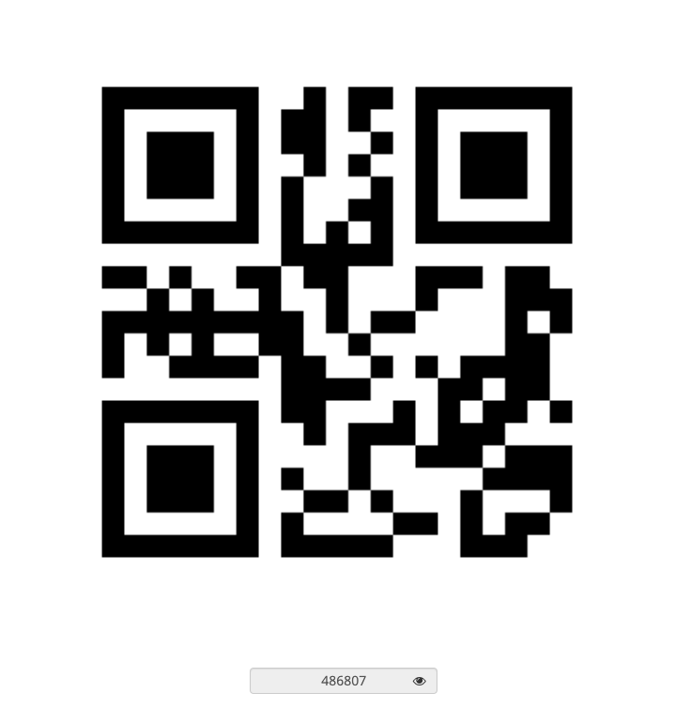

Slide 3
Key topics today
The week ahead (week 6)
Personality & Individual Differences Essay Tutorial (Submission Fri, 25th Nov)
How and why does intelligence predict important life outcomes?
RASA and EC deadline for Critical Proposal (Fri, 18th Nov)
PsychSociety film number 2!
Tuesday (15/11/2022). You can find out more information and book here.
Three Identical Strangers. It’s well worth a watch, especially if you are interested in ethics and genetics.
Strike days - 24th (Thu), 25th (Fri), 30th (Wed)
Labs - Online (and Offline) Data collection

Slide 4
Any Questions?

Slide 5
‘Operationalisation’ of variables

Slide 6
Let’s think about your forthcoming Personality essay
Two key concepts you’ll be thinking about and reading around…
Intelligence
important life outcomes

Slide 7
Hopefully, you will ask yourself…
How are these important and very tricky concepts
Defined
Measured

Slide 8
Of great importance that you reflect on this for your MD too
How have you defined your variables of interest?
IVs and DVs
How have you measured or categorised your variables of interest?
e.g. Social Media use
Gender
Frequency or low/high extraversion

Slide 9
Dani Navarro
A legend. Author of Learning Statistics with Jamovi/R

Slide 10
learnstatswithjamovi.com

Slide 11


Slide 12
Dani’s example:
• My age is 33 years.
• I do not like anchovies.
• My chromosomal gender is male.
• My self-identified gender is male*
*see footnote 2, page 14 Learning Statistics with Jamovi

Slide 13
Median Splits
Dangerzone!
We often suggest a median split to dichotomise a continuous variable, e.g. for the purposes of creating a 2 level IV.
It’s a useful exercise in calculating a ‘computed variable’ in SPSS or Jamovi
It
It is a key learning outcome that you are able to perform a standardised set of analysis, specifically, the 2x2 ANOVA with any necessary assumption checks and post-hocs + plots

Slide 14
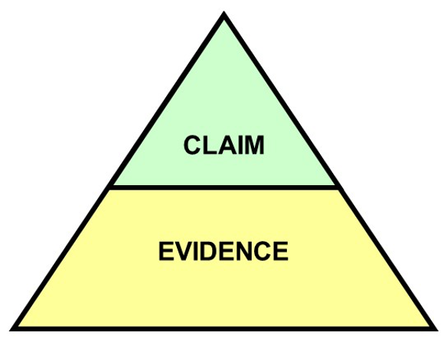
So…

Slide 16
Summary
You should now know:
Why scientists are concerned about the reliability of psychological studies
Steps the scientific community are taking to overcome these worries
Not everyone is convinced that the ‘crisis’ is as serious as it seems, or whether these changes will help solve psychology’s problems

Slide 17
Questions?

Slide 18
Lab activities
Qualtrics (99% of you will use this!)
10% of you will apply for the wrong type of account and be stuck for 2 weeks

Slide 19
References

