Slide 1
Lab 04: Open Science Practices
XX Dr. Gordon Wright

Slide 2
Overview of Lab 04

Slide 3
Keep progressing your Critical Proposals
Get your Target Paper checked by your Lab Tutor Is it still the best you can do?
Have a look at the sample Critical Proposal in the Coursework Information section of the VLE.
It got a first, but there was plenty of room for improvement.
Last year the Effect Size information and Design Schematic were not required. This year, they ARE COMPULSORY.

Slide 4
If you are happy with your Critical Proposal
You can use the lab time to continue refining your research ideas.
Start identifying and documenting your IVs and DVs. Maybe even your design!

Slide 5
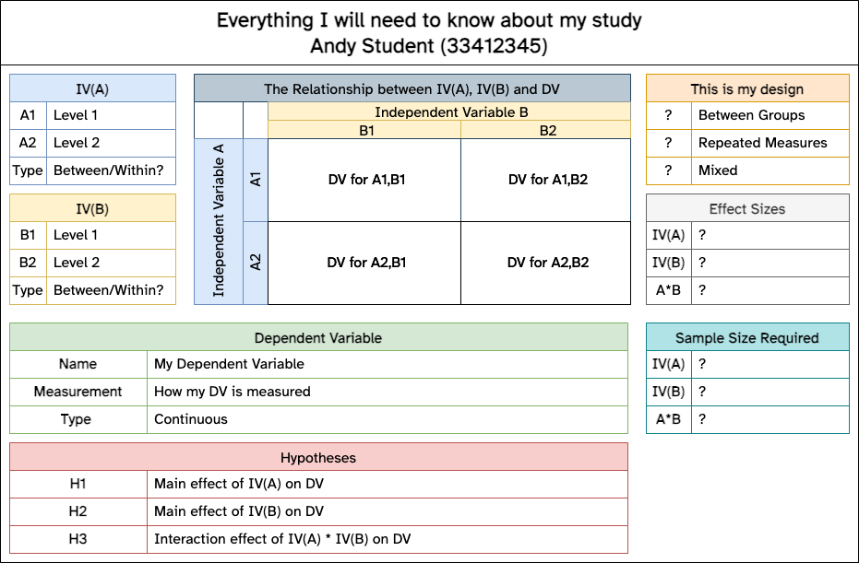
Your Design
How much of the Design of your study is known at this point?

