Slide 1
Vocation
In summary: A NICE vocation with my friends.

Slide 2
Content
Computer
Stay with my friends
Drive License

Slide 3
Computer
Nvidia released 10th GPUs such as Geforce GTX 1080 & 1070, which were designed with 16 Fnt and new Pascal Architecture. AMAZING!
Intel have released Skylake CPU such as 6700K, whose GPU HD 530 is very amazing.
My old Computer has get out of date. I bought it in 2010 with the CORE i3 550 CPU, the first generation of new CORE family.

Slide 4
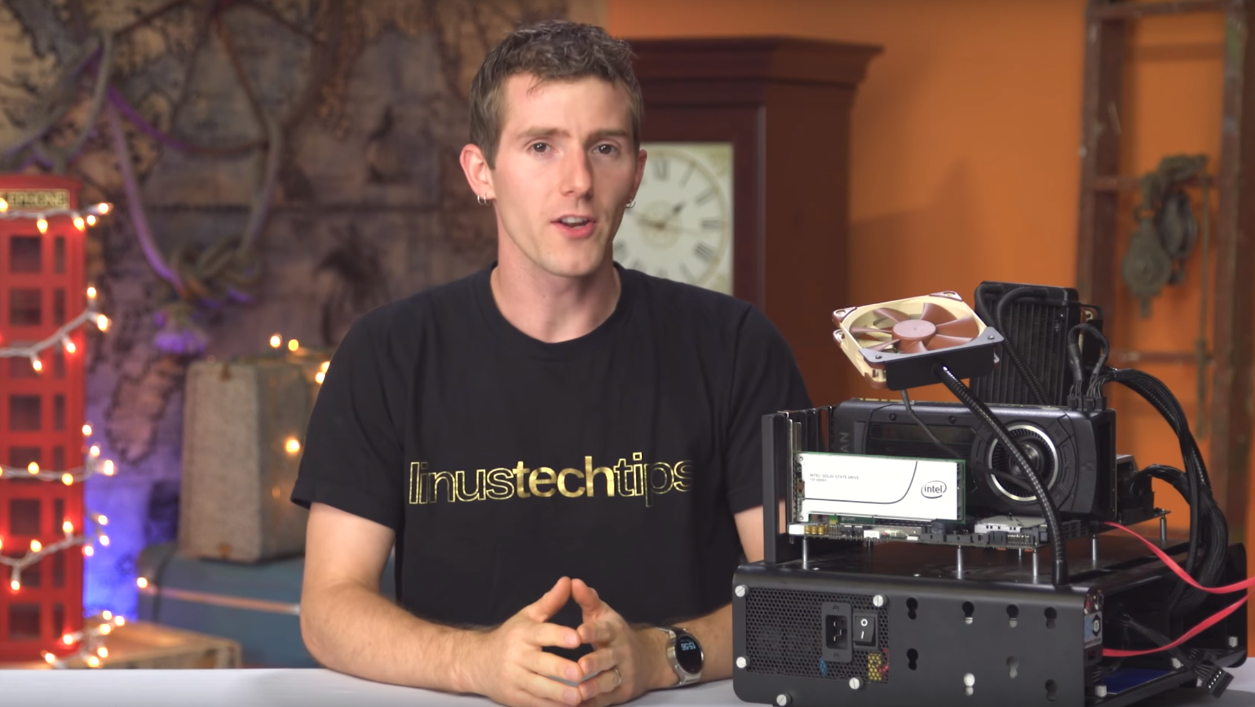
Do you know this guy?

Slide 5
There is many interest in MOD.

