Slide 1
Predicting Theme and Identifying Patterns and Structures
Group 2:刘鹏、庞子良、陈俊峰、谢宏伟

Slide 2

C
ONTENTS
1
Chronological sequence
2
Cause & Effect
3
Comparison & Contrast
4
Classification
5
Problem & Solution

Slide 3
What are the reading skills?
Introduction
Reading skills enable readers to turn writing into meaning and achieve the goals of independence, comprehension, and fluency.
Definition
·to read the written form as meaningful language
·To read anything written with independence, comprehension and fluency
·To mentally interact with the message.

Slide 4




Predicting Theme and Identifying Patterns and Structures
A piece of writing for general purposes is composed of:
A title
An introduction
echo
The theme
A body
A conclusion
Firstly

Slide 5

Predicting Theme and Identifying Patterns and Structures
For research that
involves reading a huge number of academic papers:
We will face the problems
Good or bad
Useful or useless
Certified or uncertified
New or outdate
So we should optimise our reading strategy
Secondly

Slide 6
How can I improve my reading skills?
1
A quick scan
A quick scan of the paper’s title,the abstract,the introduction
and the conclusion
While skipping the body,would present a general idea of the paper
Finally

Slide 7
How can I improve my reading skills?
2
To identify the theme or the main ideas
Sometimes shed light upon important details
Whether the paper benefits their research
Whether it is necessary to go on reading the rest or not
Finally

Slide 8
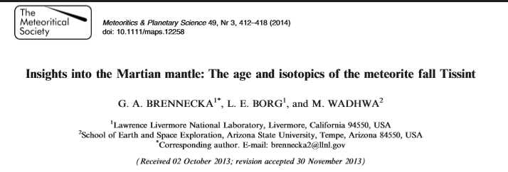
In conclusion，how and when to use reading skills?
For example:I want to figure out a age of Tissint
Scan this title

Slide 9
In conclusion，how and when to use reading skills?
For example:I want to figure out a age of Tissint
The recent witnessed fall of the meteorite Tissint represents the delivery of a pristine new sample from the surface of Mars. This meteorite provides an unprecedented opportunity to study a variety of aspects about the planet’s evolution. Using the Rb–Sr and Sm–Nd isotopic systems, we determined that Tissint, a depleted shergottite, has a crystallization age of 574 ±20 Ma, an initial e143Nd =+42.2±0.5, and an initial 87Sr/86Sr = 0.700760 _x0001_ 11. These initial Nd and Sr isotopic compositions suggest that Tissint originated from a mantle source on Mars that is distinct from the source reservoirs of the other Martian meteorites. The known crystallization ages, geochemical characteristics, ejection ages, and ejection dynamics of Tissint and other similarly grouped Martian meteorites suggest that they are likely derived from a source crater up to approximately 90 km in diameter with an age of approximately 1 Ma that is located on terrain that is approximately 600 million years old.
Scan this abstrcat
So it is worth to go on reading the rest

Slide 10
Chronological sequence
Authors can proceed with their writing in the order of time.Look for time markers at the start of a sentnce while persuing the text.Longer time markers,usually in the form of adverbial clause,tend to be placed toward the end to avoid a top-heavy sentence structure.For instance
The Chinese economy has soard since the introduction of the Epoch-making policy of reform and opening-up in 1978 .
Weird
If put adverbial clause toward to start?
After the introduction of the Epoch-making policy of reform and opening-up in 1978 , the Chinese economy has soard .

Slide 11
Chronological sequence
With those time markers,we can understand the chronological order of the Article better.For example
Research spanning many decades has shown nutrients in the gastrointestinal tract can shape animals’flavour preferences./One of the earliest findings of this effect dates back to the 1960s,when Garvin Holman of the University of Washington reported hungry rats preferred consuming a liquid paired with food injected into the stomach rather than a solution coupled with a gastric infusion of water./More recently Ivan de Araujo,a neuroscientist at the Icahn School of Mdicine at Mount Sinai,and his colleagues have shown calories can trump palatability:Their work has demonstrated mice prefer consuming bitter solutions paired with a sugar infusion injected in the gut rather than a calorie-free sweet solution.

Slide 12
THANK YOU FOR WATICHING
Add your text in here
1

