Slide 1
COMP 472 Mini project 2
Tianfei Qi 40079518
Haoxuan Lyu 40087583

Slide 2
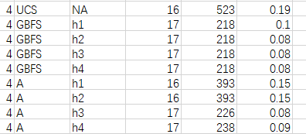
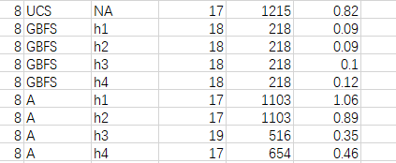
UCS and A with h1 and h2 always has the shortest length of the solution.

Slide 3
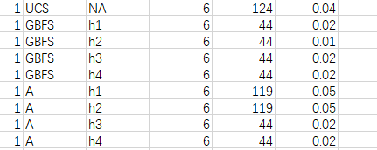
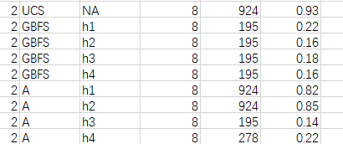
The length of the solution is the same regardless of the heuristics used by GBFS

Slide 4
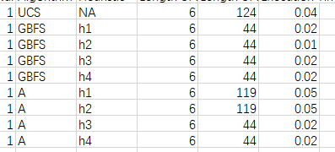
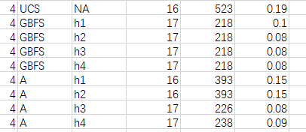
A algorithm sometimes have different length of the solution depending on the heuristics

Slide 5
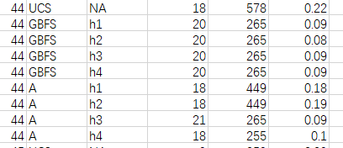
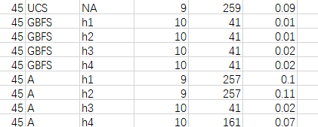
In A algorithm, h1 and h2 are admissible, h3 and h4 are not admissible

Slide 6
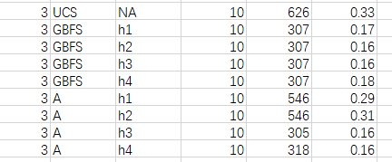
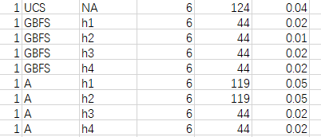
In most cases informed algorithms are faster than uninformed, but sometimes A algorithm with h1 or h2 are slower than UCS.

Slide 7
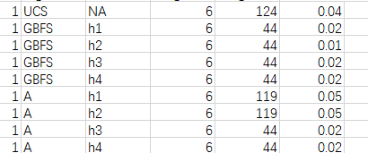
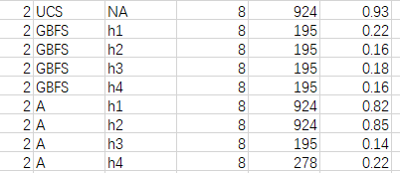
Although the length of the search path and the length of solution are same, some heuristic have different execution time.

