Slide 1

COMP 472 Mini project 2
Tianfei Qi 40079518
Haoxuan Lyu 40087583

Slide 2
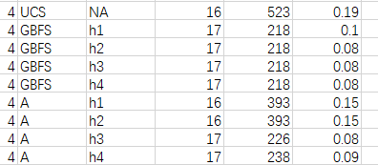
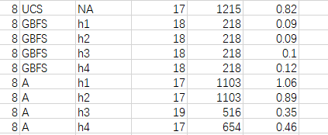
UCS always has the shortest length of the solution.

Slide 3
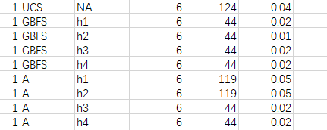
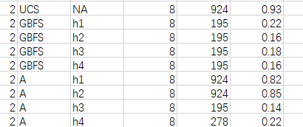
The length of the solution is the same regardless of the heuristics used by GBFS

Slide 4
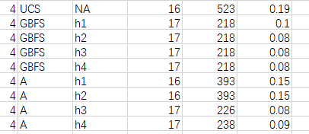
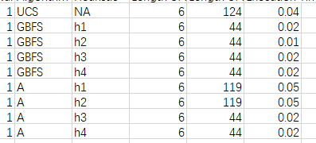
A algorithm sometimes have different length of the solution depending on the heuristics

Slide 5
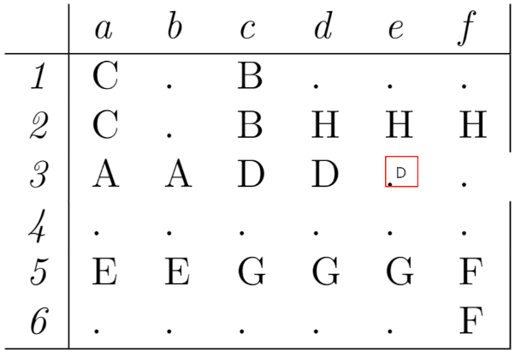
h1 is admissible, h2, h3, h4 are not admissible.

Slide 6
The predicted cost is 3, but actual minimum is 2.

Slide 7
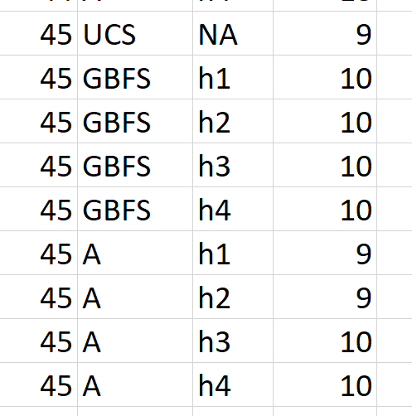
If h is not admissible, it will cause the A algorithm to return a solution that is not optimal. It is like the above data.

Slide 8
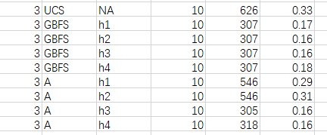
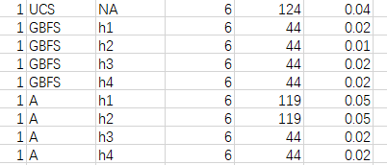
In most cases informed search are faster than uninformed, but sometimes A algorithm with h1 or h2 are slower than UCS.

Slide 9
 | Length of the solution | Length of the search path | Execution time
UCS | 10.94 | 920.96 | 1.175
GBFS | 11.21569 | 211.3 | 0.19615
A/A* | 11.04 | 514.865 | 0.602438
GBFS has the shortest length of the search path, but it has the longest length of the solution.

