Slide 2
Cloud Native Stack on Clear Linux
Ken Lu, Rick Wang

Slide 3





Clear Linux*
Clear Linux is a modular open source OS optimized for performance and security, from the Cloud to the Edge, and is designed for customization and deployability.
…
*Other names and brands may be claimed as the property of others.

Slide 4
Performance throughout the stack
Clear Linux optimizes across the whole stack
End User Applications, Solutions
Application Interface & Frameworks
To get end user performance, optimization at all layers is required
Clear Linux is highly tuned for Intel platforms where all optimizations turned on by default
Clear Linux channels the best of Intel’s industry leading kernel expertise to provide the highest performing kernel for your OS.
OS Middleware Components
Runtime Libraries
OS Kernel & Device Drivers
Intel Platforms

Slide 5
TensorFlow* optimizations example throughout the stack
TensorFlow
GCC
Intel® AVX512 Optimizations
EIGEN
Optimized Python modules
Numpy / Pandas
Intel® AVX2 & Intel AVX512 Python* optimizations
Python
GLIBC
Additional routines for AVX512
Intel® architecture optimizes builds
Tuning kernel for workloads
Kernel
Intel Platforms
*performance critical workload

Slide 6


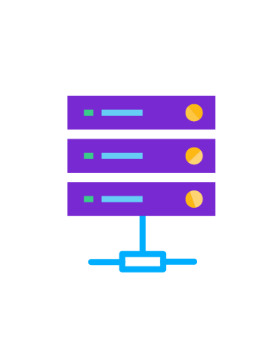




Security
Clear Linux stays in lockstep with upstream for current security upgrades and is designed to deliver available security mitigations to customers rapidly.
System is designed with “safe & sane” security principles in mind
Constant vulnerability scanning
Aggressive mitigation policy
Address high & critical level threats issued from the National Vulnerability Database promptly
101010010100101101101001010101010101010101011001101101
1010100101001011011010010101010110101101011011001
End devices
Edge gateways
Data center

Slide 7








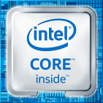

Clear Linux in Cloud Native Stack
Vertical Microservices
Vertical Microservices
Deep Packet Inspection(DPI), SD-WAN, VPN, Firewall …
Facial detection, Object recognition …
Container content composed of customer binaries along with libraries, frameworks, and other OS content pulled from the Container Base OS distribution
Optimized Runtime
Tools
Optimized Runtime
Tools
Common Microservices
Docker* Engine
Container Runtime (Kata*)
Container Orchestration
Data Plane Development Kit (DPDK)
Container Host OS manages the Docker* Engine along with container management and orchestration frameworks, etc
Container Host OS
Hypervisor/Bare Metal
*Other names and brands may be claimed as the property of others.

Slide 8
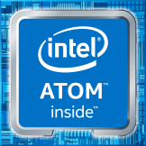
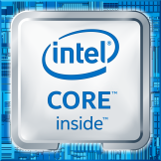
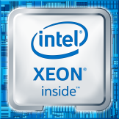
Challenge: diverse hardware platform
Edge Device
(IoT Device/Gateway/etc)
Edge Server
(MEC/Small Datacenter/etc)
Cloud Datacenter
Micro
Service
Micro
Service
Micro
Service
Micro
Service
Micro
Service
Micro
Service
Micro
Service
Micro
Service
Intel® Streaming SIMD Extensions Technology SSE4.2
Intel® Advanced Vector Extensions 2
Intel® Advanced Vector Extensions 512 / VNNI

Slide 9
Optimization for different platforms by Clear Linux* package build
Compiler flags in Clear Linux package build tuned to Intel® Advanced Vector Extensions 2 , Intel Advanced Vector Extensions 512 (Intel® AVX-512) separately
Optimized libraries selected at runtime based on available CPU features
A single Docker* image could be deployed on diverse edge platforms
Computer Vision Application
/usr/lib64/libopencv_core.so.4.1
dynamic linker
/usr/lib64/haswell/libopencv_core.so.4.1
/usr/lib64/haswell/avx512_1/libopencv_core.so.4.1
Intel® AVX-512-enabled CPU
*Other names and brands may be claimed as the property of others.

Slide 10
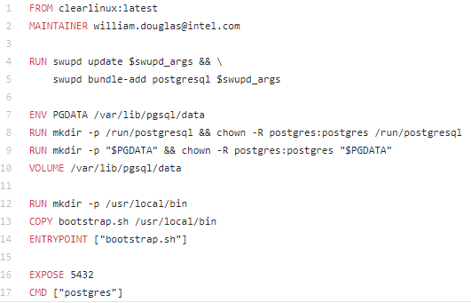
Optimized Dockerfile with Clear Linux* bundle design
Customer Application or Service
python-basic
go-basic
node-basic
Clear Linux* Container Base
A bundle provides a complete functionality, similar goal like the microservice
Package’s dependencies within single bundle were resolved at build time in Clear Linux
*Other names and brands may be claimed as the property of others.

Slide 11


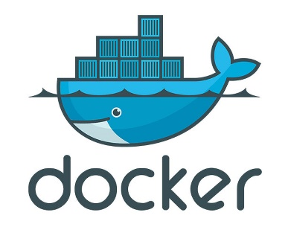
Call to action
https://github.com/clearlinux/dockerfiles
…….
Mariadb*
Nginx*
Redis*
Postgres*
Httpd*
https://hub.docker.com/u/clearlinux/
*Other names and brands may be claimed as the property of others.

