Slide 1
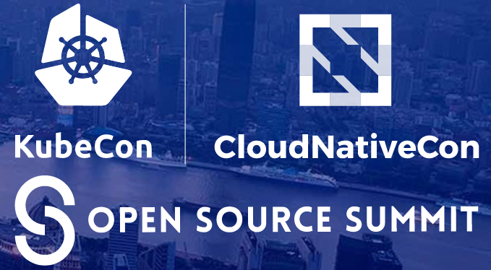
Multi-tenancy & BlockchaiN Deploying Hyperledger Fabric on Kubernetes
Tong Li (IBM) 6/26/2019 9:00AM Shanghai

Slide 2
Tong Li
Tong Li, @email4tong
Senior Software Engineer at IBM
Developer advocator
Focus on cloud computing, containers and blockchain technology development
Software application deployment and automation enthusiastic supporter
Hyperledger Fabric Cello committer

Slide 3
Agenda
Hyperledger Fabric (HF)
HF Network
Deploy networks
Seeding/Orderering network
Organization network
Expand HF network
Channel Management Dashboard
Channel Management Chaincode
Q & A

Slide 4
Hyperledger Fabric (HF)
HF is a blockchain framework implementation
Open Source, hosted by The Linux Foundation
HF leverages container technology
Smart contracts called “chaincode” that comprise the application logic of the system
Permission based
Blockchain technology is a method which defines
how an event is recorded onto a digital ledger
Notes:
Blockchain technology is a method which defines how a real life event is recorded onto a digital ledger

Slide 5
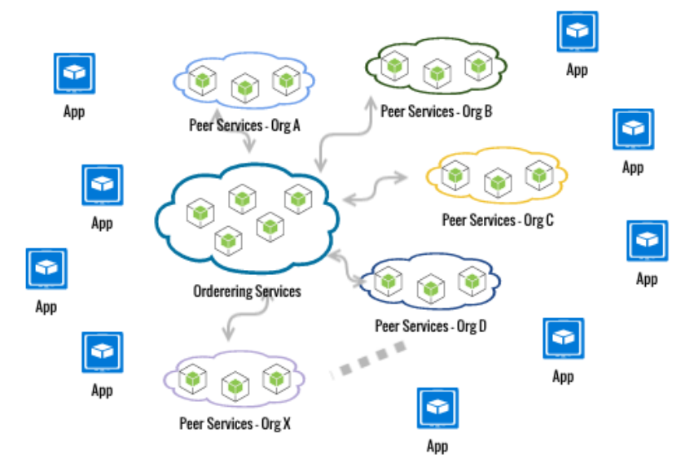
NF Networks
Network Components
Orderers
Peers
Apps - Chaincode
Apps – Client
Component Ownership

Slide 6
Deploy networks
Seeding a HF network, getting things started
Orderer nodes and/or Peer nodes
Organization network
Peer nodes
Environment to run HF components (Multi-Tenancy)
Container based
Native HF executables, physical/virtual servers
Use Hyperledger Cello Ansible Agent to deploy
Orderer only network or Peer only network or both
There are many ways and environment that you
can use for your HF network

Slide 7
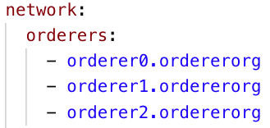
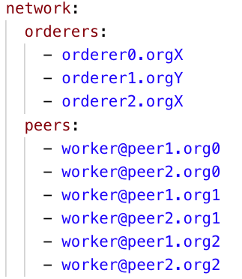
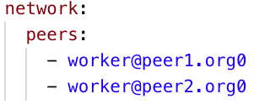
Deploy networks (cont.)
Orderer Only
Orderer & Peer
Peer Only

Slide 8
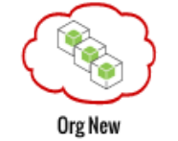
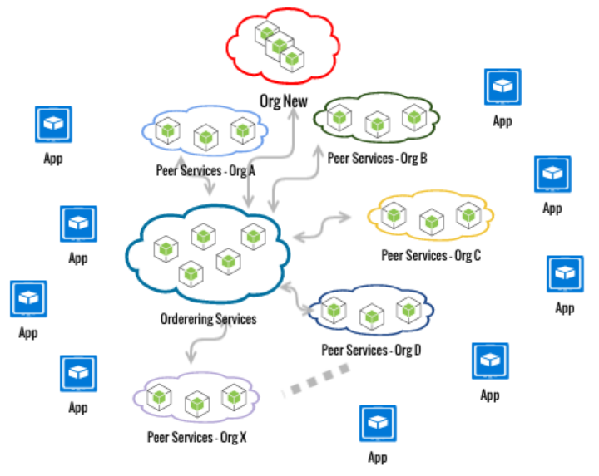
Expand HF network
+
=

Slide 9
Join a new org to an existing network
New join request created by new org admin and sent to one of the admins of the existing network, assume admin A
Admin A of an org in the network initiate the channel update & approve the request
Other admins of the orgs in the network approve the request
Admin A collect all required approvals and submit the channel update
New org is now allowed to join their peers the network/channels

Slide 10
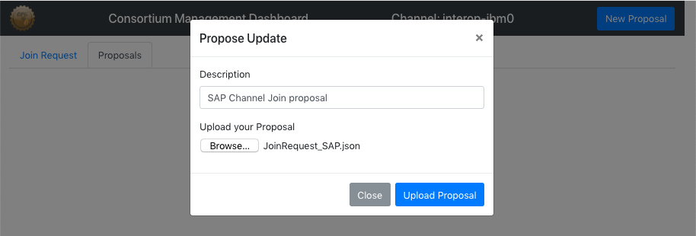
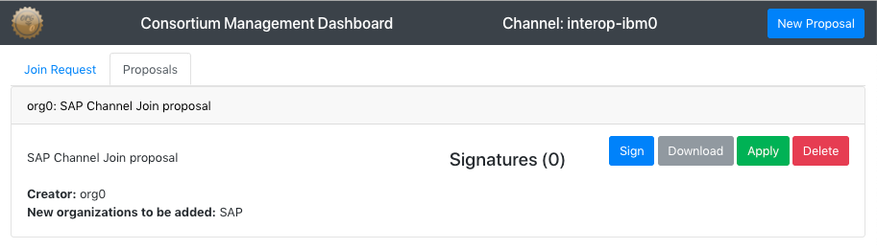
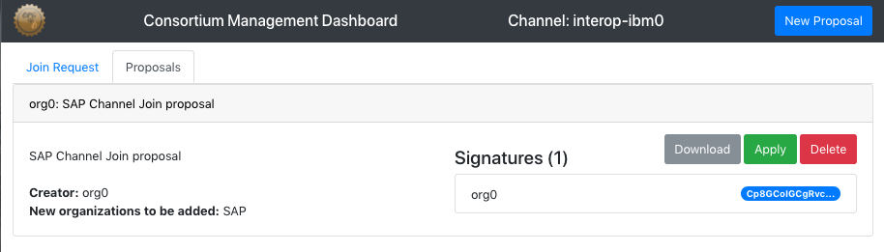
Channel Management dashboard

Slide 11
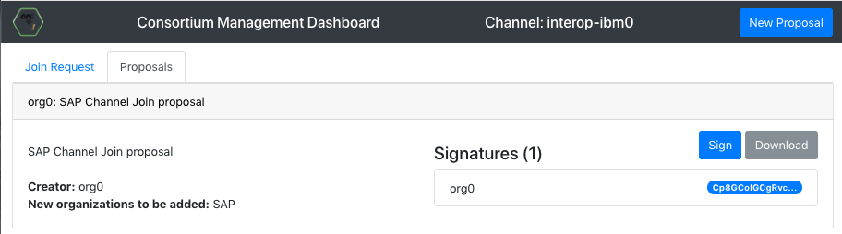
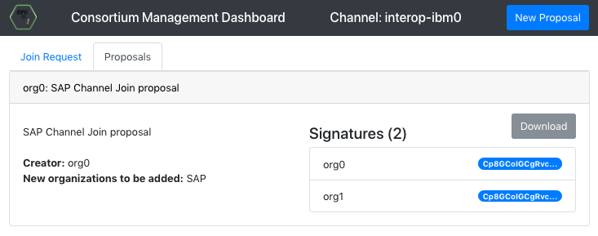
Channel Management dashboard

Slide 12
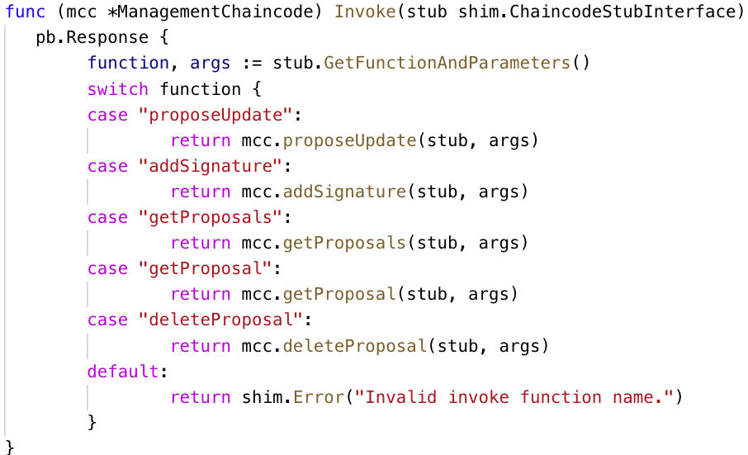
Channel Management Chaincode

Slide 13
Q & A
THANKS

